Slide 1
Making Climagraphs
How to make a special kind of graph
that helps us understand a place.

Slide 2
Here’s
how to make
a basic climagraph.

Slide 3

You start
with a frame.

Slide 4

Add letters
to indicate
the months
of the year.

Slide 5

Then, make 12
vertical bars.
They’re like
hollow “tubes”
that you fill up
with rainwater.

Slide 6
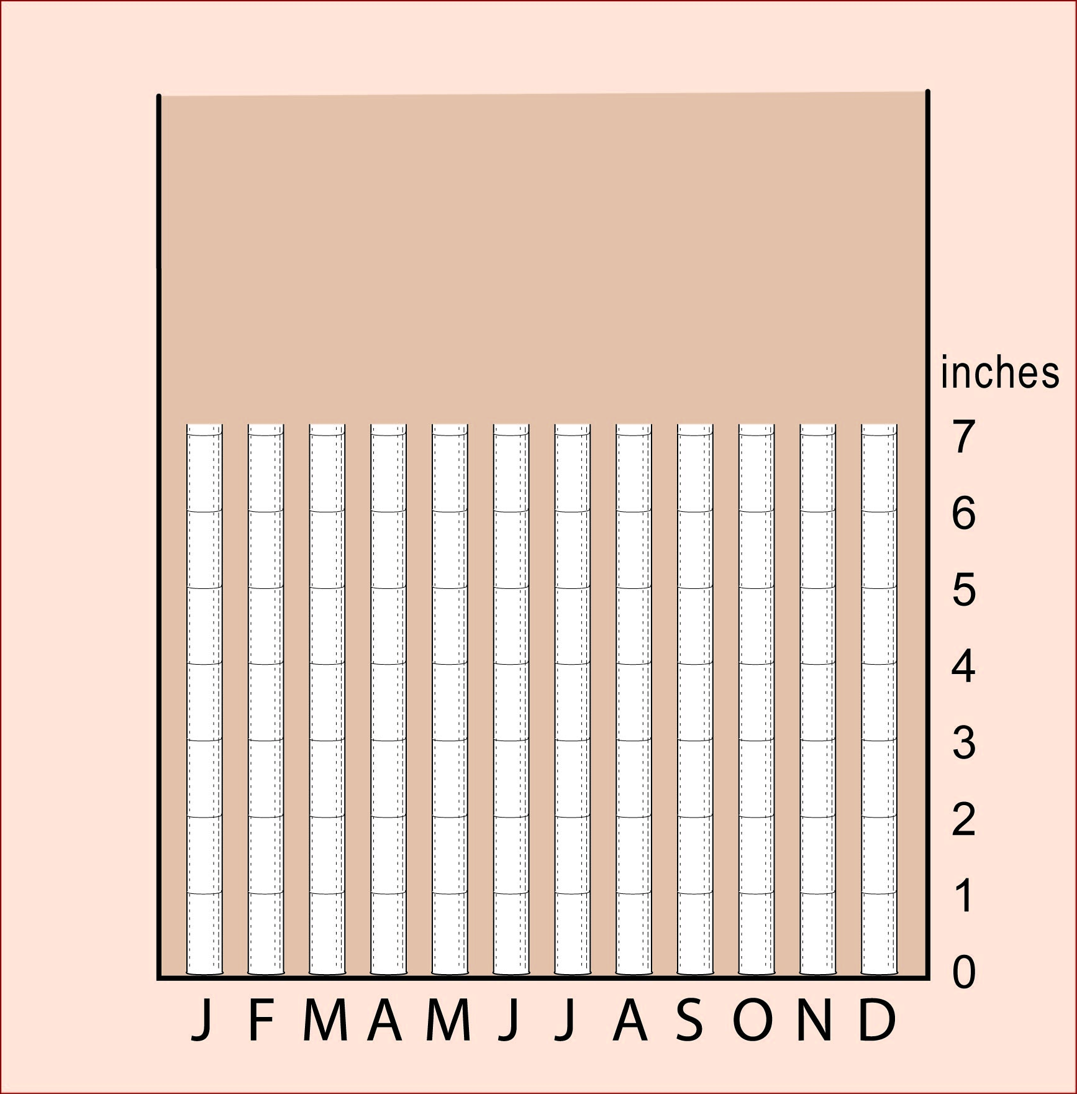
Put a scale
that tells you
how many inches
of precipitation
are in the tubes.

Slide 7
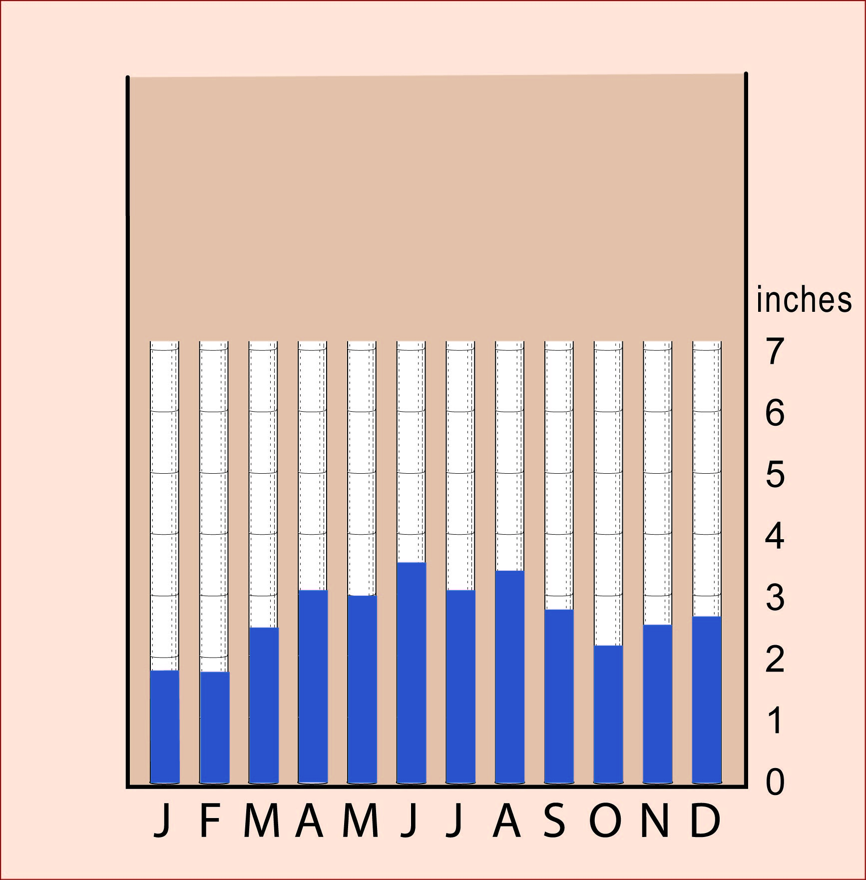
Then fill the tubes
with the amount
of rain or snow
in each month.

Slide 8
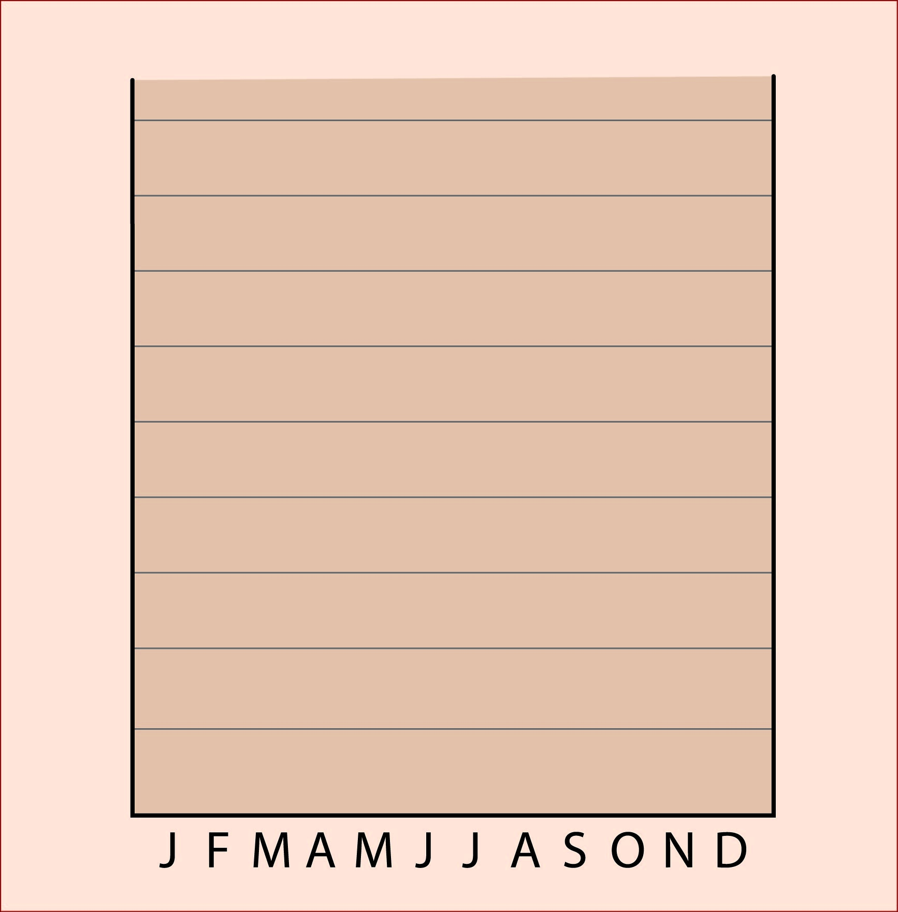
Or you can start
by drawing
horizontal lines
across the graph.

Slide 9
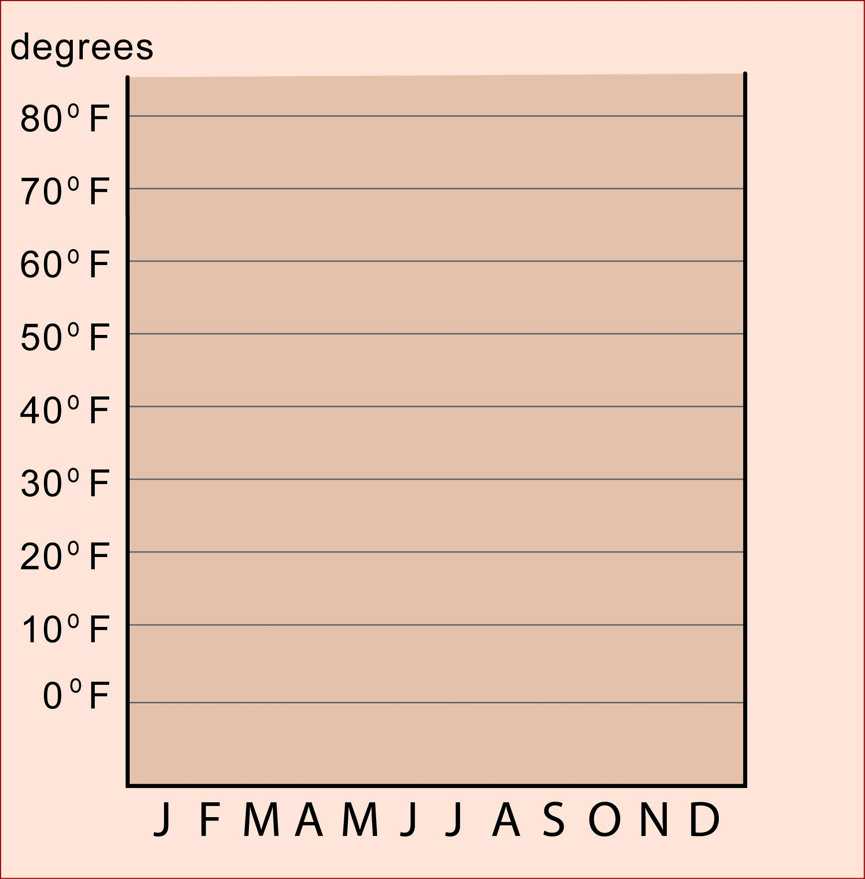
Label each line
with a number
to show the temperature.

Slide 10
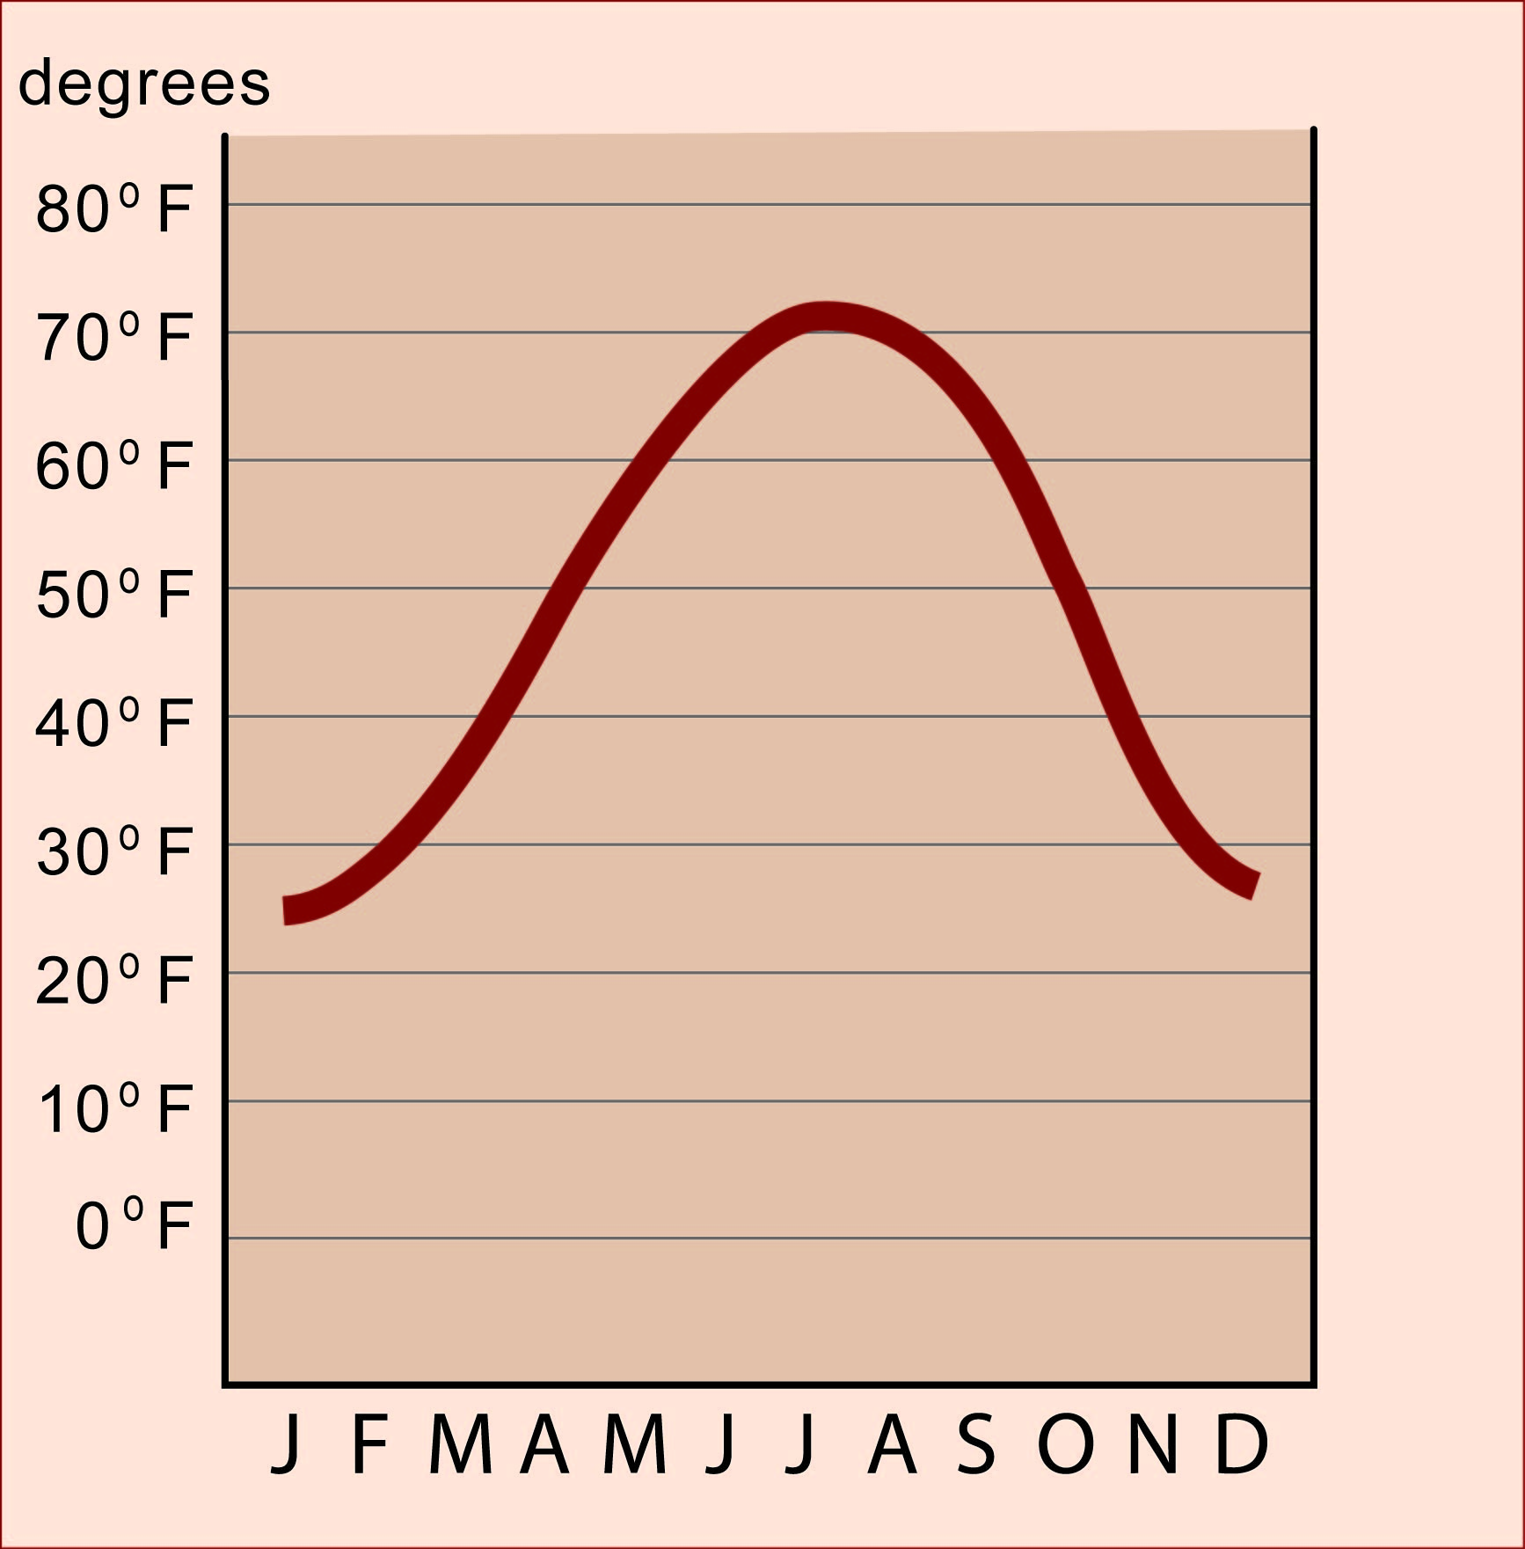
Then draw a line
that represents
the temperatures
in each month.
Remember . . .
These are average
temperatures - -
if the average is 70,
it might be 80 at 2 pm
and only 60 at night.
and it can
change a little
from day to day.

Slide 11
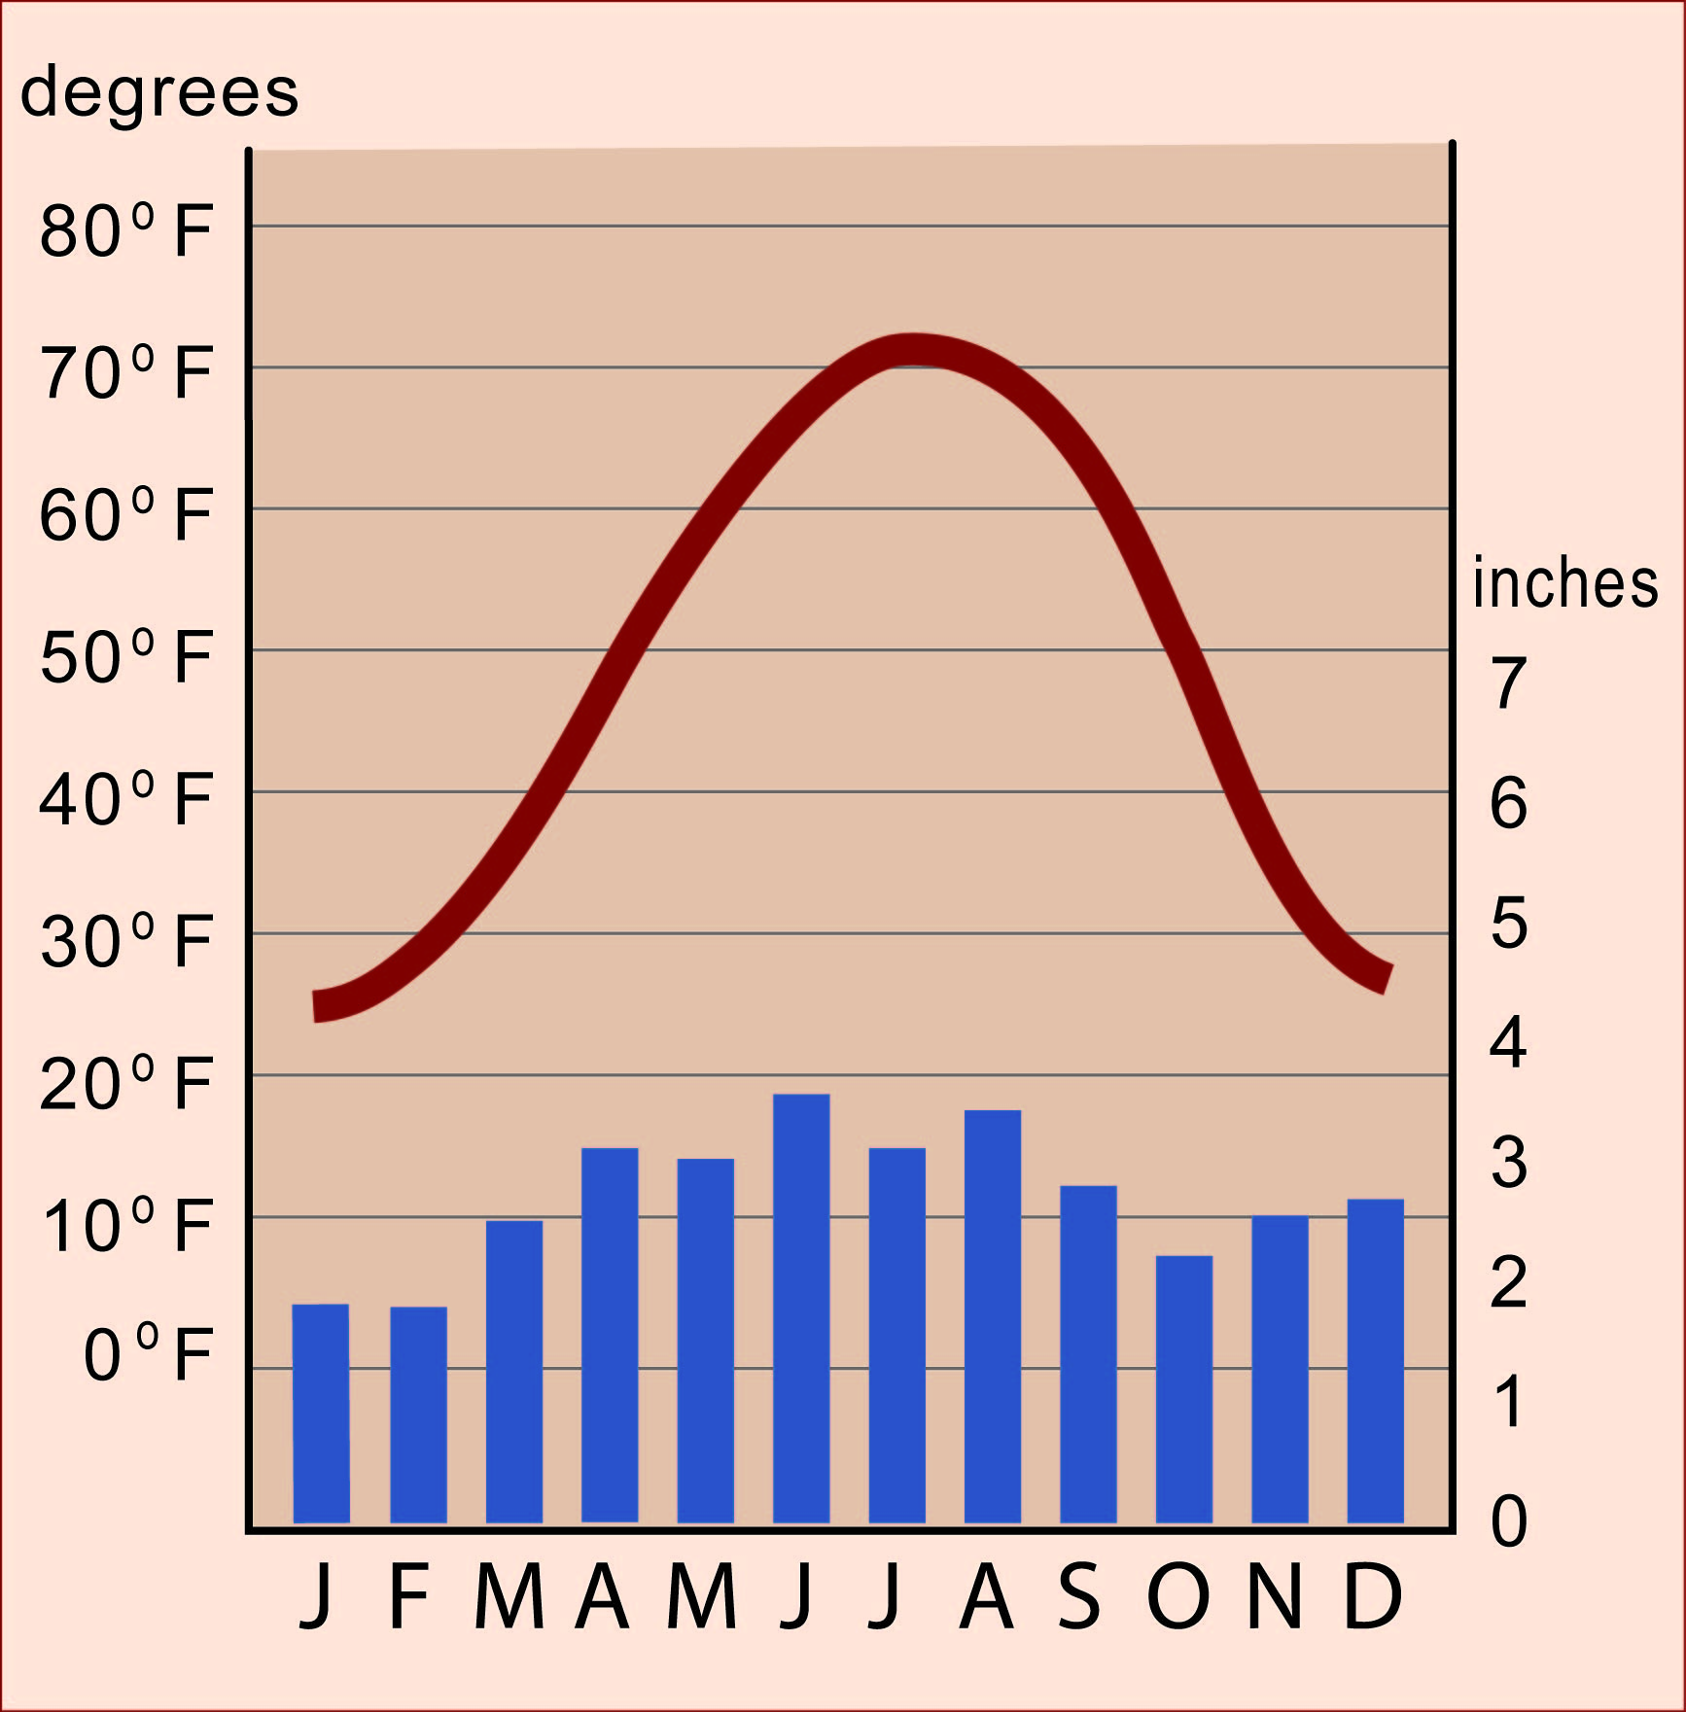
Put those graphs
together, and
you have finished
your climagraph.
WAIT . . .
There are ways
to make it easier to read
and more useful.

Slide 12
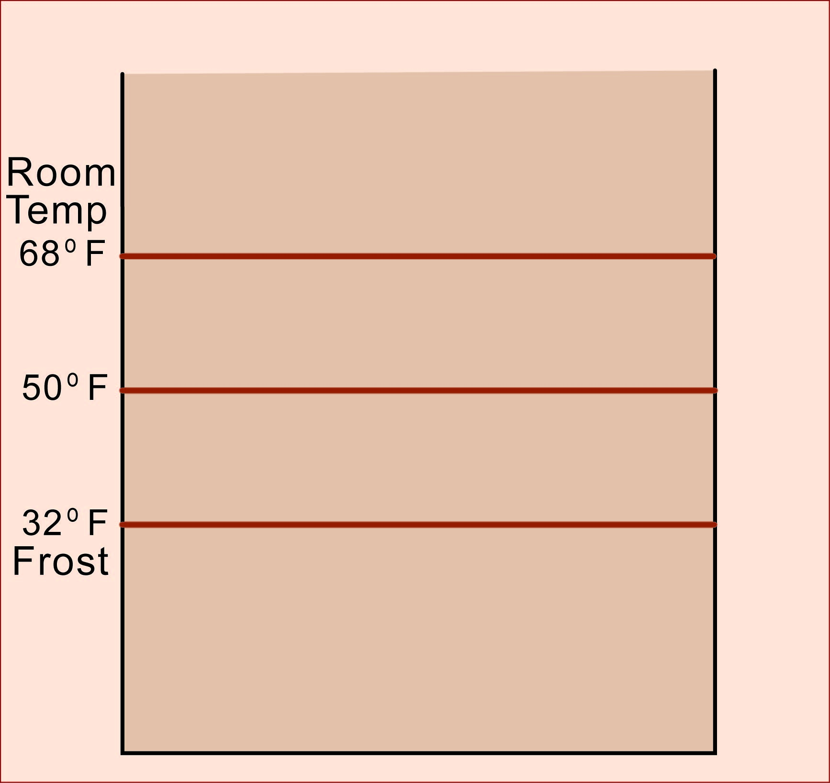
Start by drawing
just three lines
to represent
key temperatures.
Room temperature.
People want heaters
if the temperature
is far below this line,
and airconditioners
when it is above it.

Slide 13
Start by drawing
just three lines
to represent
key temperatures.
People have to bury
sewers and waterlines
if temperatures stay
below this line
for a whole month.
Snow doesn’t melt
and lakes freeze over
if the temperature
stays below this line.
Freezing of water.

Slide 14
Start by drawing
just three lines
to represent
key temperatures.
Risk of frost.
If average temperature
goes below this line,
there is a good chance
of frost that month.

Slide 15
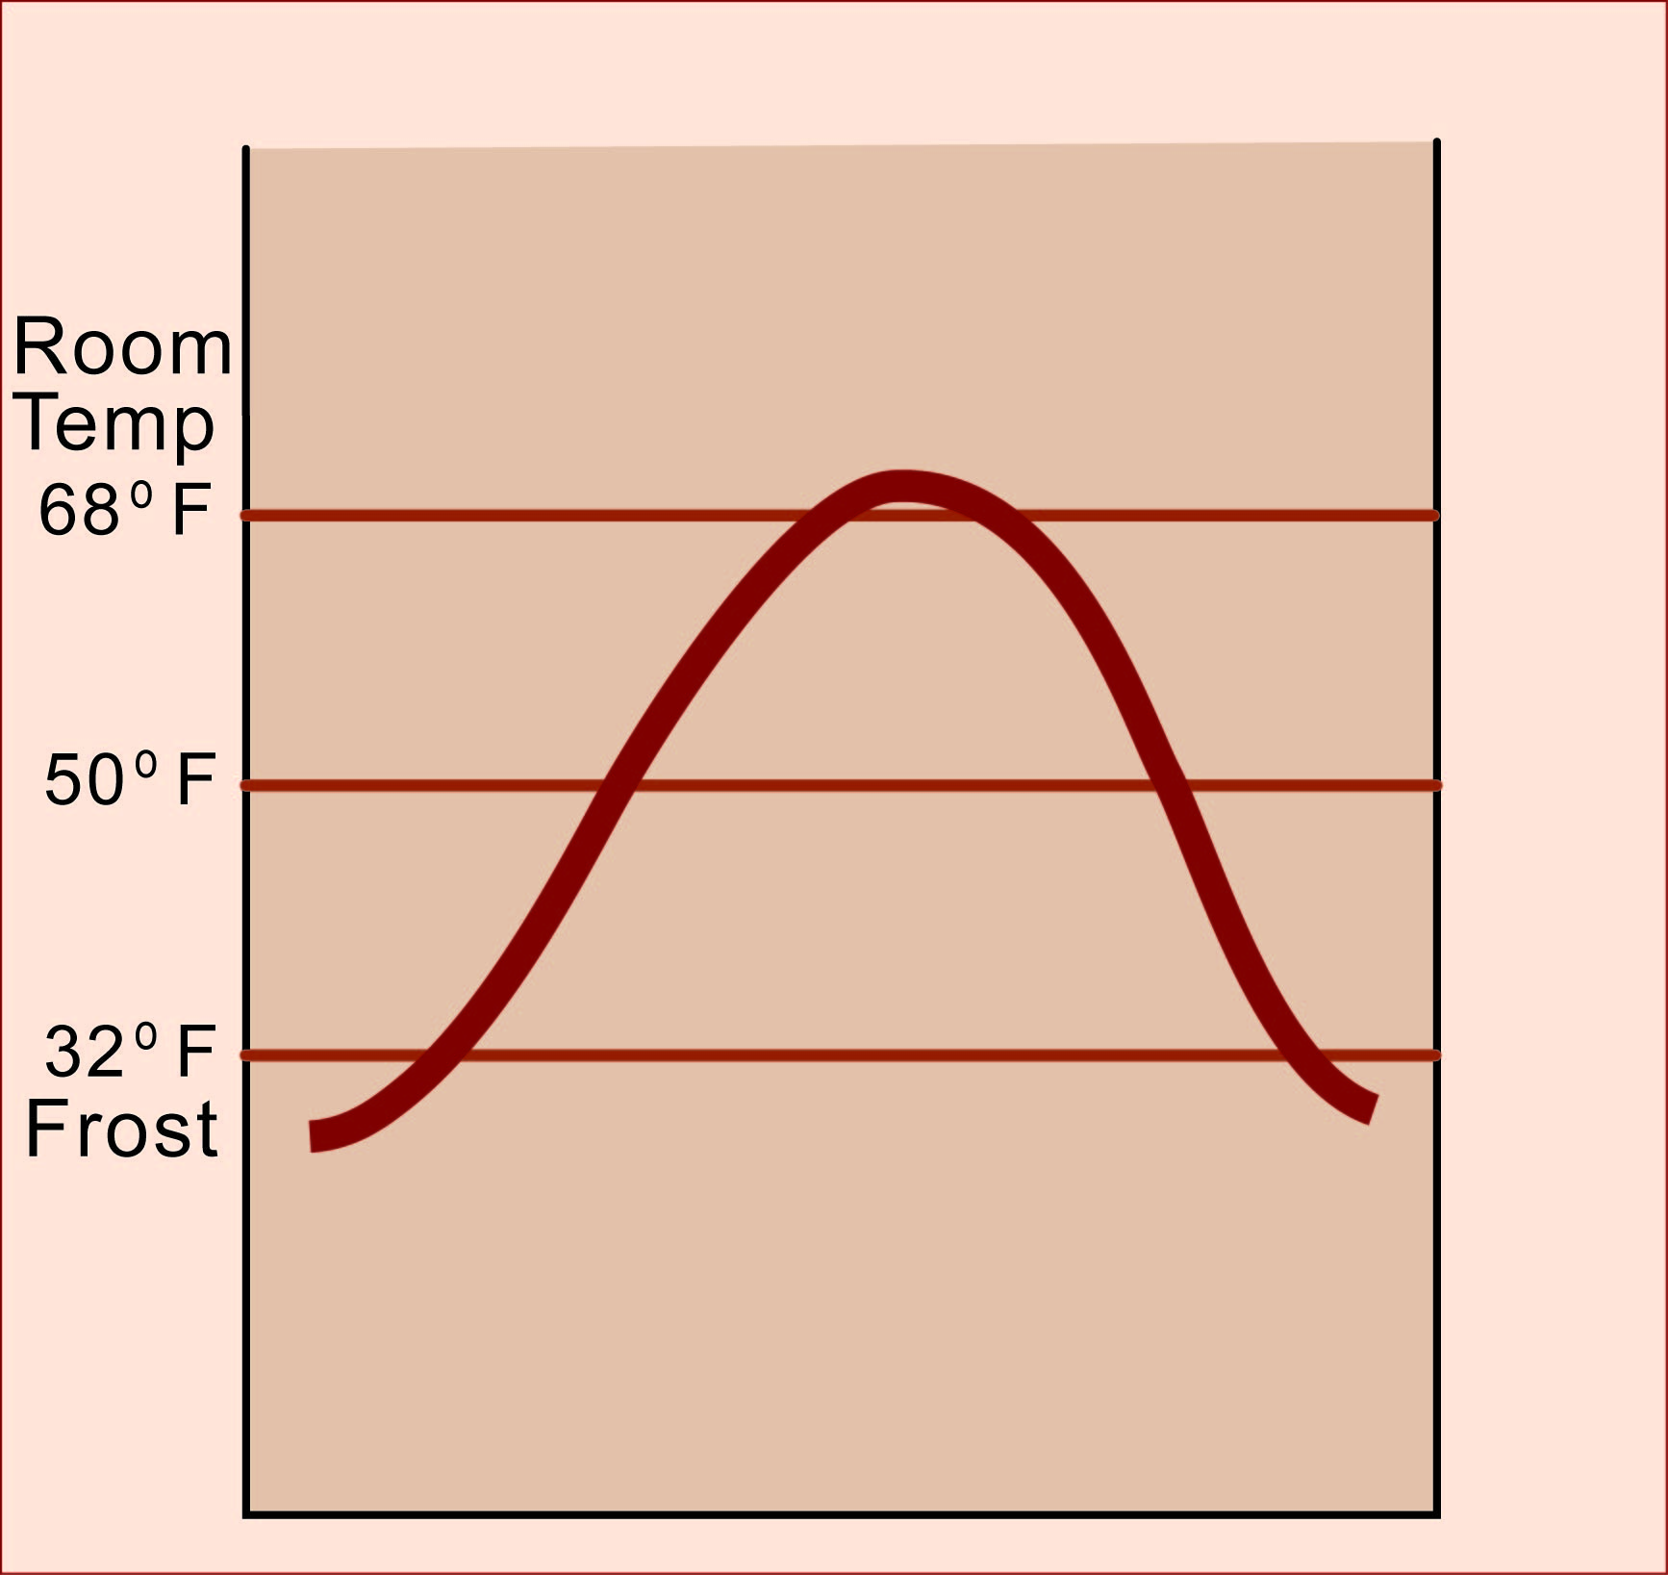
Then, when you
draw the line
for temperature,
you can see . . . .

Slide 16
This place has
about two months
with frozen soil.

Slide 17
And one month
when airconditioning
might be useful.

Slide 18
The growing season
is approximately (about)
six months long.

Slide 19
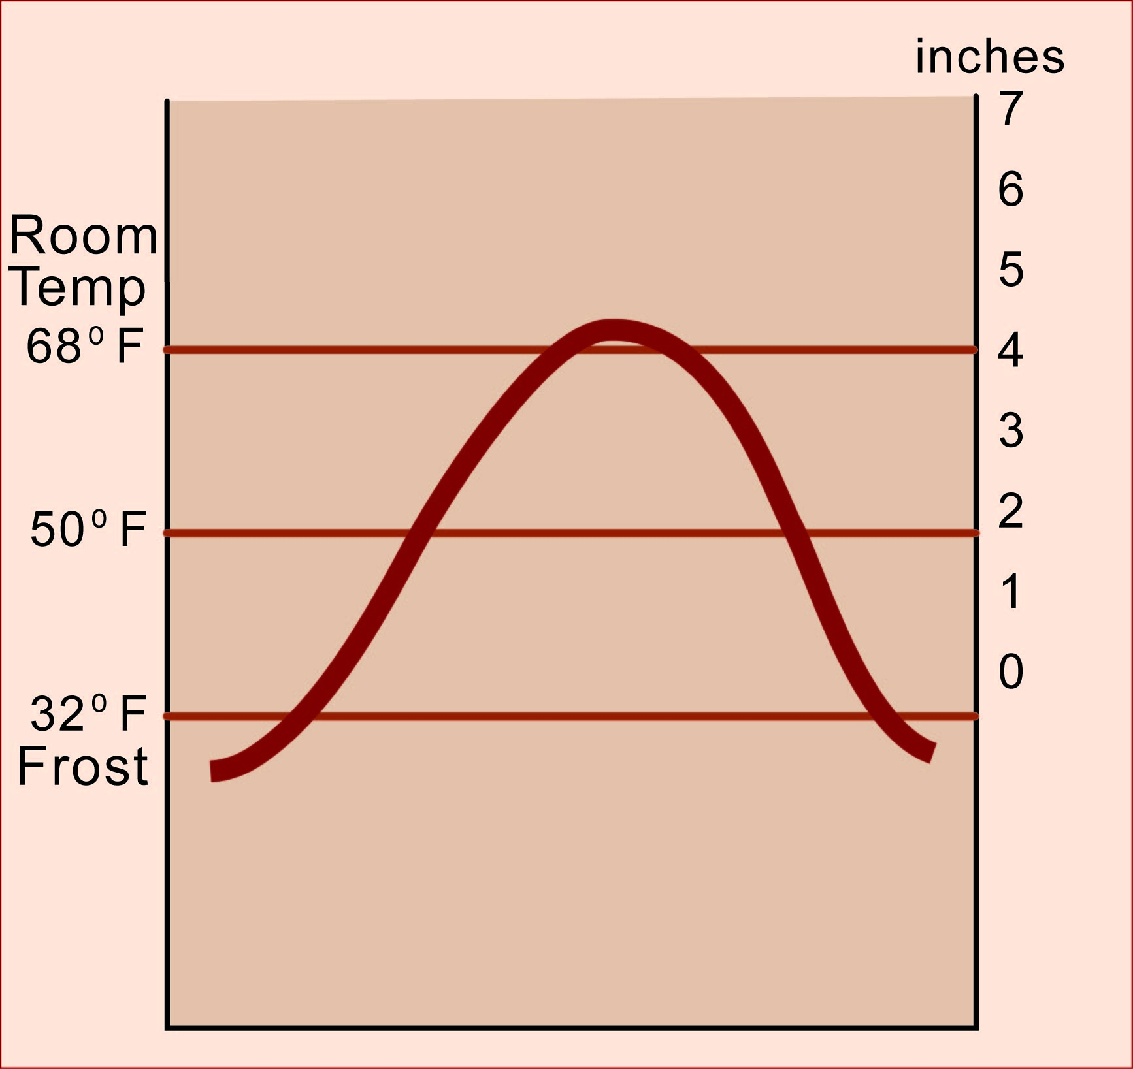
Then, you can add
a precipitation scale
that is designed to fit
the temperature scale.
4 inches is
about the amount
of water that
healthy plants need
if the temperature
is about 70 degrees.

Slide 20
Then, you can add
a precipitation scale
that is designed to fit
the temperature scale.
And they need
almost two inches
if the temperature
is about 50 degrees.

Slide 21
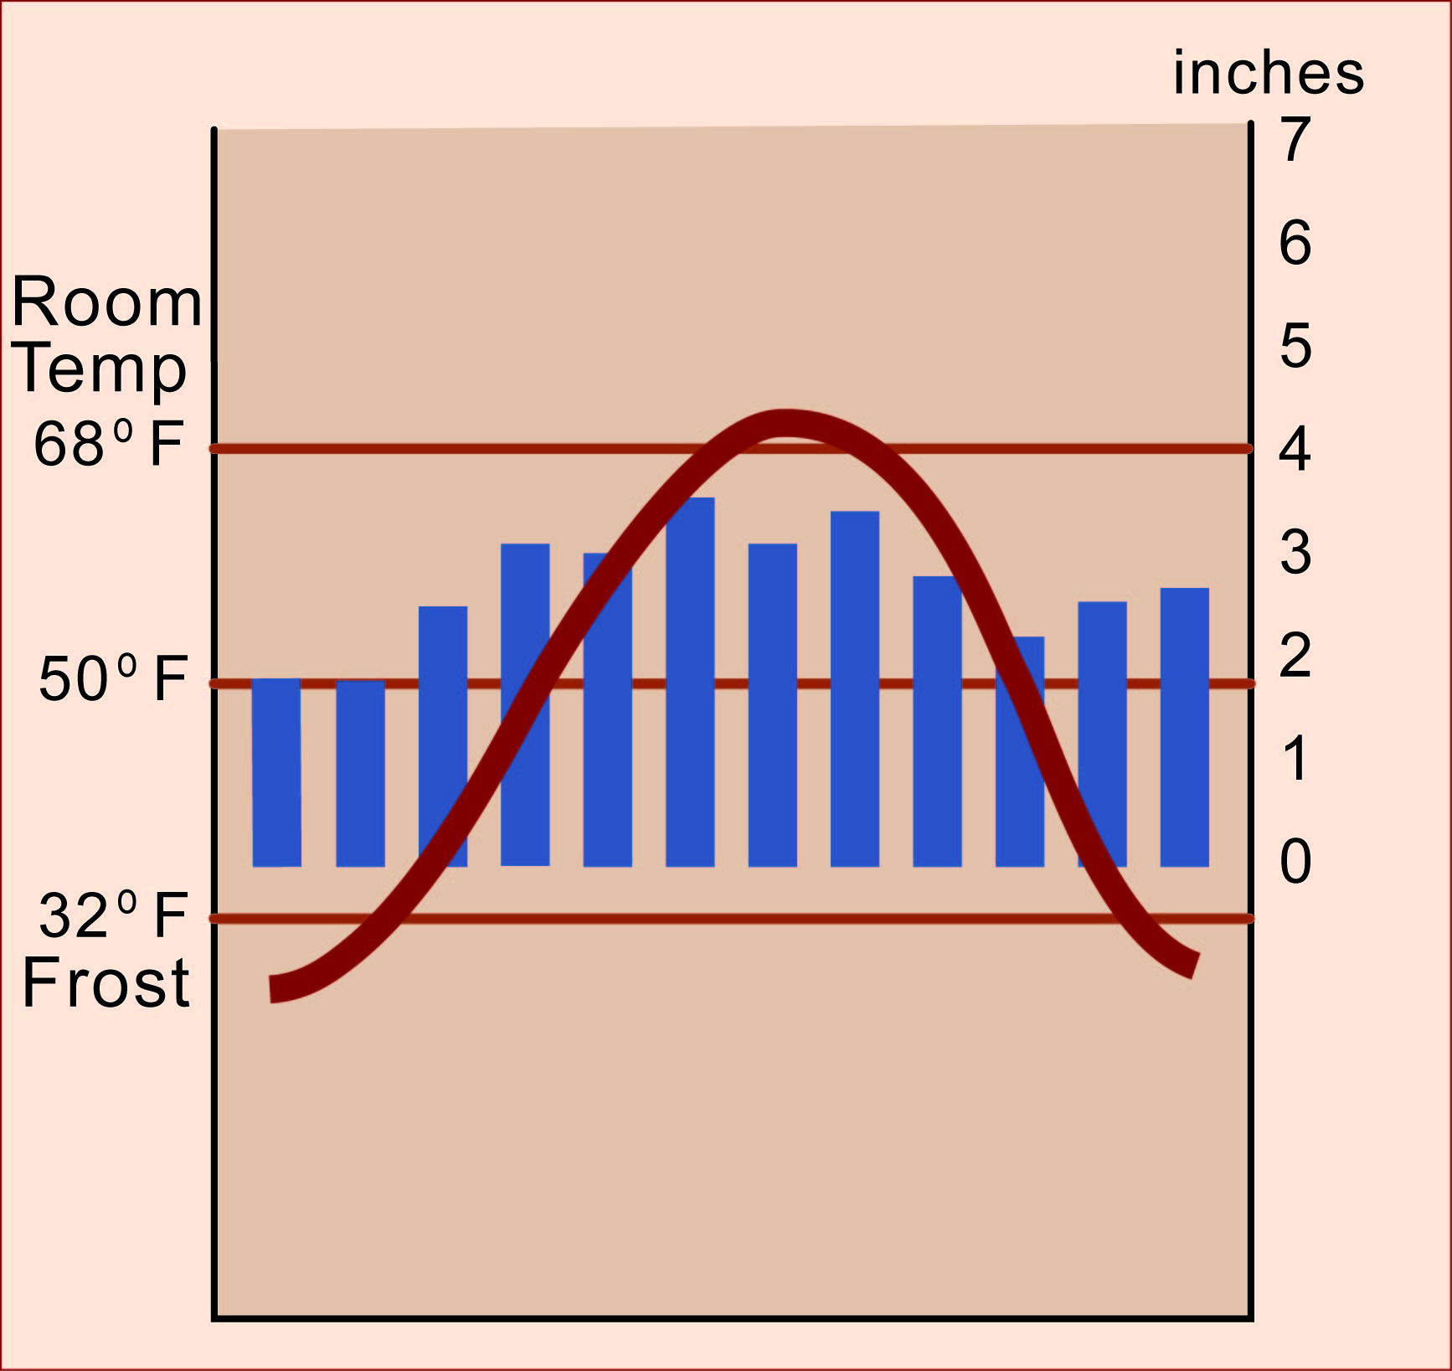
Now draw the bars
for rain or snow
to fit that scale.

Slide 22
That surplus water
can run off and make
rivers and lakes.
Or it can seep
through the soil
and remove nutrients.
That’s more water
than plants need.
When a precipitation bar
goes higher than
the temperature line,
that month has surplus water.
Now draw the bars
for rain or snow
to fit that scale.
Now draw the bars
for rain or snow
to fit that scale.

Slide 23
When precipitation bars
do not reach as high
as the temperature line,
that month has a water deficit.
Now draw the bars
for rain or snow
to fit that scale.
But if it lasts for months,
you have a grassland,
or even a desert.
If the deficit is short,
plants can live by using
water from the soil.

Slide 24
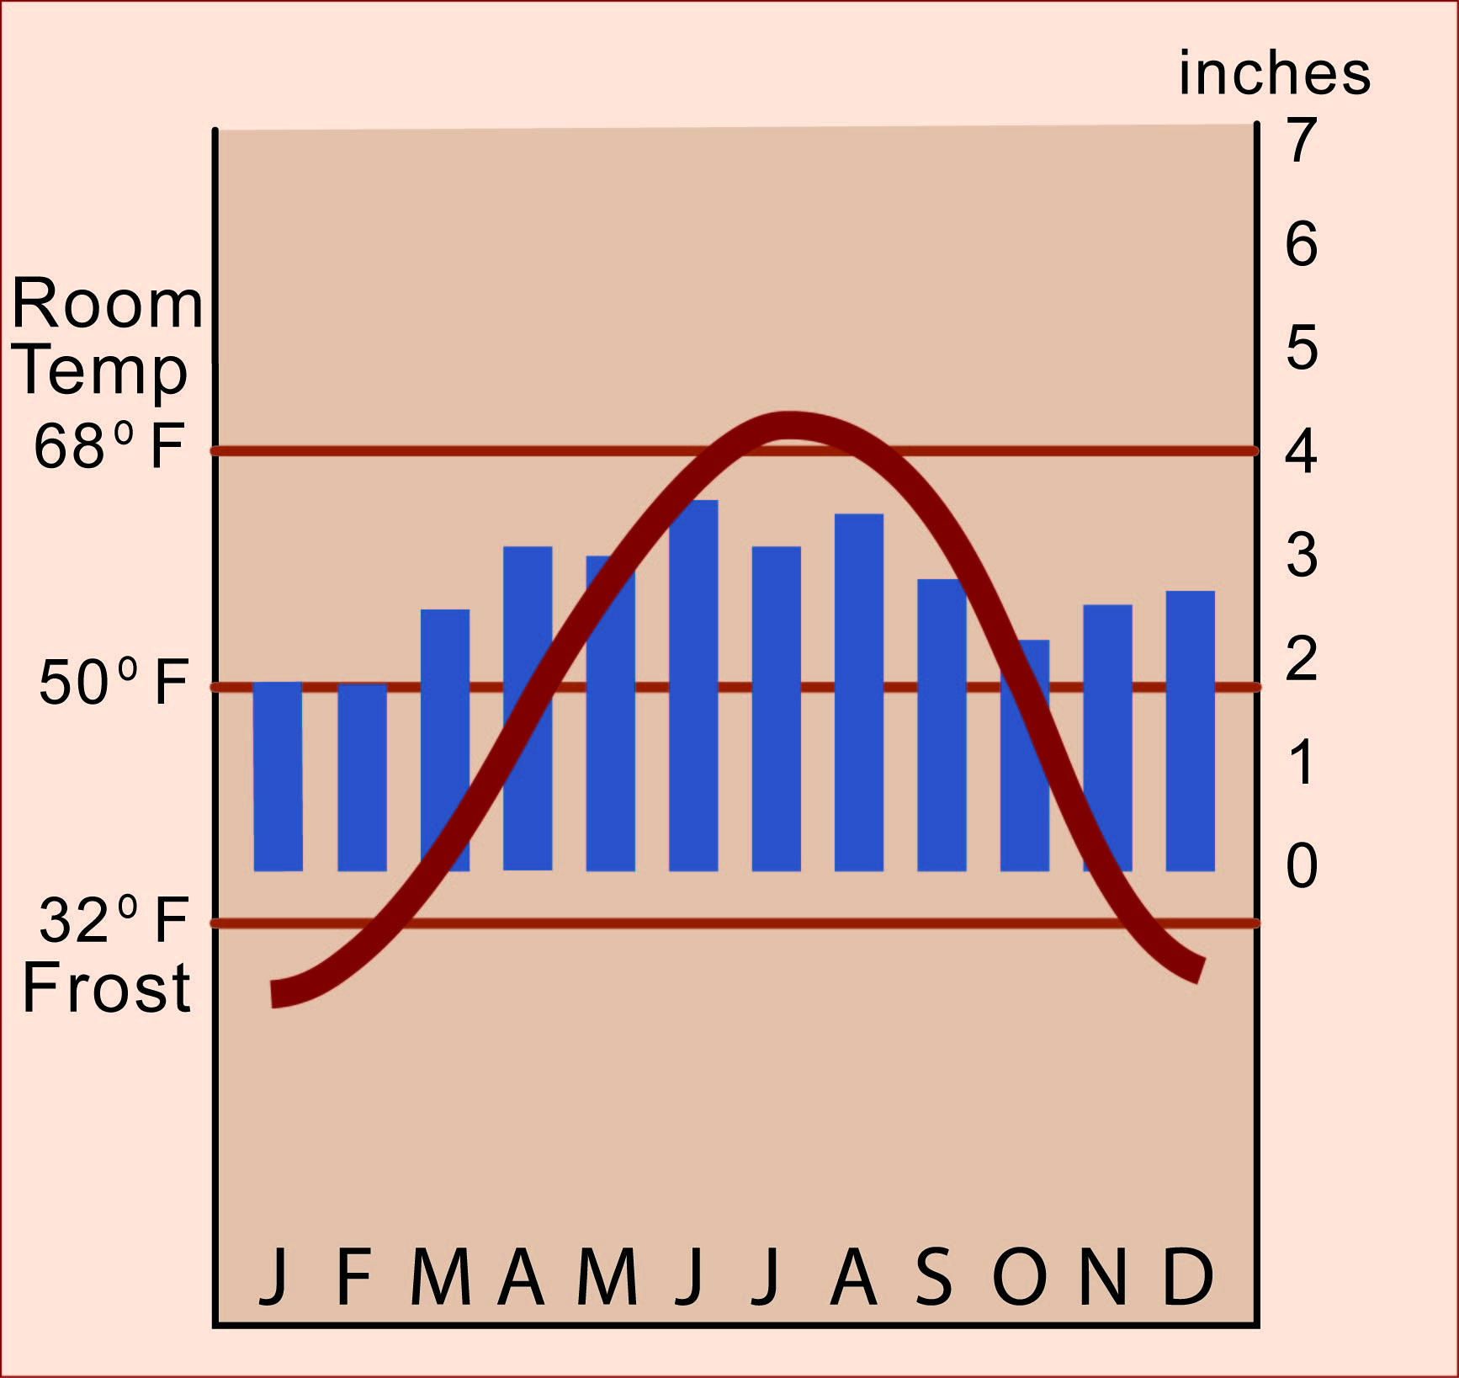
You see? A simple graph,
carefully drawn, can tell you
a great deal about a place.

Slide 25
This graph shows the climate of Detroit.
What does it tell you
about “the Motor City”?
You see? A simple graph,
carefully drawn, can tell you
a great deal about a place.
Detroit has a significant water surplus
in winter and spring, but plants
have to take water out of the soil
during a short water deficit in summer.
And the ground
is frozen for
two months
each year

Slide 26
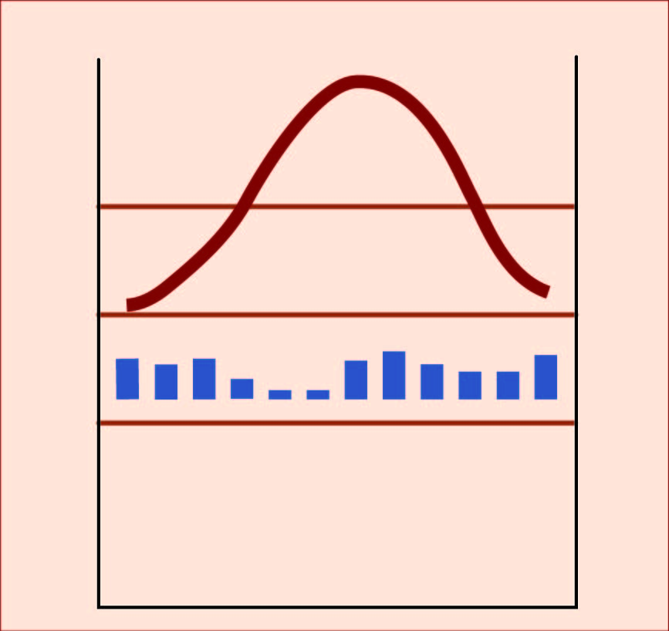
A city like Phoenix, Arizona,
has several really hot months
and a significant water shortage
in every month of the year
That’s why it is a desert!

Slide 27
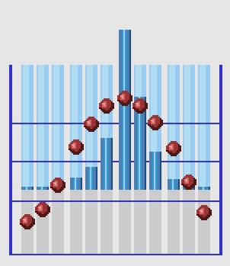
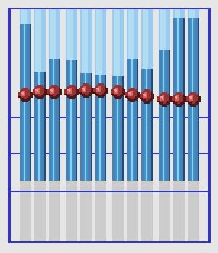
Here are the climagraphs for Beijing, the capital of China, and Singapore, a city right on the Equator. Which is which?
What can you tell about these two places?
(Note: these climagraphs use dots instead of a line for temperature,
but the idea is the same. Climagraphs do not all look exactly the same!
Most of them use vertical bars for rain, and they all have 12 months!)

