Slide 1
Oil in the world
GLCE G1.3.3 Explain the different ways in which places are connected and how those connections demonstrate interdependence.
GLCE E3 Analyze reasons for individuals and businesses to specialize and trade, and the benefits and costs of trade.
A quick map activity

Slide 2
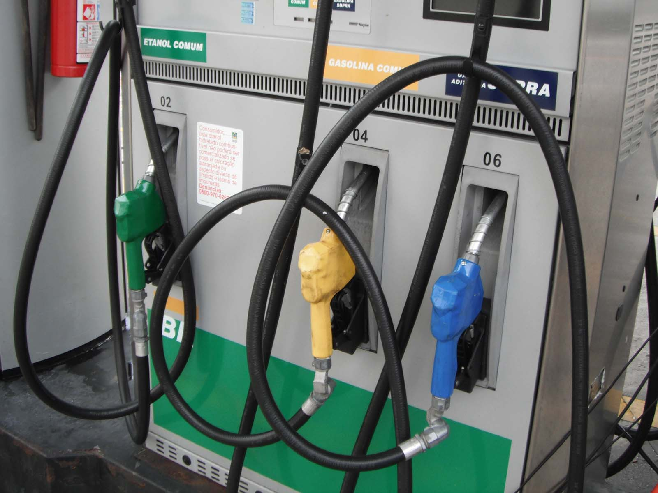
When you see
a gas station,
in your mind you
should also see . . .

Slide 3
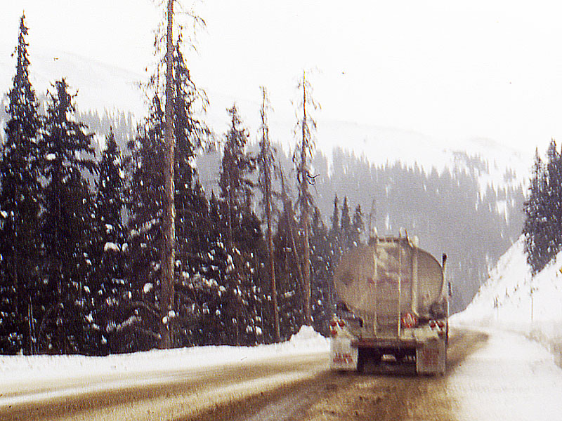
a tank truck,
often driving
in bad weather . . .

Slide 4
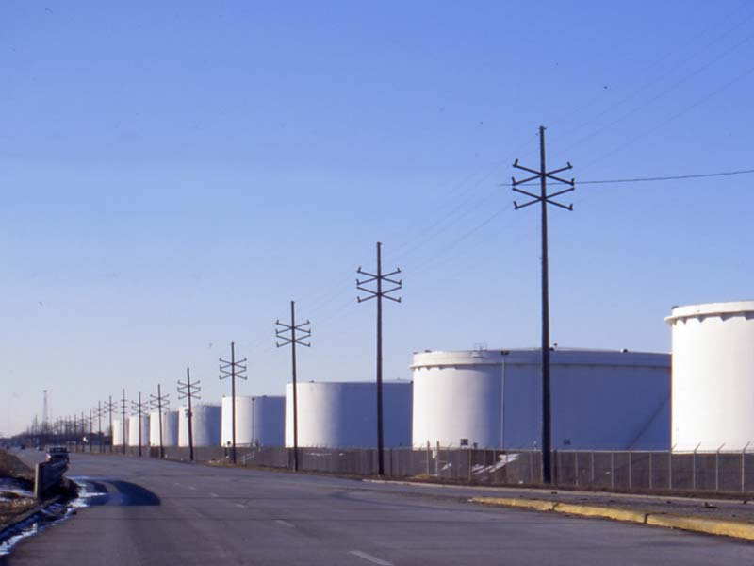
some large
storage tanks

Slide 5
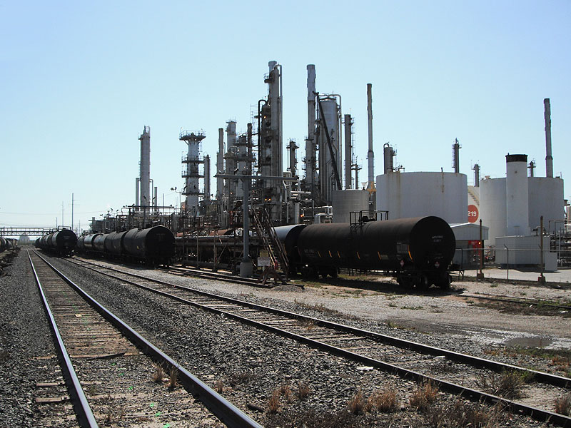
an oil refinery

Slide 6
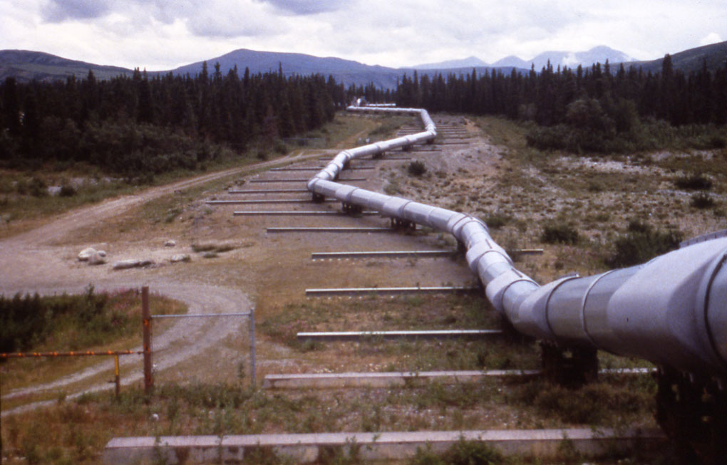
a long pipeline

Slide 7
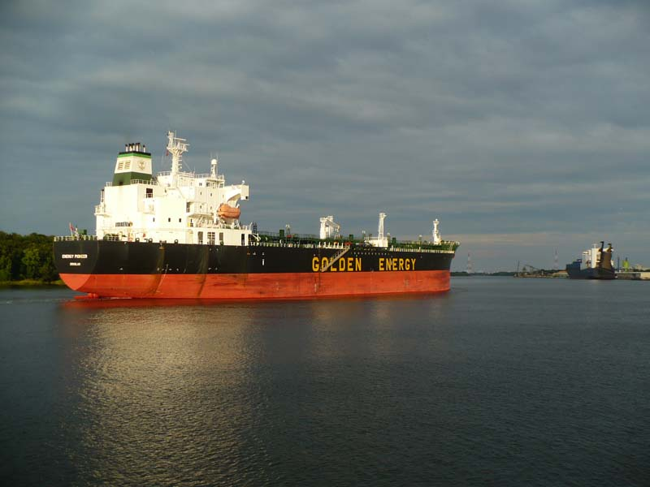
maybe a ship

Slide 8
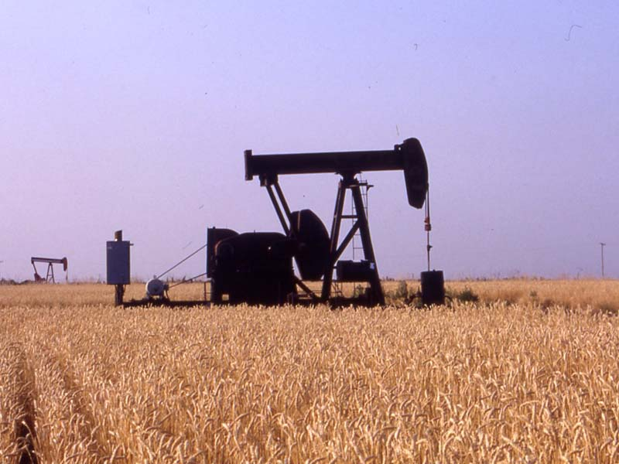
an oil pump

Slide 9
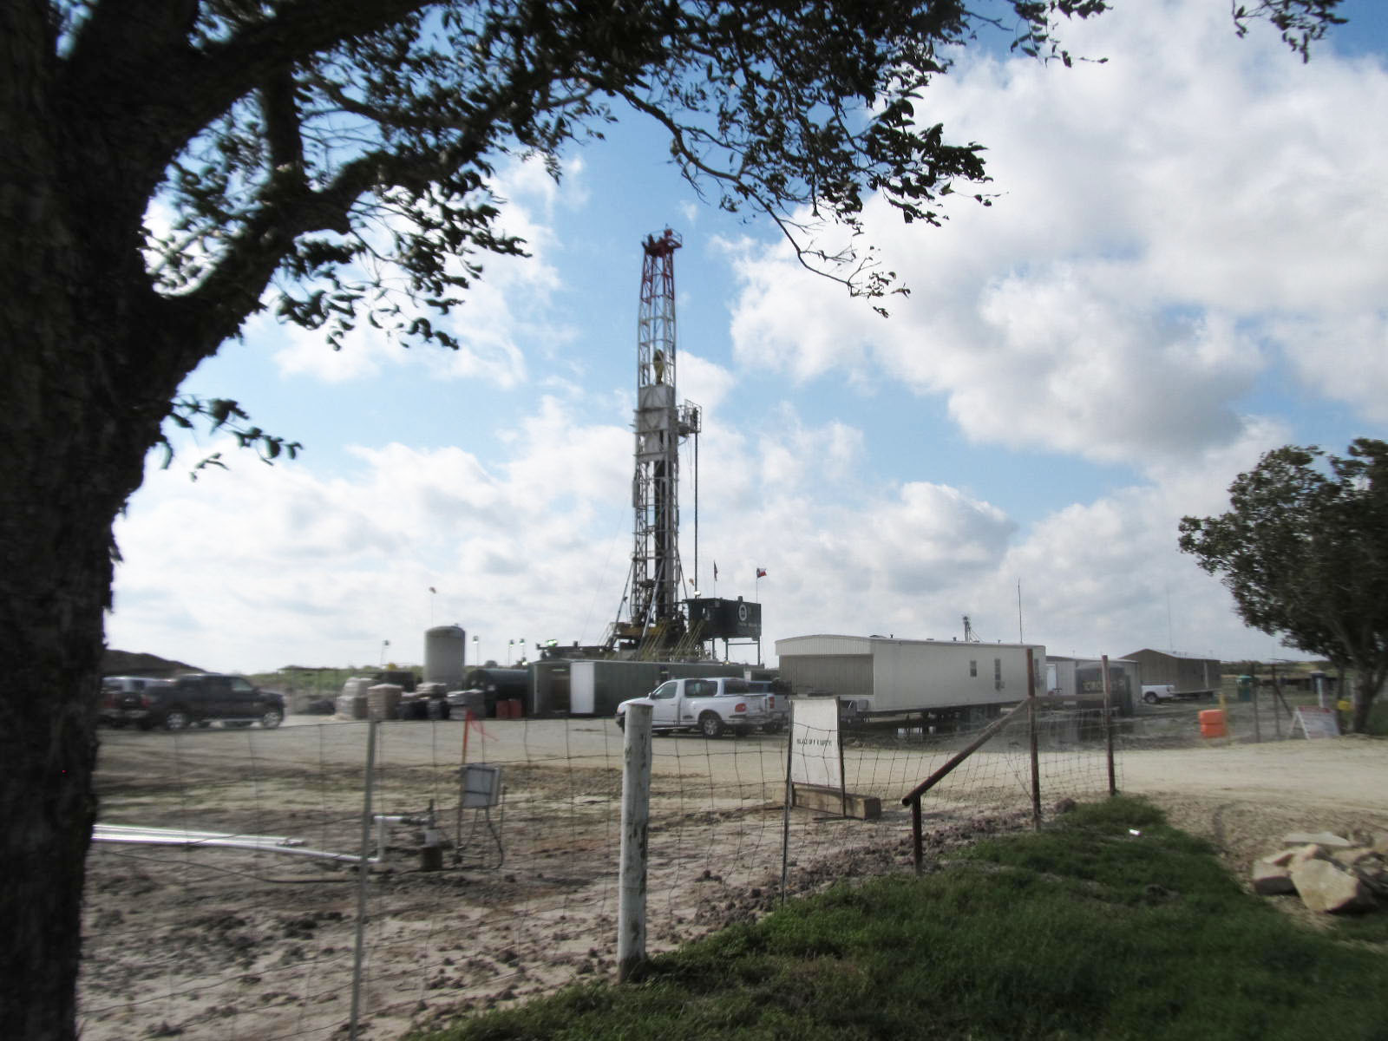
and a
drilling rig

Slide 10
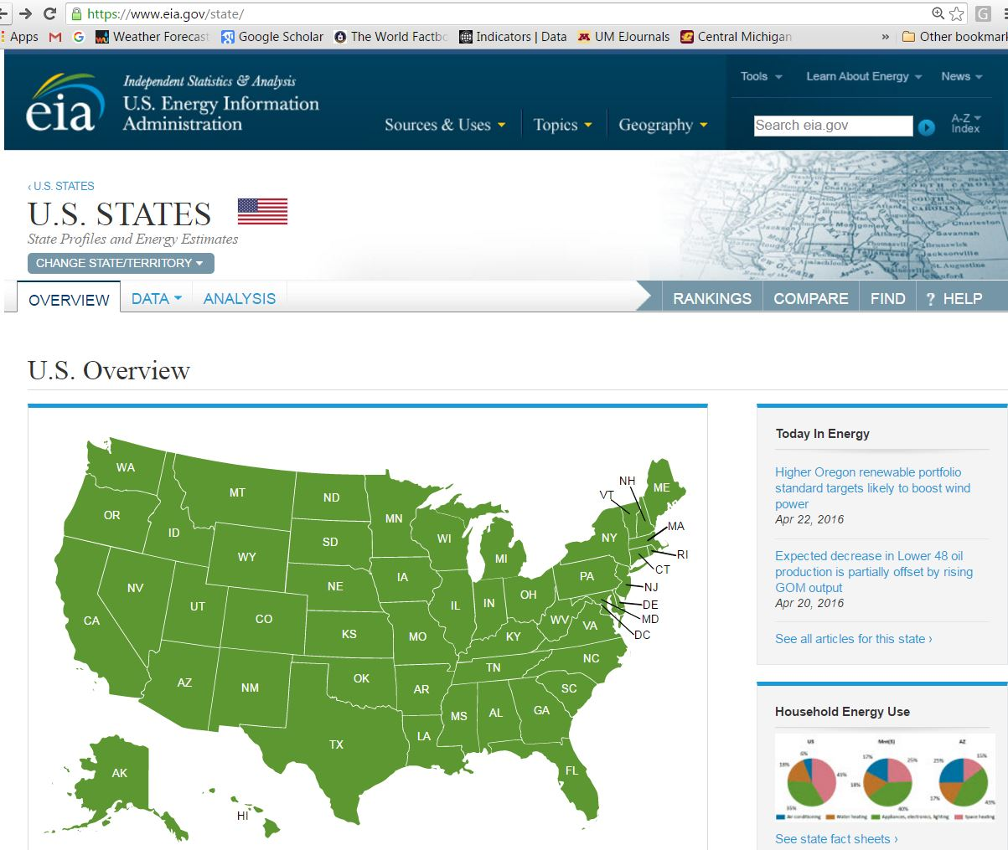
and $8,400,000,000
going out of Michigan
every year
about 40% of that total
goes completely out
of the United States

Slide 19
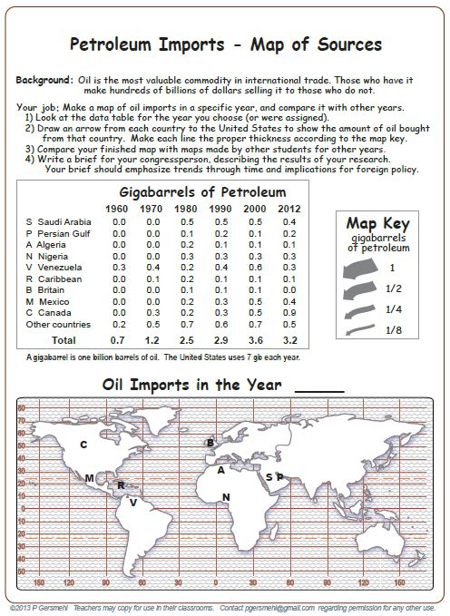
Another worksheet
looks at where
we get our oil
(and why that fact
might help terrorists).

Slide 21
What year is this?

Slide 22
Copyright 2016, Phil Gersmehl
Teachers who saw this presentation at a workshop
or downloaded it from our internet site have permission
to make a copy on their own computers for these purposes:
1. to help them review the workshop,
2. to show to colleagues or administrators,
3. to show the presentation in their own classrooms or at sessions they lead at teacher conferences,
4. to use individual frames (with attribution) in their own class or conference presentations.
For permission for any other use,
including posting frames on a personal blog or uploading to any network or website,
contact pgersmehl@gmail.com

