Slide 1
M
INERAL
R
ESOURCE
R
EVIEW

Slide 2
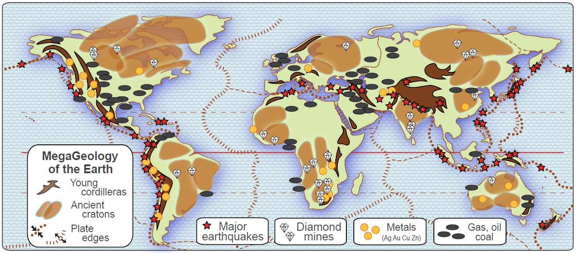
Here is a simple geology map of the world.
It shows how resources are related to underlying rocks.
Problem – it doesn’t look very simple.
In fact, it looks like a big mess.

Slide 3
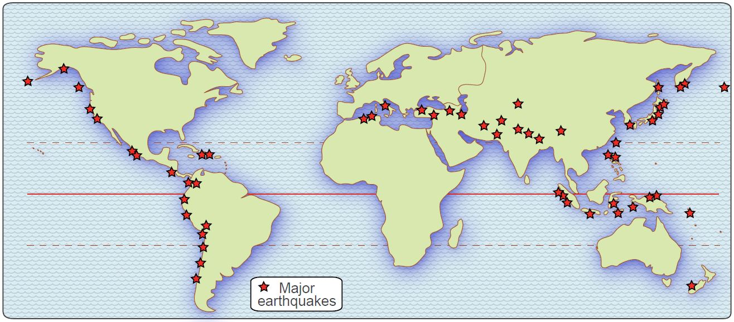
Let’s take the map apart and look at one thing at a time.
Here are the locations of major earthquakes since 1950.
The simple map clearly shows that
earthquakes are “lined up” – in long lines.

Slide 4
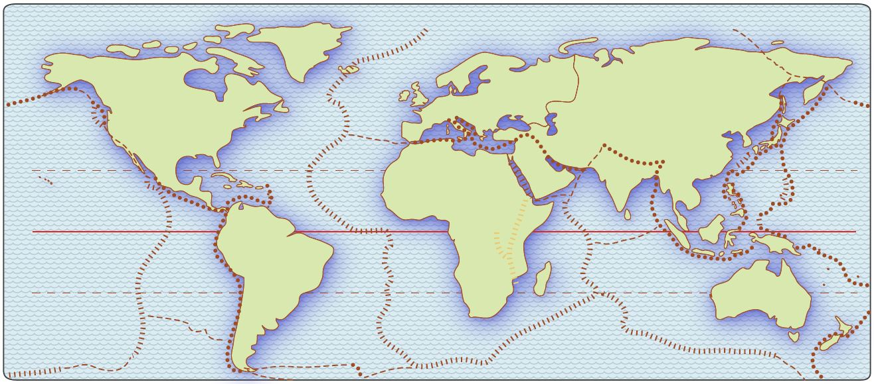
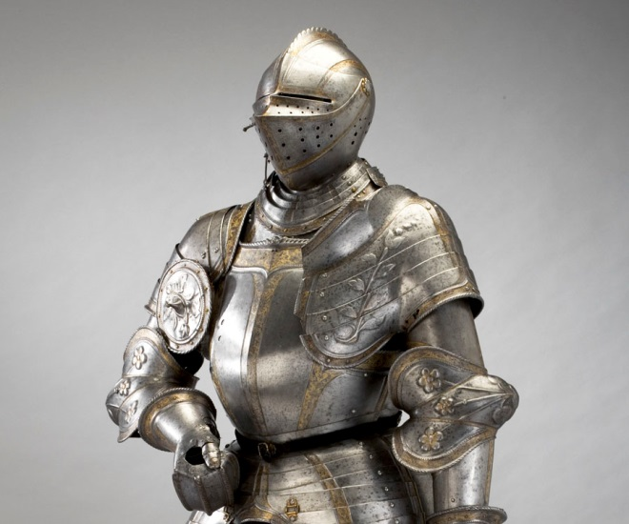
The earth’s crust is fairly thin, like the shell of an egg,
and it is broken into a number of separate “plates”.
Think of plates of armor on a medieval knight –
not plates and bowls on your dinner table!

Slide 5
Put those two maps together, and you see that
most earthquakes occur near the edges of crustal plates.
The biggest earthquakes occur
where crustal plates collide (dotted lines).
Earthquakes also occur where plates
are pulling apart (dashed lines),
but the shaking is much weaker.

Slide 6
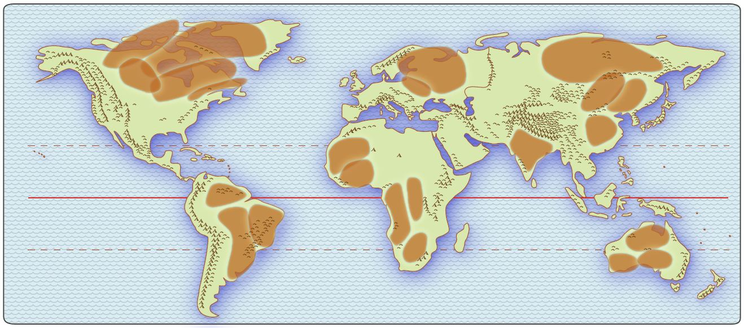
The map now shows ancient cratons (also called shields).
These are the oldest rocks on the earth surface.
To remember this map, make a generalization about each bunch,
like “eastern South America” or “most of India”.

Slide 7
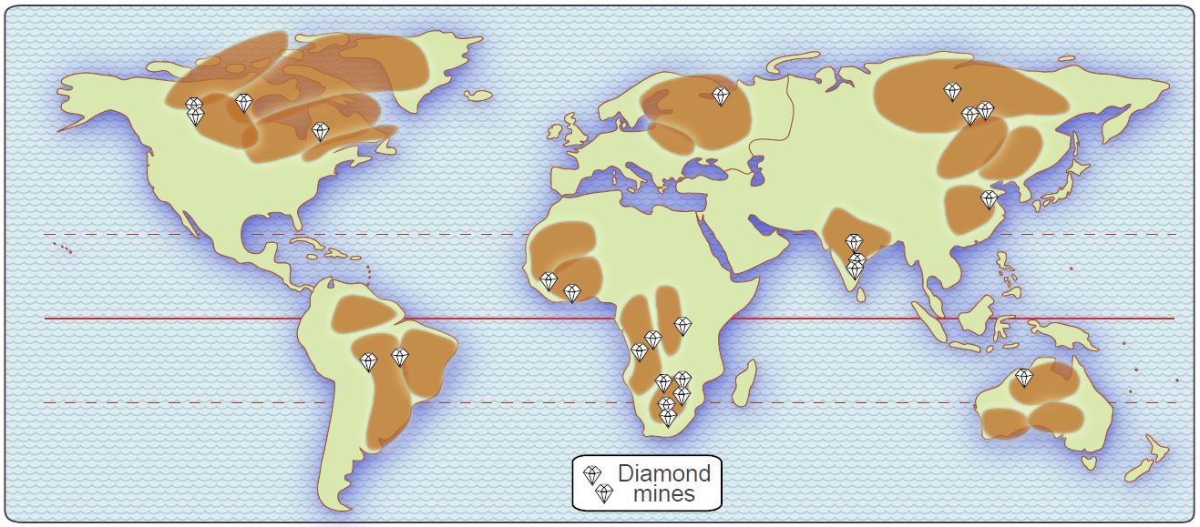
Ancient shields tend to be infertile and rocky, BUT
you can also find diamonds and other gemstones in them.
Not all cratons have diamonds in them,
but nearly all diamond mines are in ancient shields.

Slide 8
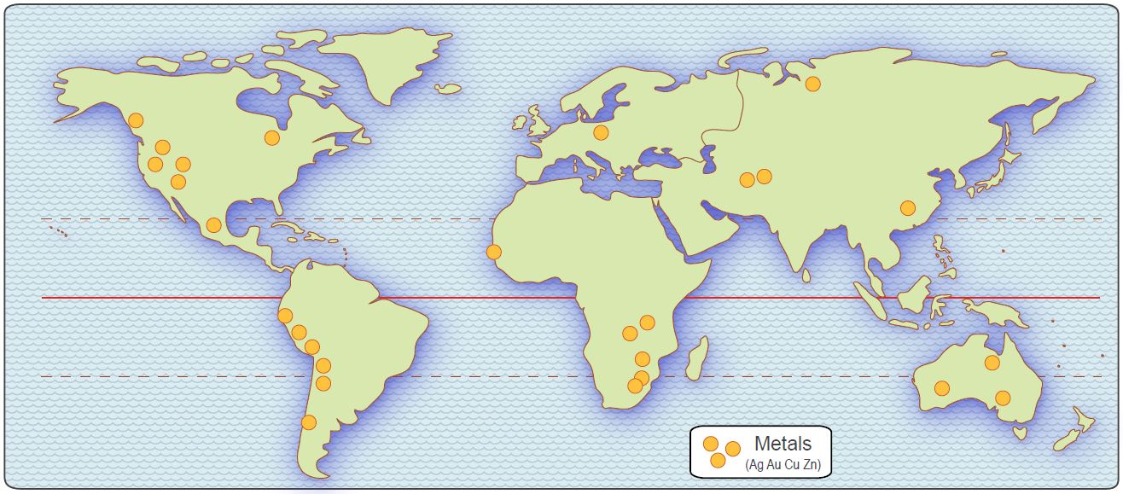
The map now shows the major mines for metals
like gold, silver, copper, nickel, zinc, chromium, etc.

Slide 9
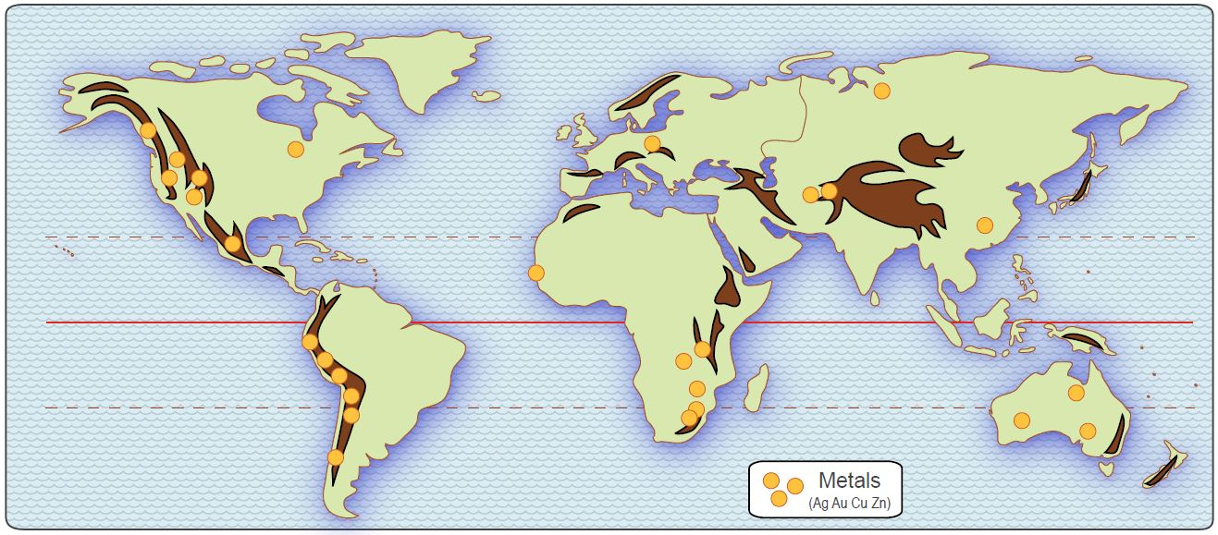
These metals are more likely to be found in or near
the relatively young rocks of cordilleras (mountain ranges).
Again, to remember this map, make generalizations:
(“mountains are in lines near the east coast of Africa”).

Slide 10
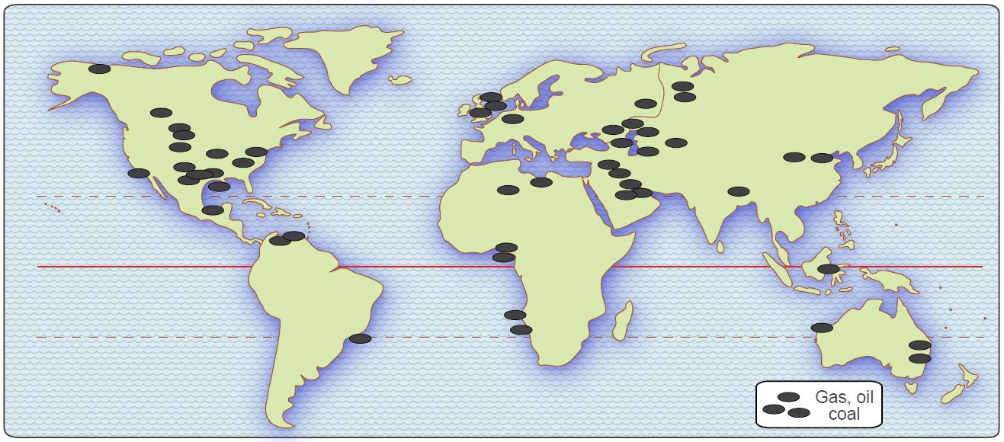
The third major category of mineral resources
are the fossil fuels – coal, oil, and natural gas.
Here again, the pattern looks confusing and hard to describe,
until you click and add the cratons and cordilleras to the map.

Slide 11
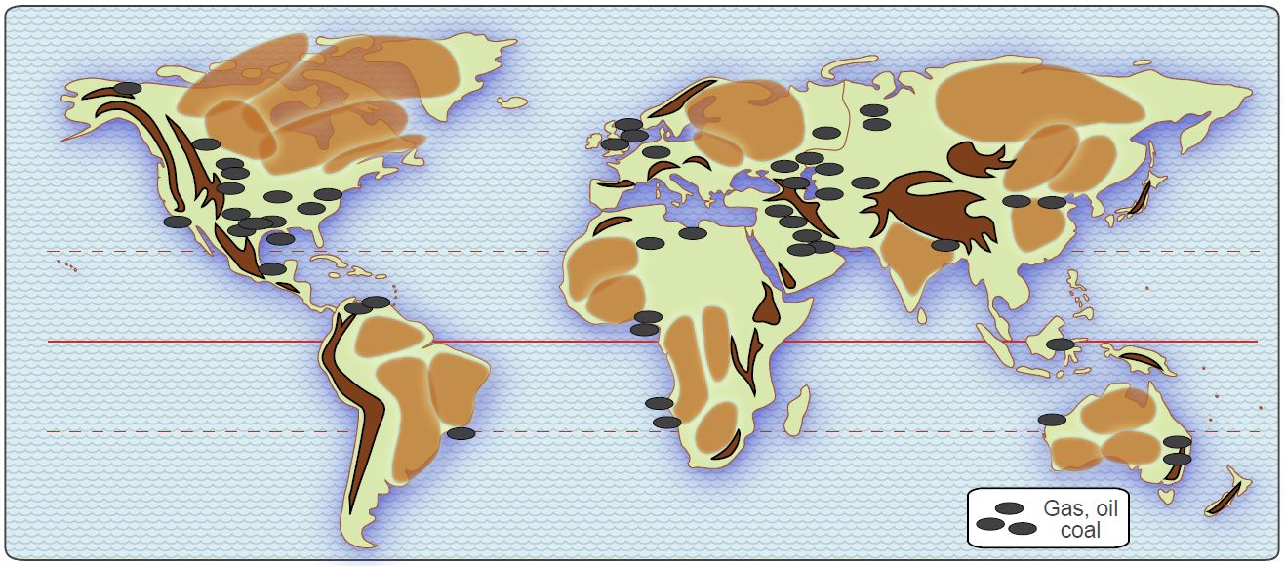
Fossil fuels occur in the sedimentary rocks
between the ancient cratons and the young cordilleras.
You can drill for oil in the cratons and cordilleras,
if you want to, but you are not likely to find any!

Slide 12
To get an idea about the chances of finding resources
in a country, mentally put the country on this map.

Slide 13
W O R D W A L L
Cordillera – mountain area made of relatively young igneous rock
Craton – lowland area made old igneous and metamorphic rock
Crust – outer “skin” of the earth, 20-40 miles thick (like armor on a knight)
Earthquake – ground shaking that occurs as crustal plates “collide”
Fossil fuel – rock made of deposited and hardened plants and animals
Gemstone – ancient and very hard crystal, like diamond, ruby, or sapphire
Igneous – rock made when molten (hot liquid) rock cooled and hardened
Metal ore – rock that contains gold, silver, copper, nickel, chromium, etc.
Metamorphic – rock made by heating and compressing older rock
Plate – separate piece of the outer crust of the earth
Sedimentary – rock made of deposited and hardened pieces of other rock

Slide 14
Copyright 2016, Phil Gersmehl
Teachers who saw this presentation at a workshop
or downloaded it from our internet site have permission
to make a copy on their own computers for these purposes:
1. to help them review the workshop,
2. to show to colleagues or administrators,
3. to show the presentation in their own classrooms or at sessions they lead at teacher conferences,
4. to use individual frames (with attribution) in their own class or conference presentations.
For permission for any other use,
including posting frames on a personal blog or uploading to any network or website,
contact pgersmehl@gmail.com

