Slide 1
Strategic Straits
-
Targets of Conflict
6-G4.4.1 Identify factors that contribute to conflict and cooperation (e.g., control of natural resources).
6-G4.4.2 Evaluate from different perspectives, examples of cooperation and conflict.
6-C4.3 Conflict and cooperation between and among nations ---
international issues, treaties, agreements, organizations

Slide 2
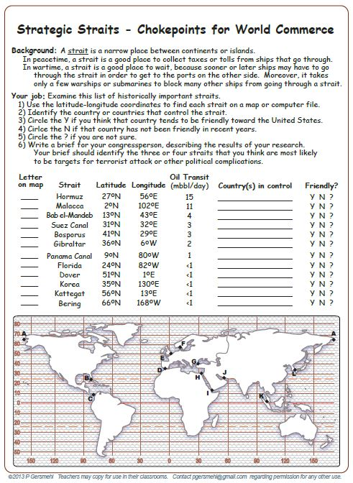

Slide 3
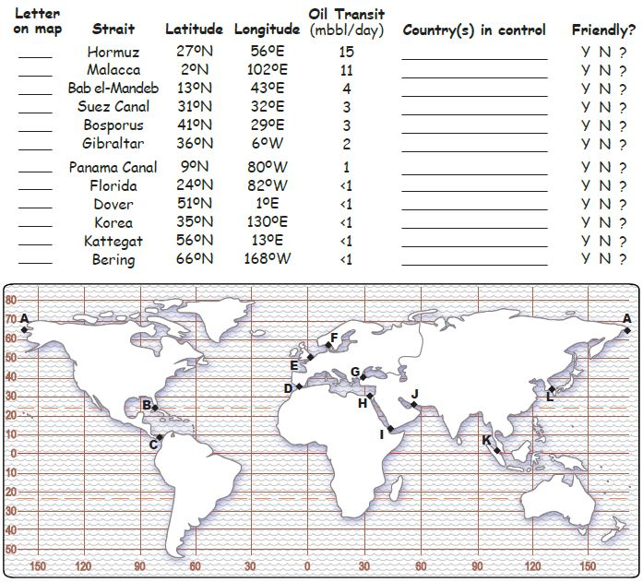

Slide 4
This part
will require
some research
Few students will have
this prior knowledge.

Slide 5
But this part
can be done
in class.
A
Russia, US

Slide 6
Big Question
Which straits are likely to be
causes (or even targets)
in future conflicts?

Slide 7
Copyright 2015, Phil Gersmehl
Teachers who saw this presentation at a workshop
or downloaded it from our internet site have permission
to make a copy on their own computers for these purposes:
1. to help them review the workshop,
2. to show to colleagues or administrators,
3. to show the presentation in their own classrooms or at sessions they lead at teacher conferences,
4. to use individual frames (with attribution) in their own class or conference presentations.
For permission for any other use,
including posting frames on a personal blog or uploading to any network or website,
contact pgersmehl@gmail.com

