Slide 1
7th Grade Social Studies Network
ANCIENT CITIES

Slide 2
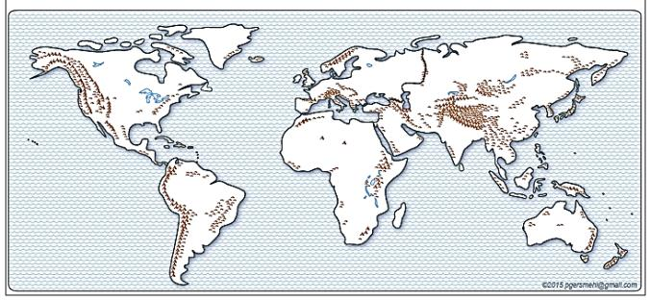

Background for Teachers
Content focus: Ancient cities
Purposes:
to increase skill in finding regions and patterns on maps
to increase skill in describing associations
{human-environment interaction}
2

Slide 3
We will use simple maps
about world history and geography.
Specifically, we will:
1. Use the map title and map key
to talk about the map topic
(the focus of a thematic map,
the kinds or amounts of something)
in different parts of the world)
2. Use “location” phrases to describe
where things are located
(inside, in the middle, in a corner, on the edge;
on the north, south, west, or east side,
in a line, in a region, close to vs. far from).

Slide 4
We will use simple maps
to work on the following GLCEs.
6 – G1.1.1
Use maps . . . to investigate the world at [several] scales.
6 – G1.1.2
Draw a sketch map or add information to an outline map of the world.
6 – G1.3.1
Use the fundamental themes of geography
(location, place, human environment interaction, movement, region)
to describe regions or places on earth.
6 – G3.2.2
Explain why some regions provide greater opportunities for humans.
7 – H1.2.1
Explain how historians use a variety of information to explore the past.
7 – W2.1.3
Use historical and modern maps to locate, describe, and analyze . . .
permanent settlements and the development of early civilizations.

Slide 5
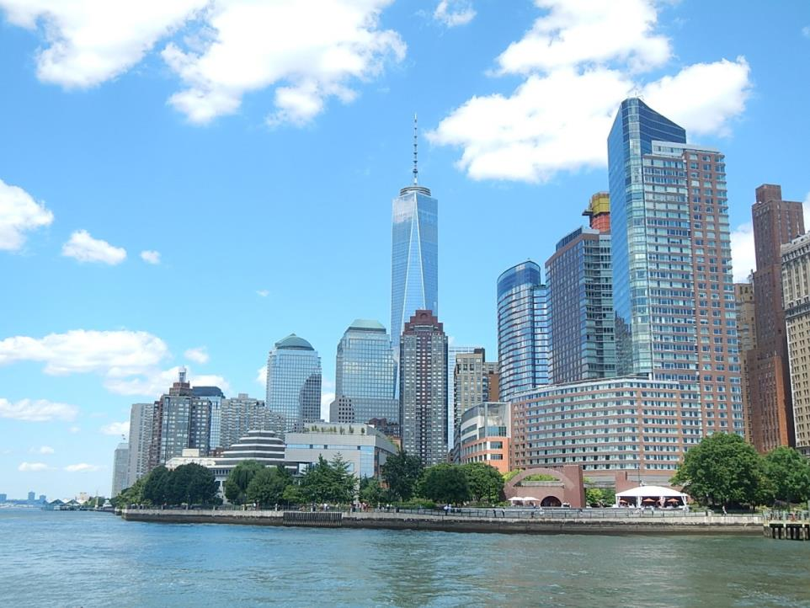
A Modern “Mega-city”
Lower Manhattan (“downtown”), New York City, 2015

Slide 6
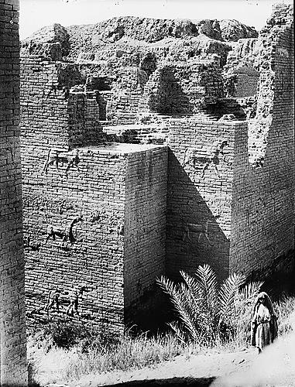
An Ancient “Mega-City” - 575 BCE
Ruins of the ancient Ishtar Gate in Babylon, Mesopotamia.

Slide 7
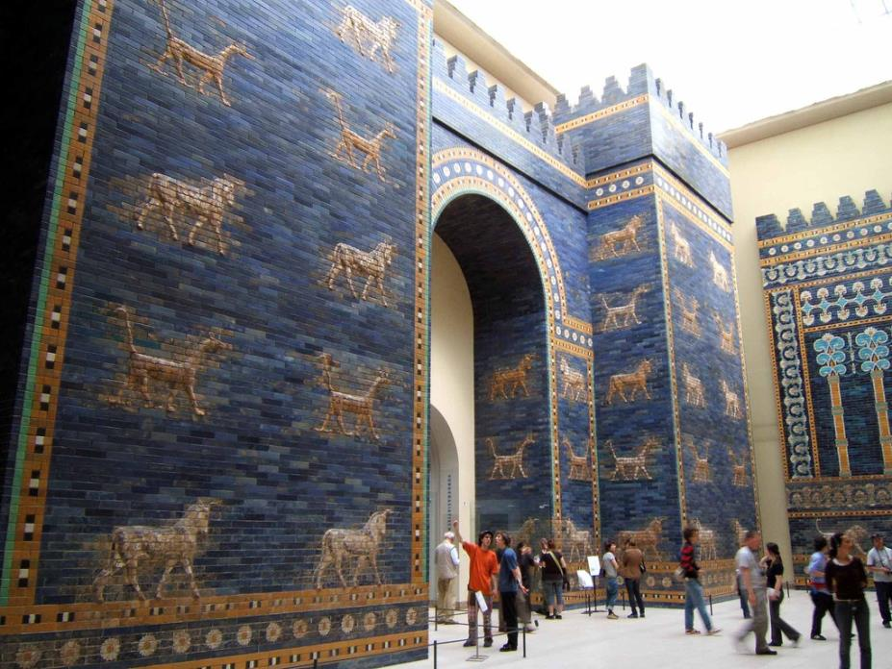
Restoration of the Ishtar Gate in Berlin, Germany.

Slide 8
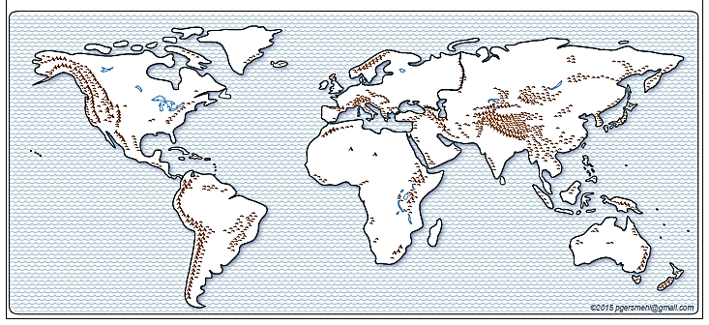

Where were the really big ancient cities?
(Where did people choose to live in the past?)

Slide 9
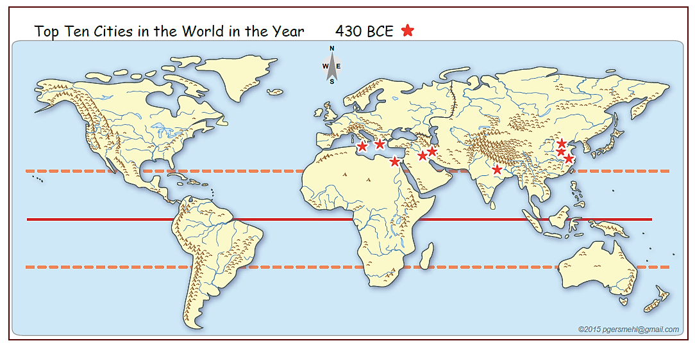
Long ago:
430 BCE
Look for Region, Pattern
Tropic N
Equator
Tropic S
Region: Draw a box around a group of similar places. Describe location of box.
Pattern: Are ancient cities spread evenly throughout the world?
Are they arranged in a line? If so, describe the location of the line.

Slide 10
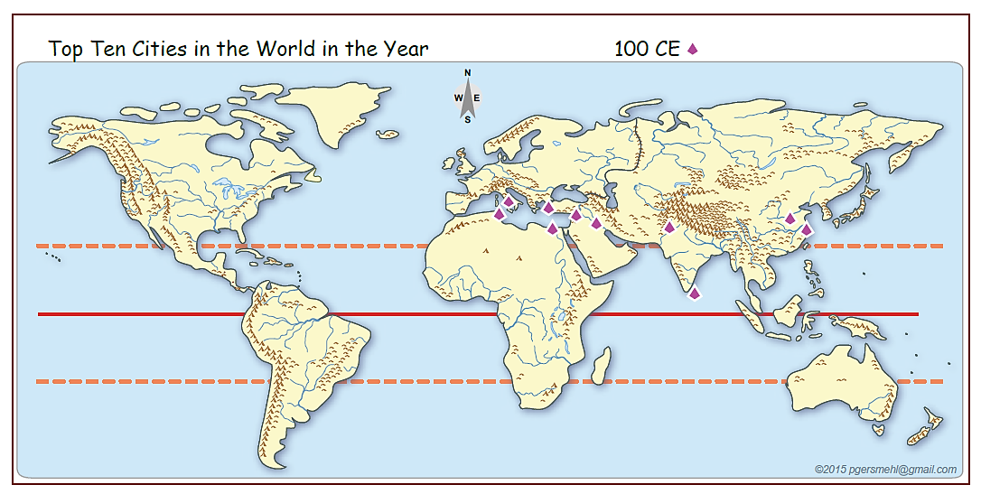
Long ago:
100 CE
Look for Region, Pattern
Region: Draw a box around a group of similar places. Describe location of box.
Pattern: Are ancient cities spread evenly throughout the world?
Are they arranged in a line? If so, describe the location of the line.

Slide 11
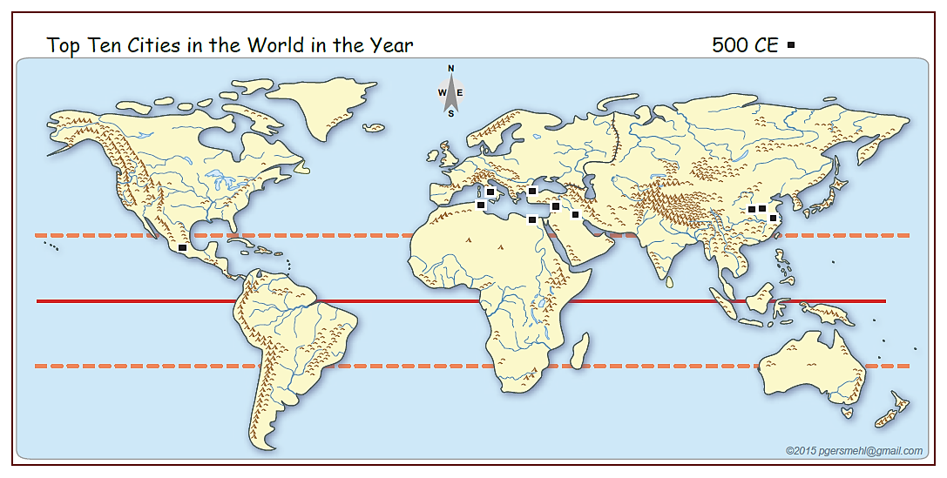
Long ago:
500 CE
Look for Region, Pattern
Region: Draw a box around a group of similar places. Describe location of box.
Pattern: Are ancient cities spread evenly throughout the world?
Are they arranged in a line? If so, describe the location of the line.

Slide 12
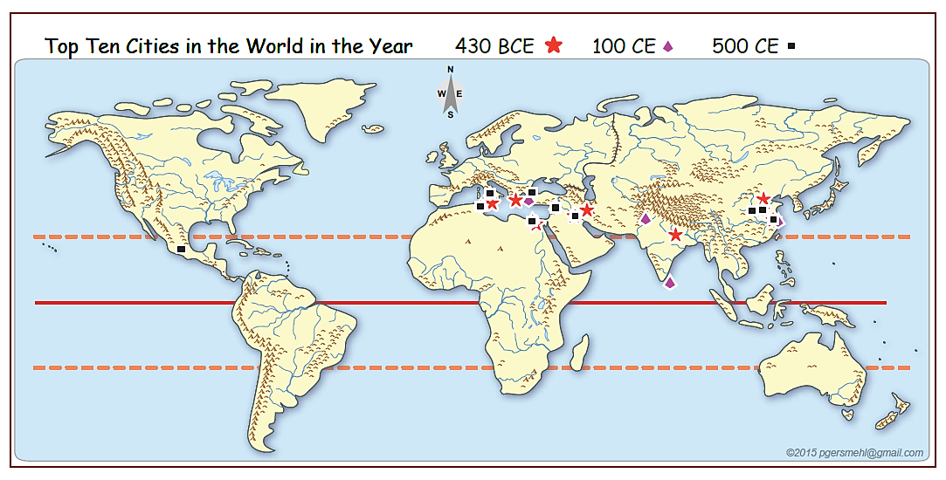
Long ago:
430 BCE, 100 CE, 500 CE
We put
all three maps
together.
Where
did large numbers of people live
in the past?
Why there?
What are some possible reasons
that might explain why people chose to build
most of the ancient cities in such a small region?

Slide 13
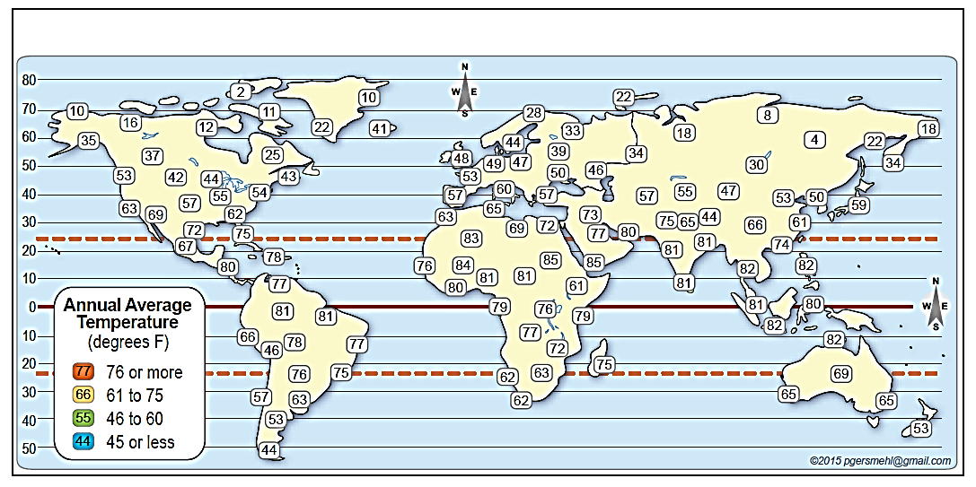
Temperature
(average annual)
The numbers show average annual temperatures.
Warmest: Mark the warmest temperatures with a red box.
Coldest: Mark the coldest temperatures with a blue box.

Slide 14
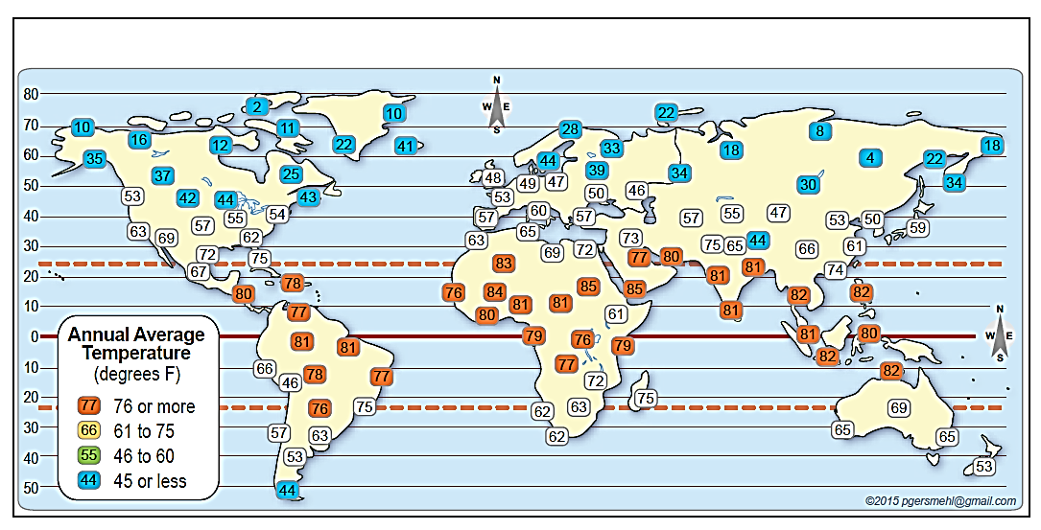
Use region or pattern “vocabulary”
to describe what you see after you color
the places with high and low temperatures.
Temperature
Equator
Pattern: Are the coldest temperatures spread evenly throughout the world?
Look for a line; draw a line. Describe the location of the line.
Are the warmest temperatures spread evenly throughout the world?
Look for a line; draw a line. Describe the location of the line.

Slide 15
Use region or pattern “vocabulary”
to describe what you see
when you find the high and low temperatures.
Temperature
Equator
There are some exceptions
to our generalization
Pattern: Are the coldest temperatures spread evenly throughout the world?
Look for a line; draw a line. Describe the location of the line.
Are the warmest temperatures spread evenly throughout the world?
Look for a line; draw a line. Describe the location of the line.

Slide 16
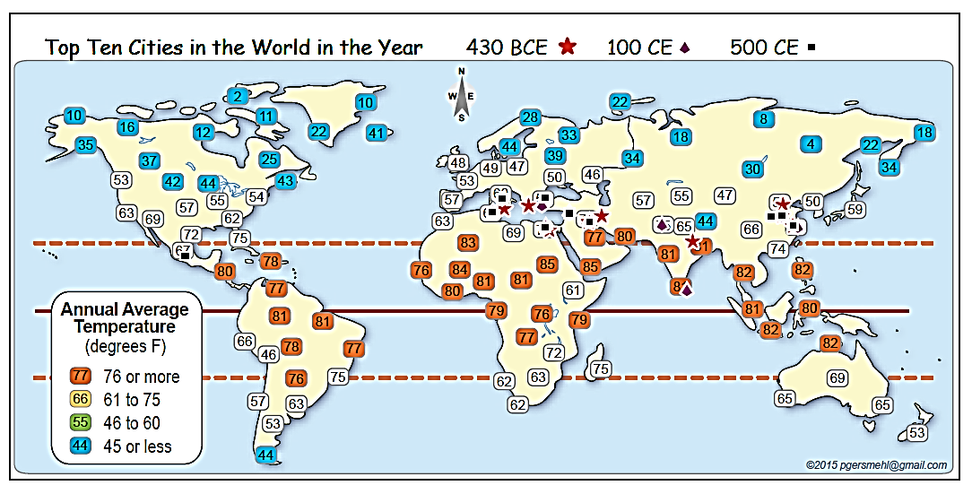
Temperature and largest ancient cities.
Equator
Geographic Association:
What temperatures are associated with
(occur together with)
the region or line of the largest cities?

Slide 17
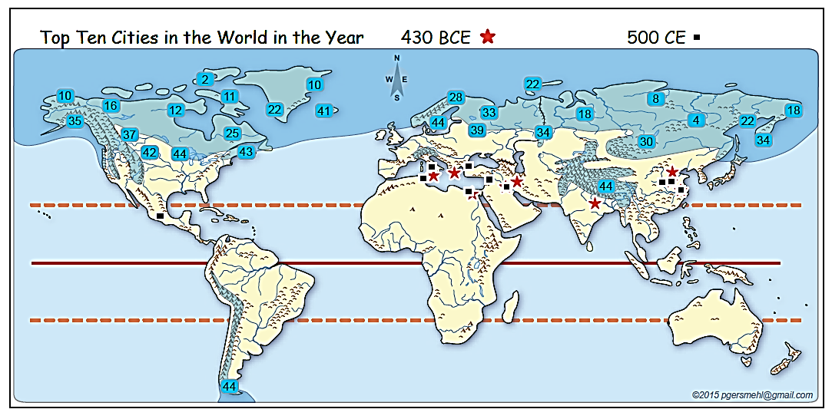
Temperature (average annual)
and Short Growing Season
Equator
Here, the mapmaker used information from many more weather stations
to draw a line around the areas that have very short growing seasons.
How does this information help us understand the pattern of ancient cities?

Slide 18
Sources:
Data source for largest ancient cities:
Tertius Chandler, Four Thousand Years of Urban Growth: An Historical Census
See Excel table (AncientCities _430BC&100-400-800AD_Data.xls)
Maps: We use layers in the “clickable PDF” called
BI1B Ancient Cities and Temperatures clickable.pdf
from the world map section of the website www.Mi6thGradeClass.com
Sept. 2015 carol.gersmehl@gmail.com Michigan Geographic Alliance

Slide 19
When you teach
about ancient cities,
remember the old adage:
Memorizing
is what people do
when they do not understand
what they are trying to learn.

Slide 20
Here are a few more maps
to use in discussion, review,
or assessment.

Slide 21
Simple graphic summary:
“Where were the big cities in ancient times?”
Focus
importance of latitude
Review
location of equator,
pattern, transition
Why there?
COLD
Tropic N
HOT
Equator
Tropic S

Slide 22
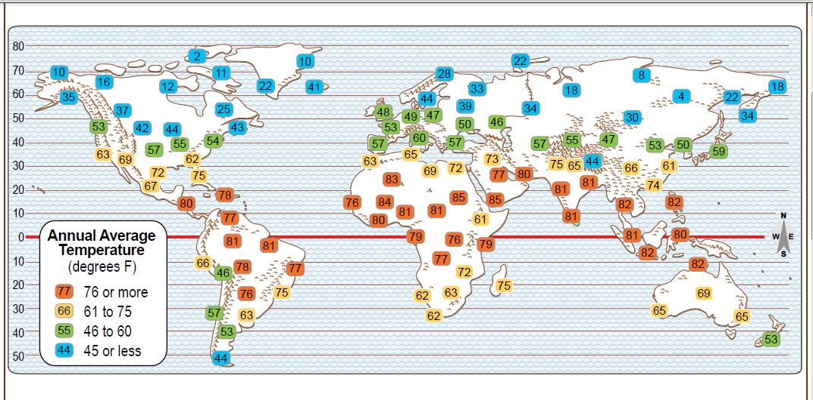
Temperature
Equator
Transition: Describe a sequence along a route.
How does temperature change as we move
north or south, away from the Equator?

Slide 23
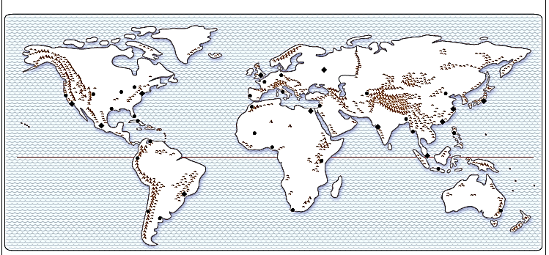

You can draw circles on a desk map
(blobs on a screen, or pool noodles on a floor map!)
and use that simple map to start a discussion
about the conditions that influence where people live today.
Each circle represents
1% of the world’s population.

Slide 24
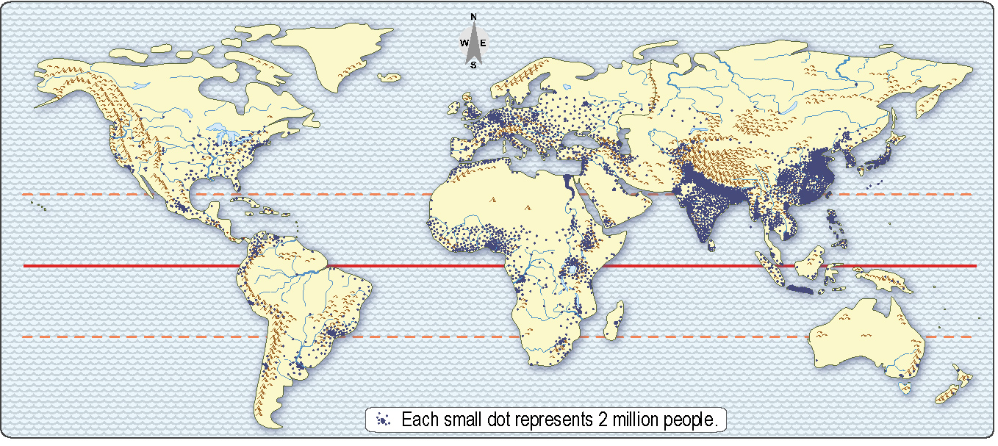
Here is a much more detailed dot map of world population –
each dot represents 2 million people
(about 160 dots in the United States).

Slide 25
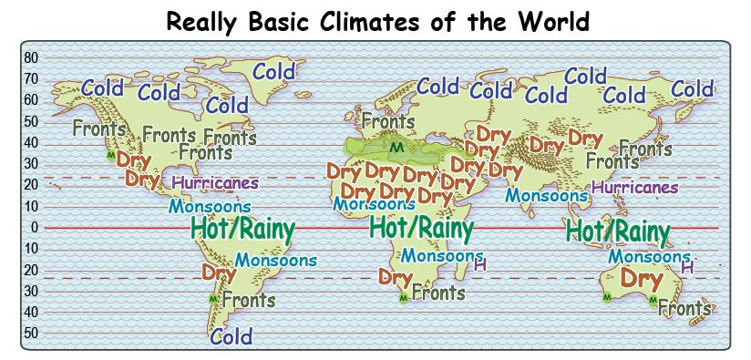
This map (from the simple climate clickable)
uses words to describe the climate in different areas
(each kind of climate can be displayed individually or in any combination).

Slide 26
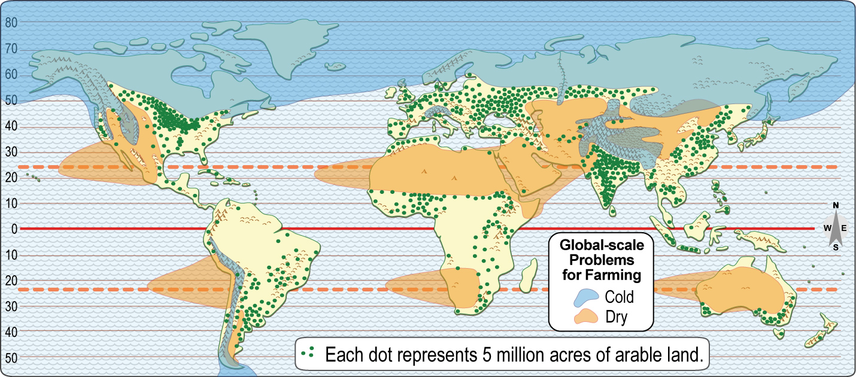
This map (from the world clickable)
has information about cold areas, dry areas,
and cropland.

Slide 27
Here we add the “one-percent dots” from an earlier map
to the world map of cold areas, dry areas, and cropland.

Slide 28
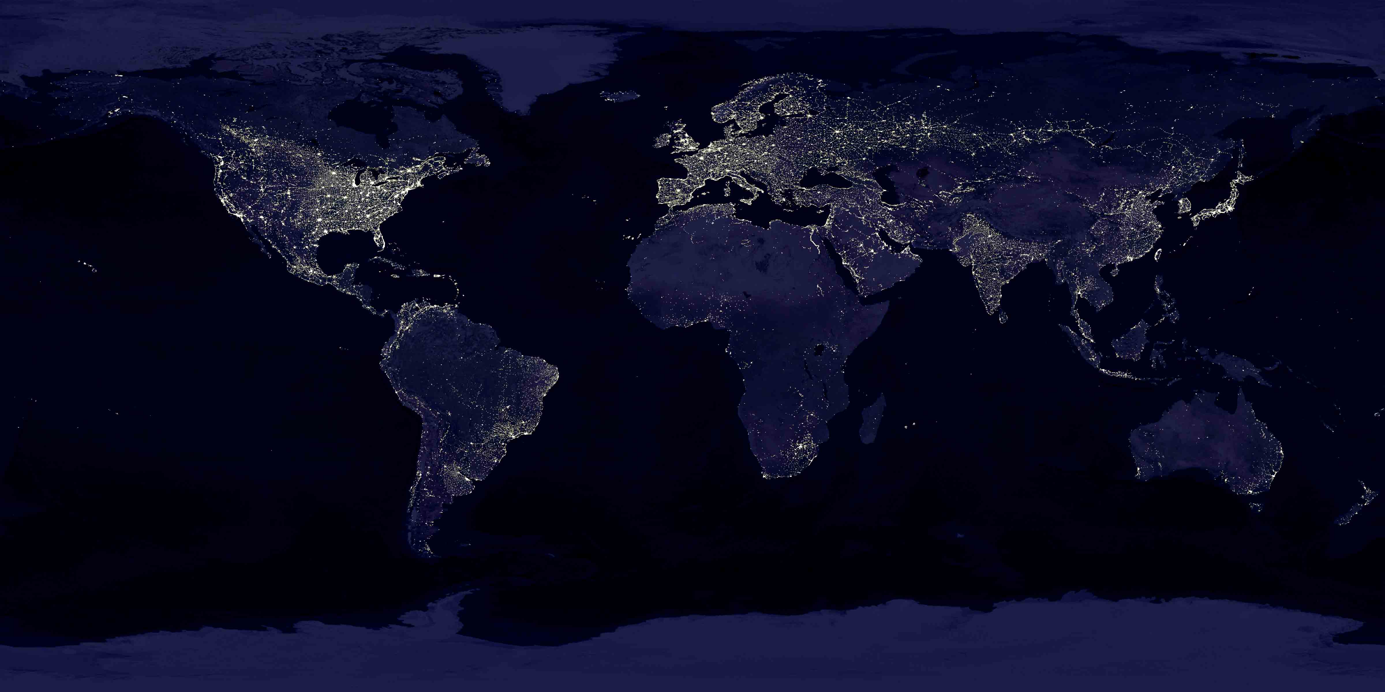
Finally, a “night-time” map of the world,
compiled by NASA from satellite images.

