Slide 1
Culture
of the
Pioneers
What kind of “cultural baggage”
would a pioneer family take with them
as they moved to the western frontier?

Slide 2
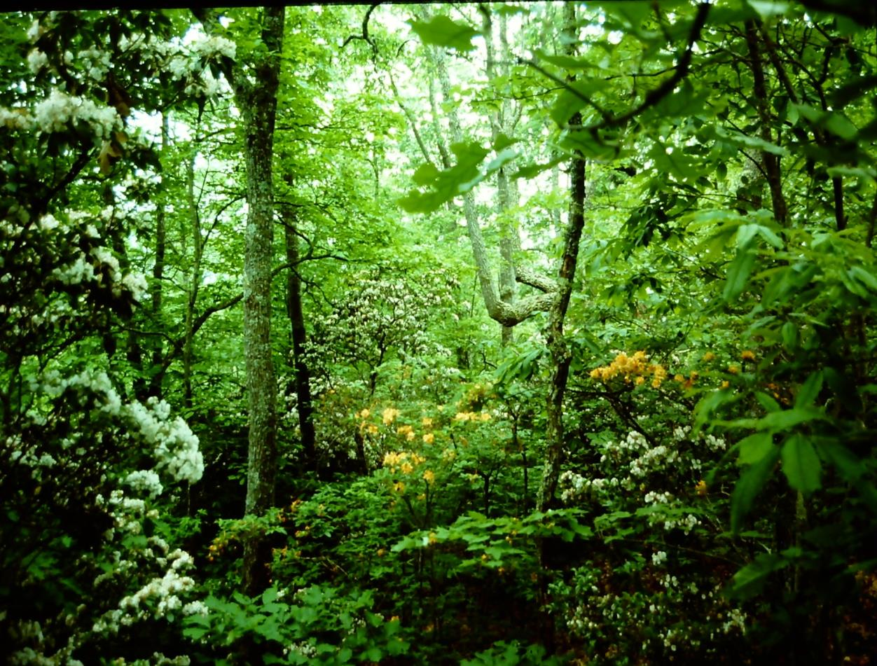
When Europeans arrived in the 1500s,
most of eastern North America was covered by forest.
The forest was especially thick on steep slopes.

Slide 3
In many places, the forest was more open,
because Native American people often set fires
to burn brush and make conditions better for animals.

Slide 4
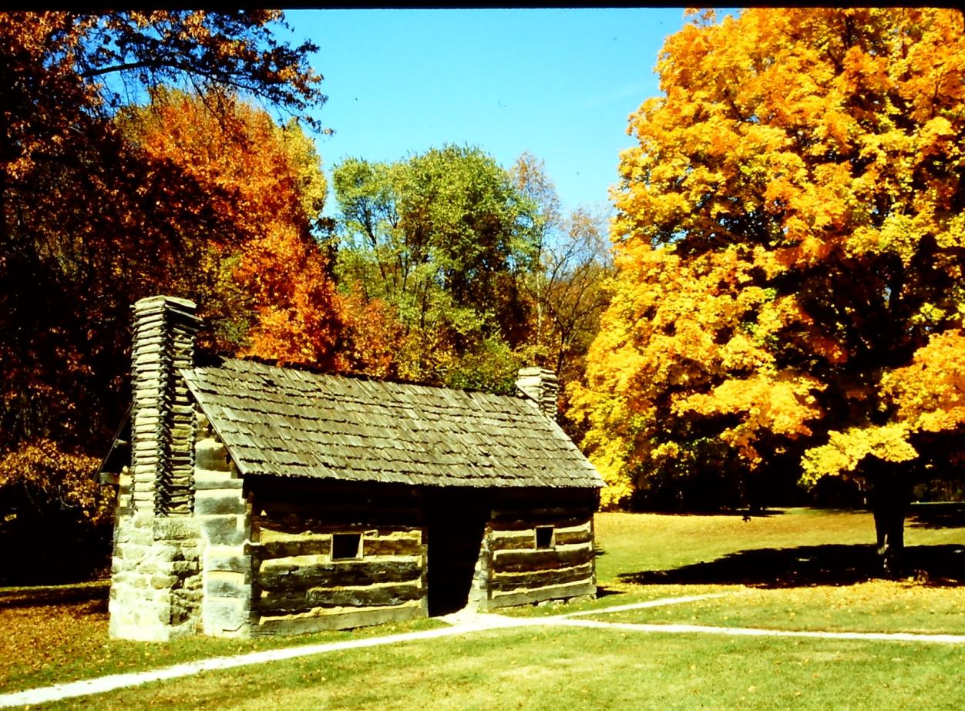
Most people who lived in a forest region
(like Europe or eastern North America), had learned how to build log cabins with roofs made out of wooden shingles.

Slide 5
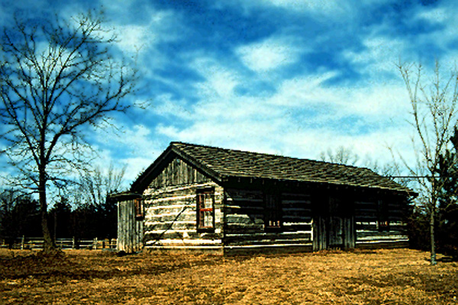
You could say these people had a log-cabin culture,
Like any cultural artifact, there are good examples
and some that are not so well done.

Slide 6
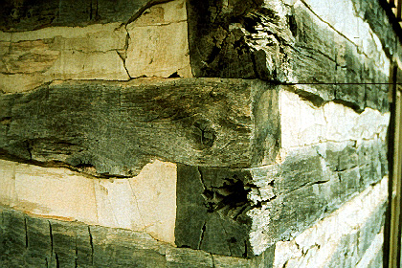
This one, for example, looks sturdy,
but a closer look shows that the logs are cut square.
This is easy to do, but square logs can trap rainwater,
which can cause the wood to rot.

Slide 7
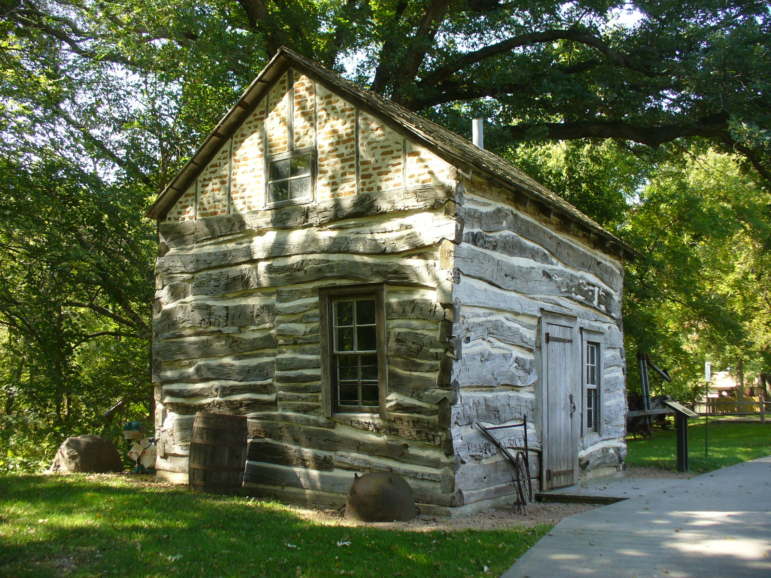
This cabin doesn’t look as “neat,” BUT
it is actually an example of superior log cabin culture.

Slide 8
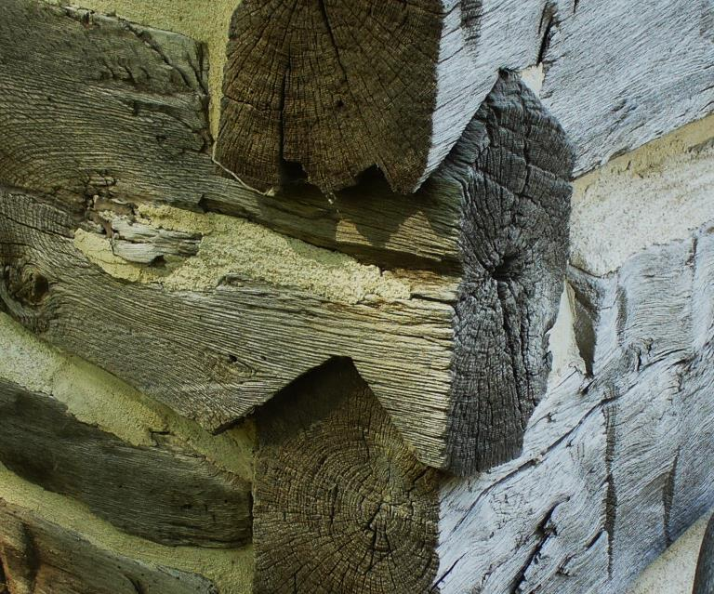
Note that the log ends are upside-down Vs.
These require more time and skill to make,
but they shed rainwater better and last a lot longer.

Slide 9
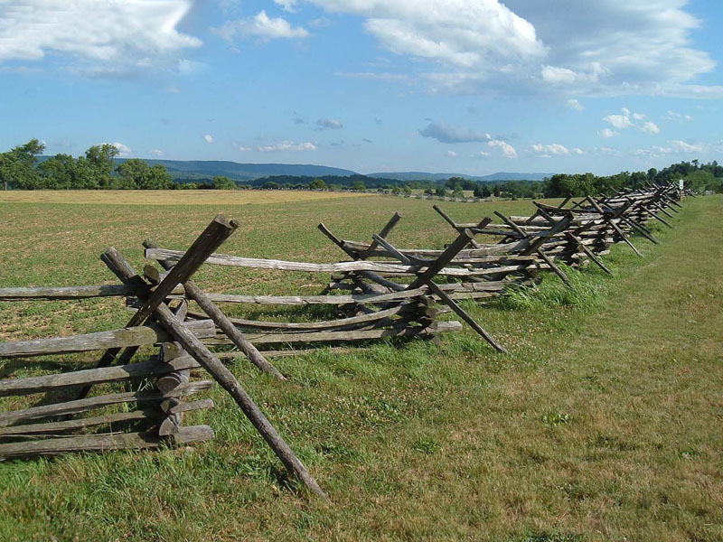
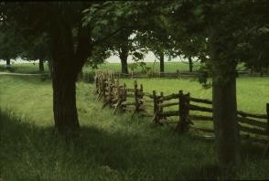
It’s the same with fences.
The one on top
is easier to build fast
and some people think it looks more “authentic,”
but the one below
is more effective
and uses less wood
per mile of fence.

Slide 10
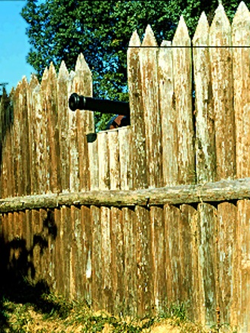
Everywhere you look
in eastern North America,
you see evidence
of log-cabin cultural ideas.

Slide 11
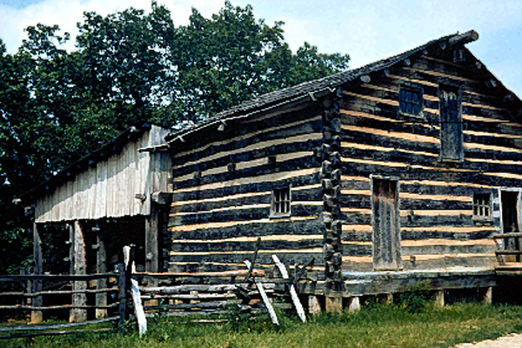
So let’s stop and ask a key question:
If you grew up in this cabin, but you decided to move west
in order to claim a free homestead on the frontier,
What would you take in your wagon?

Slide 12
DEFINITION
Culture (n) – shared ideas about how to behave
and the tools needed to use those ideas.

Slide 13
The culture of the pioneers –
a wagon full of tools, and heads full
of mental rules about how to use them.
Axe – to chop trees down, to clear fields for corn, and to build cabins.
Saw – to cut logs to length, and to turn logs into boards for building.
Wedge – to split logs into rails for fences and corrals.
Froe – to split logs into thin sheets for roof shingles and boards.
Whetstone – to sharpen axes, saws, froes, and other tools.
Firebrick – to line a chimney for a wood-burning stove or fireplace.
Nails – to fasten boards together in buildings, furniture, wagons, etc.
Hammer – to drive nails (or to pull them out to be reused).

Slide 14
The culture of the pioneers –
a wagon full of tools, and heads full
of mental rules about how to use them.
Corn seed – and plow, harness, planter, corn knife, husking tool.
Apple seed – trimming saw, ladder, pail, corer, cider press, bottles.
Cotton seed – gin, spinning wheel, loom, scissors, needles.
Long Rifle – lead, bullet mold, powder, keg, sling, repair parts.
Well – shovel, spade, tile mold, pump, pipe, pail, dishpan, bathtub.
Cooking pot – flint, steel, hatchet, fire grate, wood stove, ash bin.
Candle mold – tallow tub, fire grate, wick trimmer, candle holder.
and so on – lots of tools, lots of mental rules, lots of skill.

Slide 15
The culture of the pioneers –
a wagon full of tools, and heads full
of mental rules about how to use them.
And a big question

Slide 16
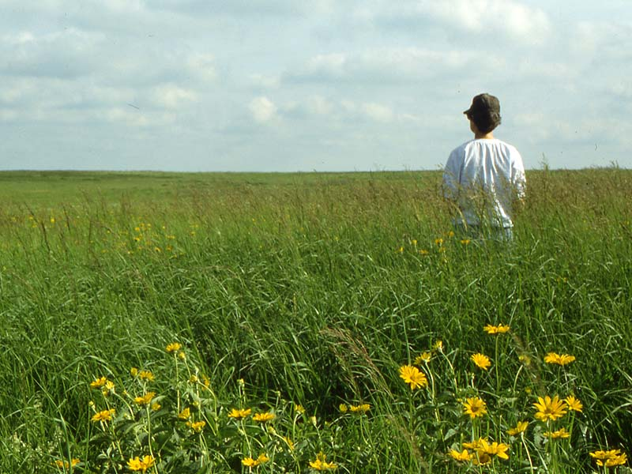
Question –
how many of those tools,
ideas, and skills
are useful
in this environment?

Slide 17
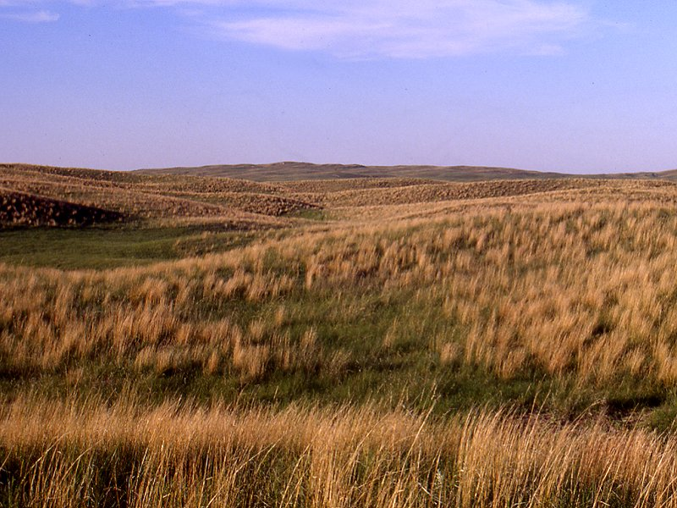
Most of the middle of the United States
is a natural grassland, too dry for trees.
Out here, an axe, corn planter, cider press,
shallow-well pump, and single-shot rifle
are about as useful as an airplane made of bricks.

Slide 18
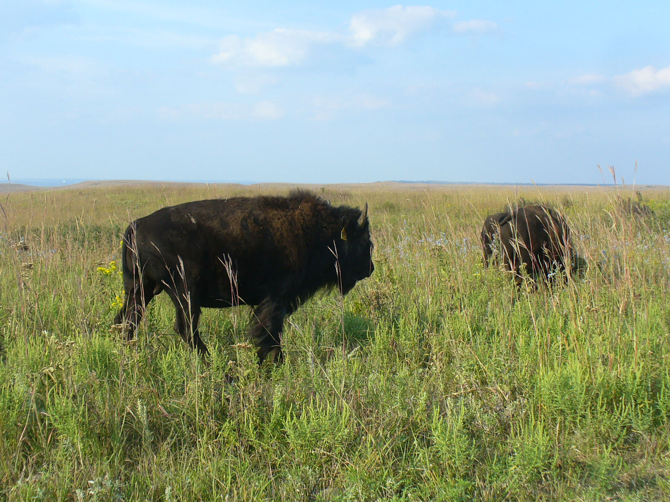
Even the animals out here
(IF you can get close to them)
are not likely to fall after a shot
from a front-loading deer rifle.

Slide 19
DEFINITION
Culture (n) – shared ideas about how to behave
and the tools needed to use those ideas.

Slide 20
DEFINITION
Culture (n) – shared ideas about how to behave
and the tools needed to use those ideas.
DEFINITION
Culture shock (n) – what you feel when you go into a place where your cultural ideas do not fit the environment.
Your tools do not work!

Slide 21
DEFINITION
Culture (n) – shared ideas about how to behave
and the tools needed to use those ideas.
DEFINITION
Culture shock (n) – what you feel when you go into a place where your cultural ideas do not fit the environment.
DEFINITION
Cultural adaptation(n) – changing your ideas to fit the conditions around you better.
Your tools do not work!
Finding tools that work!

Slide 22
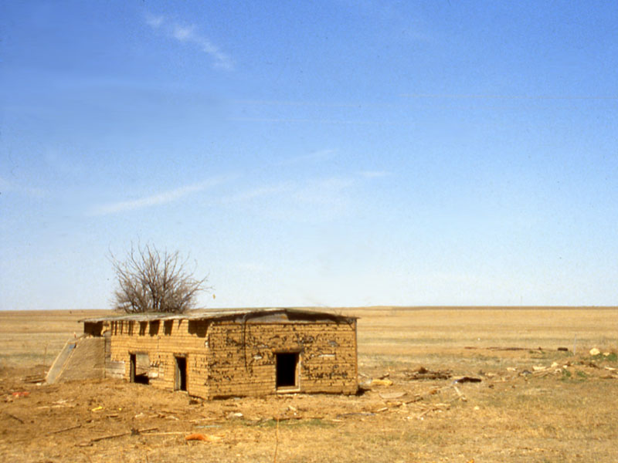
In a grassland, people had to build houses out of something else besides wood
(unless they could afford to ship some in).
This is a sod house (one made mostly of grass and dirt).
It does not look like
a nice place to live,
BUT . . .

Slide 23
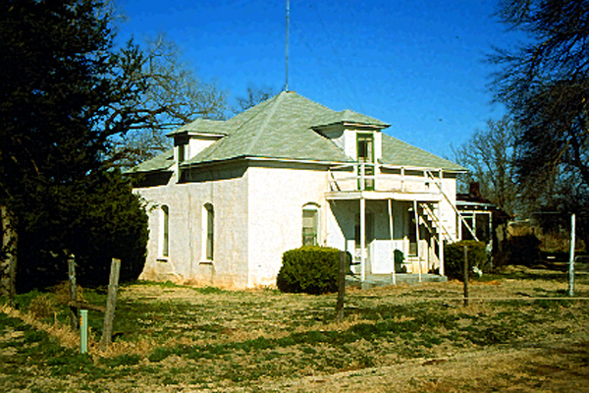
This is also a sod house.
It is an example
of a better kind
of “sod-house culture.”

Slide 24
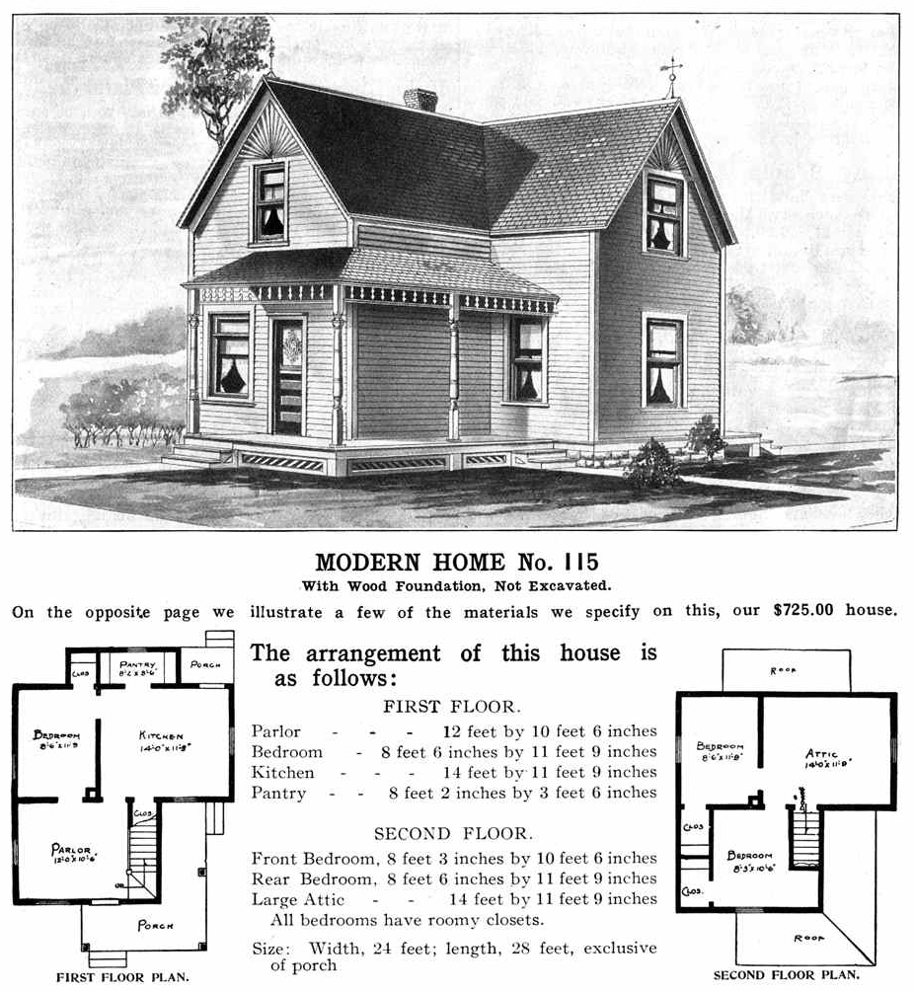
Eventually
(after railroads were built across the Plains)
companies like Sears
could sell the plans
and ship the materials
to build the kind of houses
you see all over the Plains.

Slide 25
In Walter Prescott Webb’s book, The Great Plains,
you can read the stories of many discoveries and inventions
that people needed to live comfortably in a dry grassland environment.
Without even reading this book, can you think
of some inventions might be needed?
Wheat – a crop that can grow with less rain than corn needs.
Steel plow – a tool that can work in dry soil full of grass roots.
Longhorn cow – an animal that could eat dry, tough grasses.
Barbed wire – to keep the longhorns from eating your wheat.
Fencing pliers – to hold, cut, stretch, and attach barbed wire.
Deepwell pump – to bring water up hundreds of feet.
Windmill – to run the deepwell pump (it’s really windy out here!)
Repeating rifle – to hunt and defend in a treeless environment.
etc., etc., etc.,

Slide 26
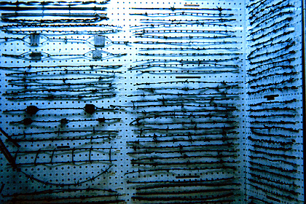
Go into any county historical museum
in the Great Plains states, and you will see evidence
of the pride that people have in their inventiveness.
This is a display of some of the 700+ patents
for different kinds of wire fence.

Slide 27
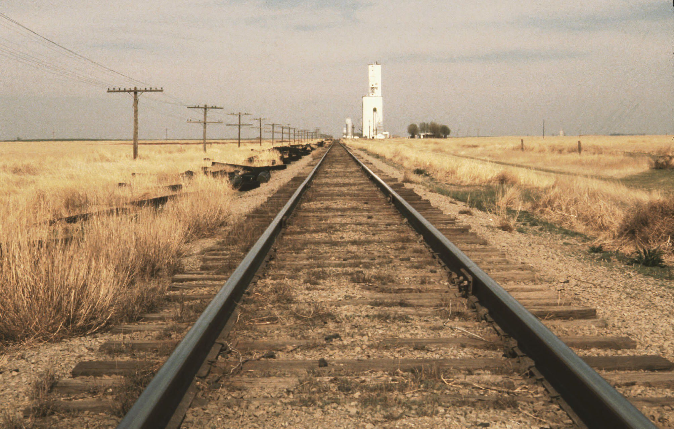
One of the most important inventions
cannot fit in a museum, but you can see it
running through nearly every town in the region –
a railroad to haul wheat to customers in faraway cities
(and to bring wood and other supplies back to the farmers).

Slide 28
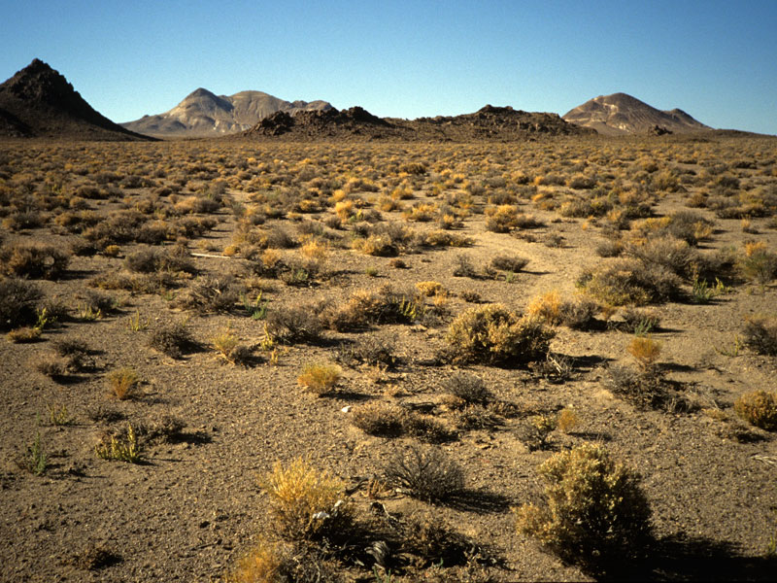
Go still farther west, and the climate gets even drier. Eventually, even the best inventions were not enough.
Very few people live in the very dry regions,
because there is not enough rain or snow to support
a continuous plant cover (or a large animal population).

Slide 29
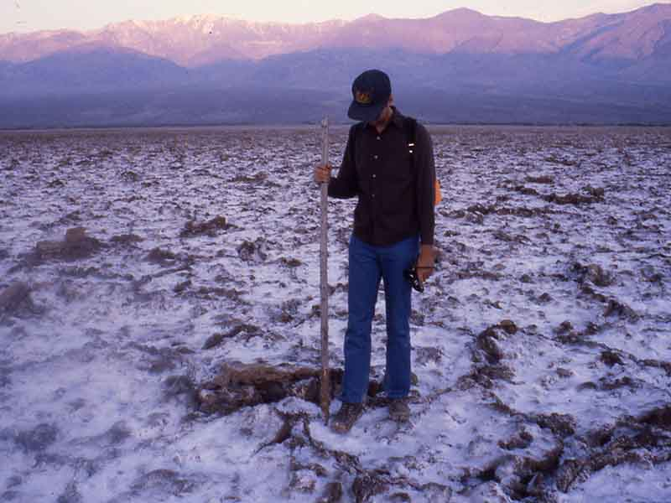
Death Valley in California is extremely dry.
Plants are very few and far between, and the ground is covered by toxic salts
(which tend to accumulate in the soil in very dry places).

Slide 30
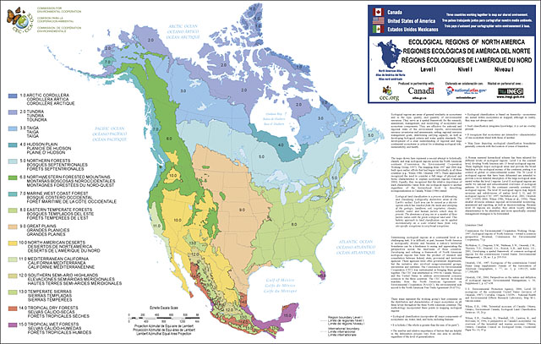
What’s the moral of this story?
When you see a map that uses lines and colors
to mark areas it calls “forest,” “grassland,” and “desert,”
you know people need different tools and cultural ideas
in order to make a living in these different environments.

Slide 31
What kind of “tools” do you need
to live in the place where you are?
Have you ever gone to a place
where none of those tools work well?

