Slide 1
Three Highland Regions and
Three River Systems
Constructing a good mental map of
South America

Slide 2
Definition: a region is a group of places
that are like each other
and close to each other
If you draw a line around the places,
the result is a regional map.
Why do we make regional maps?
Because it is usually easier to remember
the general shape of a region,
rather than the locations
of many individual places.
Let’s look at how to make
a simple regional map
to help us remember
the environments
in South America.

Slide 3
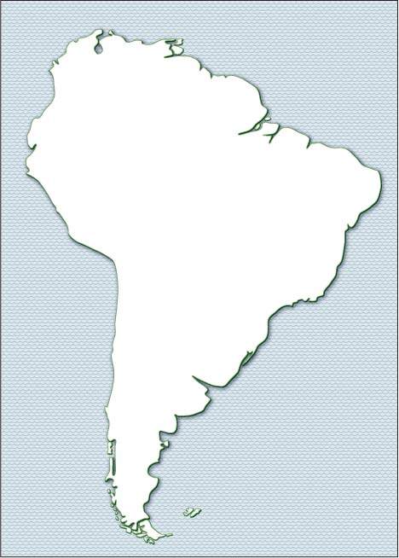
The continent
of South America
looks a little bit like an ice-cream cone.
In this unit,
we will see how
to draw three lines
that can separate
South America
into seven
major regions.

Slide 4

The most important line
runs roughly parallel
to the West Coast.
It reaches
a little farther inland
near the “big bend”
in the West Coast.
It gets closer
to the West Coast
in the southern part
of the continent.

Slide 5

This line divides
South America
into two main regions:
1. the Andes Mountains,
a region of young rocks,
earthquakes, volcanoes,
and rugged mountains,
2. a much larger area
of worn-down hills
(made of ancient rocks)
and low, flat plains
(made by river floods).

Slide 6
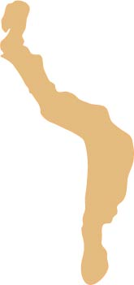
The Inka Empire
ruled over most of
the mountain region
in the early 1500s.

Slide 7
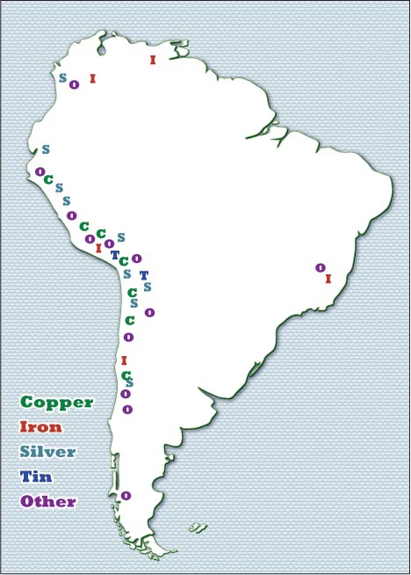
The mountain region
also has nearly all
of the metal mines
that are the source
of a lot of wealth
in South America.

Slide 8
The large eastern part
has two separate areas
of low, worn-down hills
made of really old rocks.

Slide 9

The larger area
(the Brazil Highlands)
looks like roughly half
of a big, egg-shaped
mass of ancient rock . . .
because, in fact, it is!
The other half is in Africa,
when the “supercontinent”
called Pangaea split apart
and the separate pieces
moved to opposite sides
of the Atlantic Ocean.

Slide 10
The hills start
very close to the coast
in the area around
Rio de Janeiro.

Slide 11
To the north, there is
a small coastal plain
between the hills
and the Atlantic shore.
The hills start
very close to the coast
in the area around
Rio de Janeiro.

Slide 12
The other
highland area
is easier to draw
if you know
the location
of the Equator.

Slide 13
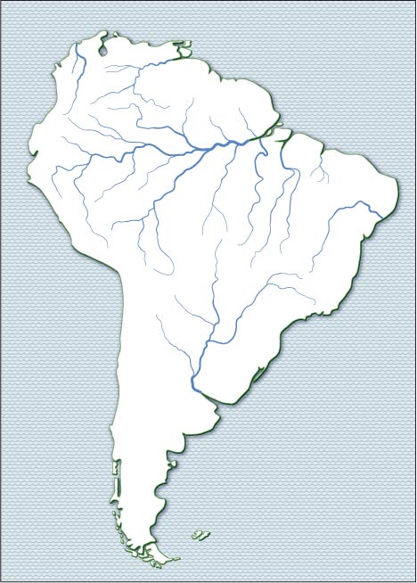
The Equator crosses
into South America
at the deep “notch”
where the Amazon River
flows into the Atlantic.
That’s just luck –
but it makes it easy
to remember the location
of the equator on maps
where the mapmaker
forgot to draw it in
AND it makes it easier
to remember the location
of the largest river
on the planet.

Slide 14

The northern border
of the Guiana Highlands
runs roughly parallel
to the ocean shore.
The southern border
of the Guiana Highlands
runs fairly close
to the equator.

Slide 15
Guiana
Highlands
That’s it –
three lines,
and three
highland regions.
Do you remember
their names?
Andes
Mountains
Brazil
Highlands

Slide 16
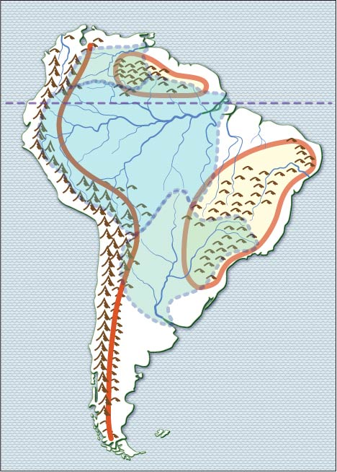
The Orinoco watershed is small
but it gets a lot of rain,
so the river is also quite large.
Three large river systems
carry water away
from these high areas.
The Amazon River
is by far the largest
river in the world.
This large river
has three names –
Paraguay, Parana,
and Rio de la Plata.

Slide 17
Finally, this “empty” area
is called Patagonia.
It is a windy grassland
with dry summers
and cold winters.

Slide 18
Can you remember
the locations and names
of three highlands,
three river basins,
and a grassland?

Slide 19
Guiana
Highlands
Andes
Mountains
Brazil
Highlands

Slide 20
Orinoco
River
Guiana
Highlands
Amazon
River
Andes
Mountains
Brazil
Highlands
Rio de la
Plata

Slide 21
Orinoco
River
Guiana
Highlands
Amazon
River
Andes
Mountains
Brazil
Highlands
Rio de la
Plata
Patagonia

Slide 22
If you can remember
the general position
of these three lines
(plus the Equator)
you can divide
South America
into seven
major regions.

Slide 23
Orinoco
River
Guiana
Highlands
Amazon
River
Andes
Mountains
Brazil
Highlands
Rio de la
Plata
Patagonia

Slide 24
Here are four
historic facts

Slide 25
The Inka Empire
ruled over most of
the mountain region
in the early 1500s.

Slide 26
Most European
colonial powers
wanted a safe
landing area
on the north coast.
The stars represent
the capital cities of
four small countries
on the north side
of the Guiana Highlands.
People there speak
four different
European languages,
a lasting effect
of the colonial era.
European languages,
a lasting effect
of the colonial era.

Slide 27
Three countries
put their capitals
next to this river.
It’s called Paraguay
(in Paraguay),
Parana
(in Argentina)
and Rio de la Plata
(between Argentina
and Uruguay)

Slide 28
Finally, Brazil
built its new capital
– Brasilia –
in the middle of
the Brazil Highlands
(higher above sea level
than 99% of the country!)

