Slide 1
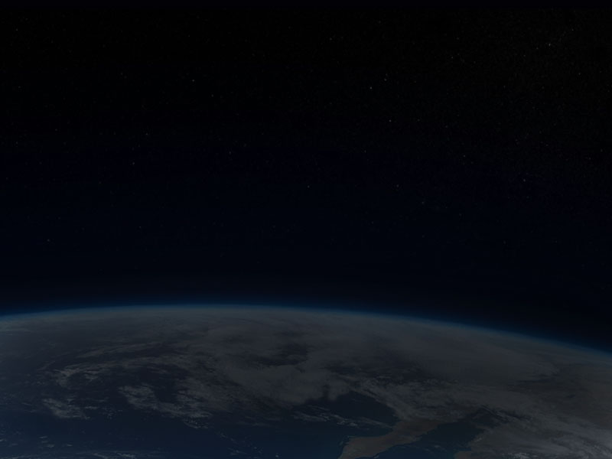
what makes deserts?
Phil Gersmehl
Michigan Geographic Alliance
pgersmehl@gmail.com

Slide 2
To understand how climate
could play an important role in history,
students should be aware of three things:
1. the system that makes tropical deserts,
2. the system that causes natural climate cycles,
3. the difference between weather and climate.

Slide 3
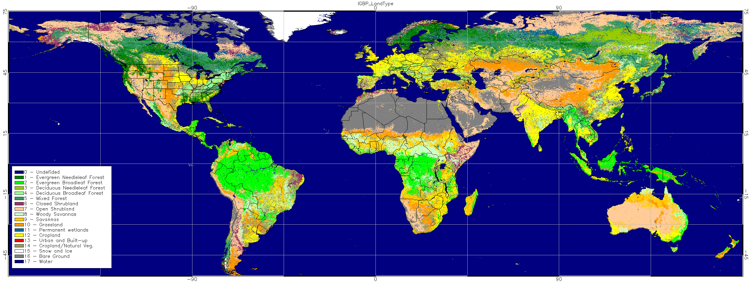
1. What causes deserts to form on the Tropic lines?
Typical textbook maps of global land cover have a lot of info.
They might be fun to look at, but they’re almost impossible to remember.

Slide 4
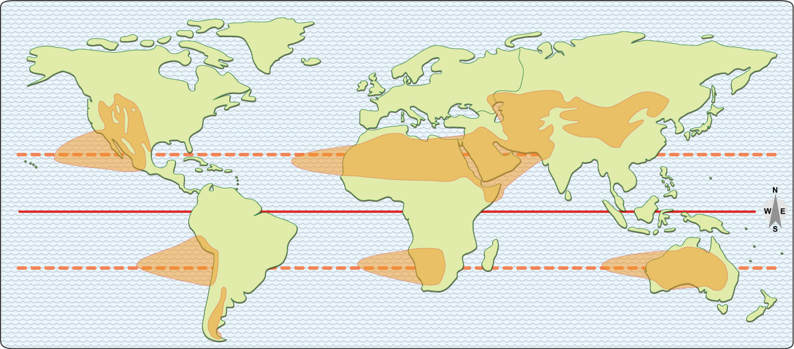
Let’s remove the clutter and focus on the dry areas.
“Why do deserts occur where they do?”

Slide 5
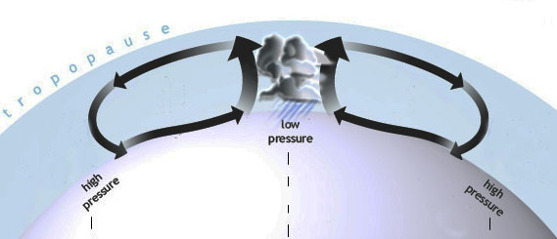
Q. What causes tropical deserts?
A. Rain near the equator.
Sun-heated air
rises and makes rain
over the equator . . .
AND
This globe is turned
so the equator is up.
the air must come down somewhere.

Slide 6
Given the present facts about the earth:
its size, rotation, distance from sun, density of air, etc.
“down” is about 20-30 degrees north or south of where it went up.
And where the air comes down, it makes a desert.

Slide 7
Given the present facts about the earth:
its size, rotation, distance from sun, density of air, etc.
“down” is about 20-30 degrees north or south of where it went up.
How would you describe the geographic pattern of deserts?
“Start 1000 miles west of each continent on the Tropic line.
Fan out to about 20 latitude degrees by the time you hit land.”
And where the air comes down, it makes a desert.

Slide 8
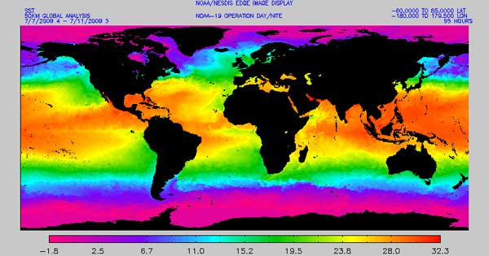
The deserts seem to “start” off the west coasts of the continents because the ocean is cooler there; the warmer ocean water off the east coasts is more likely to cause hurricanes than deserts.
With the earth’s size, rotation speed, distance from sun, etc.
“down” is about 25 degrees of latitude from where it went up.

Slide 9
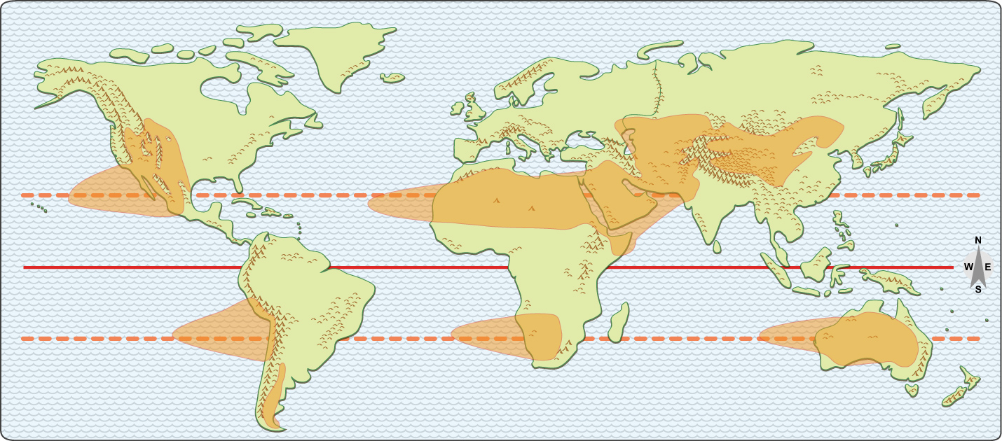
Add mountains to the map, and you can see how deserts
expand toward the poles on the east side of the mountains.
“Rainshadow” deserts
east of the mountains
in the westerly wind area
Another
rainshadow
here
But none here
(no continent!)

Slide 10
Adding latitude lines will let you measure the extent
of the deserts on each continent.
(mnemonic: Tropical deserts extend roughly from latitude 15 to 30)

Slide 11
That’s it – two simple rules to remember,
instead of half a dozen complex shapes.
Rule 1: Start on the Tropic line and fan out toward the east.
Rule 2: Expand poleward on the east sides of mountains.

Slide 12
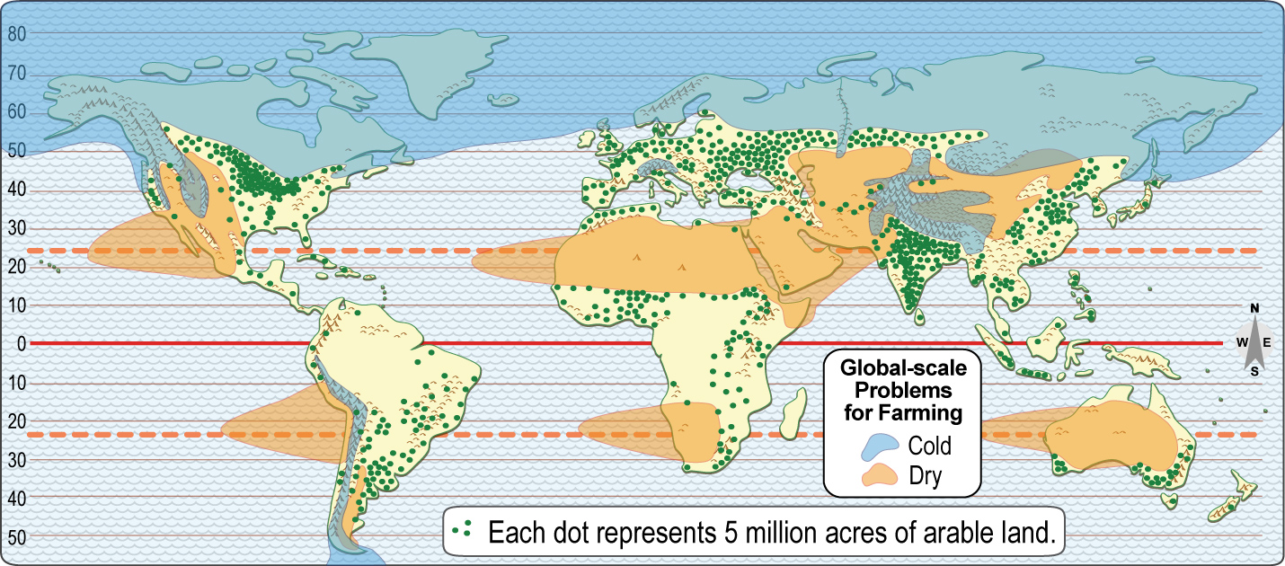
If you add a blue color to show cold areas,
your mental map of deserts can do a good job of explaining the world pattern of cropland.

Slide 13
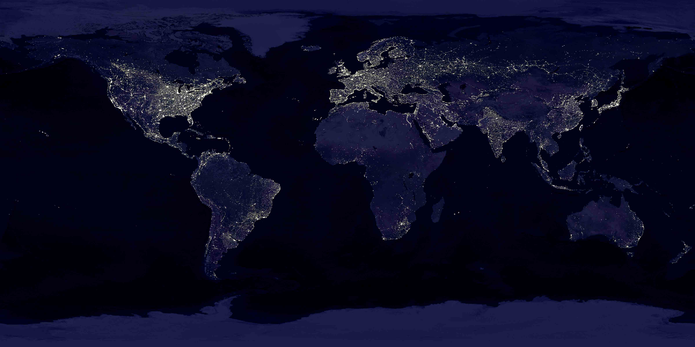
Knowing the location of good cropland, in turn,
can help us understand why people live where they do.

Slide 14
Summary.
Deserts today tend to form
near the Tropic lines
BUT
they “move” with the seasons, and can “move” even farther with El Nino, or if the climate
gets warmer or cooler.

Slide 15
Copyright 2015, Phil Gersmehl
Teachers who saw this presentation at a workshop
or downloaded it from our internet site have permission
to make a copy on their own computers for these purposes:
1. to help them review the workshop,
2. to show the presentation in their own classrooms, at sessions they present at teacher conferences, or to administrators in their own school or district,
3. to use individual frames (with attribution) in their own class or conference presentations.
For permission for any other use,
including posting frames on a personal blog or uploading to any network or website that can be accessed from outside your school,
contact pgersmehl@gmail.com

