Slide 1
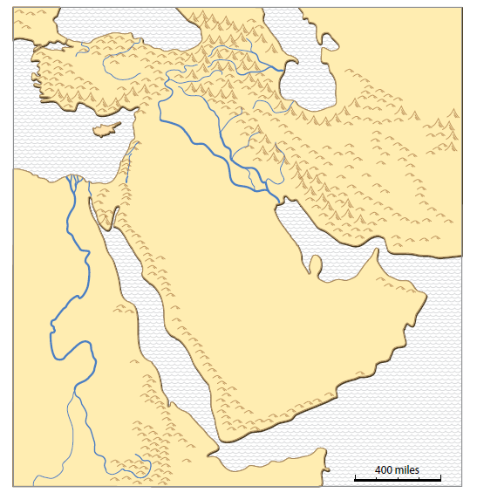
Natural Resources in Southwest Asia
This map comes from
the clickable PDF
named
“SW Asia miniAtlas.”
carol.gersmehl@gmail.com

Slide 2
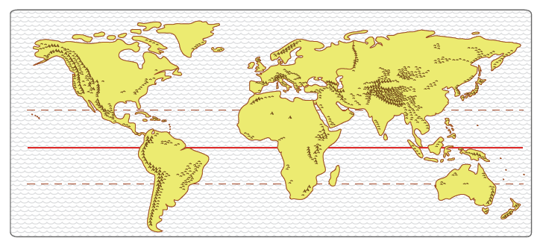
Where is Southwest Asia?
Europe
Asia
Americas
Africa
Describe where Southwest Asia is located
in relation to other continents.

Slide 3
Natural Resources in Southwest Asia
Definition:
Natural Resource
Something in nature
that people
know how to use
to make life better

Slide 4
Natural Resources in Southwest Asia
Using 2 PowerPoint presentations,
we will look at the
history and geography
of four major resources:
1. Conditions that helped
ancient farmers
2. Dryland trees with
sweet-smelling sap
3. Connections to
other places
4. Fossil fuels for cars,
ships, trains, and planes

Slide 5
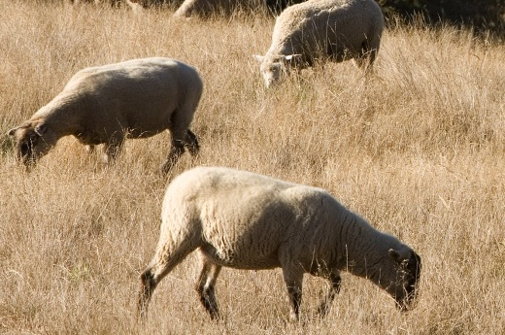
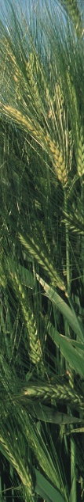
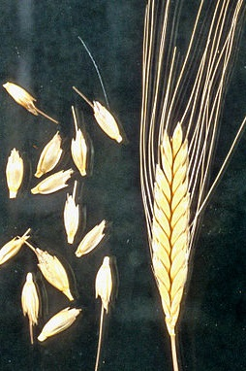
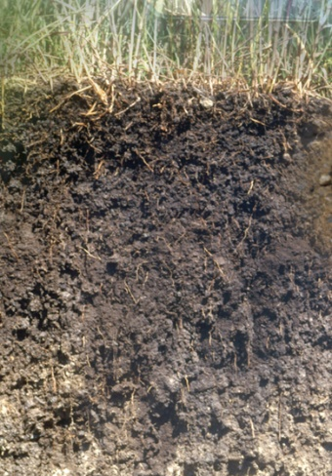
1. Conditions helped earliest farmers
Find things in nature
that people used
to do farming
before 6000 BCE in Southwest Asia:
____ Soft soil
____ Enough rainfall
for wild wheat
to grow
____ Wild goats &
sheep that
people could tame
Match
pictures to labels.
A
C
B
B, D
A
C
D
Photos: USDA (U.S. Department of Agriculture

Slide 6
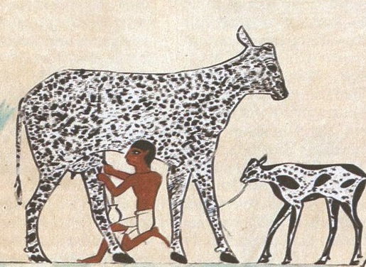
Natural Resources in Southwest Asia
Something in nature
that people know how to use to make life better
People found wild wheat
and barley seeds
----
and they planted them
and made bread.
People found wild goats and cattle
------
and they tamed them
and milked them.
Earliest farming
in
Southwest Asia
Photo: USDA
(U.S. Department of Agriculture)
Picture: Wikipedia, public domain

Slide 7
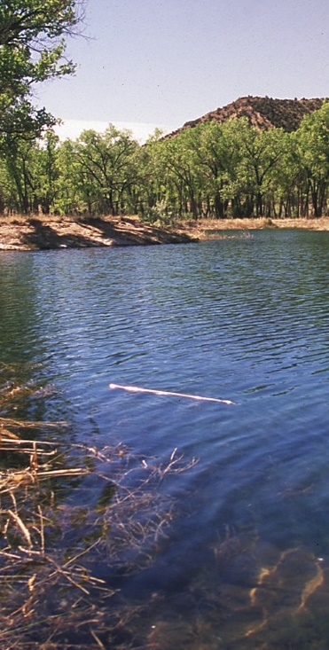
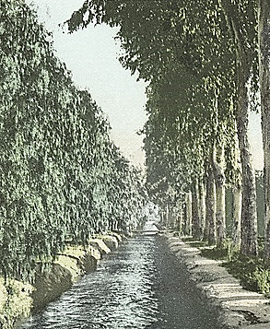
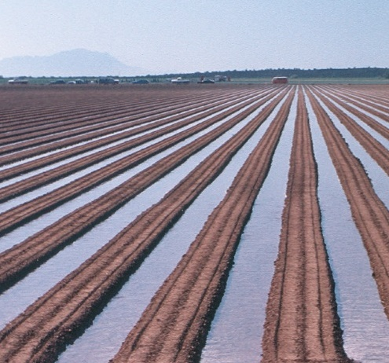
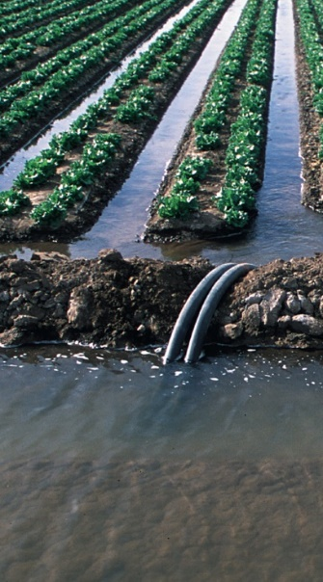
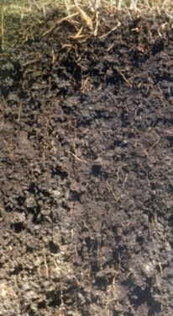
Nature and Knowledge
Something in nature
Fresh water
in nearby
rivers
G
Photo G:
NYPL
______________
Which pictures?
Knowledge and cooperation
to build irrigation
systems
that people
knew how to use
to do early farming in river valleys of
Southwest Asia
E
_______________
Soft
soil
H
Pictures? Knowledge?
Photos E, F, H, I: USDA
(U.S. Department of Agriculture)
F
I

Slide 8

In ancient times,
natural conditions in Southwest Asia
helped people start some of the
earliest farming communities.
a. People found wild plants that provided wheat seeds
that people could gather.
b. People found soft soils here, too.
Why is this important?
People could more easily plant seeds
using simple digging tools
in soft soils near rivers.
People planted wheat that they could use for bread.
c. What other conditions helped
plants to grow well here?
Plants grow well when there is enough rainfall or fresh water
that comes from nearby rivers.
Plants also need enough warm days
to grow long enough to produce lots of seeds.

Slide 9
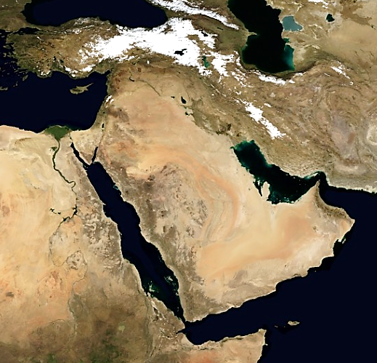
What in nature
would help people
to do early farming?
(raise plants for food)
For example, it would be helpful to have
- enough rainfall
to grow wheat,
- fresh water nearby
for people
Winter snow
Plants
Desert
Plants
Plants
Desert
Desert
Desert
Desert
Desert
Plants
1. Find very dry places that
look orange in this image.
2. Find darker green-brown areas
that have more vegetation.
Plants
Image: NASA EarthObservatory

Slide 10
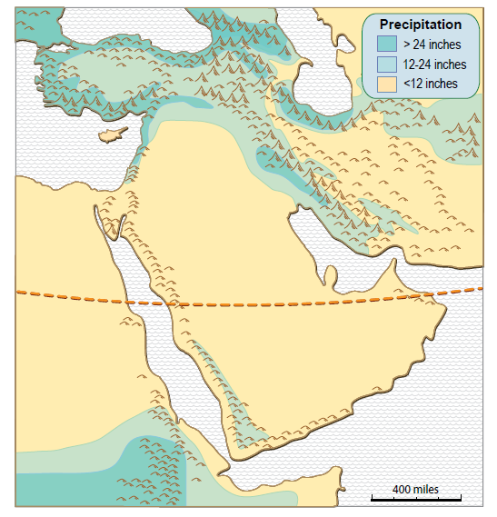
Sea
What good conditions
for farming
do you see
inside this area?
Sea
Sea
Tropic of Cancer

Slide 11
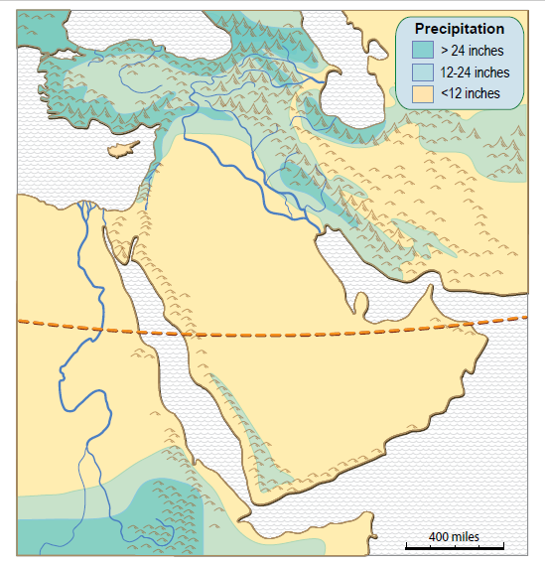
What additional
good conditions
for farming
do you see
inside this area?
What is this
special area called?
Conditions in the
Fertile Crescent
helped
early farmers.

Slide 12
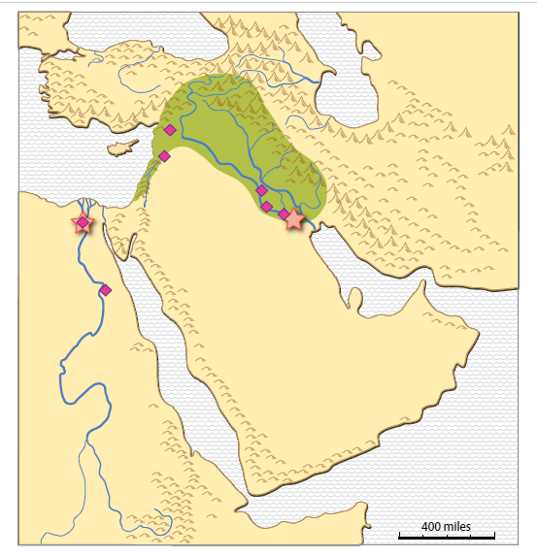

Earliest Cities
in the World
Where were the
earliest cities
located?
Describe
what occurs
“together with”
the earliest cities.
Most of these early cities
are near rivers.

Slide 13
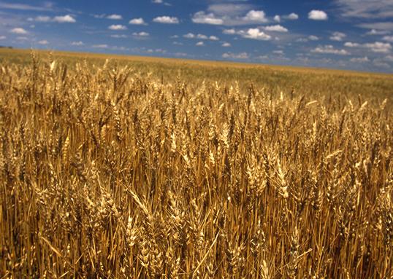
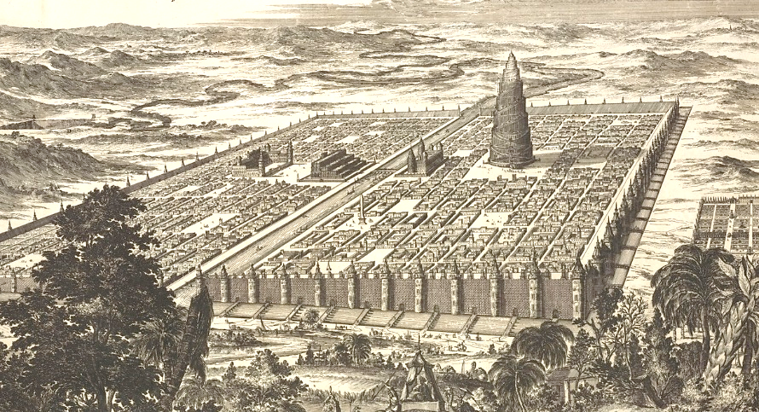
Wheat Source: USDA
How did early farming
lead to early cities?
- Farmers could stay in one place
and raise plants.
They didn’t have to walk miles
each day to hunt or gather food.
- More people could live together in a place,
especially where farmers could use
river water to grow more and better plants.
Drawing of Babylon:
New York Public Library

Slide 14
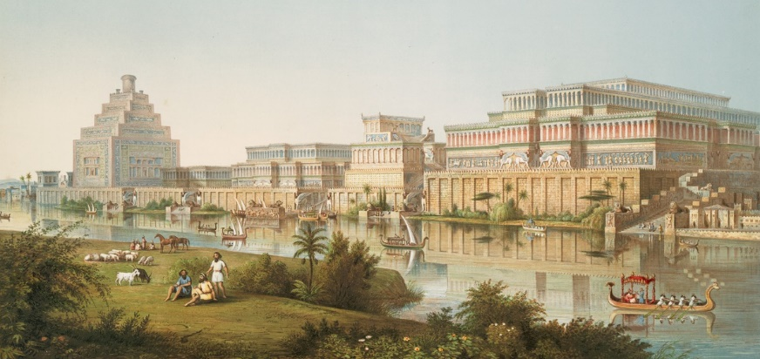
Cities in the Fertile Crescent
(3000 – 2500 and 2000 – 1700 BCE)
NINEVEH
Tigris River
Source: New York Public Library
Farmers in the Fertile Crescent and Mesopotamia could grow enough food
to feed many other people.
These other people included soldiers,
religious leaders, scientists, and law makers.

Slide 15
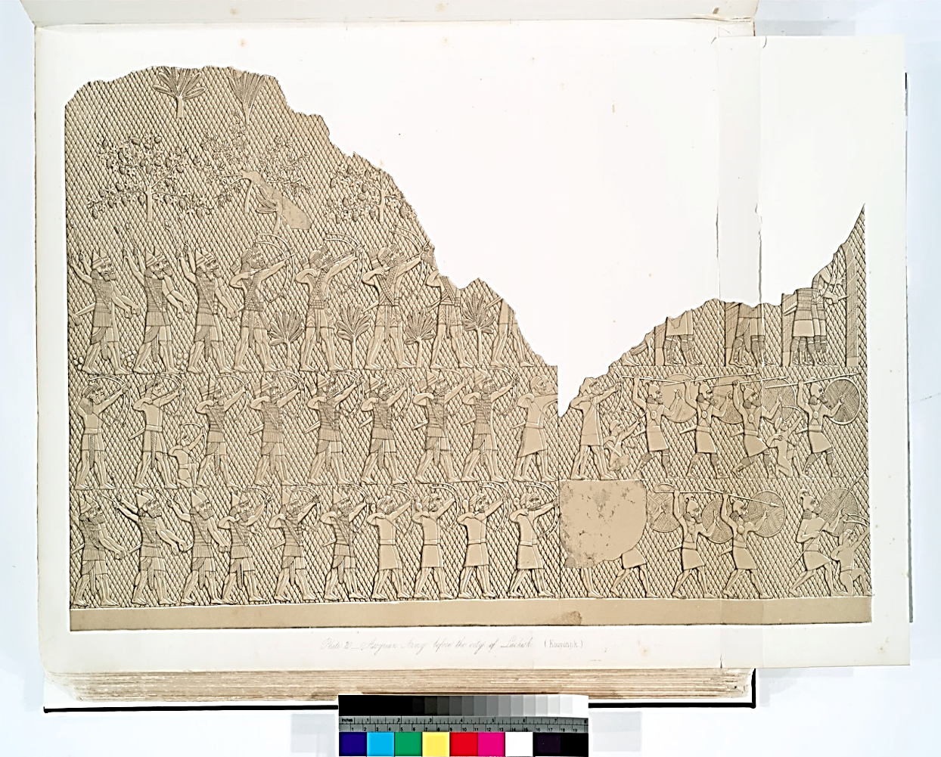
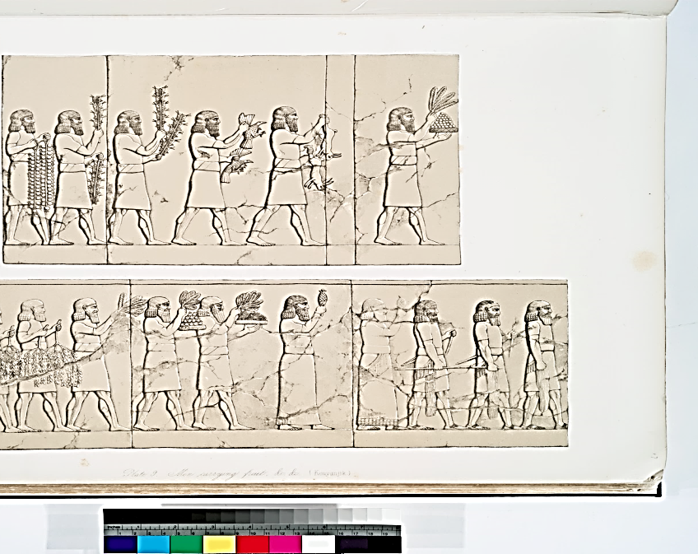
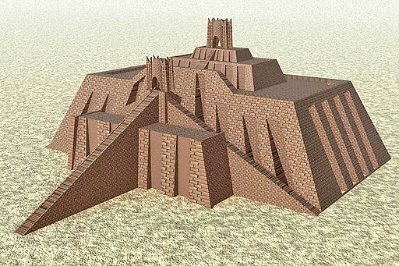
Farmers in the
Fertile Crescent and Mesopotamia
grew enough food
to feed many
other people.
Who were the other people,
and what work did they do?
(soldiers, law-makers, scientists, builders, religious leaders)
Soldiers
What foods did farmers bring
to the city?
Temple (Zigurat)
Pictures: New York Public Library

Slide 16
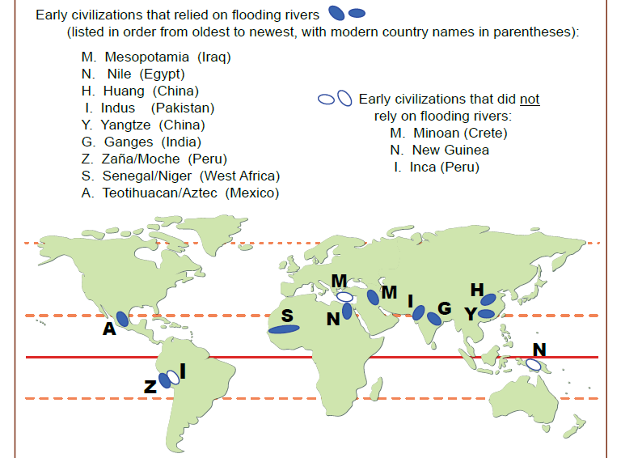
Natural resources helped early farming:
Earliest!
This map is in Unit 5 handouts.

Slide 17
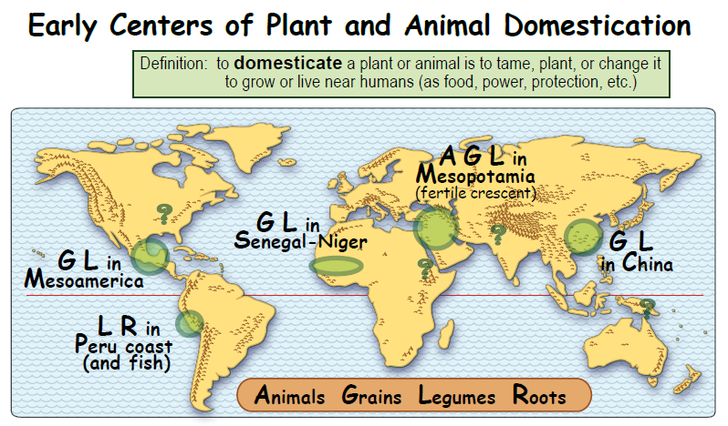
Conditions helped ancient farmers.
This map is in Unit 5 handouts.

Slide 18
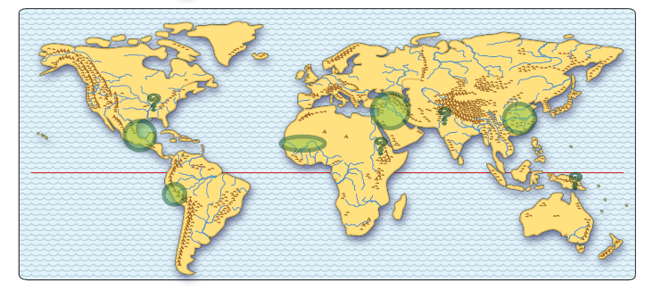
Earliest Farming
Describe the geographic pattern (arrangement)
of the places where agriculture first began.

Slide 19
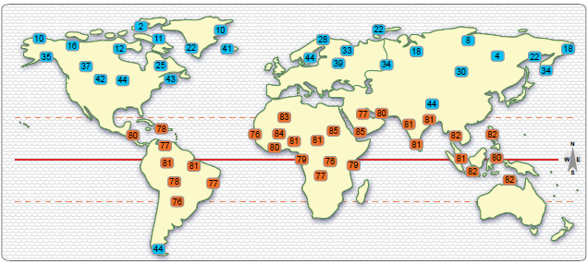
Which temperatures occur together with the places
where agriculture first began?
Coldest Temperatures
Hottest
Temperatures

Slide 20
REVIEW
a. Where did the earliest farming start?
b. What natural resources
supported
early farming in this place?
(How, Why here)
c. What consequences followed early farming
in Southwest Asia?
--- GLCE ---
6 – G4.4.1 Identify factors that contribute to conflict and cooperation
between and among cultural groups
(e.g., control/use of natural resources,
power, wealth, and cultural diversity).

Slide 21
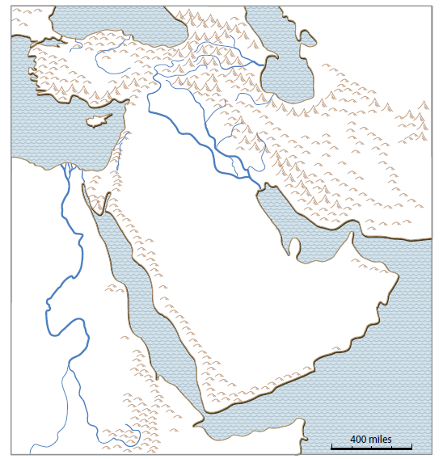
Natural Resources in Southwest Asia
REVIEW
a. Where did the earliest farming start?
b. What natural resources supported
early farming in this place? (How, Why here)
c. What consequences followed early farming
in Southwest Asia?
This map is in
Unit 5 handouts.

Slide 22
Natural Resources — Part 1 (Earliest Farming)
Sources & Citations
Clickable PDFs – SW Asia Mini GIS,
World Activity-Cities and Temperatures
New York Public Library – Source for pictures (public domain)
http://digitalcollections.nypl.org/search/index?filters%5Brights%5D=pd&keywords=Arabia Enter search words at top; on left, check “Show Only Public Domain.”
USDA (U.S. Department of Agriculture) – Source for pictures
Wikipedia – Source for pictures (public domain)
Wheat: https://en.wikipedia.org/wiki/Taxonomy_of_wheat#/media/File:Hullednakedwheat.jpg
Zigurat: https://en.wikipedia.org/wiki/Ziggurat_of_Ur#/media/File:Ziggurat_of_ur.jpg
Domestication of plants and animals:
https://en.wikipedia.org/wiki/Domestication#/media/File:Egyptian_Domesticated_Animals.jpg https://en.wikipedia.org/wiki/Domestication#/media/File:Maler_der_Grabkammer_des_Menna_012.jpg
Book – The Emergence of Agriculture by Bruce D. Smith
http://photogallery.nrcs.usda.gov/netpub/server.np?find (public domain)

