Slide 1
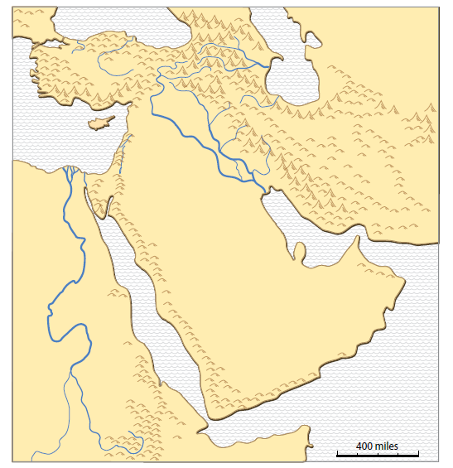
Natural Resources in Southwest Asia
This map comes from the clickable PDF named “SW Asia miniAtlas.”
Part 2 of two PPTs.
carol.gersmehl@gmail.com

Slide 2
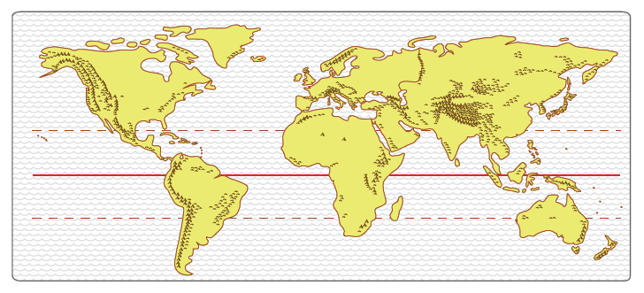
Where is Southwest Asia?
Europe
Asia
Americas
Africa
Describe where Southwest Asia is located in relation to other continents.

Slide 3
Natural Resources in Southwest Asia
Definition: Natural Resource
Something in nature
that people know how to use to make life better

Slide 4
Natural Resources in Southwest Asia
Using 2 PowerPoint presentations,
we will look at the history and geography
of four major resources:
1. Conditions that helped
ancient farmers
2. Dryland trees with sweet-smelling sap
3. Connections to other places
4. Fossil fuels for cars,
ships, trains, and planes

Slide 5
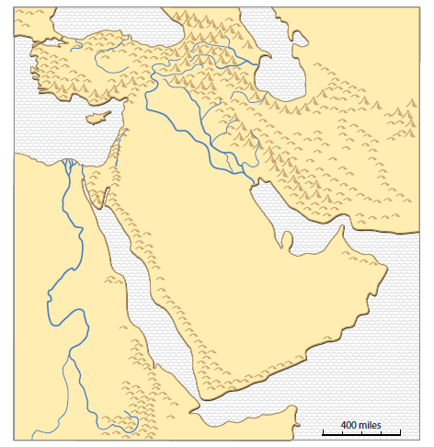
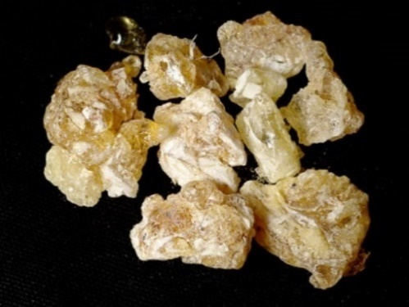
2. Tree sap can be a natural resource.
In ancient times (500 BCE-200 CE), frankincense was an expensive luxury that came from southern Arabia.
It smelled wonderful (especially when burned)
in a time when there were few perfumes or soaps!
Note where the frankincense & myrrh (incense) area is on your basemap.
Arabia
Frankincense
Myrrh
(Frankincense photo is from Wikipedia, public domain.)

Slide 6
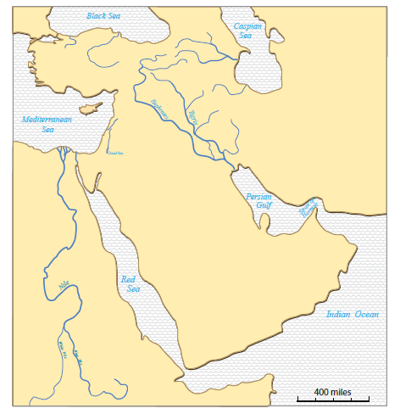
Valuable tree sap
Frankincense is a sap from trees that grow in southern Arabia.
Use the links below to see photos of
trees that produce frankincense:
http://www.omanwhs.gov.om/english/Frank/gallery/myalbum.html
https://www.youtube.com/watch?v=KHc9bKzaw-s
Arabia
Incense area
How does this area in Arabia compare with where we live?

Slide 7
To Greece & Rome
Rich people who lived far away in Greece & Rome and in India wanted to buy frankincense
(in ancient times, especially 500 BCE to 200 CE).
On your basemap, draw an arrow toward Rome,
and another arrow toward India.
Arabia
Incense area
To India
What came in trade from Greece & Rome?
What came in trade from India?
gold
spices

Slide 8
Mediterranean
Sea
Traders used camels in caravans to carry frankincense from southern Arabia
to the Mediterranean Sea. Ships carried it to ancient Greece and Rome.
Arabia
Incense area
(Photo is from New York Public Library, public domain.)

Slide 9
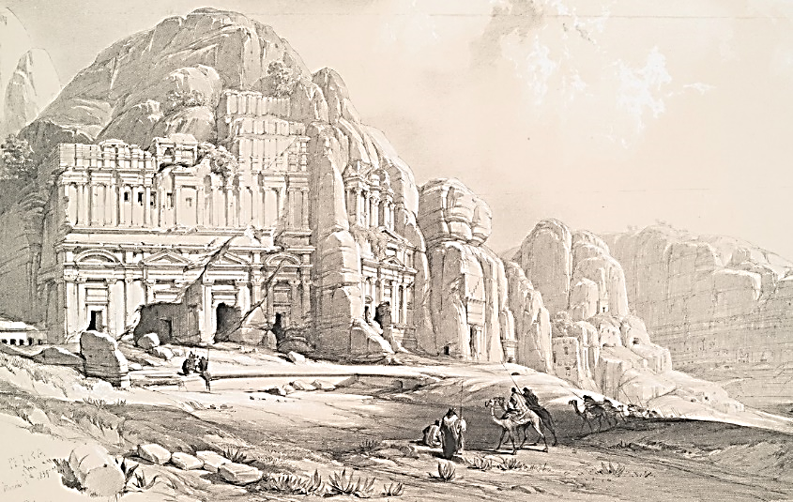
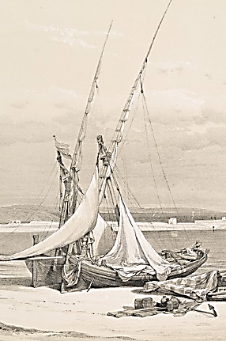
Petra was a trade-route city.
Cities grew along the trade routes.
Cities gained wealth by providing food and safe shelter to camel caravans.
Other cities were ports for ships that carried frankincense across seas.
Arabia
Incense area
(Photos are from New York Public Library, public domain.)

Slide 10
Use an internet site that has an interactive map
that shows
empires-kingdoms-important regions in BCE times.
http://geacron.com/home-en/?&sid=GeaCron464508
Zoom in on Southwest Asia.
Look at BCE years (-500, -200) and 200 CE to see empires and kingdoms in Southwest Asia and other parts of the world.

Slide 11
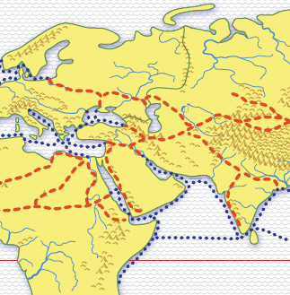
Rome
India
SUMMARY: What precious tree sap moved along the red trade route through Southwest Asia?
(Frankincense)
What came from India to pay for the valuable tree sap?
What came from Rome to pay for the valuable tree sap?
(Spices from India, Gold from Rome)

Slide 12
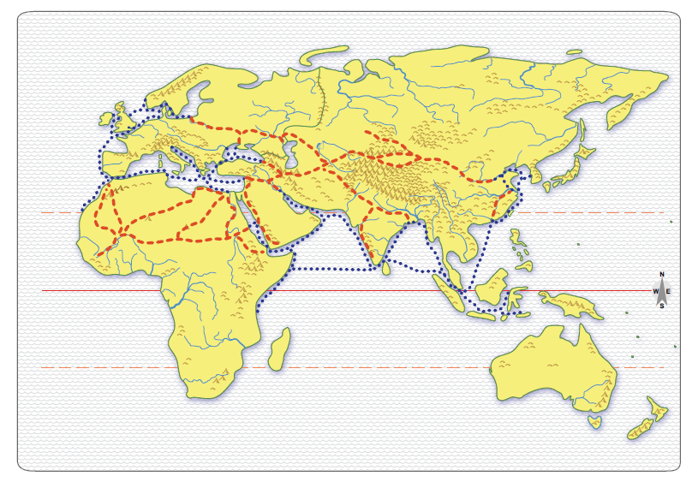
3. A central location can be a natural resource.
Describe where Southwest Asia is located in the network of major trade routes shown on the map.

Slide 13
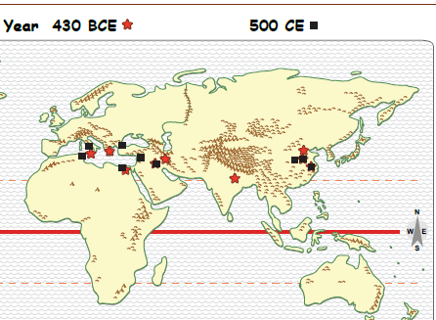
Was Southwest Asia in a central location?
Largest Cities at 2 Times
Europe
Asia
Africa
Can you find three “regions” of largest cities?
Where is Southwest Asia in relation to the other regions?

Slide 14
Largest cities at 2 times
The region in the East (China)
produced luxurious silk fabric.
Each “region” of large cities had rich people who wanted valuable goods from other regions.
--
How did the valuable goods move between regions?
See the next map!

Slide 15
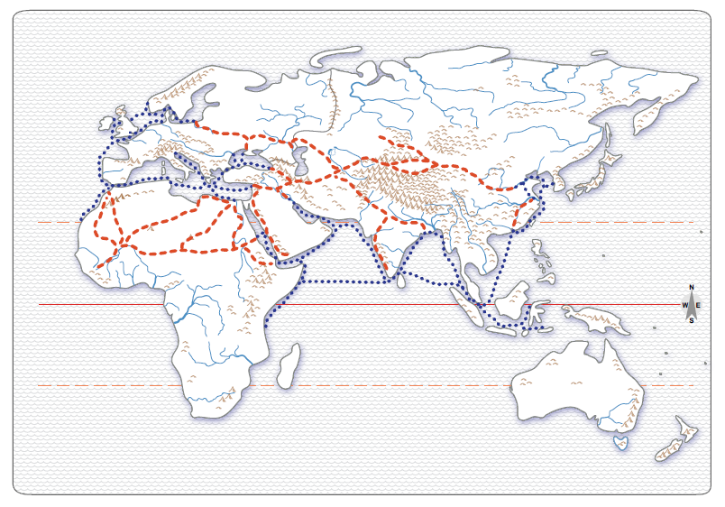
Europe
Asia
Africa
What types of routes do you see in Southwest Asia?
The red lines show land routes. ______ carried goods.
The blue lines show water routes. ______ carried goods.
----
Notice where red and blue lines meet.
In these places, cargo is moved from ships to camels or vv.
This provides a lot of jobs for people.

Slide 16
Europe
Asia
Africa
3. Southwest Asia was in a “middle” location along ancient trade routes
This was a CONNECTIONS resource in ancient times.

Slide 17
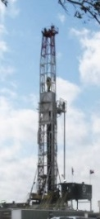
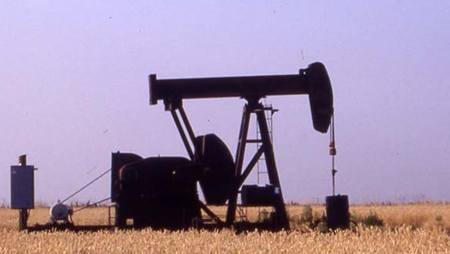
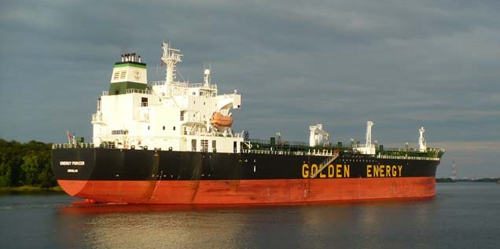
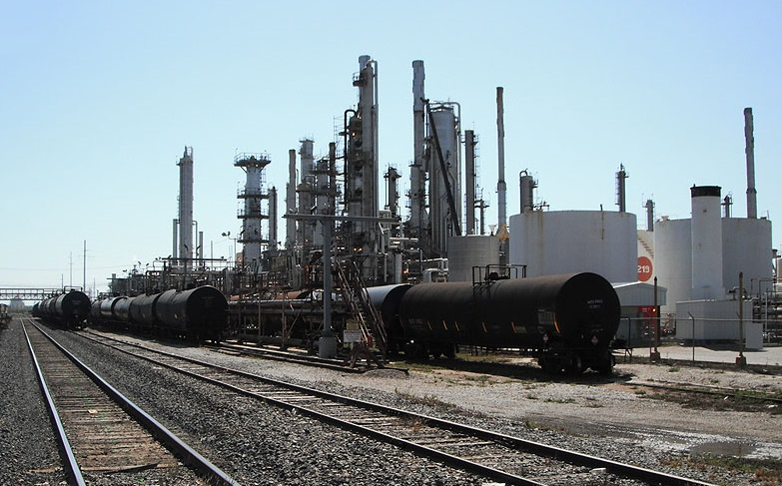
4. Valuable fuel resource (modern times)
Oil is so important in modern life, that -- people drill thousands of feet into the earth,
-- pump oil out of deep in the earth
-- move oil across oceans in huge tanker ships
-- turn it into gasoline in refineries
-- move it across the country in tank cars
(Photos are from P. Gersmehl.)

Slide 18
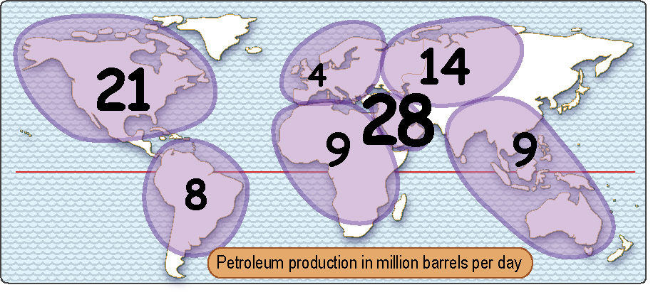
4. A valuable fuel resource
Which world region produces the most oil each day?
Europe
Southwest Asia
Which world region produces the lowest amount of oil each day?
This map is in the Unit 5 handouts.

Slide 19
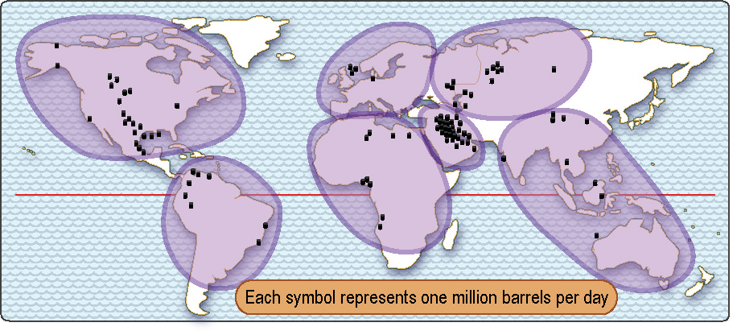
Valuable fuel
Which world region produces the most oil each day?
Europe
Southwest Asia
Which world region produces the lowest amount of oil each day?
Source: U.S. Energy Information Administration

Slide 20
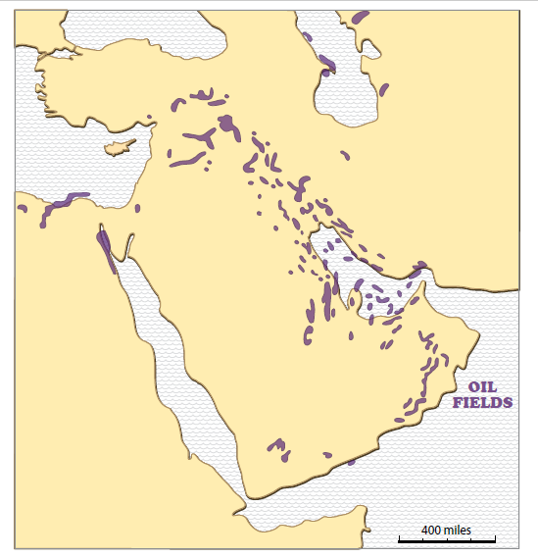
Valuable fuel
Is oil found everywhere in Southwest Asia?
How would you describe where most of the oil is located?
Only part of Southwest Asia has oil to sell.
This map comes from the clickable PDF named “SW Asia mini GIS.”

Slide 21
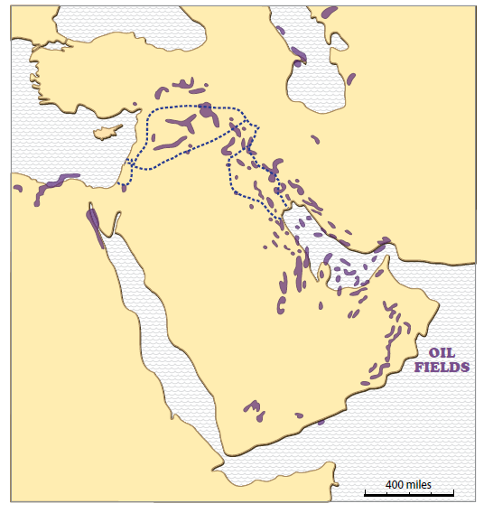
Valuable fuel
After the first World War
(after 1919),
two countries from Europe
(France, England)
took control over oil producing areas.
How do you think people who lived there felt about being controlled?
French
English

Slide 22
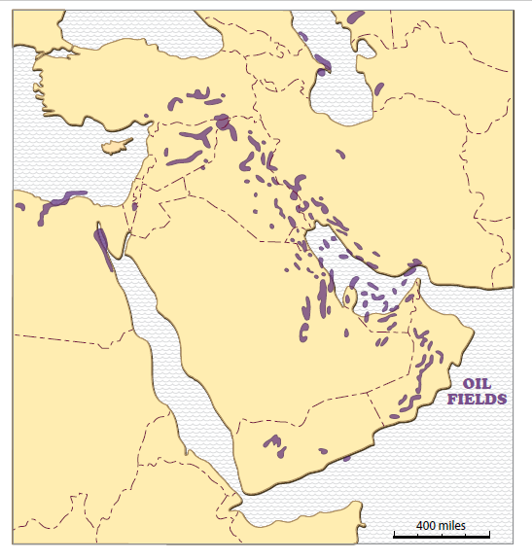
Valuable fuel
After the second World War (after 1945),
European countries drew country borders in Southwest Asia.
These are new countries (only about as old as your grandparents)!
Did all of the new countries get the same amount of oil riches?

Slide 23
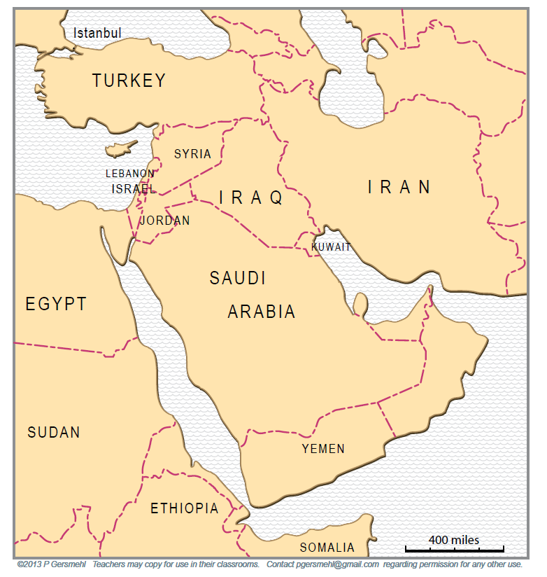
Valuable fuel
The numbers show how many millions of barrels
of oil
were produced each day in 2014
in each country.
(The map shows a dot if the country produced less than 1 million barrels per day in 2014.)
1
3
3
2
12
2
3
1
Which country produces the largest amount of oil?

Slide 24
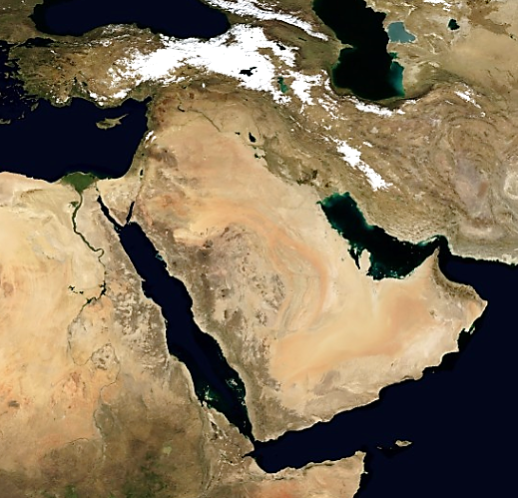
Can you find
Saudi Arabia
in this image?
Desert
Find very dry places that look orange in this image.
Desert
Desert
Desert
Saudi Arabia
has used some of the money gained from selling oil to dig deep (very expensive)
wells to reach underground water.
Desert
Desert
(Image is from NASA EarthObservatory.)

Slide 25
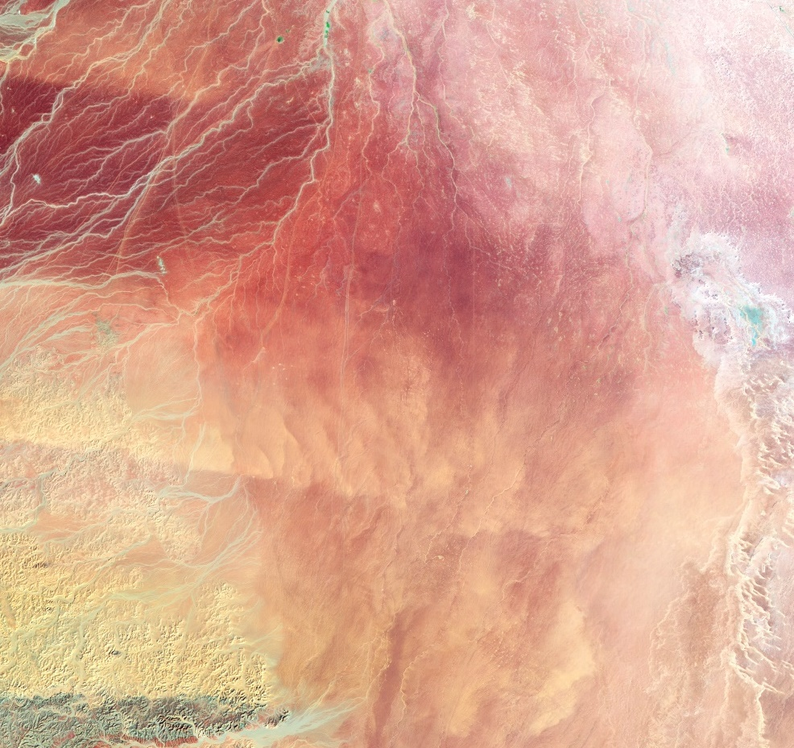
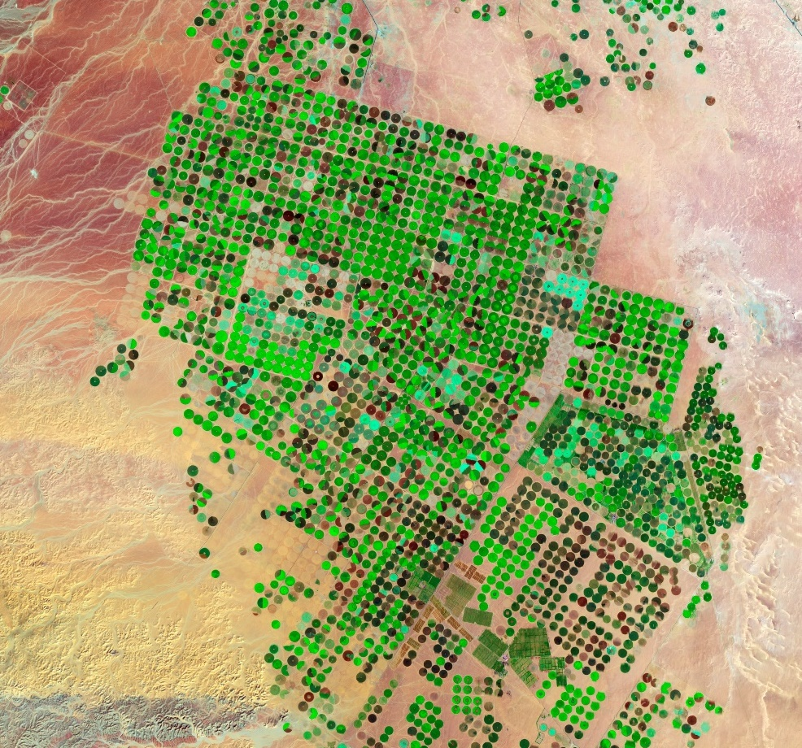
1987 – before water wells
2012 – after water wells
Saudi Arabia used some of its money from selling oil to dig very deep WATER wells in the desert.
People use the water to grow plants (grains, vegetables, fruits) in the desert.
(Images are from NASA EarthObservatory.)

Slide 26
REVIEW
a. In ancient times (BCE), what tree sap resource from Southwest Asia was highly valuable to people in other parts of the world?
b. In ancient times, how did people in Southwest Asia move a valuable resource to other places?
c. What resource coming from Southwest Asia in modern times (in 1900s and 2000s CE) is highly valuable to people in other places?
d. In modern times, what other places tried to control a valuable resource found in Southwest Asia?
Frankincense
Land & water trade routes
Oil
European
countries (France, England)

Slide 27
Natural Resources - Part 2 (Frankincense, Middle location, Oil)
Sources & Citations
Clickable PDFs - SW Asia Mini GIS (and oil photos from P. Gersmehl)
NYPL (New York Public Library) - Source for pictures (public domain) http://digitalcollections.nypl.org/search/index?filters%5Brights%5D=pd&keywords=Arabia Enter search words; on left, check “Show Only Public Domain.”
NASA EarthObservatory - Images of desert agriculture & topography/land cover (public domain) http://earthobservatory.nasa.gov/IOTD/view.php?id=77900&eocn=image&eoci=related_image ; http://eoimages.gsfc.nasa.gov/images/imagerecords/74000/74418/world.topo.200408.3x5400x2700.jpg
U.S. Energy Information Administration - Oil data http://www.eia.gov/cfapps/ipdbproject/IEDIndex3.cfm?tid=5&pid=53&aid=1
Wikipedia - Source for pictures (public domain)
Frankincense - https://en.wikipedia.org/wiki/Frankincense#/media/File:Frankincense_2005-12-31.jpg

