Slide 1
Major Religions
and
the Spread of Islam
6th grade Unit 4 carol.gersmehl@gmail.com Dec. 2, 2015

Slide 2
Proposed new GLCEs:
6 – G4.1.1 Define culture and describe examples of cultural change through diffusion, including what has diffused, why and where it has spread, and consequences.
6 – G4.1.3 Describe cultures of the region being studied including the major languages and religions.
7 - 4.1.2 World Religions: Using historical documents and historical and current maps, analyze the continued spread and interactions of major world religions from 300 – 1500 C.E.

Slide 3
Major Religions in 2010
Which three religions have the largest numbers of believers?
Christianity: 2.1 billion believers
Islam: 1.6 billion believers
Not affiliated: 1.1 billion
Hinduism: 1.0 billion believers
Buddhism: 487 million believers
Folk religions: 405 million believers
Judaism: 14 million believers
Source: http://www.pewforum.org/2015/04/02/religious-projection-table/2010/percent/all/

Slide 4
Major Religions in 2010
Christianity: 2.1 billion (31% of the world)
Islam: 1.6 billion (23% of the world)
Not affiliated: 1.1 billion (16%) (Did not choose a religion.)
Hinduism: 1.0 billion (15% of the world)
Buddhism: 487 million (7%)
Folk religions: 405 million (6%)
Judaism: 14 million (less than 1%)
Source: http://www.pewforum.org/2015/04/02/religious-projection-table/2010/percent/all/

Slide 5
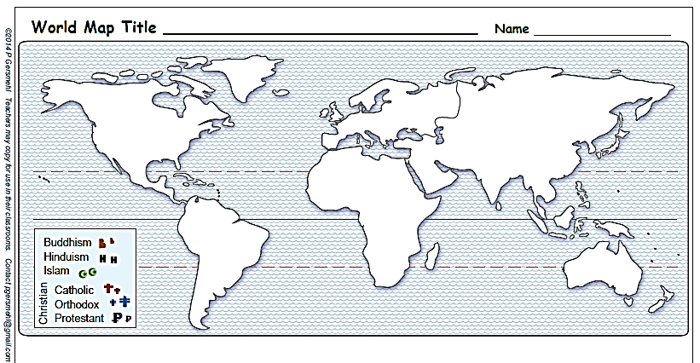
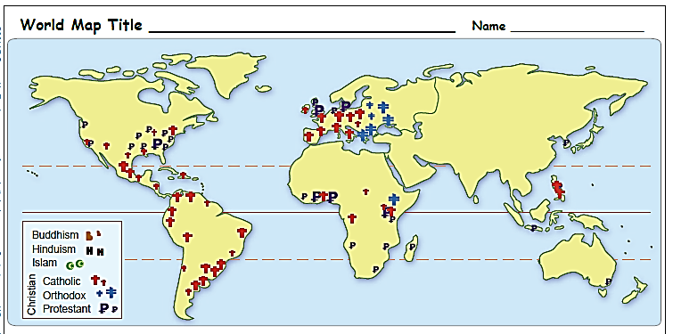
Origins: Where did major religions begin?
Maps are from “PDF_World clickable religion maps”
t
Christianity
Islam
Hinduism
t
H
I
I
H
In which continent did major religions begin?
How did Christianity spread? …to which continents?
Where did Christianity begin?
To which continents did it spread?
t
Large numbers
Christianity: Catholic, Orthodox, Protestant

Slide 6
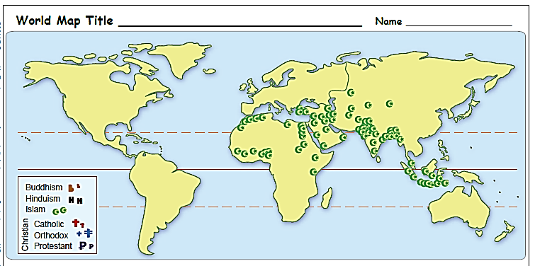
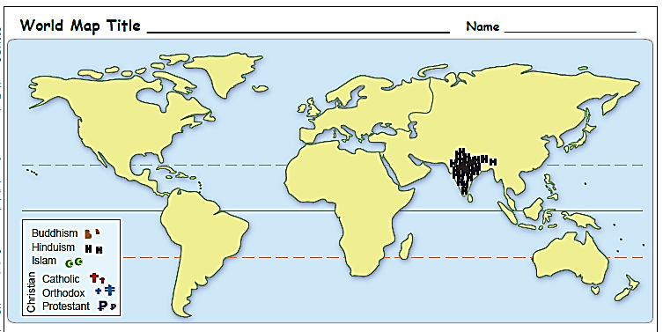
How did Islam spread? …to which continents?
From “PDF_World clickable religion maps”
To which continents did Islam spread?
I
Large numbers
Islam (Muslim believers)
How did Hinduism spread? …to which continents?
H
To which continents did Hinduism spread?
Large numbers
Hinduism

Slide 7
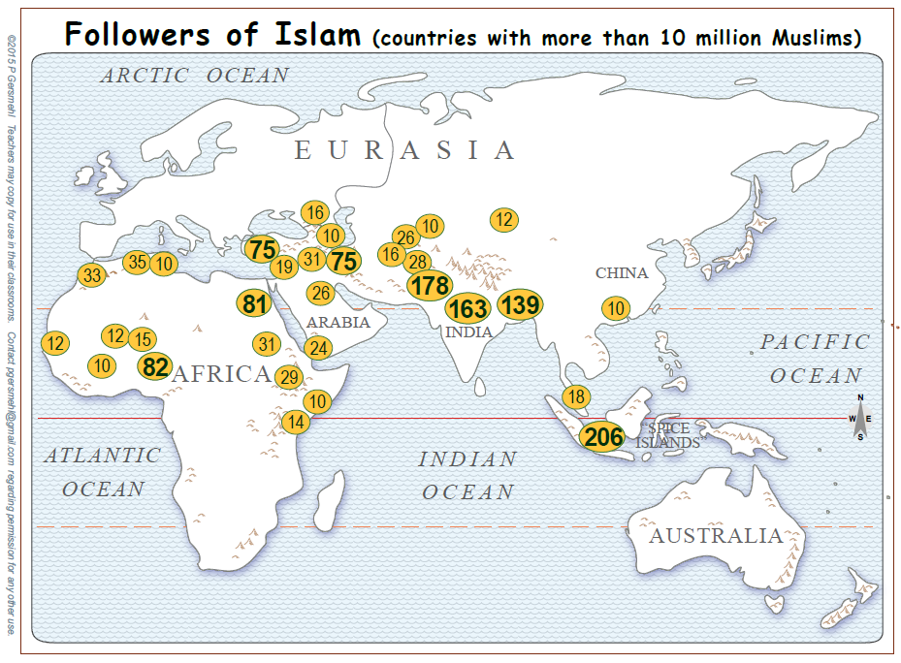
To which continents did Islam spread?
(resulting in large numbers of believers)
U.S. (2)
(1)
(2)
(4)
I
Numbers are in millions
(Data from 2009)
Source: www.perforum.org/files/2009/10/weightedmap.pdf
Countries with less than 10 million: U.S. (2), France (4), Germany (2), U.K. (1)

Slide 8
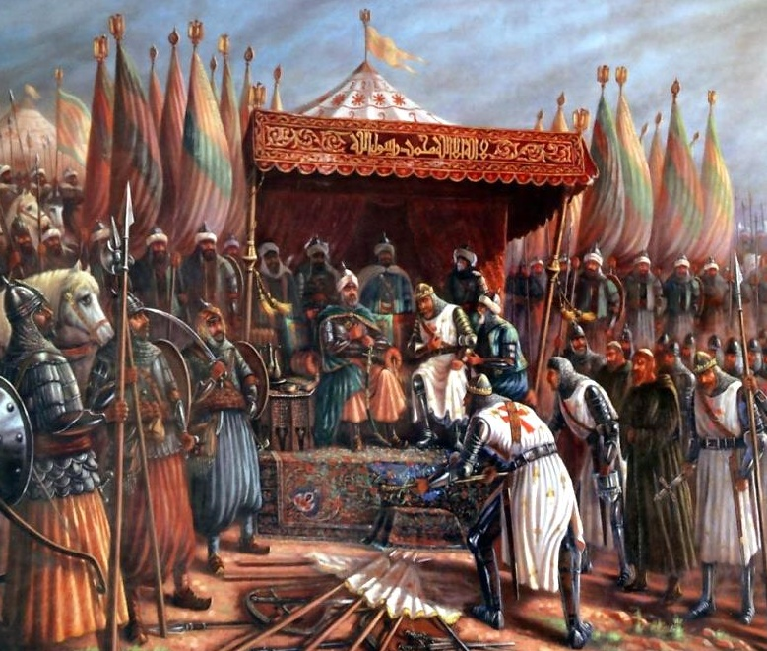
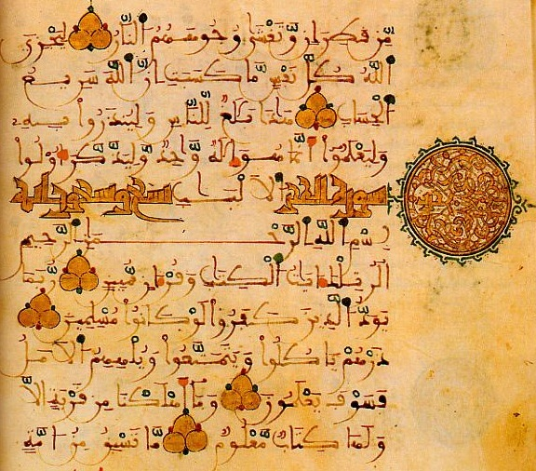
The Spread of Islam
1. Muslim armies conquered and ruled.
2. People chose Islam as their religion for many reasons.
Saladin (a Muslim sultan)
defeated Christian Crusaders
at Jerusalem in the 1100s.
Muslims believe that the Quran
is the word of God, revealed to the Prophet Muhammad.

Slide 9
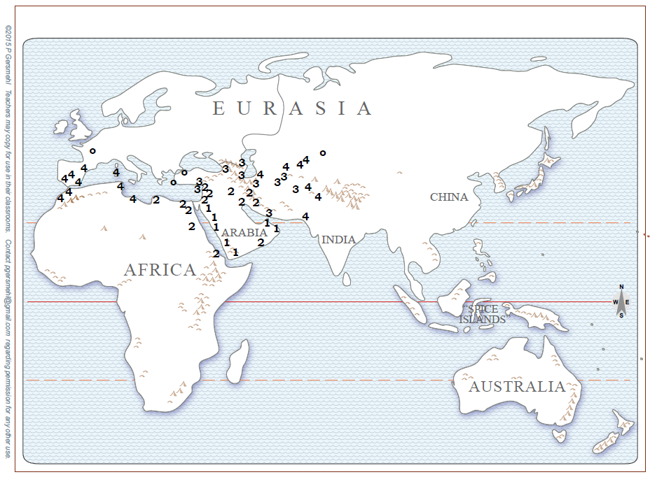
Spread of Islam
(Muslim armies rule places.)
1: Arab (Muhammad) by 630
2: Arab by 640
3: Arab by 650
4: Arab & Berber by 750
We will use numbers to trace
the spread of Islam.
Find the 1’s to see the places
where armies first brought Muslim rule.

Slide 10
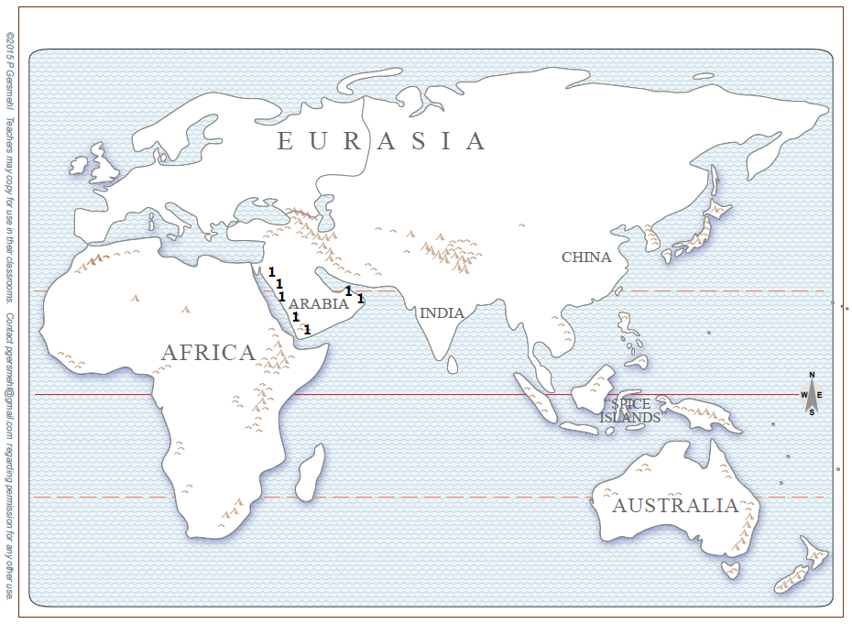
Spread of Islam
(Armies bring rule.)
1: Arab (Muhammad) by 630
M
Islam began in Arabia in 622.
It was started by the Prophet Muhammad who lived in Mecca.
Write M on your map to show Mecca.
- - -
Shade the 1s.

Slide 11
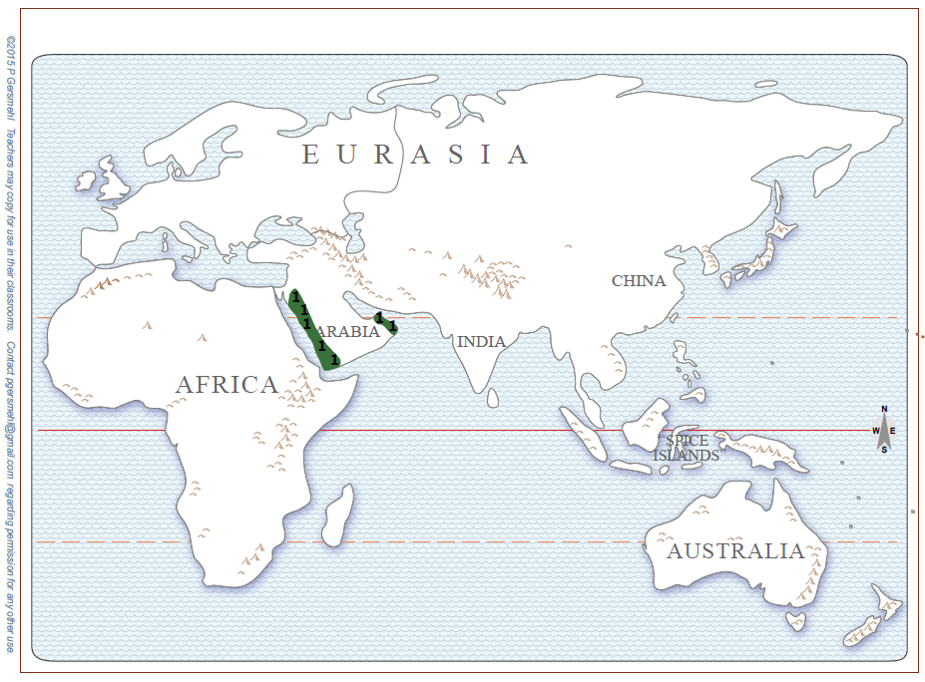
Spread of Islam (Muslim armies rule places.)
1: Arab (Muhammad) by 630
Arab Muslim armies ruled the “1” places while the Prophet Muhammed was still living.
Most Arabs in those towns converted to Islam as their religion.

Slide 12
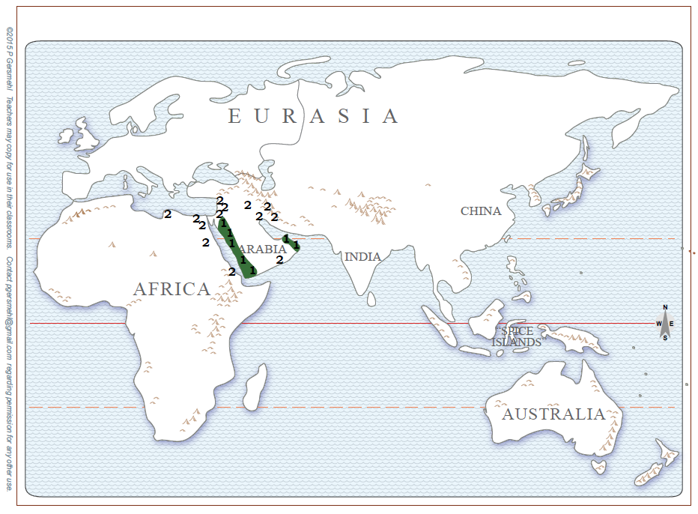
Spread of Islam
(Muslim armies rule places.)
1: Arab (Muhammad) by 630
2: Arab by 640
After the Prophet Muhammad died, Arab armies spread Muslim rule to nearby towns.
Shade the “2”
places.

Slide 13
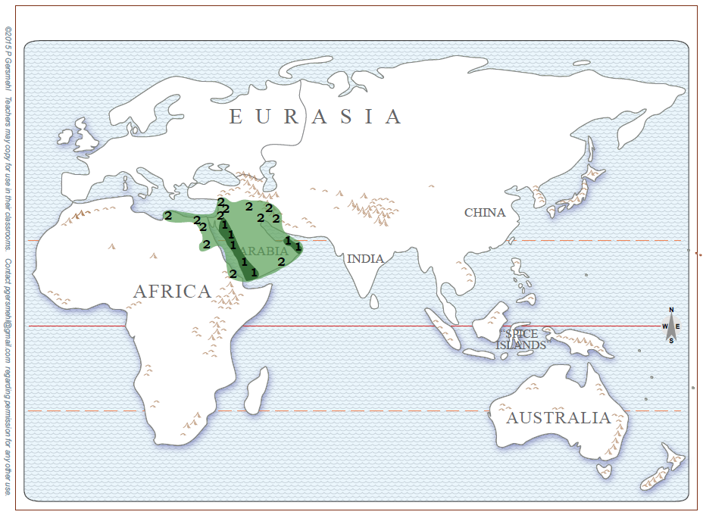
Spread of Islam
(Muslim armies rule places.)
1: Arab (Muhammad) by 630
2: Arab by 640
Between 622 and 640,
Arab armies defeated weaker governments and ruled in important trading towns.

Slide 14
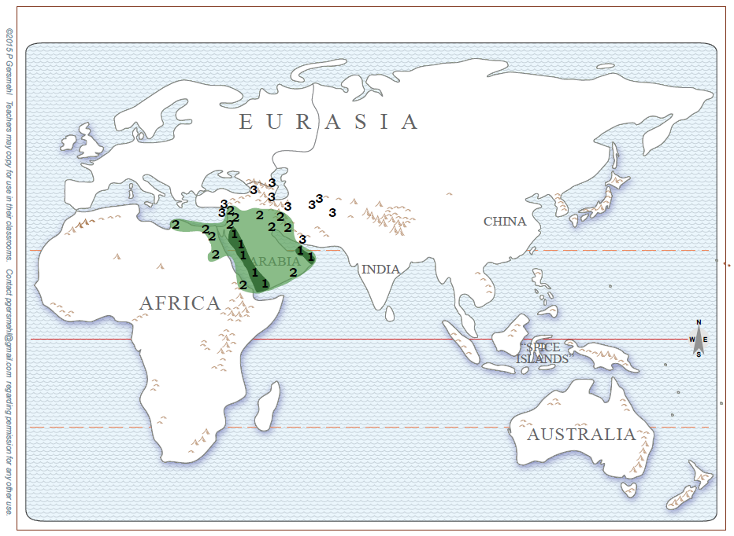
Spread of Islam
(Armies bring rule.)
1: Arab (Muhammad) by 630
2: Arab by 640
3: Arab by 650
Arab armies defeated weaker governments and ruled in important trading towns (1s, 2s).
In 10 years, the Muslim armies conquered more trading towns (3s).
Shade the “3”
places.

Slide 15
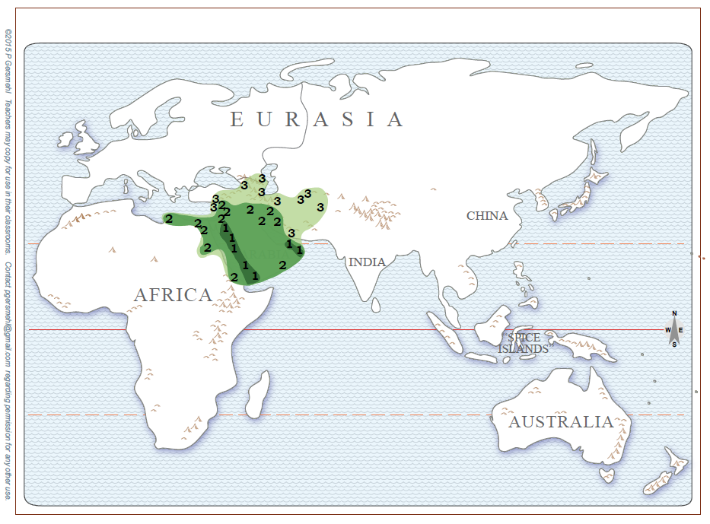
Spread of Islam
(Armed conquest did not mean fast conversion.)
1: Arab (Muhammad) by 630
2: Arab by 640
3: Arab by 650
At places 2 and 3, it took almost
200 years (or longer)
before most people chose to convert to Islam.
Conquest and rule took 20 years in the 2s and 3s.
---
How long did conversion take?

Slide 16
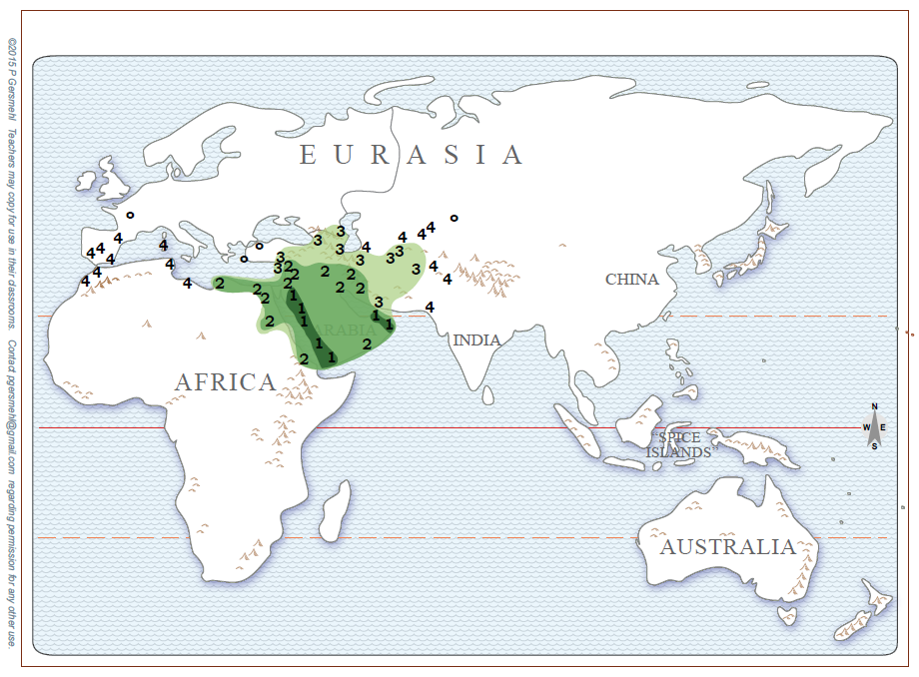
Shade the “4”
places.
Spread of Islam
(Muslim armies rule places.)
1: Arab (Muhammad) by 630
2: Arab by 640
3: Arab by 650
4: Arab & Berber by 750
Between the years 650 and 750, Arab Muslim armies pushed East into which continent? ___________
At the same time, Berber Muslim armies pushed West into which two continents:
___________ ___________

Slide 17
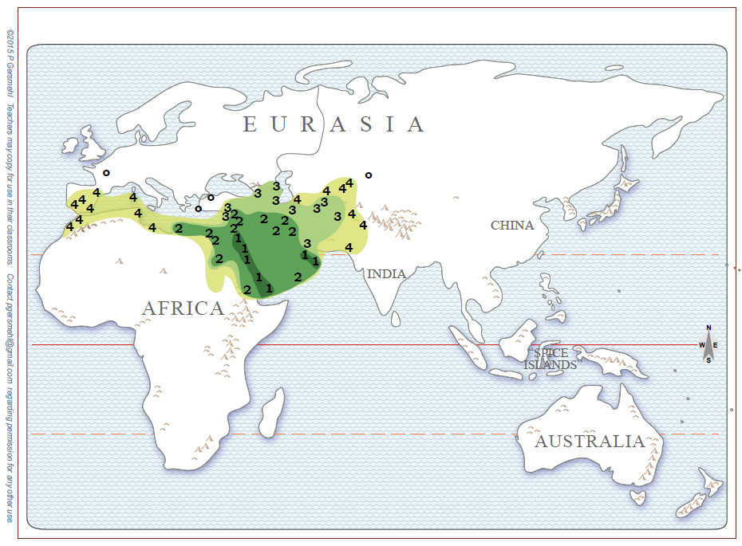
Spread of Islam
1: Arab (Muhammad) by 630
2: Arab by 640
3: Arab by 650
4: Arab & Berber by 750
Muslim armies ruled the green-shaded areas.
In places numbered 2, 3, and 4, it took almost 200 years
(or longer)
before most people converted to Islam.

Slide 18
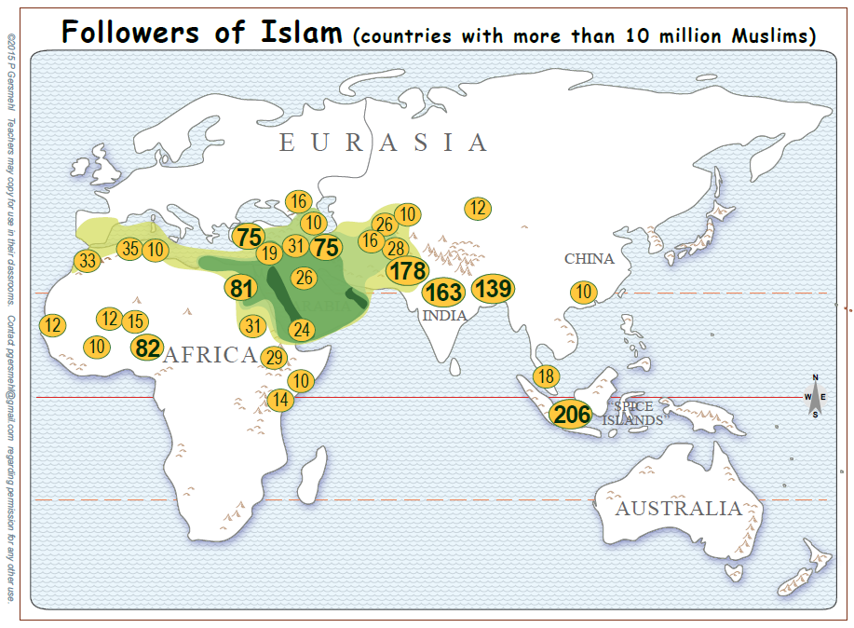
Spread of Islam
by 750
in relation to Muslim populations today
By 750, armies had spread Islamic rule
throughout the green-shaded areas.
Next we will see how Islam reached BEYOND the green-shaded places.

Slide 19
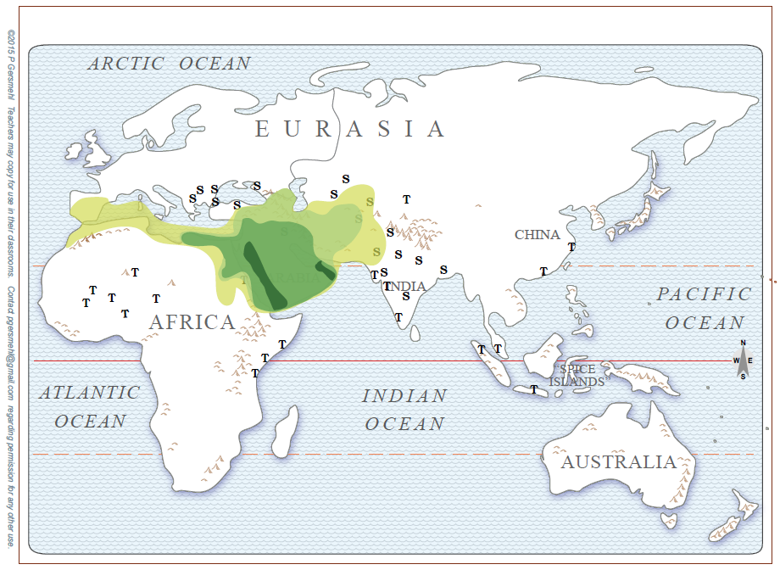
Spread of Islam
(by traders & missionaries)
1: Arab (Muhammad) to 632
2: Arab to 644
3: Arab to 651
4: Arab & Berber to 750
T: Trade links 700-1000
Arab traders and missionaries spread Islam as they traveled
to the main trading centers
of the ancient world
(marked T on the map).
Find the “T”
places.

Slide 20
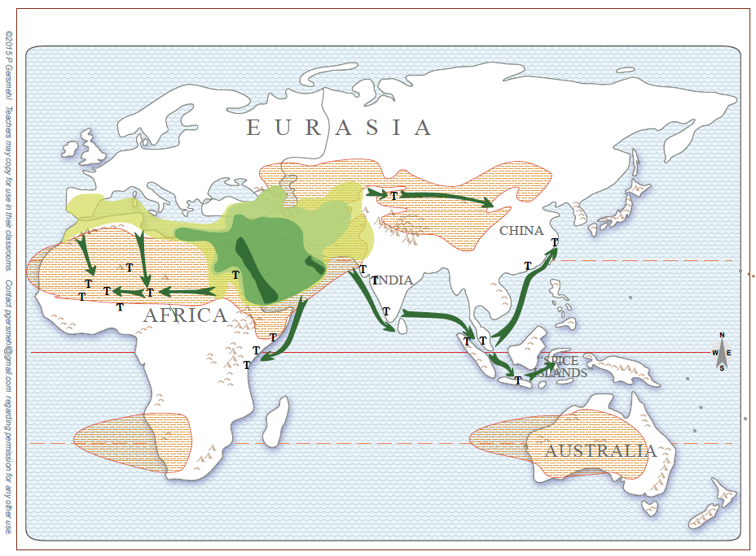
Spread of Islam
(by traders & missionaries)
1, 2, 3, 4: Armies
T: Trade links 700-1000
Silk cloth
Salt
Gold
Spices
Ivory
INDIAN OCEAN
Spices
What valuable goods did the traders want?
- - -
How did traders travel long distances?

Slide 21
Spread of Islam
(Muslim armies rule places.)
S: Seljuk & Sultanate rulers 1100 – 1500
Find Seljuk Ss in Turkey & Europe.
Seljuk
Sultanate
Find Sultanate Ss in India.
After 1100, Seljuk and Sultanate armies brought Islamic rule to the S places.

Slide 22
Find India!
From “PDF_World clickable religion maps”
Find Muslim symbols in India.
Sultanate armies brought Muslim rule to India.
Islam (Muslim believers)
What other religion remained in India?
Hinduism

Slide 23
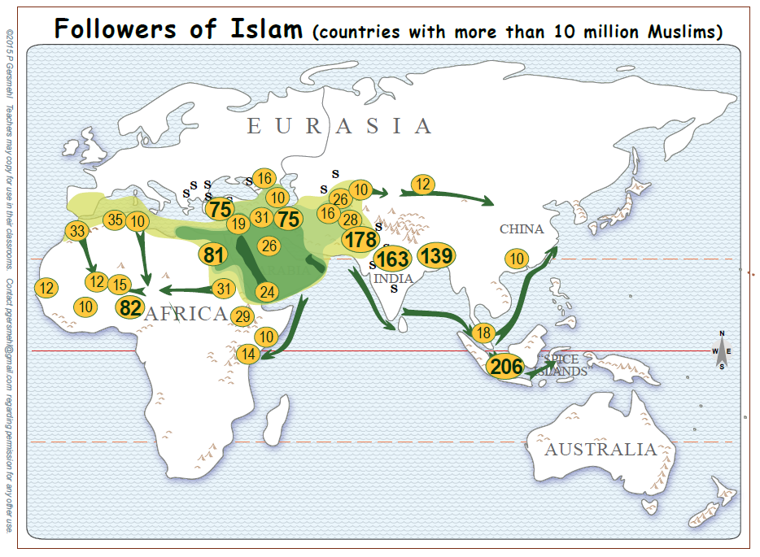
Spread of Islam
and Muslim populations today
REVIEW
Where did armies spread Islamic rule?
---
Where did traders and missionaries spread Islamic beliefs?

Slide 24
Carol used the following resources for this “Spread of Islam” PowerPoint.
Clickable PDFs by Phil Gersmehl:
E Hemisphere Spread of Islam.pdf , World clickable religion maps.pdf
Curriculum:
Era 5_Islam_World History for Us All - Afroeurasia and the Rise of Islam http://worldhistoryforusall.sdsu.edu/eras/era5.php#land complete unit
The Spread of Islam, Yale University Press, yalebooks.com
http://www.yale.edu/yup/pdf/cim6.pdf
Atlases:
Geoffrey Barraclough, The Times Concise Atlas of World History, 1982
Ian Barnes, World Religions, 2007
Patrick K. Obrien (ed.), Philip’s Atlas of World History, 1999
Malise Ruthven, Historical Atlas of Islam, 2004
Nystrom maps online: worldhistoryatlas.com/AWH/Homepage.html
Data: Pew Research Center’s Forum on Religion & Public Life • Mapping the Global Muslim Population, October 2009 http://www.pewforum.org/2009/10/07/mapping-the-global-muslim-population/
www.perforum.org/files/2009/10/weightedmap.pdf
Pictures: Both pictures on Slide 3 are public domain.
Quran: http://en.wikipedia.org/wiki/History_of_the_Quran#/media/File:AndalusQuran.JPG http://en.wikipedia.org/wiki/History_of_the_Quran
History of Islam: http://en.wikipedia.org/wiki/History_of_Islam
Saladin: http://commons.wikimedia.org/wiki/File:Saladin_and_Guy.jpg
carol.gersmehl@gmail.com Dec. 2, 2015

