Slide 1
WATER BUDGETS in MESOPOTAMIA (The Greater Anatolia Project)
Does an upstream country
have a “natural right”
to take water
out of a river?

Slide 2
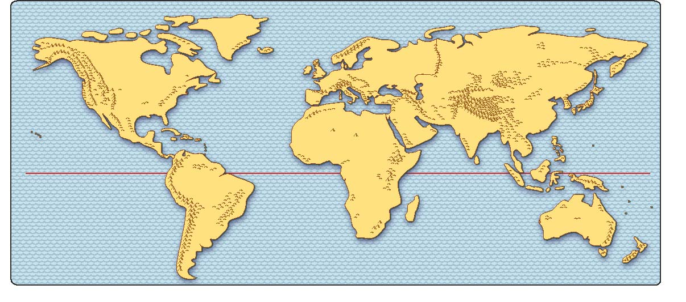

Slide 3
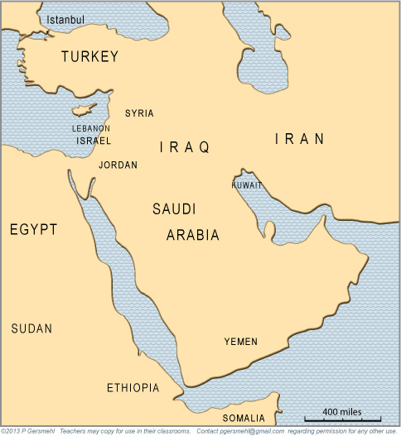
We’ll focus on three countries.

Slide 4
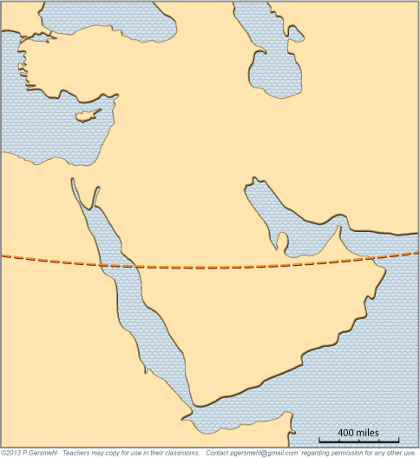
The Tropic of Cancer
runs right through this area.
What do you think
this line is?

Slide 5
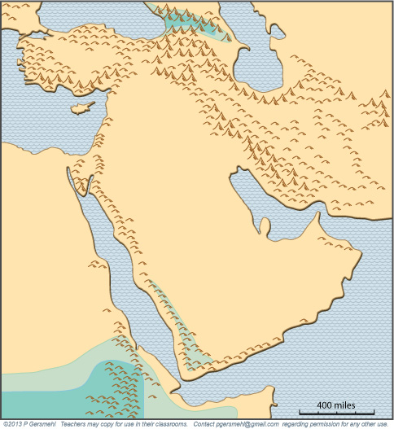
The highlands of Ethiopia
get some rain in summer.

Slide 6
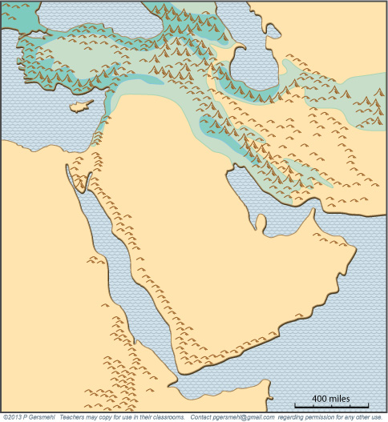
Parts of Turkey and Iran
get some rain in winter.

Slide 7
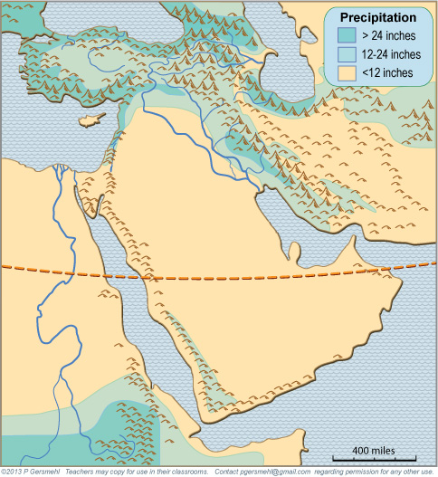
Two rivers
are really
important.
Euphrates
and Tigris
flood
in early
spring
NILE
floods
in late
summer
The area near the Tropic line
is a very dry desert.

Slide 8
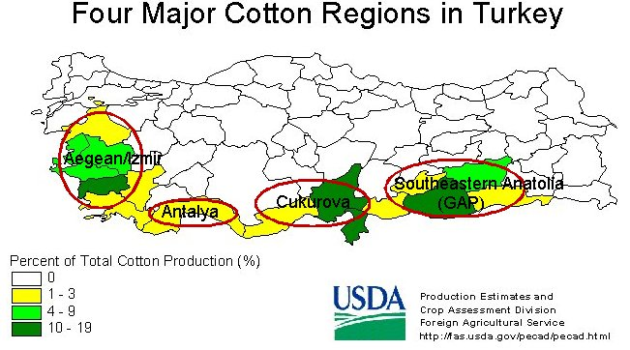
We’ll focus on
the source area
of the Tigris
and Euphrates

Slide 9
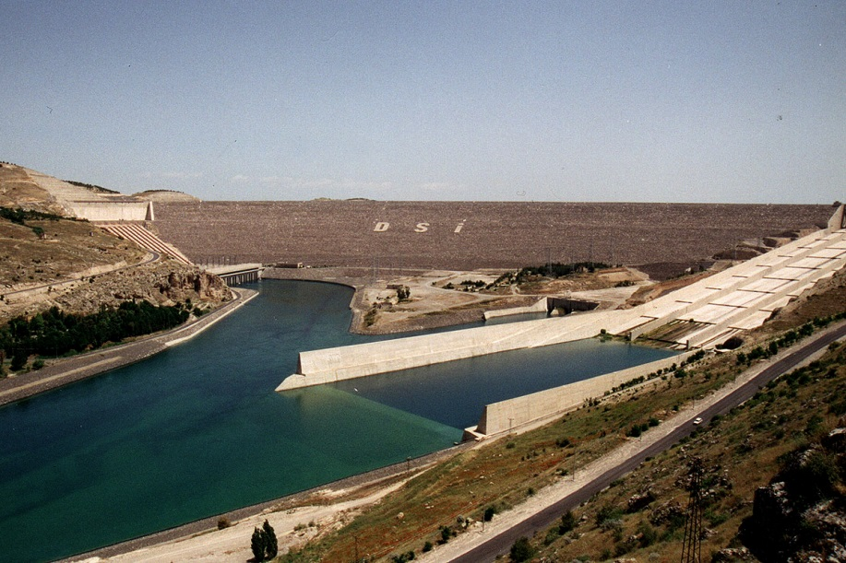
This is the Ataturk Dam
(It is named for the leader who is
called “the father of modern Turkey.”)

Slide 10
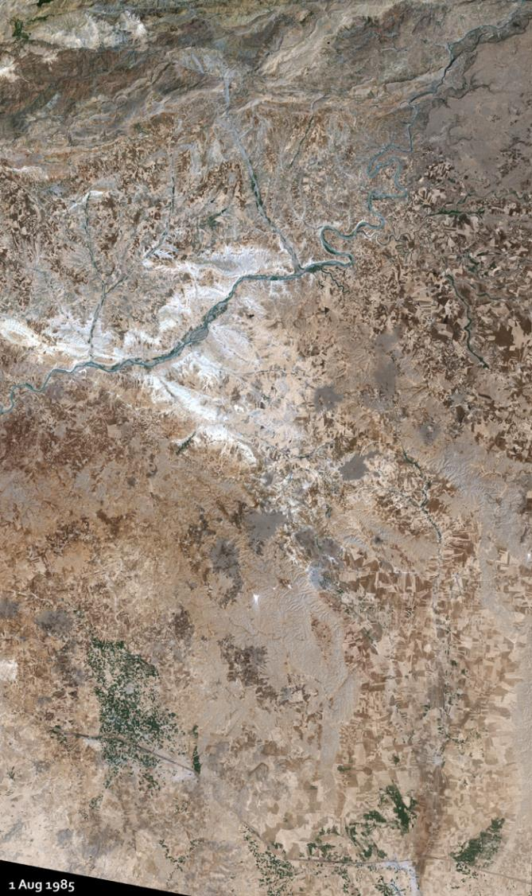
1985
This is the area as seen
from a satellite before the dam.
The white color is salt in the desert!

Slide 11
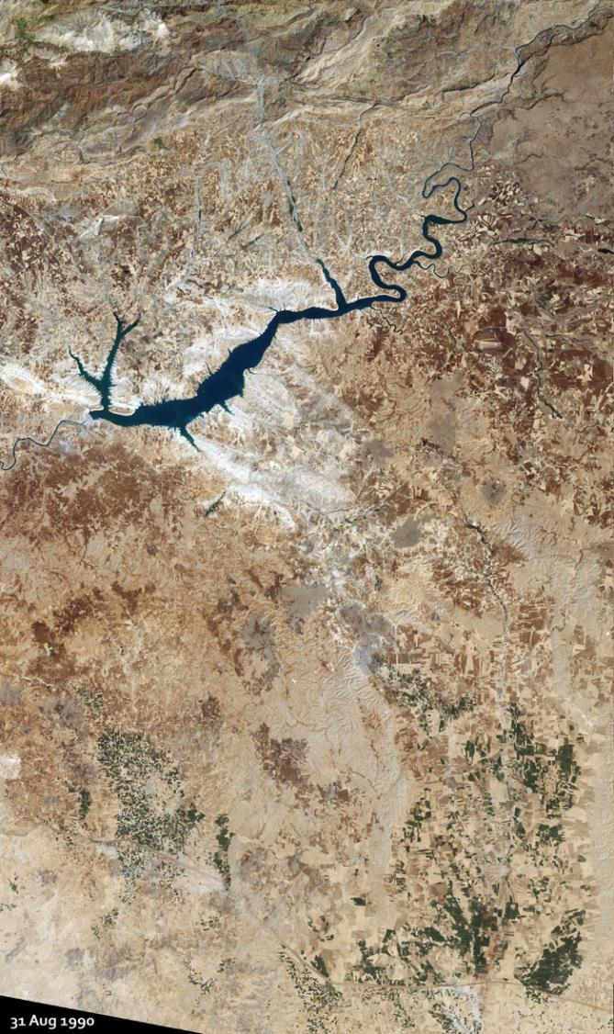
1990
Ataturk
Dam
The reservoir (lake)
upstream of the dam
is starting to fill up.

Slide 12
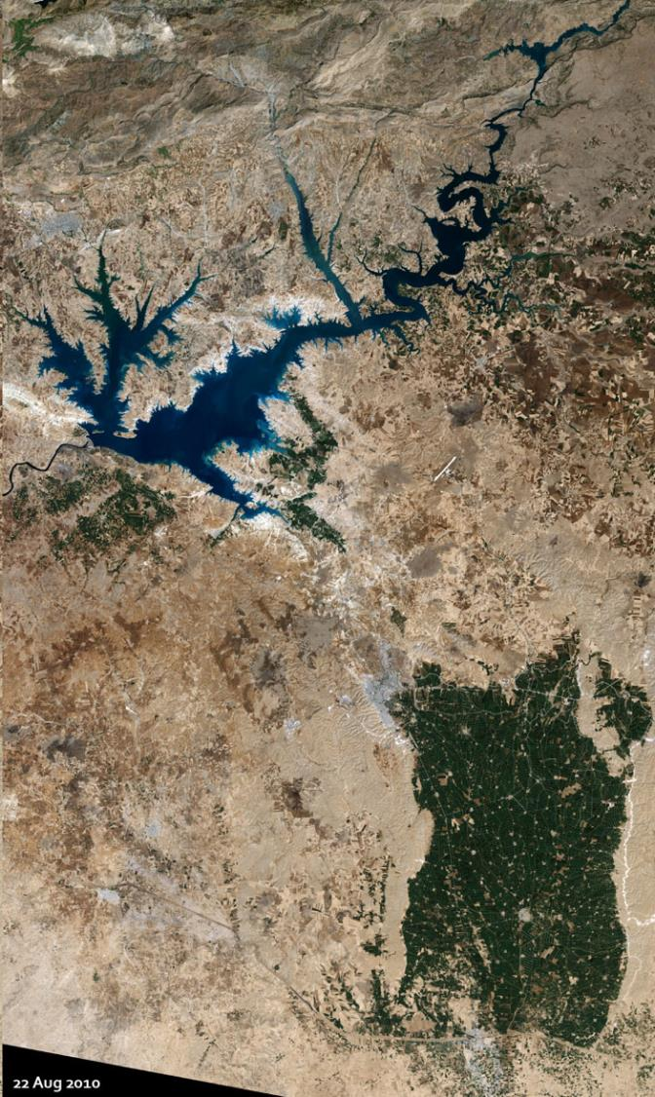
2010
The reservoir
is nearly full.
And they
are sending
water to irrigate
these fields.

Slide 13
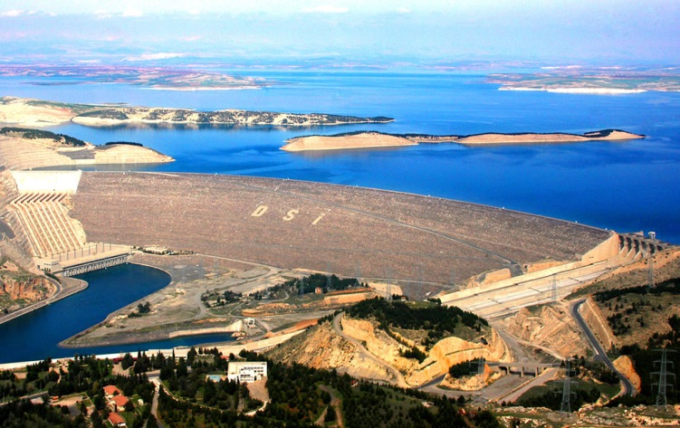
Another view of the dam
and the lake behind it.

Slide 14
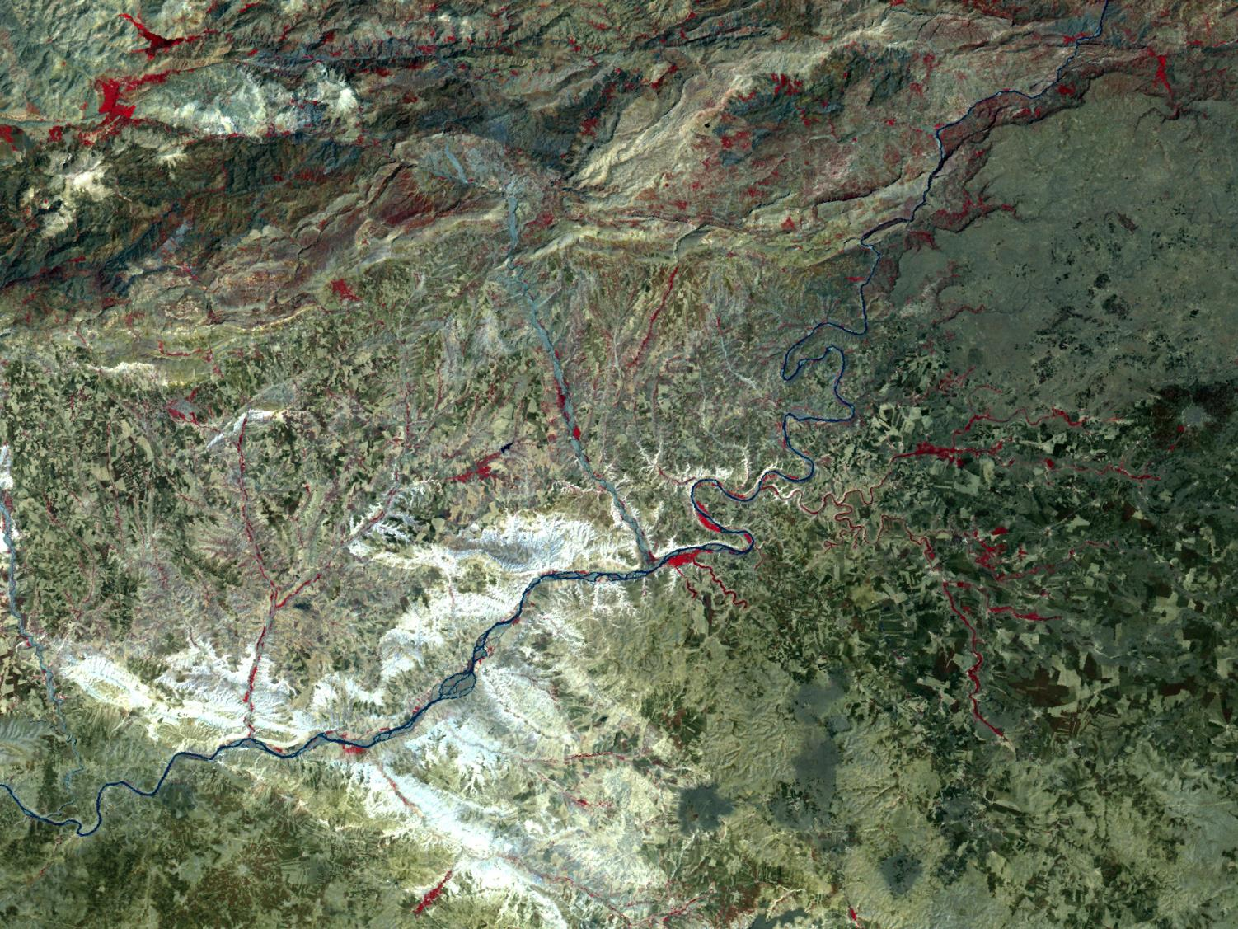
This is the view
from a different satellite
before the dam was finished.
The analyst “trained” the computer to
1. find all the places that look like
they have healthy green plants
and
2. color them a bright red
so we can see them more easily.

Slide 15
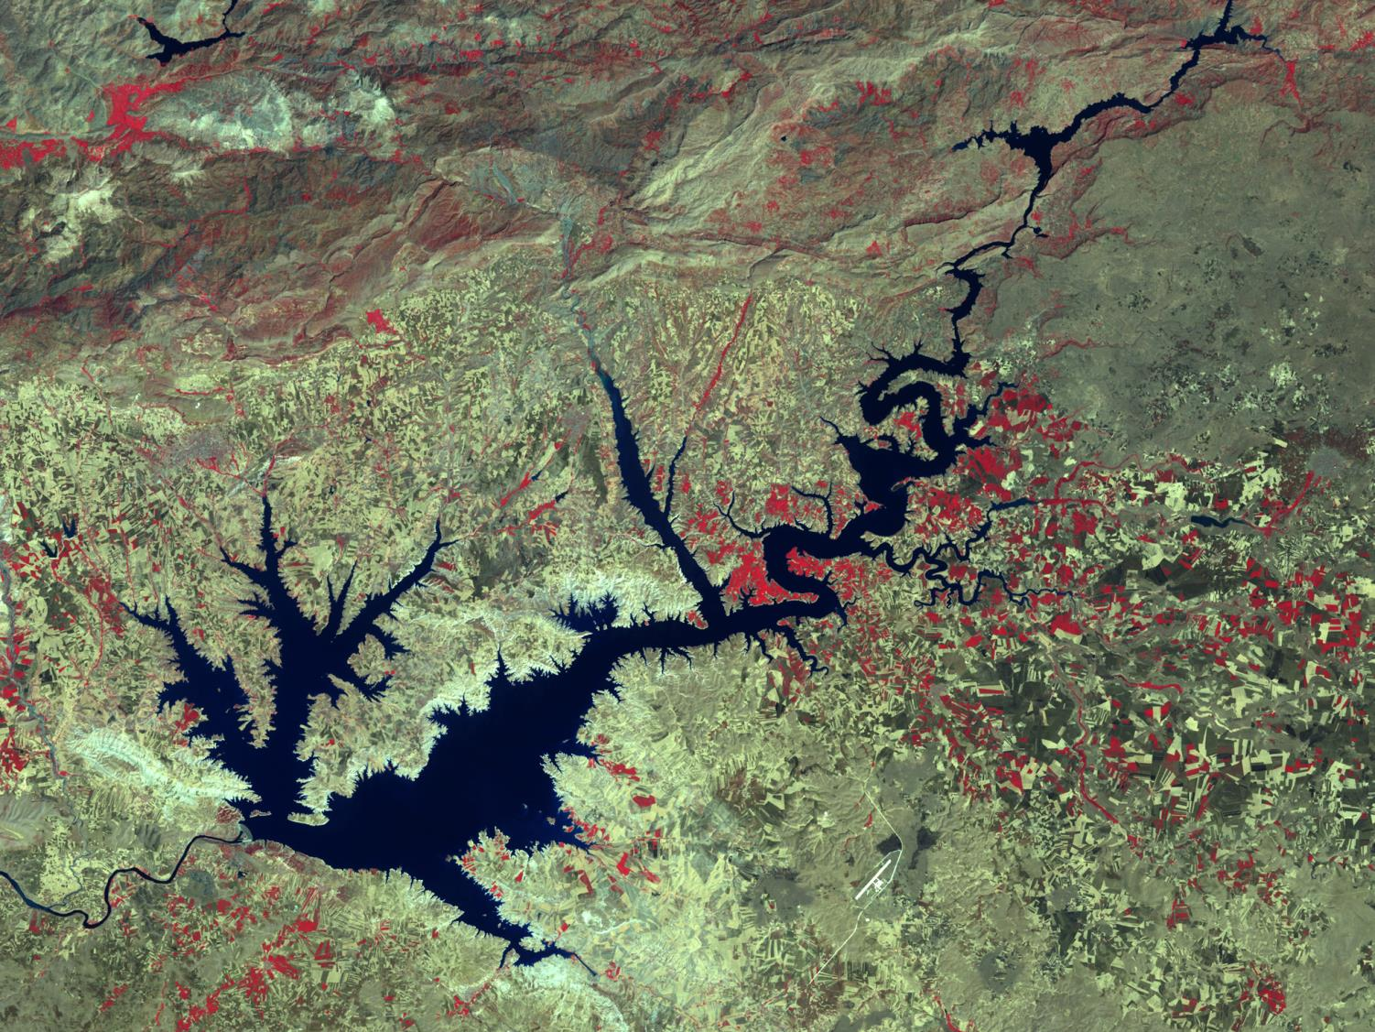
This is the view
after the dam was finished
and the reservoir filled with water.

Slide 16
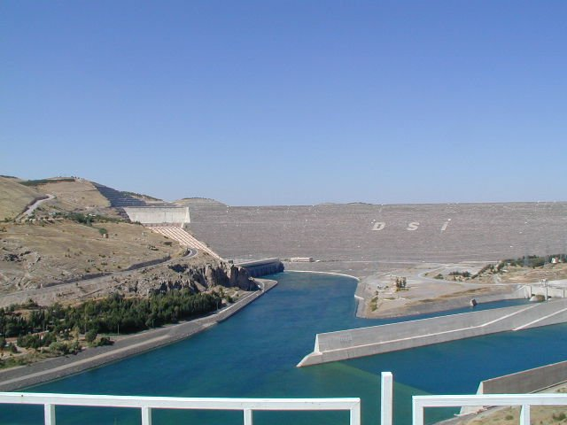
The dam has
electric generators.

Slide 17
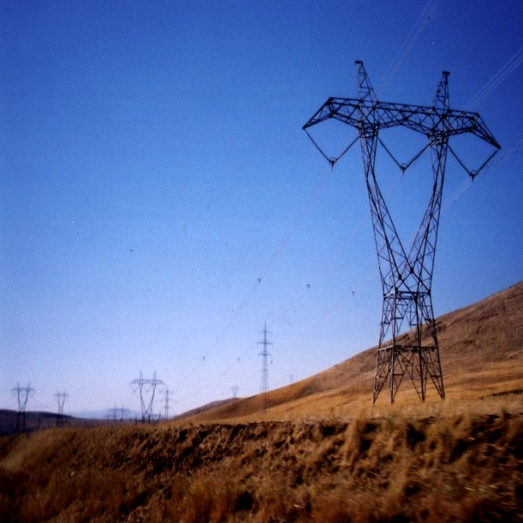
These powerlines
carry the electricity
to nearby cities.

Slide 18
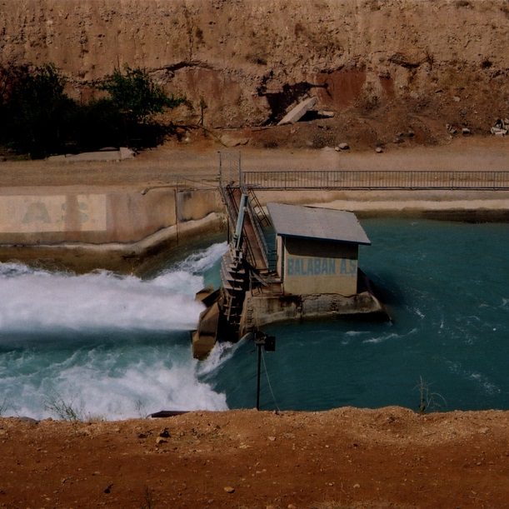
A control gate
monitors the flow
of water to the fields.

Slide 19
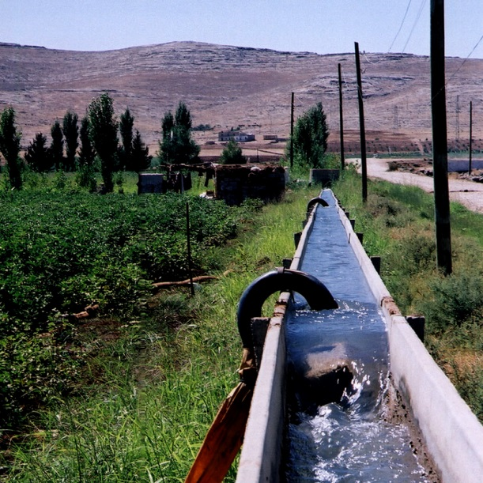
Small canals
distribute the water
in the irrigated area.

Slide 20
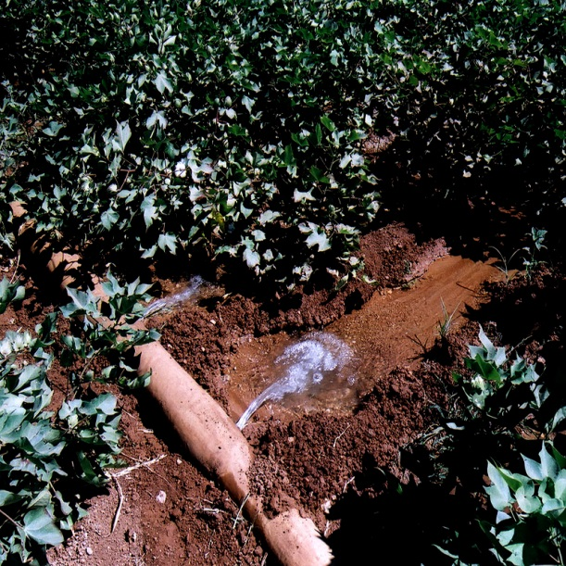
Small ditches and pipes
carry the water
to individual fields.

Slide 21
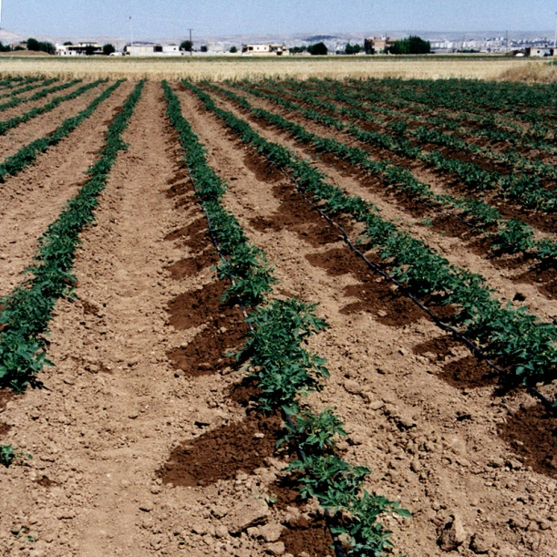
These tiny pipes
are part of a “drip”
irrigation system.

Slide 22
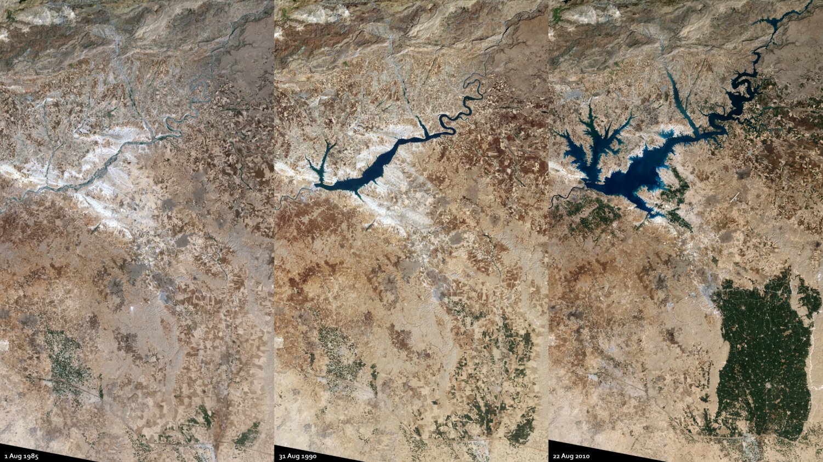
Review
Dam
Reservoir
Salty desert
Irrigated
fields

Slide 23
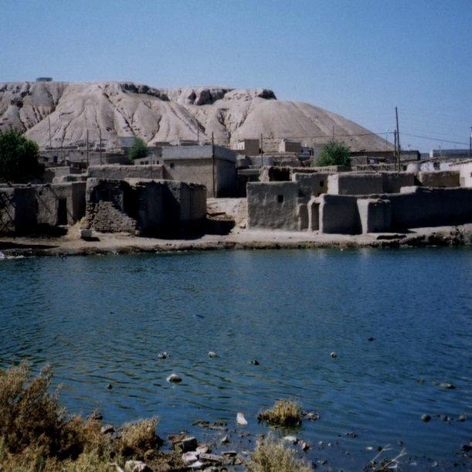
A problem:
Some small villages
were flooded
by the rising lake.

Slide 24
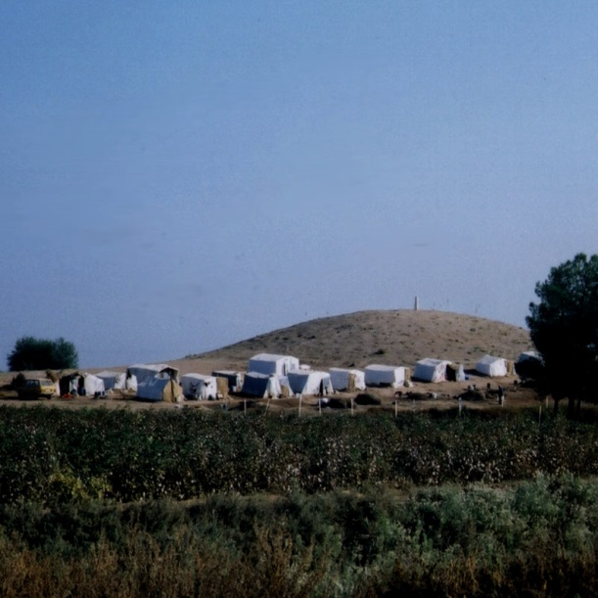
Even in 1996,
some “displaced people”
were living in tent camps
after their towns
were flooded.

Slide 25
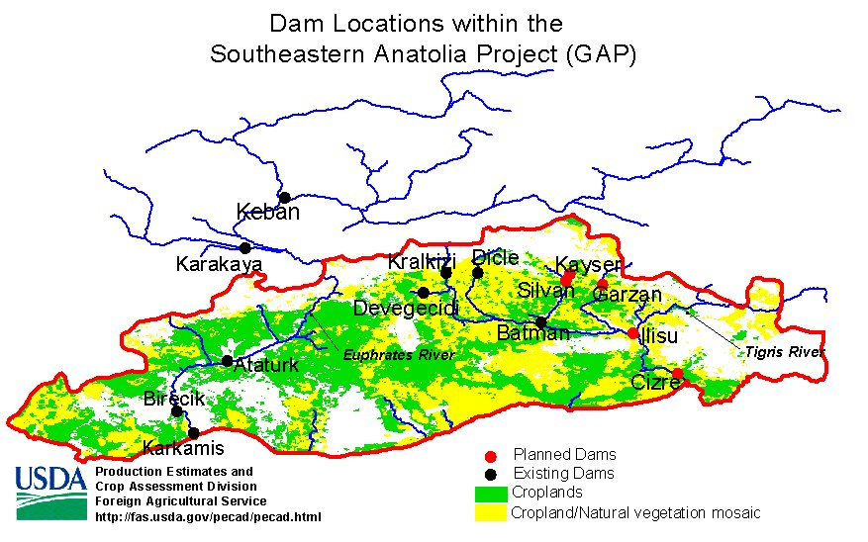
The Ataturk Dam
is just one of many
in the GAP
(Greater Anatolia Project).

Slide 26
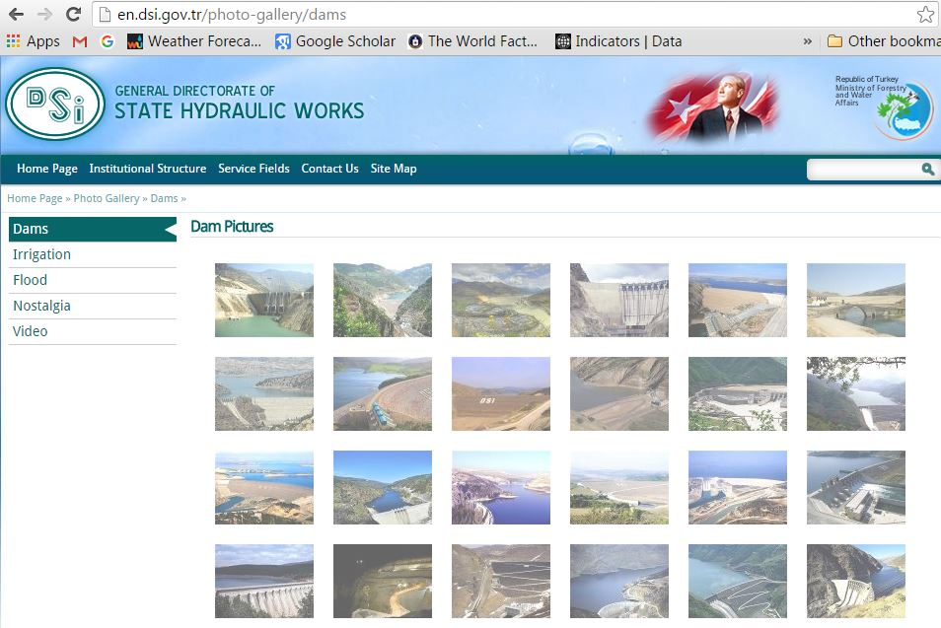
You can see pictures
of some of the dams
on the website of the
Turkish government.

Slide 27
WATER BUDGET FOR A PLACE

Slide 28
WATER BUDGET FOR A PLACE
INFLOW
The amount of water
flowing into an area
from upstream
in a river system

Slide 29
WATER BUDGET FOR A PLACE
INFLOW
RAIN & SNOW
The amount of water
in the precipitation
that falls on the place

Slide 30
WATER BUDGET FOR A PLACE
The amount of water
taken out of the river
by people in the place
INFLOW
RAIN & SNOW
WITHDRAWAL

Slide 31
WATER BUDGET FOR A PLACE
INFLOW
The amount of water
flowing downstream
to the next place
RAIN & SNOW
WITHDRAWAL
OUTFLOW

Slide 32
It’s like your budget for a week.
Inflow is what your parents give you (can be zero!)
Addition is what you earn yourself.
Withdrawal is what you spend.
Outflow is what you have left.
WATER BUDGET FOR A PLACE
INFLOW
RAIN & SNOW
WITHDRAWAL
OUTFLOW

Slide 33
PAST
WATER BUDGET FOR A PLACE
TURKEY
No inflow in Turkey,
because both rivers start
in the hills of Anatolia
0
INFLOW
RAIN & SNOW
WITHDRAWAL
OUTFLOW

Slide 34
PAST
WATER BUDGET FOR A PLACE
TURKEY
0
INFLOW
+38
RAIN & SNOW
-4
WITHDRAWAL
=34
OUTFLOW

Slide 35
PAST
WATER BUDGET FOR A PLACE
TURKEY
SYRIA
0
34
INFLOW
+38
+2
RAIN & SNOW
-4
-7
WITHDRAWAL
=34
=29
OUTFLOW

Slide 36
PAST
WATER BUDGET FOR A PLACE
TURKEY
SYRIA
IRAQ
0
34
29
INFLOW
+38
+2
+32
RAIN & SNOW
-4
-7
-38
WITHDRAWAL
=34
=29
=23
OUTFLOW

Slide 37
PRESENT
WATER BUDGET FOR A PLACE
TURKEY
SYRIA
IRAQ
0
23
15
INFLOW
+37
+2
+31
RAIN & SNOW
-14
-10
-39
WITHDRAWAL
=23
=15
=7
OUTFLOW

Slide 38
FUTURE PLANS
WATER BUDGET FOR A PLACE
TURKEY
SYRIA
IRAQ
0
10
0
INFLOW
+36
+2
+30
RAIN & SNOW
-26
-18
-48
WITHDRAWAL
=??
=??
=10
OUTFLOW

Slide 39
QUESTION
People in Turkey are proud
of their dams and green fields.
BUT
Is it fair for them
to keep building them?

Slide 40
Before you decide too quickly –
Scientists note
that the best sites for building dams
are in the hills and valleys of Turkey,
not the flat floodplains of Syria and Iraq.
Turkey has offered to store water
and sell it to Syria and Iraq
in the months when it is needed.
Like the Aral Sea, and the Colorado River,
and the Huang He, and the Indus Valley,
and the Rio Grande, and . . . and . . .
this is a classic choice between
conflict and cooperation
Otherwise, a lot of water
is wasted in floods that occur
in the wrong time of year.

Slide 41
QUESTION
What would you recommend?

Slide 42
Copyright 2015, Phil Gersmehl
Photos by D Brown, M Harris, and P Gersmehl
Teachers who saw this presentation at a workshop
or downloaded it from our internet site have permission
to make a copy on their own computers for these purposes:
1. to help them review the workshop,
2. to show to colleagues or administrators,
3. to show the presentation in their own classrooms or at sessions they lead at teacher conferences,
4. to use individual frames (with attribution) in their own class or conference presentations.
For permission for any other use,
including posting frames on a personal blog or uploading to any network or website,
contact pgersmehl@gmail.com

