Slide 1
Locations of
Ancient Capitals
This lesson explores the difference
between geographic conditions
and geographic connections
(and why the difference is important).

Slide 2
The place you are about to investigate
is a real place,
at a real time in history.

Slide 3
The place you are about to investigate
is a real place,
at a real time in history.
You might try to figure out
where in the world this is.
We are keeping its identity secret, for now,
in order to focus on a more important question.

Slide 4
Here is the big question:
How do people decide
where to build a town?

Slide 5
While we do this,
try to think about
how you are making a decision,
not just
what decision you are making.

Slide 6
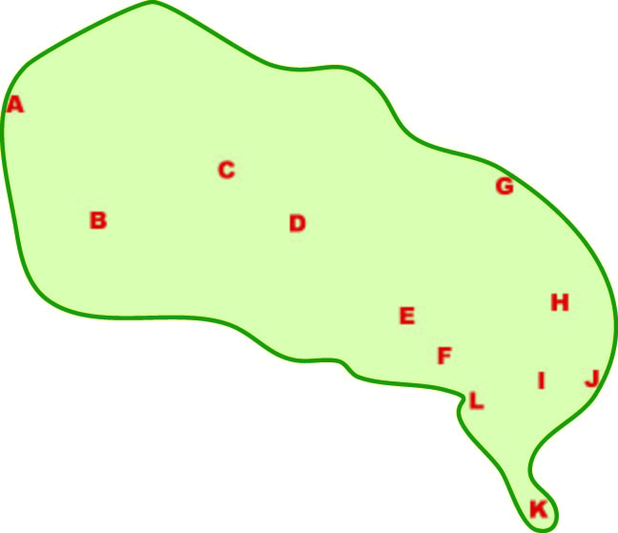
Here are a dozen places
where you might live.
Which would you choose?

Slide 7
Asking you to vote after looking at a simple map
exposes a basic problem with democracy:
Advantage:
Disadvantage ?

Slide 8
Asking you to vote after looking at a simple map
exposes a basic problem with democracy:
Advantage:
people cannot blame anyone else
when they get what they vote for.
Disadvantage ?

Slide 9
Asking you to vote after looking at a simple map
exposes a basic problem with democracy:
Advantage:
people cannot blame anyone else
when they get what they vote for.
Disadvantage ?
it takes time and effort
to learn what is needed
to cast an informed vote.

Slide 10
Here is that map again,
with your twelve choices on it.
What else would you like to know?

Slide 11
Before we go any farther,
let’s make sure we all understand
the concept of “location.”

Slide 12
To a geographer,
the idea of location
has two parts:
The Conditions
in a specific place,
right there

Slide 13
Cold
Bears
Iron ore
To a geographer,
the idea of location
has two parts:
Low
Hills
The Conditions
in a specific place,
Sandy
Trees
Rainy

Slide 14
To a geographer,
the idea of location
has two parts:
The Conditions
in a specific place,
Can you name a kind of place condition
that did not flash on the screen?

Slide 15
Road
Canal
To a geographer,
the idea of location
has two parts:
Far from
camp
The Conditions
in a specific place,
Treaty
Trade
The Connections
with other places
Upstream

Slide 16
Can you name
any kind of connection
that did not flash
on the screen?
To a geographer,
the idea of location
has two parts:
The Conditions
in a specific place,
The Connections
with other places

Slide 17
Here is a quick review. When you click, a phrase
will flash on the screen. Decide whether the phrase
is a geographic condition or connection. Then click.
Upstream from swamp
Good well water
Part of NATO
Level land for house
Close to town
Fertile soil
Geographic
Condition
Geographic
Connection

Slide 18
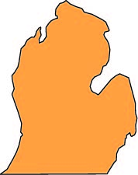
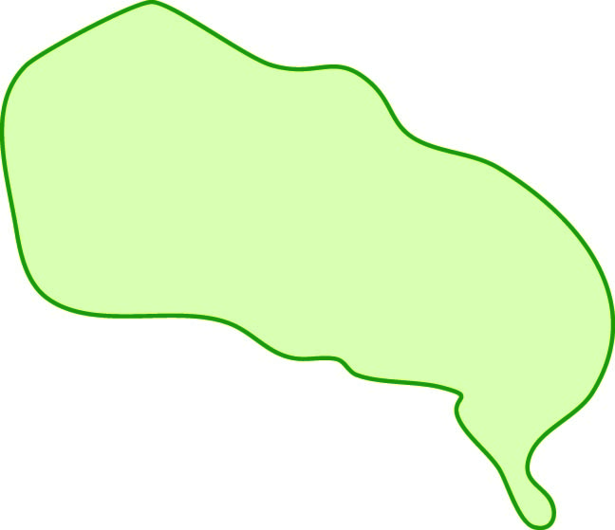
This map shows an area
about two thirds as large
as the United States
(w/o Alaska).
Most of the area,
however,
is much warmer
than most of the U.S.
Think Brazil,
or Africa, China, India . . .
Some place where people
could get two or three crops
in a single year.
No snow!
(Is that good or bad?)

Slide 19
It’s in the middle.
You can rule.
It’s on a coast.
You can fish.
It’s by a bay,
safe from wind.
Here are a dozen places
where you might live.
The map doesn’t have
a lot of information,
but it’s better than nothing!
Discuss, and choose
up to three places.
Write the main reason
why you chose each place.
It’s on a peninsula,
easier to defend.

Slide 20
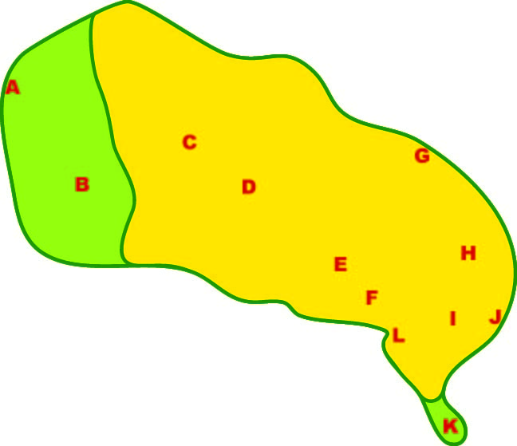
Information about conditions:
A yellow color shows areas
that are hot and dry.
The green areas are cooler,
especially in the rainy season.
Did you change your mind
when you saw
that new information?

Slide 21
Let’s connect this
to World History -
specifically, the big eras
in the Michigan GLCEs.

Slide 22
“Era 0” - Prehistory
Where do you think
hunters and gatherers
would choose to live?

Slide 23
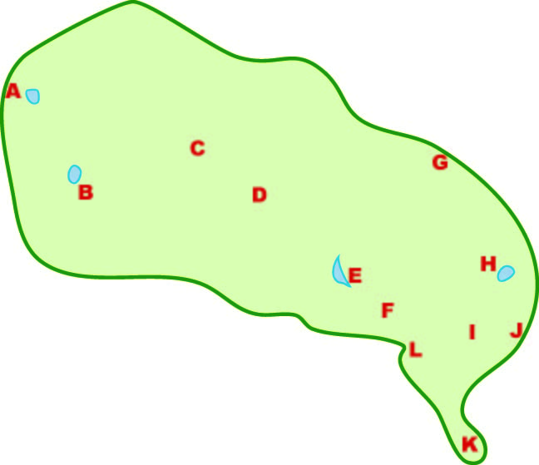
What if the map
showed only some lakes?
Where do you think
hunters and gatherers
would choose to live?

Slide 24
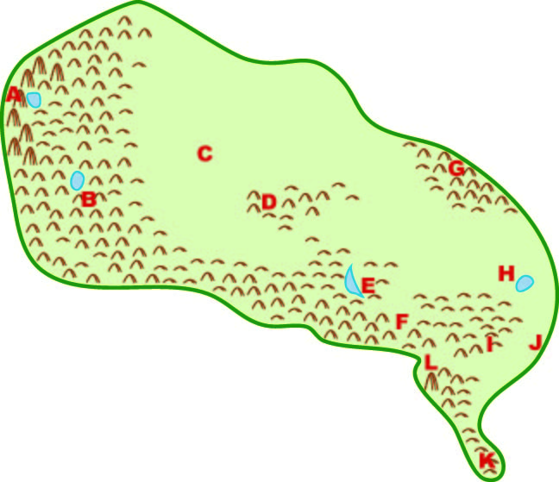
Era 1a - Beginnings
The map now shows
hills, mountains, and lakes.
You are still a hunter.
Where would you choose to live?

Slide 25
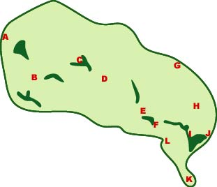
Era 1b - Agriculture
People know how to plant seeds.
The green areas have fertile soil,
You are a farmer.
Where would you choose to live?

Slide 26
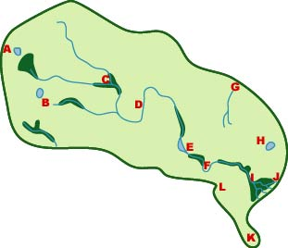
Era 2a - Trade
People know how to build boats.
The blue lines are rivers.
You are a trader. Which place
would you choose as your base?

Slide 27
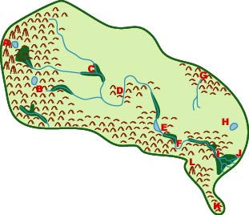
Era 2b - Urban Civilization
You are a powerful ruler.
Where would you put your capital?

Slide 28
Era 3a - “Global” Empire
People came from the east
and conquered much of this area.
You are the governor of the colony.
Where do you want your capital?

Slide 29
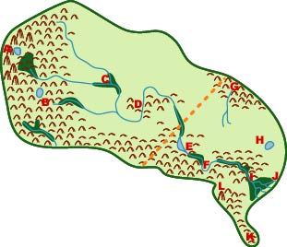
Era 7 - Modern Times
Another powerful overseas people
split your land into two countries.
Where would you put the capital
of each new country?

Slide 30
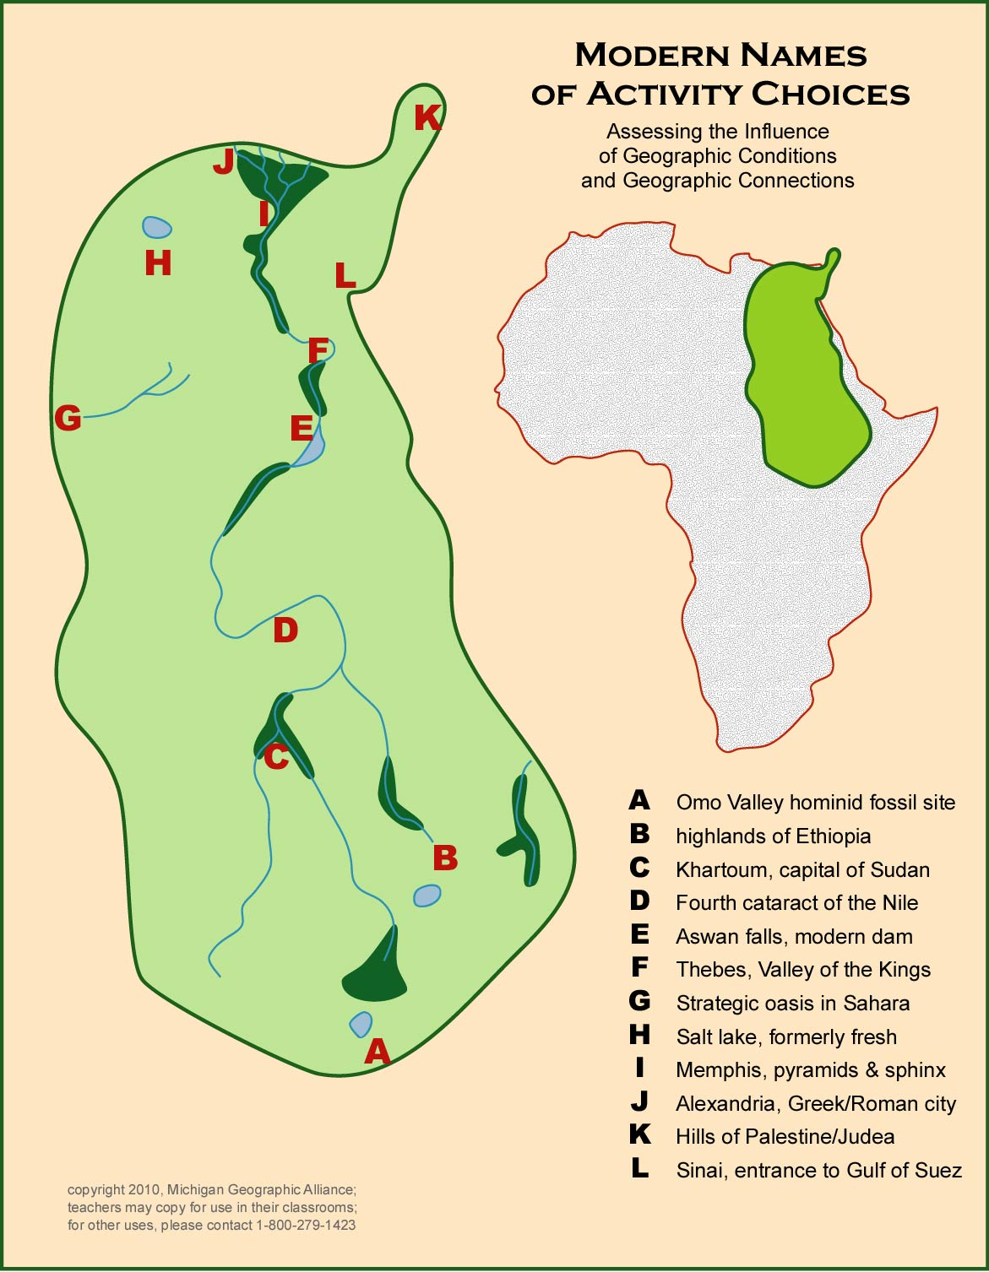

Slide 31
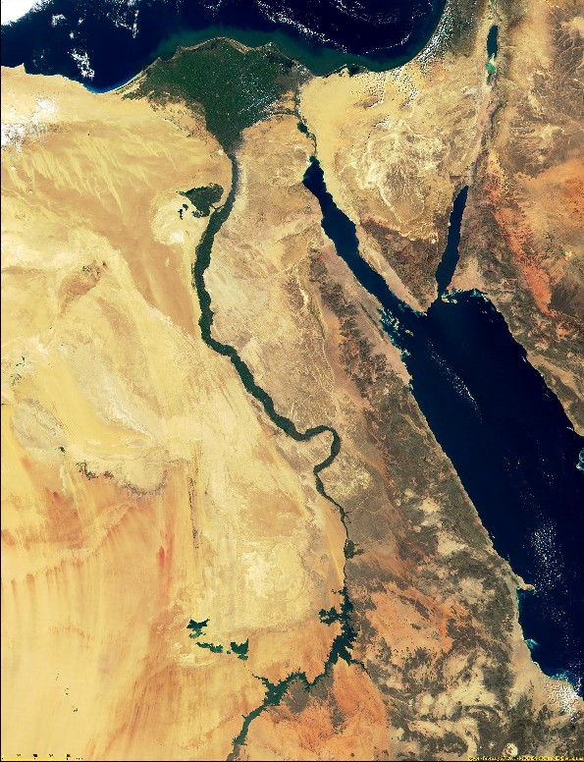
K
J
I
H
L
F
E

Slide 32
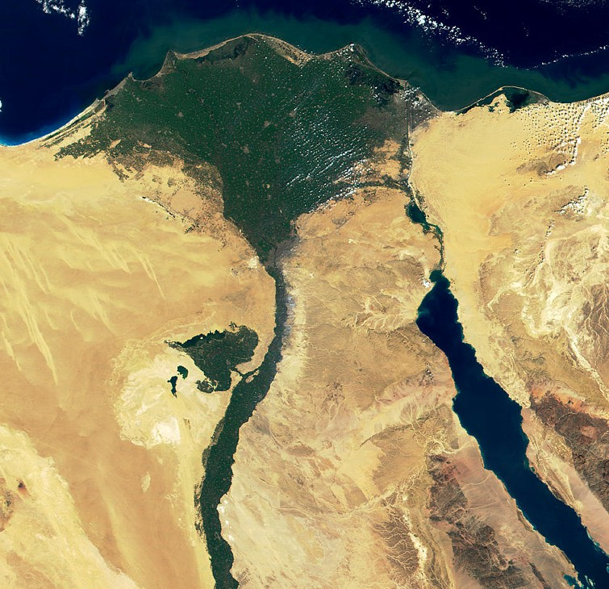
A
C
I

Slide 33
A
Conclusion
If students look at history
as the result of decisions
that people made
in their environment,
it engages more “brainpower,”
and they can remember it better.
C
I

Slide 34
The location
of nearly every
important city
in the ancient world
makes sense when
you look at the world
through their eyes.

