Slide 1
Russian Forts
Taking land,
from Kazan
to the Pacific

Slide 2
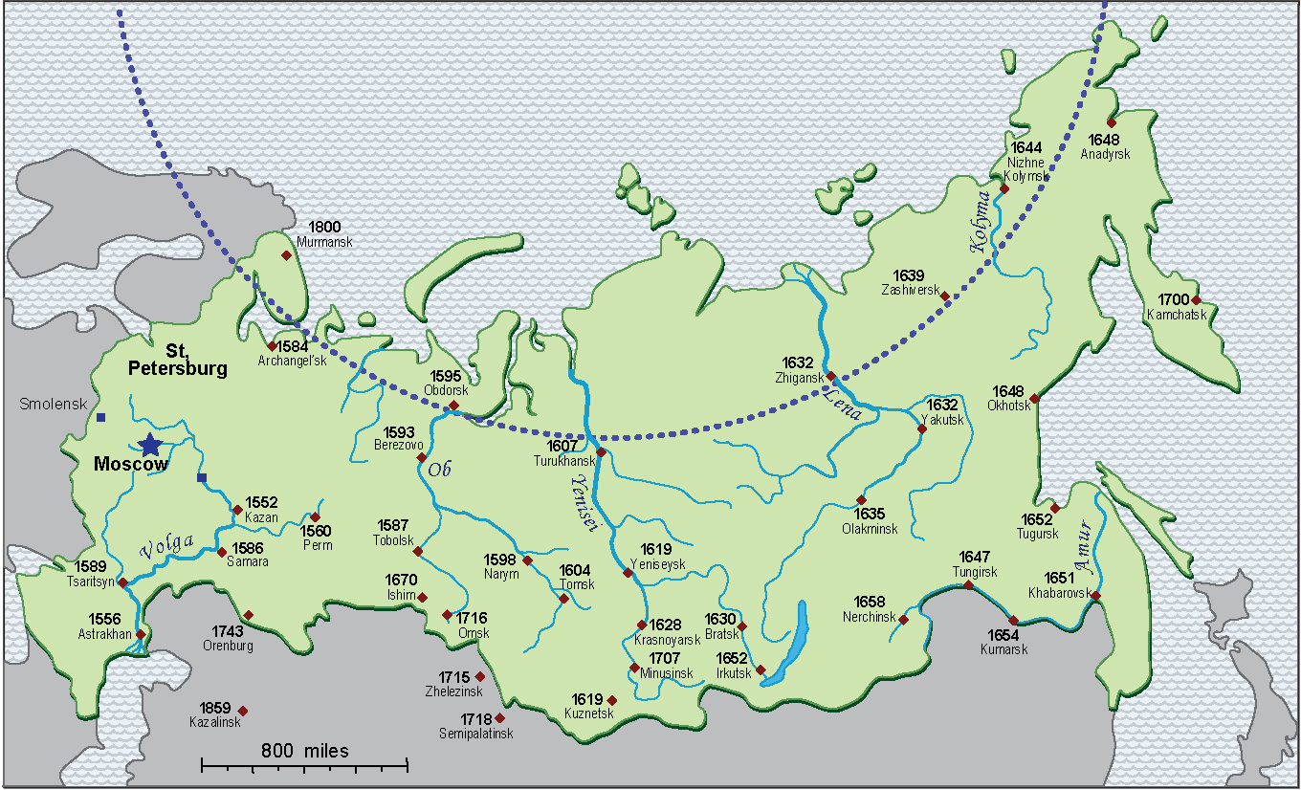
Frontier forts
and the dates
they were built

Slide 3
In the 1550s
(while sailors were
exploring the Americas)

Slide 4
1560-1599

Slide 5
1600-1619

Slide 6
1620-1639

Slide 7
1640 - 1699

Slide 8
1700 - 1860

Slide 9
1560-1599

Slide 10
1560-1599
1600-1639

Slide 11
1560-1599
1600-1639
1600-
1639

Slide 12
1560-1599
1600-1639
1600-
1639
after 1700

