Slide 1
1812 napoleon invaDES russia

Slide 2
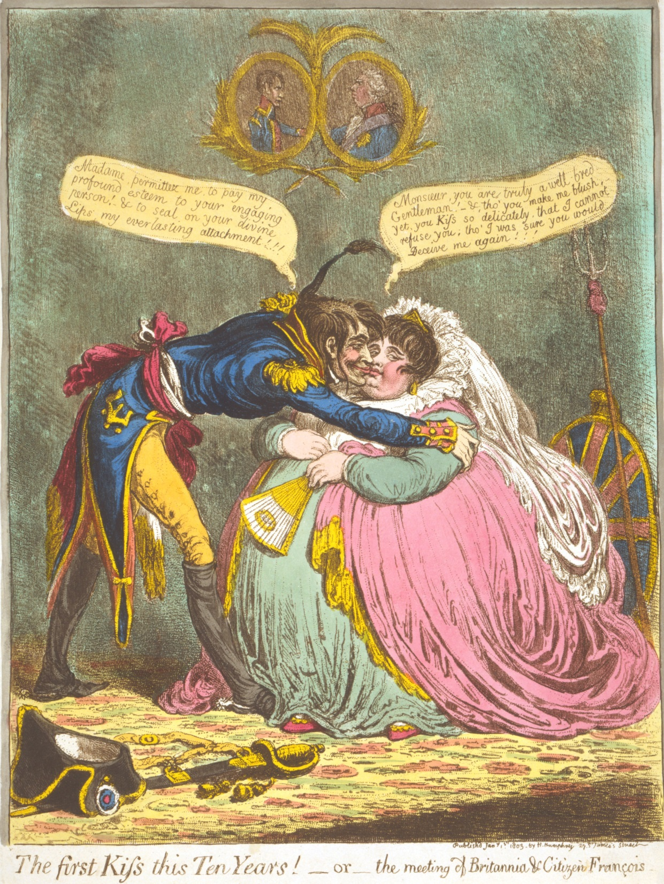
This 1803 cartoon shows France “kissing” England.
Napoleon wanted
the fighting to end
so he could focus
on conquering
Europe and Russia.

Slide 3
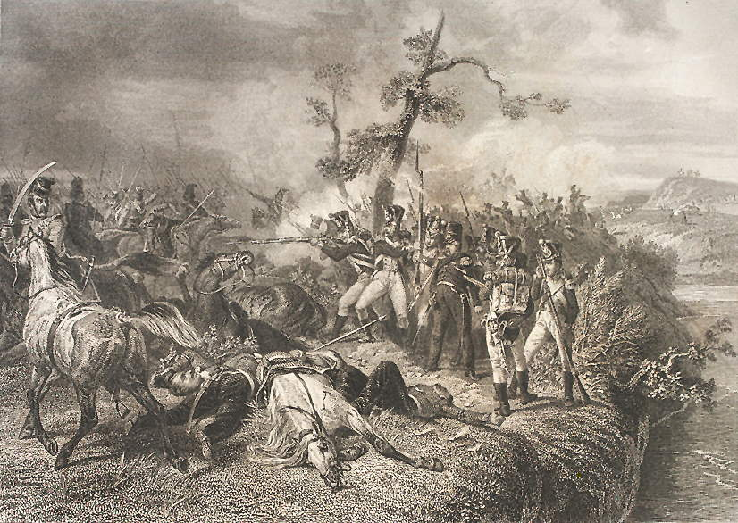
Late summer 1812
The French army
easily defeated
a small Russian
force at Vitebsk –
but the delay
allowed the Russians
to move their main army farther east.

Slide 4
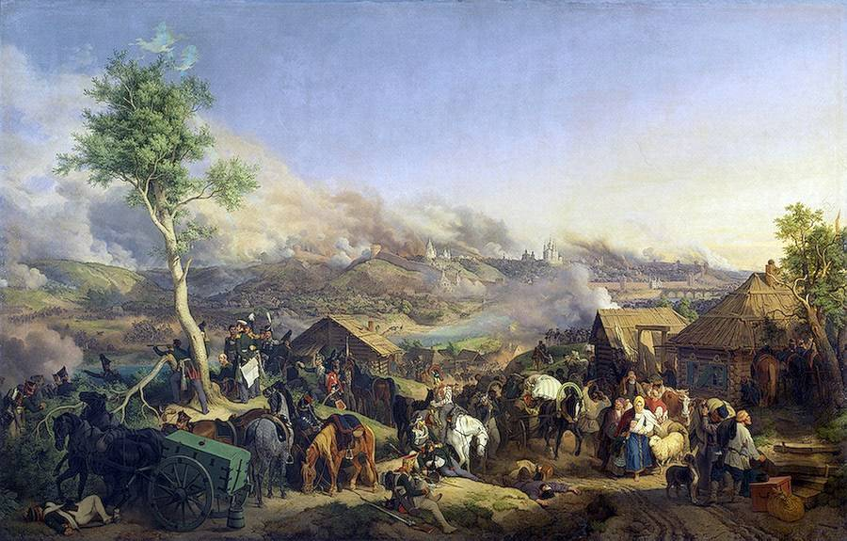
Early fall 1812
The French army defeated
the Russians at Smolensk –
but the Russians burned
the city and took all the food
as they retreated east.

Slide 5
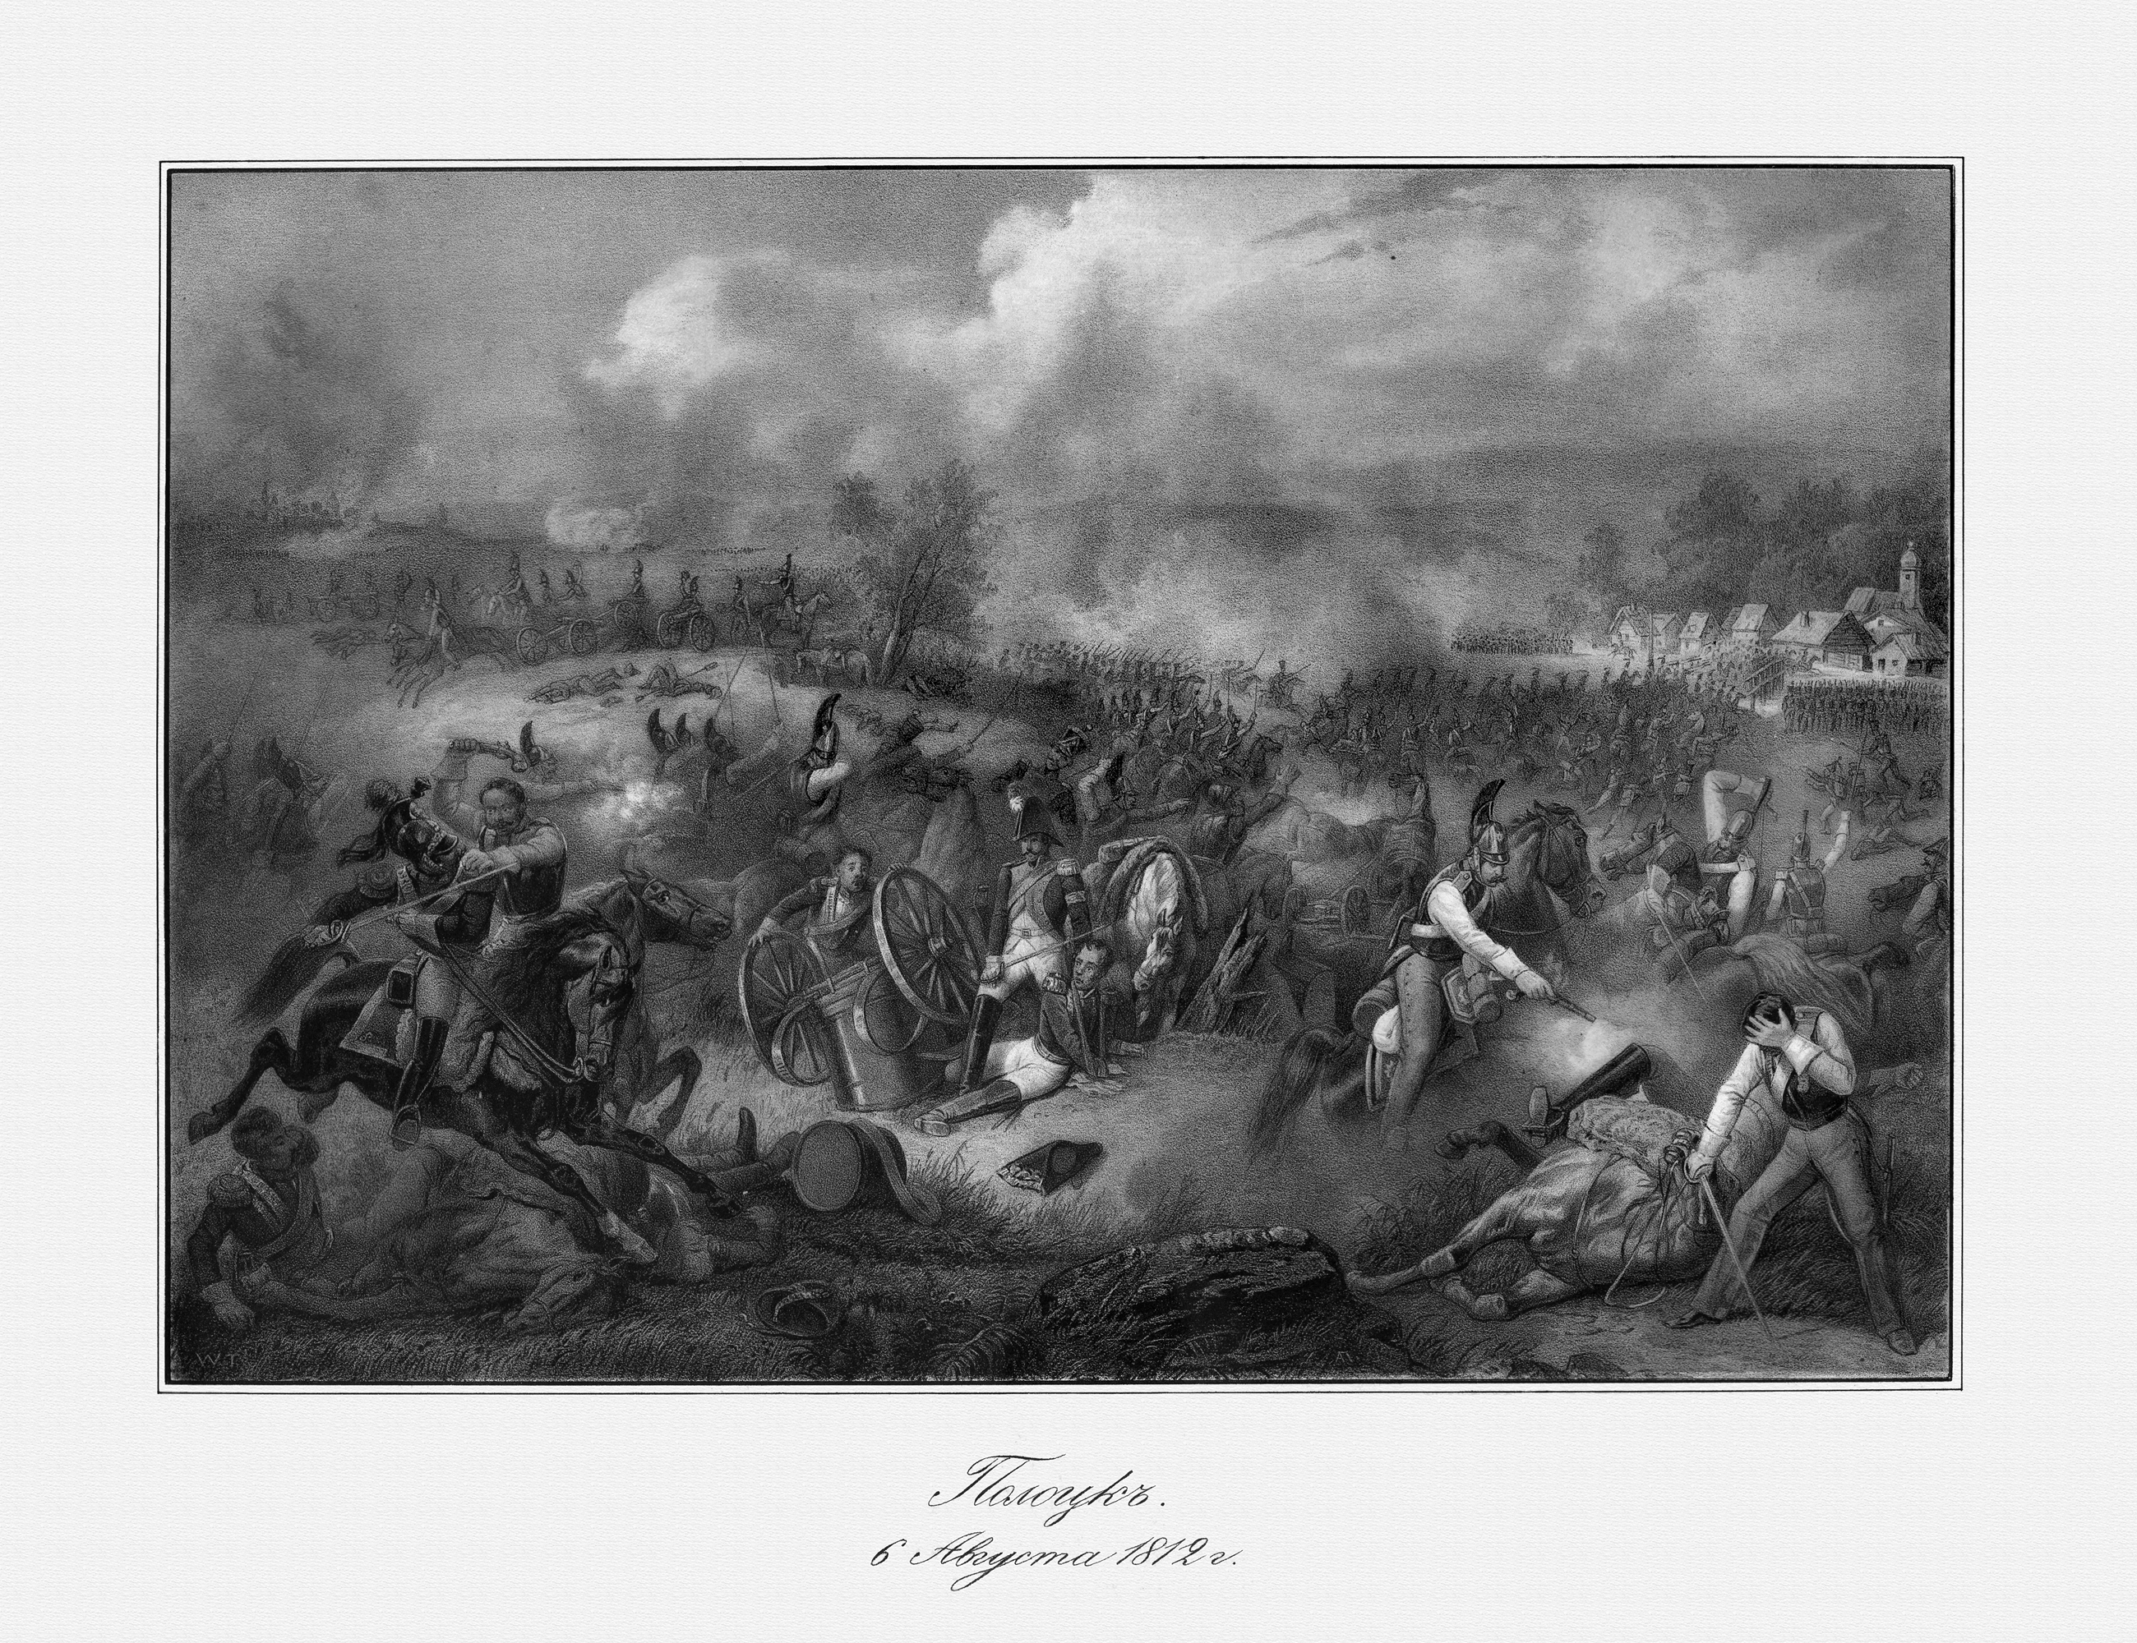
Fall 1812
A combined Russian army
overwhelmed the French
rear guard at Polotsk.
This cut the supply line
to Napoleon’s army.

Slide 6
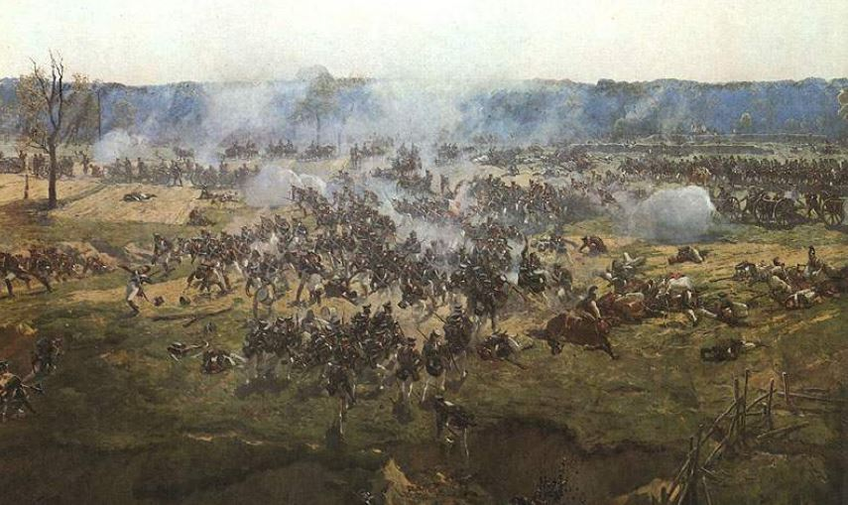
Fall 1812
The Russian army
finally tried to make a stand
at Borodino, near Moscow.

Slide 7
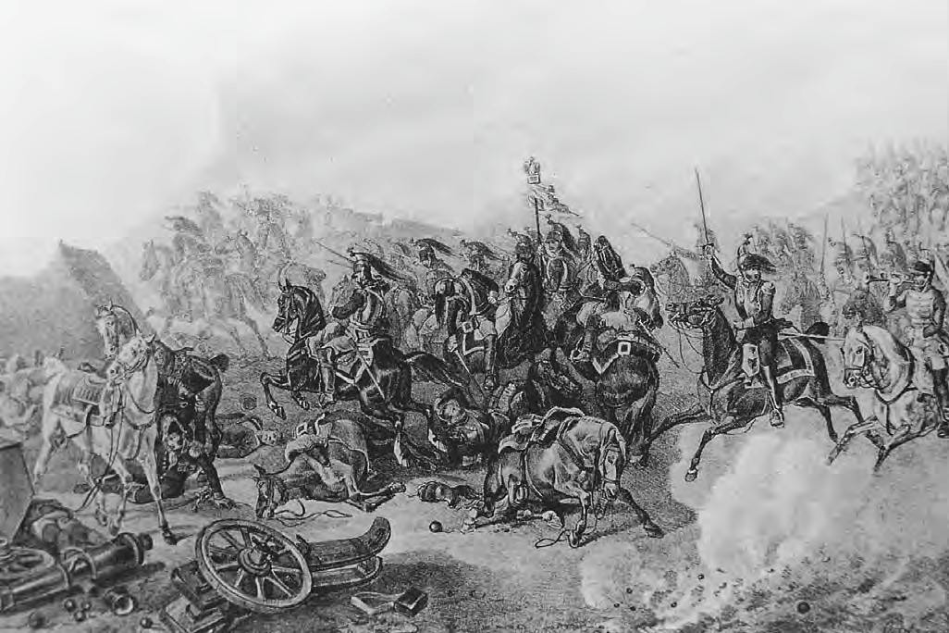
Fall 1812
The Borodino battle
included many
separate fights
over a large area.

Slide 8
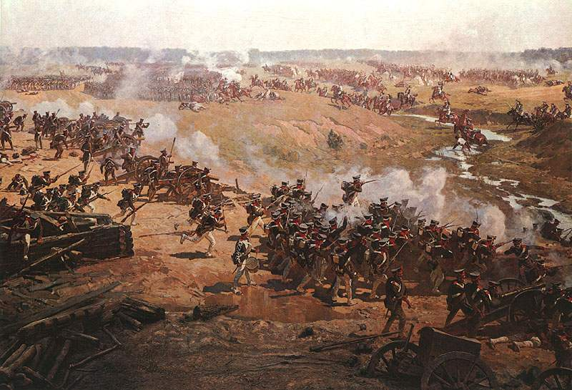
Fall 1812
When the Battle of Borodino
was over, each side had lost
more than 30,000 soldiers.

Slide 9
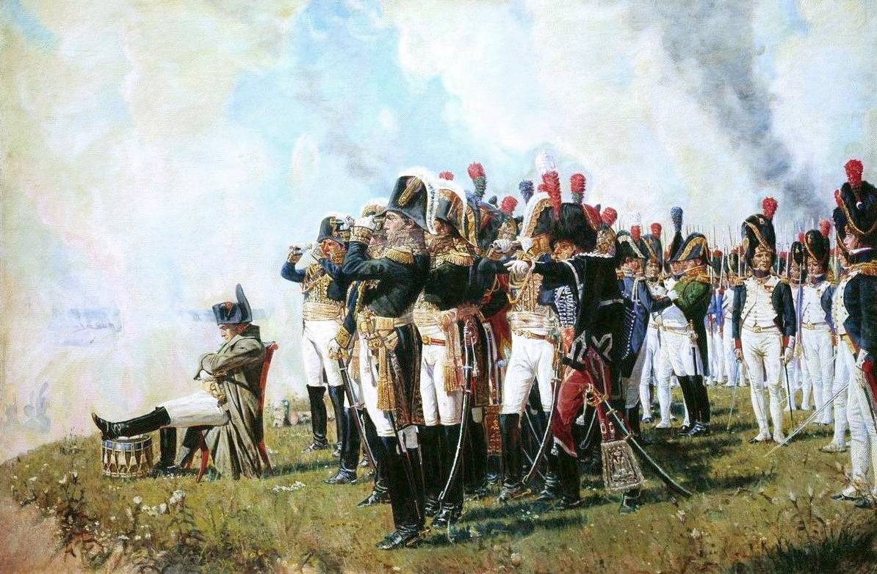
Fall 1812
Napoleon chose not to order
his elite Guard into the battle.
This allowed the Russian army
to escape and burn Moscow.

Slide 10
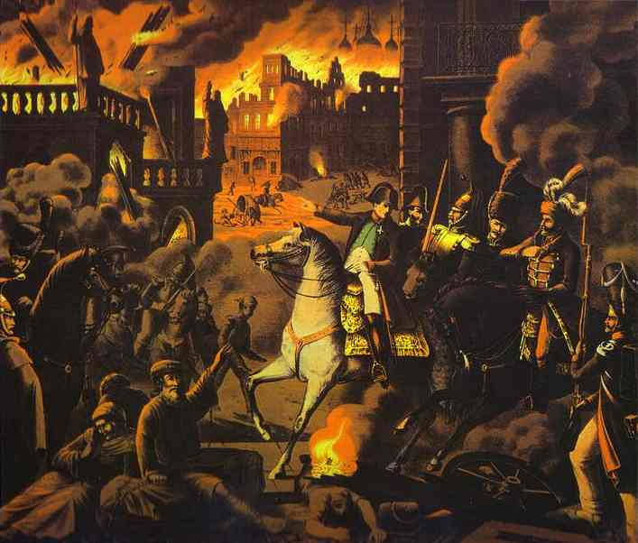
Fall 1812
Napoleon entered Moscow
to find the city was on fire.
Before they left, the Russians destroyed the water system
and all fire-fighting equipment.

Slide 11
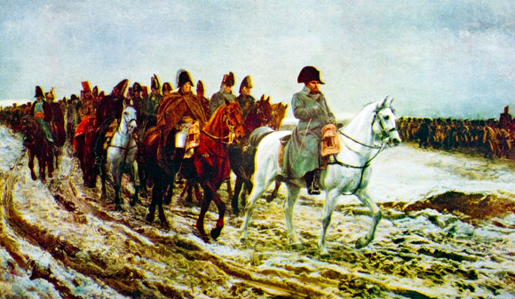
Winter 1812
Napoleon decided to go back
to France, rather than stay
in the burned city of Moscow.

Slide 12
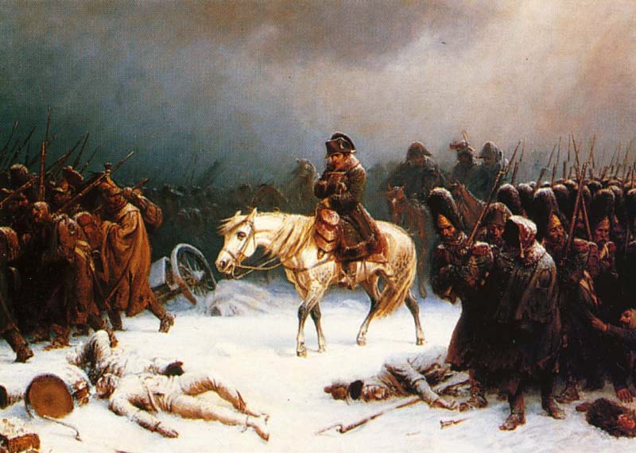
The French were short of food and fuel,
and often attacked by Russian militia.
Thousands were killed, starved to death,
or froze as temperatures stayed below zero.

Slide 13
You can make a map to show the progress
and retreat of the French army.
1. Write the number of troops on the line
by each place listed on the data table or named in the reading.
2. Draw lines between the places to show how the armies moved.
3. Follow the map key and adjust the thickness
of the lines to show the size of the armies.
4. Mark the major battles with a symbol
to show their locations.
5. Compare your map with the famous one
reproduced on the next screen.

