Slide 1
Population Pyramids for Regions in China
Using logical reasoning
to solve a puzzle

Slide 2
Your job is to match four population graphs with the regions in China that they represent. It’s not hard – China has some regions that are very different from each other. It just takes careful logic to discover the clues.

Slide 3
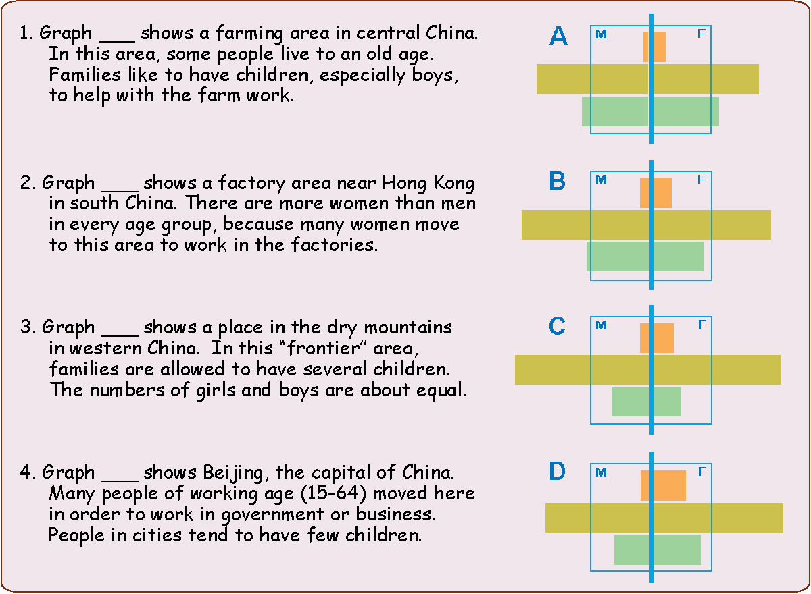

Slide 4
1
What clue
might be
the most obvious
on these
graphs
?

Slide 5
“especially boys”
?
This
might be
a good clue

Slide 6
“especially boys”
?
This
might be
a good clue
BUT
several places
have more boys than girls
BUT
several places
have more boys than girls

Slide 7
“more women”
?
This
might also be a good clue

Slide 8
“more women”
?
This
might also be a good clue

Slide 9
D
X

Slide 10
2
What clue
might be
obvious
on just one
of the graphs
that are left
?
D
X

Slide 11
D
This
might be
a good clue
X

Slide 12
D
This
might be
a good clue
X

Slide 13
X
3
What clue might
help someone match
the last two graphs
?
D
A
X

Slide 14
X
D
A
X

Slide 15
X
D
A
X
C
X

Slide 16
X
D
4
Does the
final graph fit
description #1
?
A
X
C
X

Slide 17
B
D
A
C

Slide 18
This was just one way you might have used logic to match these graphs with the right places.

Slide 19
These regional differences in population age structure are an important part of the geography of China. They influence the economic growth and political stability of different parts of this huge country.

Slide 21
B
D
A
C

