Slide 1
Copyright 2015, P Gersmehl
Trends
in
Food Production
Comparing China, India,
and East Africa

Slide 2
Once upon a time,
some teachers were thinking about
a Michigan Grade Level Content Expectation:
GLCE 6 – G1.2.3
Use, interpret, and create graphs representing population characteristics, natural features, and [human features] of the region under study.
Common Core Math Standard 6.EE-9.
Use variables to represent two quantities in a real-world problem that change in relationship to one another . . . Analyze the relationship between the dependent and independent variables using graphs and tables.
Common Core ELA Writing Standard 61b.
Support claim(s) with clear reasons and relevant evidence.

Slide 3
Once upon a time,
some teachers were thinking about
a Michigan Grade Level Content Expectation:
To meet these standards,
students need to understand
what a graph is trying to show.
GLCE 6 – G1.2.3
Use, interpret, and create graphs representing population characteristics. natural features, and [human features] of the region under study.
Common Core Math Standard 6.EE-9.
Use variables to represent two quantities in a real-world problem that change in relationship to one another . . . Analyze the relationship between the dependent and independent variables using graphs and tables.
Common Core ELA Writing Standard 61b.
Support claim(s) with clear reasons and relevant evidence.

Slide 4
Part 1:
Food Production

Slide 5
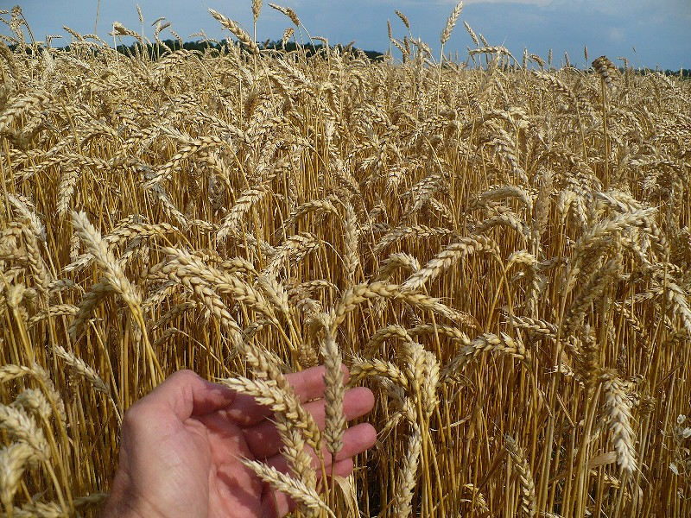
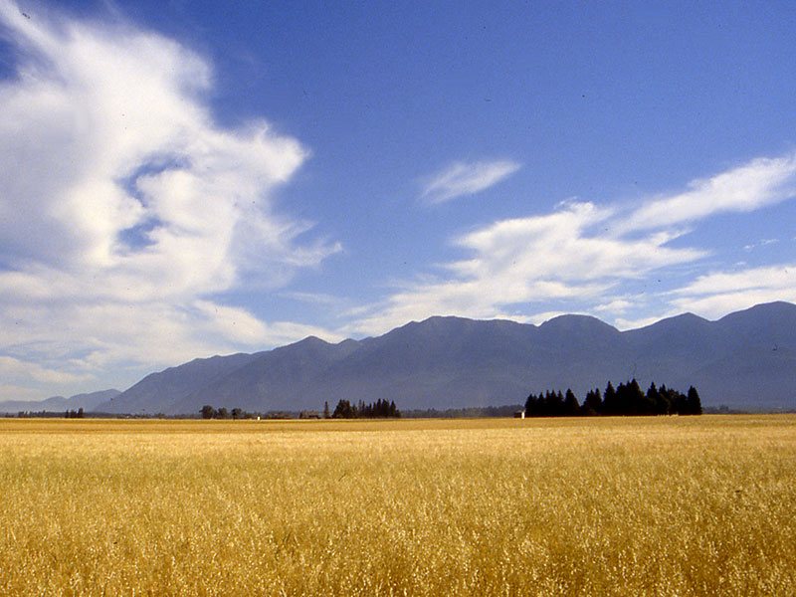
Some food producers
raise wheat for bread on huge fields.
Oregon

Slide 6
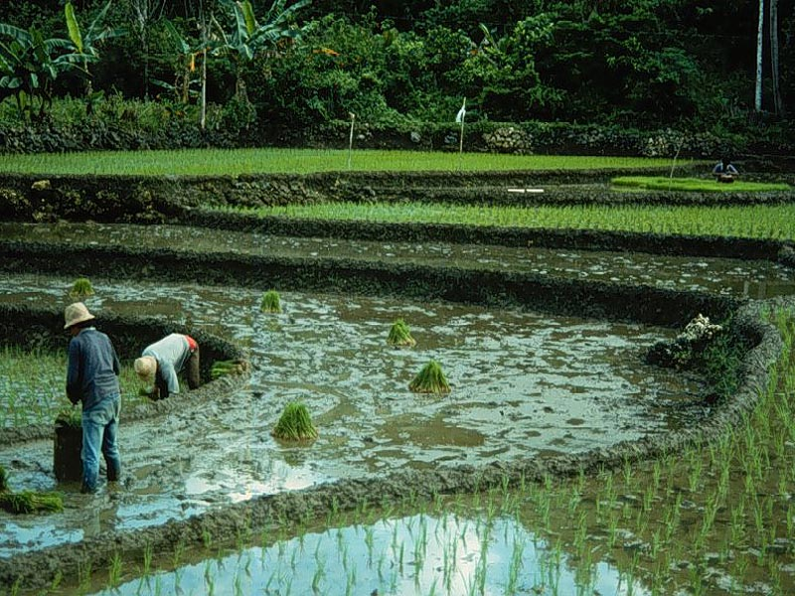
Some food producers
raise rice on small fields
with a lot of hand labor.
Philippines

Slide 7
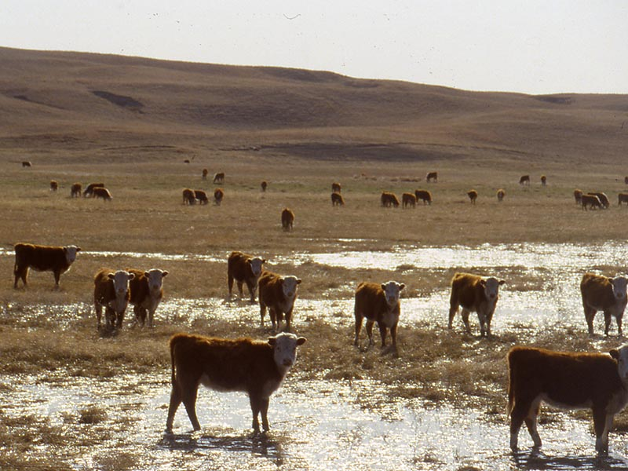
Some food producers
raise cattle for meat on huge ranches.
The cattle walk around and eat grass.
Nebraska Sandhills

Slide 8
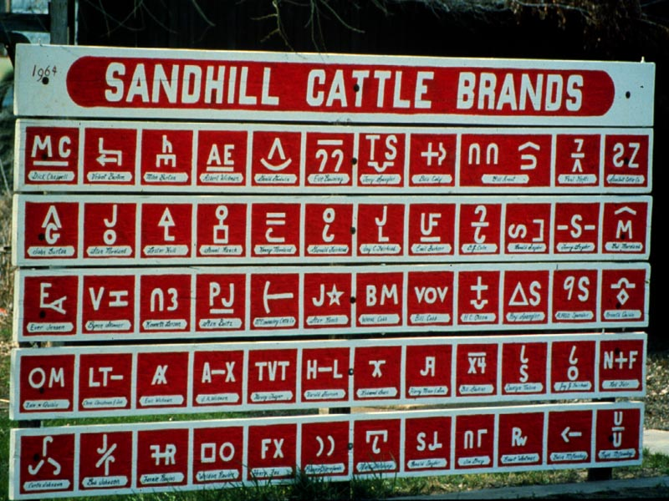
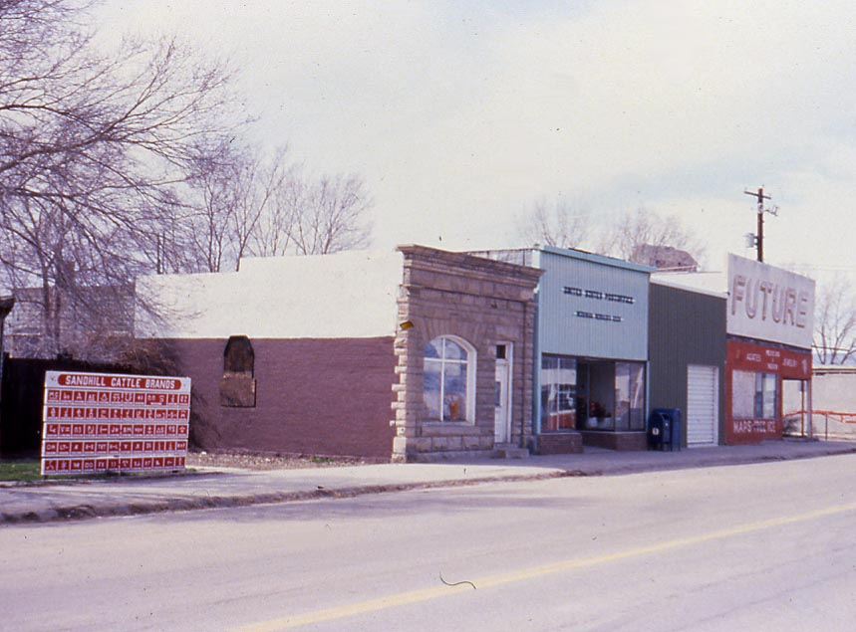
“Main street” in a small town in ranch country.
Bank, post office, general store, and a sign.

Slide 9
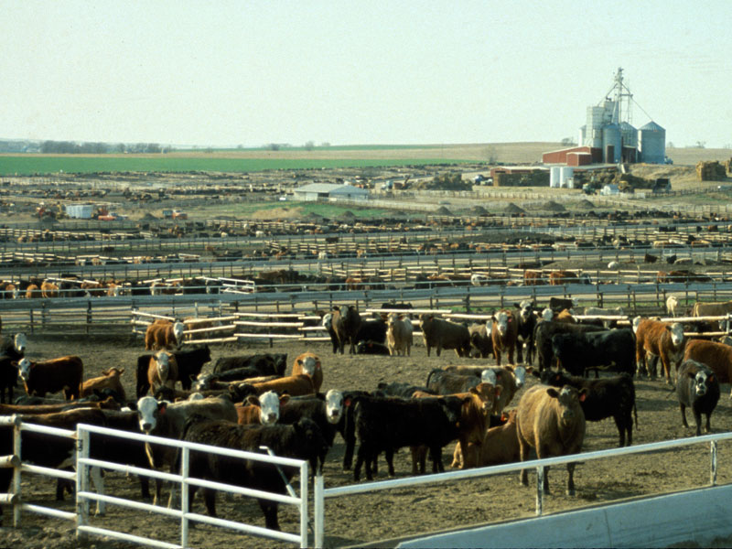
Some food producers
raise cattle for meat in feedlots.
They bring grain to the cattle in trucks.
western Kansas

Slide 10
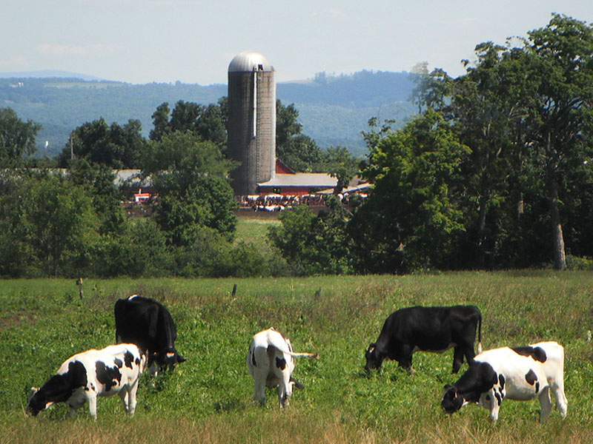
Some food producers
raise cattle for milk on small farms.
They store hay in concrete silos.
upstate New York

Slide 11
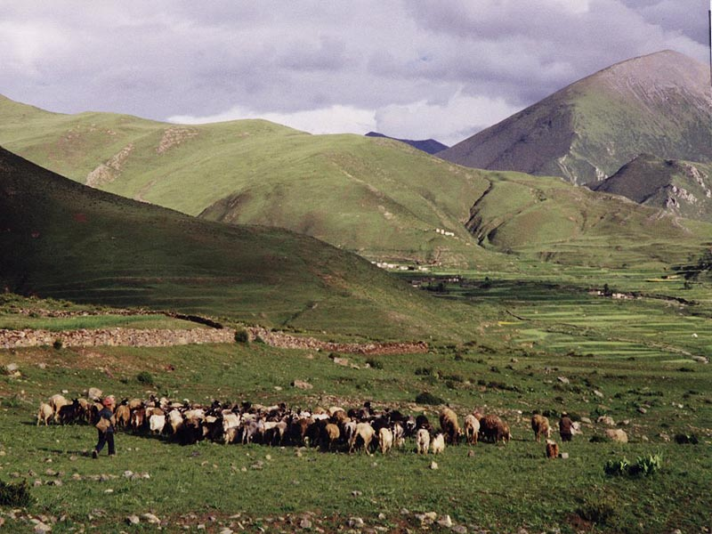
Some food producers
raise sheep on high
mountain pastures.
Tibet (in central Asia)

Slide 12
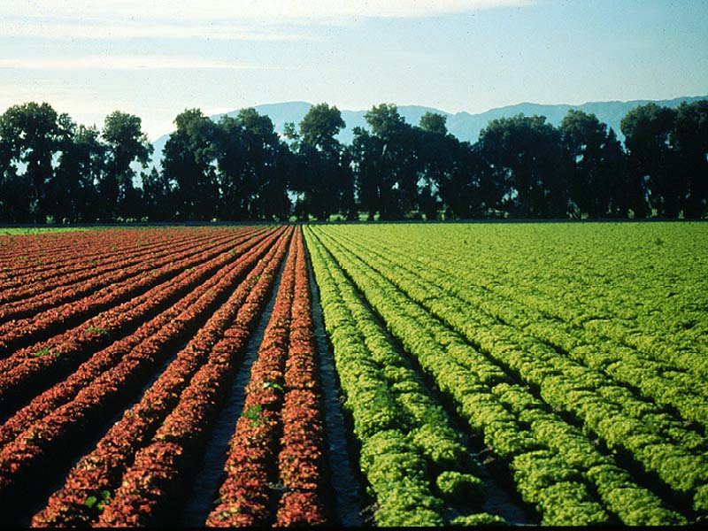
Some food producers
raise “specialty crops” like lettuce.
southern California

Slide 13
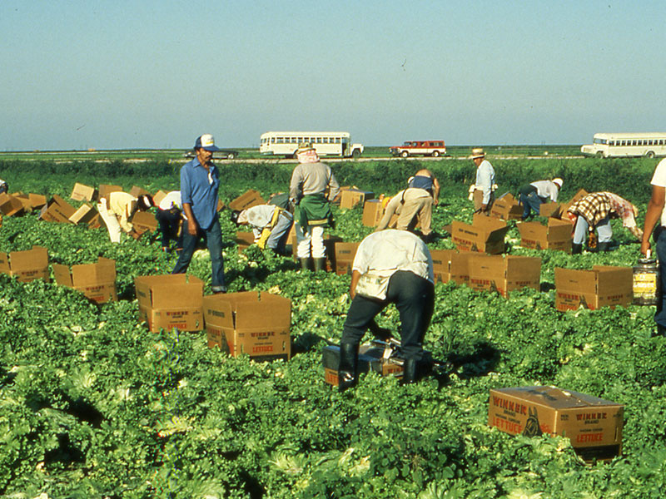
Specialty crops usually require
a lot of hand labor to pick
the crop when it is ripe.
southern California

Slide 14
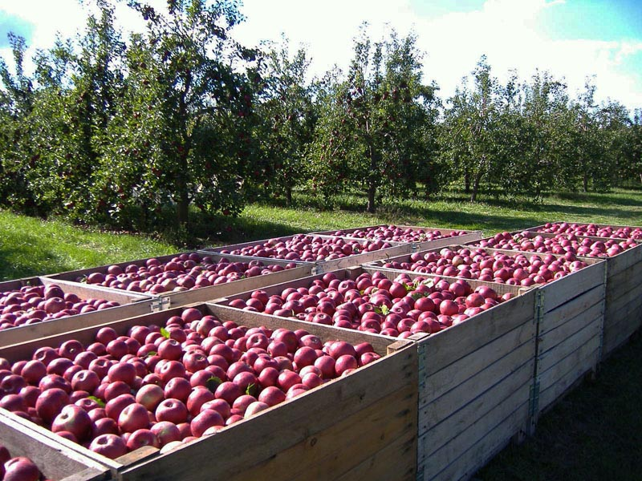
Some food producers
raise fruits that grow on trees.
upstate New York

Slide 15
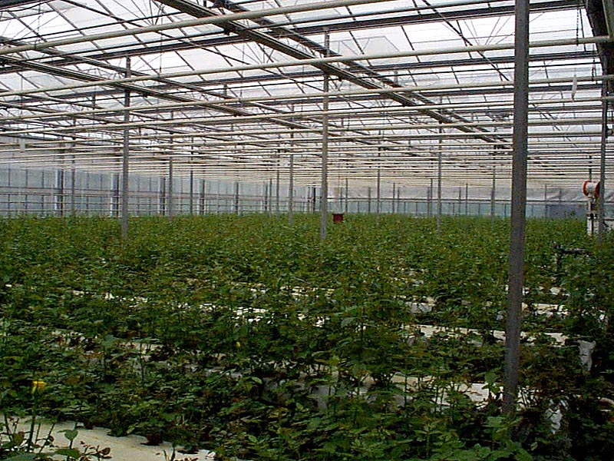
Others raise vegetables
in heated greenhouses
when it is too cold outside.
South Korea

Slide 16
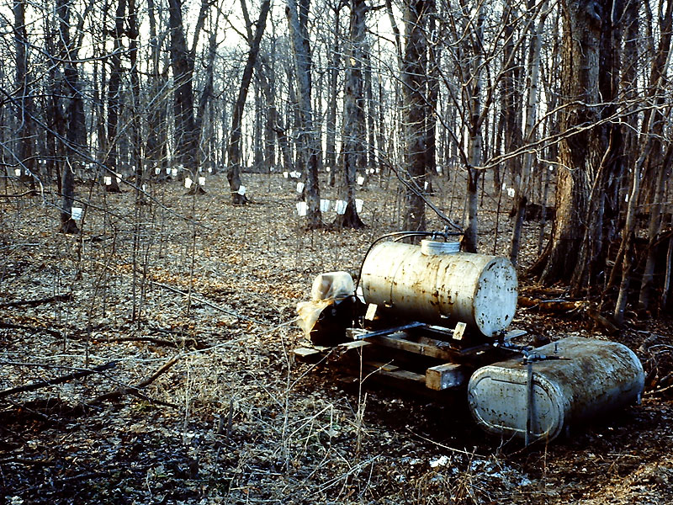
A few food producers
tap the sap from maple trees
to make syrup for pancakes.
southern Michigan

Slide 17
In short, . . . .
there are many different kinds
of food production.
If we want to compare countries,
to see where people
have enough to eat,
we have to figure out
how to “add up”
all these different kinds
of food production.

Slide 18
Part 2:
Food Trends
in China, India,
and East Africa

Slide 19
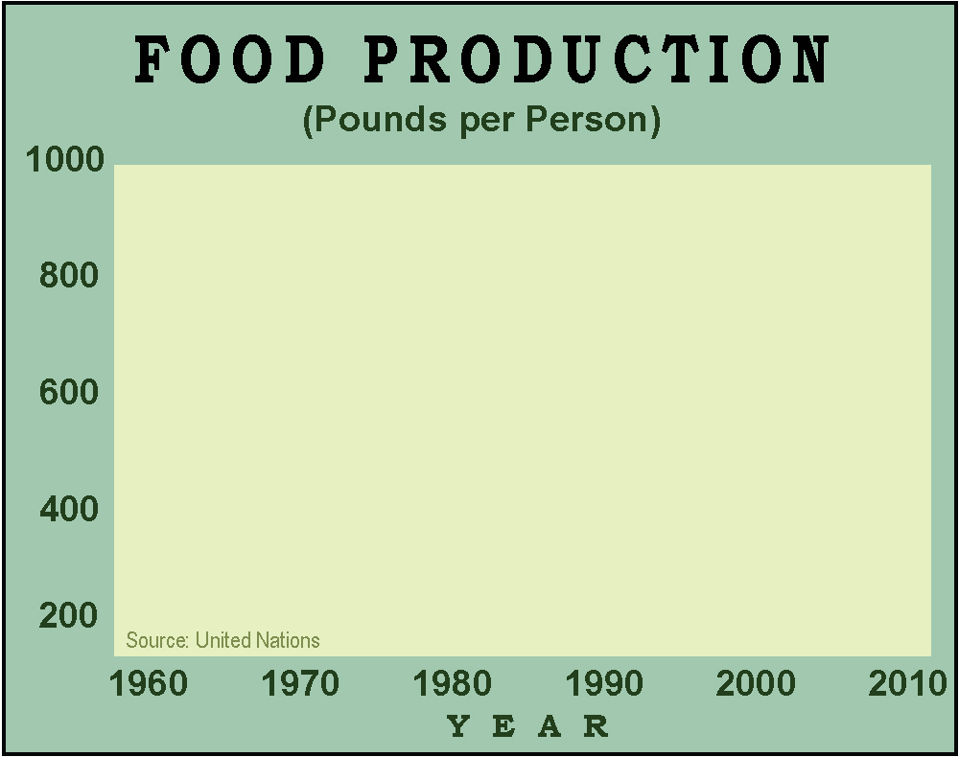
We will use
a simple measure:
pounds of food
per person.

Slide 20
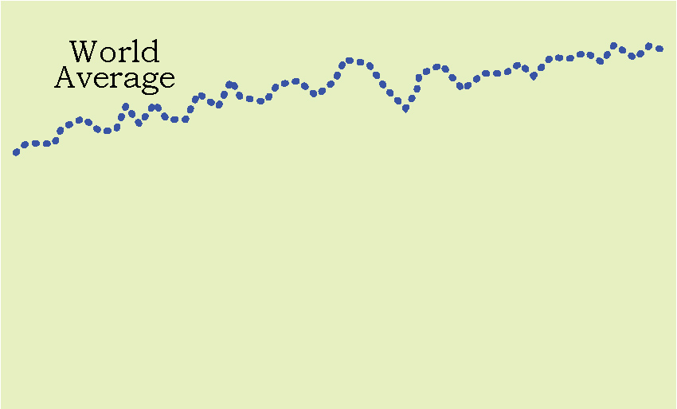
How would you describe
the trend shown on this graph?

Slide 21
Here’s one way:
“Food production per person
has gone up since 1960.”

Slide 22
During this time period, world population doubled,
from 3.4 billion in 1965 to 7 billion in 2010.
BUT
Food production must have gone up even more, . . .
Why?

Slide 23
because the average person had more to eat
in 2010 than in 1960
That is
good news!
During this time period, world population doubled,
from 3.4 billion in 1965 to 7 billion in 2010.
BUT
Food production must have gone up even more, . . .
Why?

Slide 24
To understand a graph, you have to read the title carefully.

Slide 25
In 1960, food production per person
in China, India, and East Africa
was roughly the same – a bit more
than half of the word average.

Slide 26
Since 1960, farmers in each region have doubled their food production.
Food production per person, however,
has been different in these regions.
In 1960, food production per person
in China, India, and East Africa
was roughly the same – a bit more
than half of the word average.

Slide 27
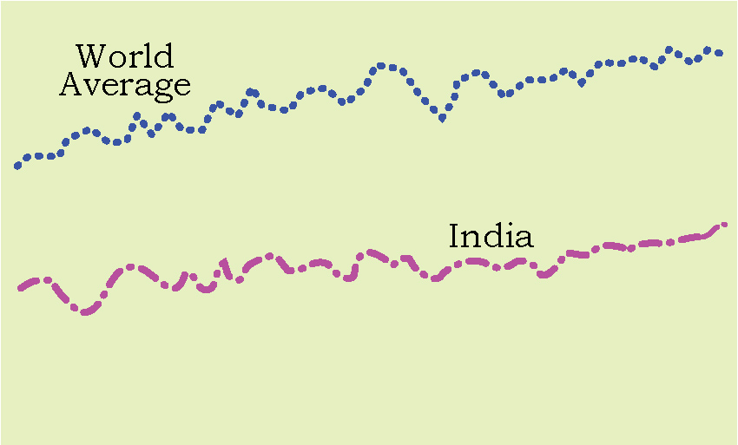
How would you describe
what happened in India?

Slide 28
In India,
food production per person
went up about the same
as the world average.
Both lines went up
roughly parallel.

Slide 29
In India,
food production per person
went up about the same
as the world average.
Both lines went up
about the same.
In other words,
the average person in India
started with about half as much food
as the average for the world in 1960,
and ended with about half the average in 2010.

Slide 30
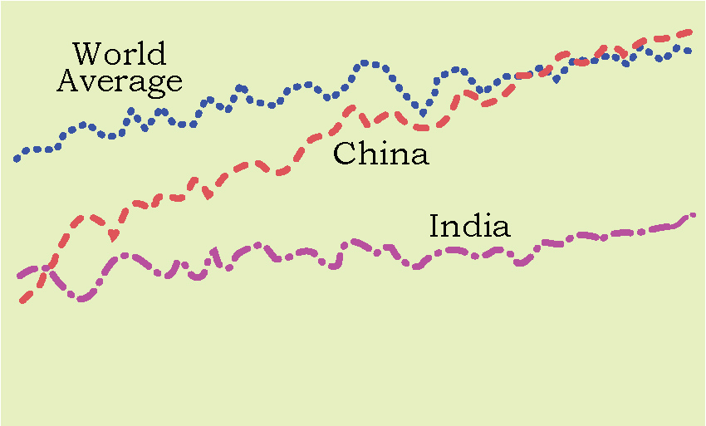
Now we have added a line for China.
How would you describe its trend?

Slide 31
In China,
food production per person
went up more than in most places.
It started about half the world average
and ended above the world average.
That is
a spectacular
achievement!

Slide 32
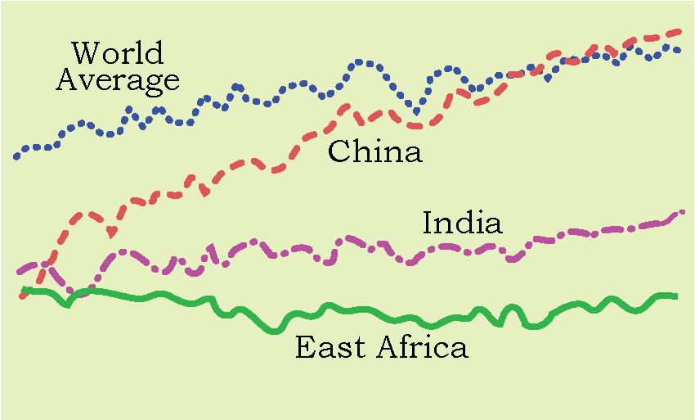
Now we have added a line for East Africa.
How would you describe its trend?

Slide 33
Total food production in
East Africa has gone up,
but production per person
has not changed much
since 1960.

Slide 34
Part 3:
Explaining Differences
in Food Production
Per Person

Slide 35
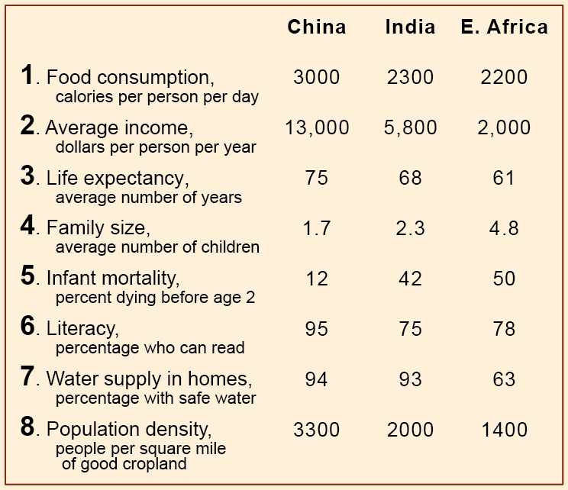
Here’s the table of data
in your handout.
Which line (1-8)
has the information
that is most useful
in explaining the trend
in food production
per person?

Slide 37
Line 1
just
describes
the result,
it doesn’t
explain it.

Slide 38
Line 8
seems odd.
You’d think
with more
land,
people
could grow
more food.

Slide 39
Line 7
is important,
but it is not
related
to food
production.

Slide 40
Line 2
tells you
that people
in China
can buy
more food,
but that
does not
explain
the trend in production
per person.

Slide 41
Line 6
is important,
but it is not
directly
related to
the amount
of food.

Slide 42
Line 3
is a result
of having
more food, not a cause.

Slide 43
Line 5
is also
a result
of having
more food, not a cause.

Slide 44
Line 4 is the key.
If people have a lot of children,
food per person can go down,
even if total food production goes up.

Slide 45
This is not easy.
When you see a bunch of numbers,
it can be hard to decide
what is useful information
and what is just a bunch of numbers.
But things like this come up
in news reports, stock markets,
and political campaigns.
It’s like a citizenship skill !

Slide 46
This is not easy.
When you see a bunch of numbers,
it can be hard to decide
what is useful information
and what is just a bunch of numbers.
But things like this come up
in news reports, stock markets,
and political campaigns.
To avoid being misled, you need to know
how to get the right message from a graph.

Slide 47
Here is the main point
about production per person.
If the production of something
goes up in a country
(or state, or town, or family)
but the number of people
goes up even faster,
the amount per person
goes down.

Slide 48
Copyright 2015, Phil Gersmehl
Teachers who saw this presentation at a workshop
or downloaded it from our internet site have permission
to make a copy on their own computers for these purposes:
1. to help them review the workshop,
2. to show to colleagues or administrators,
3. to show the presentation in their own classrooms or at sessions they lead at teacher conferences,
4. to use individual frames (with attribution) in their own class or conference presentations.
For permission for any other use,
including posting frames on a personal blog or uploading to any network or website,
contact pgersmehl@gmail.com

