Slide 1
Comparing China with the United States
In this lesson, you will learn
how to find analogous places
in two different countries
and you will learn
what “analogous places” means!

Slide 2
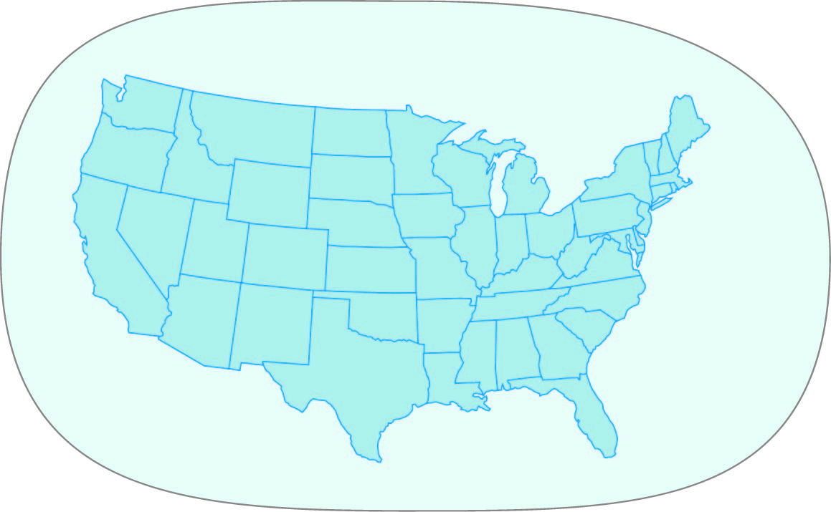
Here is a map
of the United States,
all by itself.

Slide 3
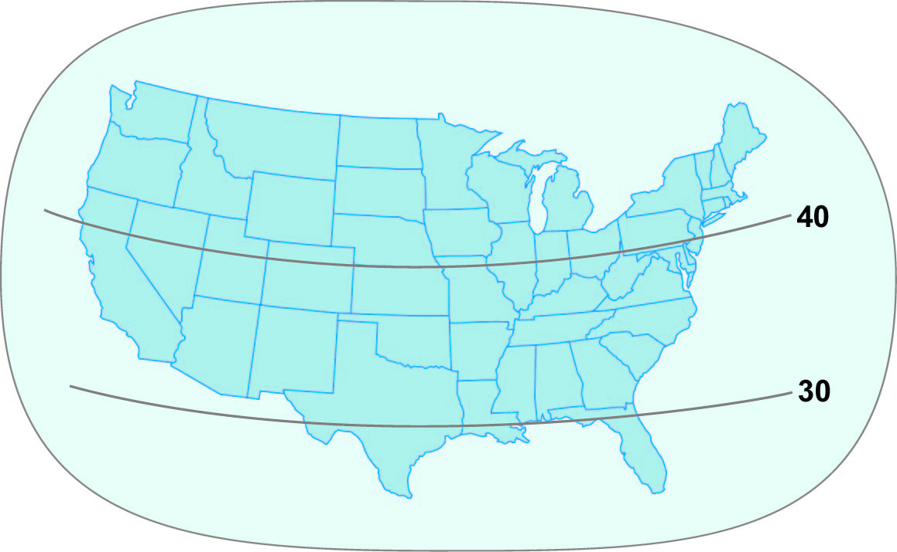
Now we have added
two important lines.
Do you know what they are?

Slide 4
These are latitude lines.
Latitude is a measure of distance,
like giant steps away from
a line called the Equator.

Slide 5
40 giant steps
of latitude
away from
the Equator
These are latitude lines.
Latitude is a measure of distance,
like giant steps away from
a line called the Equator.

Slide 6
More than 40 latitude steps
away from
the Equator
40 giant steps
of latitude
away from
the Equator
These are latitude lines.
Latitude is a measure of distance,
like giant steps away from
a line called the Equator.

Slide 7
More than 40 latitude steps
away from
the Equator
40 giant steps
of latitude
away from
the Equator
These are latitude lines.
Latitude is a measure of distance,
like giant steps away from
a line called the Equator.
Less than 30 latitude steps
away from
the Equator

Slide 8
More than 40 latitude steps
away from
the Equator
40 giant steps
of latitude
away from
the Equator
Between
30 and 40
latitude steps
away from
the Equator
These are latitude lines.
Latitude is a measure of distance,
like giant steps away from
a line called the Equator.
Less than 30 latitude steps
away from
the Equator

Slide 9
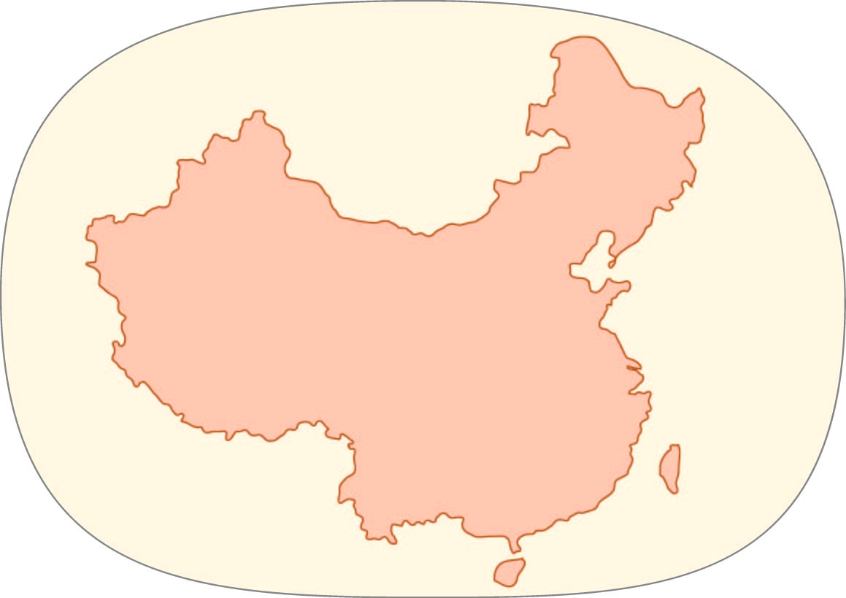
Here is a map
of a country called China,
all by itself.

Slide 10
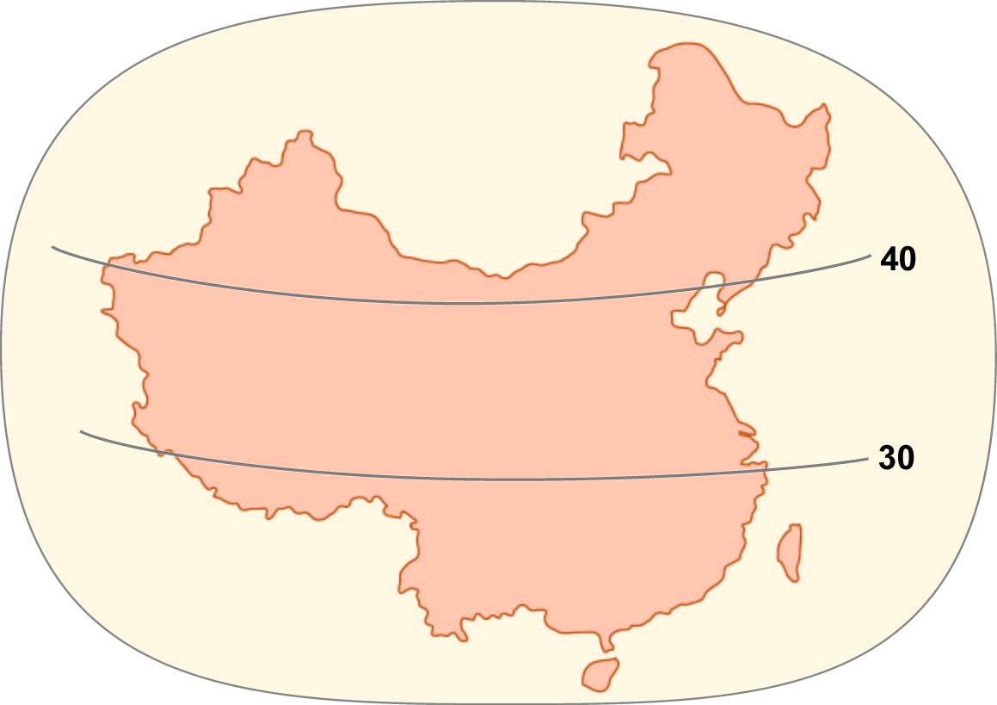
Now we have added
two latitude lines
to the China map.

Slide 11
Some of China is
more than 40 latitude steps
away from
the Equator
Now we have added
two latitude lines
to the China map.

Slide 12
Some of China is
more than 40 latitude steps
away from
the Equator
Some of China is
fewer than 30 latitude steps
away from
the Equator
Now we have added
two latitude lines
to the China map.

Slide 13
Some of China is
more than 40 latitude steps
away from
the Equator
And a lot
of China is
between
30 and 40 latitude steps
away from
the Equator
Some of China is
fewer than 30 latitude steps
away from
the Equator
Now we have added
two latitude lines
to the China map.

Slide 14
Here are the two countries, side by side.
We are going to compare them
in several different ways.

Slide 15
First, let’s compare their sizes.
Is China much smaller than the United States?
Is it much larger? Or are they about the same size?

Slide 16
Now we have added the latitude lines again.
How can these help us compare the countries?

Slide 17
Places that are more than 40 latitude steps
away from the Equator are usually
hot in summer and cold in winter.
Both countries have some places like that!

Slide 18
Places that are closer than 30 latitude steps
away from the Equator are usually hot all year –
in summer and in winter.
Which country has more places like that?

Slide 19
In the United States,
just a few small areas in
Texas, Louisiana, and Florida
Places that are closer than 30 latitude steps
away from the Equator are usually hot all year –
in summer and in winter.
Which country has more places like that?

Slide 20
In the United States,
just a few small areas in
Texas, Louisiana, and Florida
In China, a big area
in the southeastern part
of the country
Places that are closer than 30 latitude steps
away from the Equator are usually hot all year –
in summer and in winter.
Which country has more places like that?

Slide 21
Places that are between 30 and 40 degrees of latitude
away from the Equator tend to be hot in summer
and cool in winter (not really cold).

Slide 22
Temperature is really important –
so you should make your own map
to help you remember.

Slide 23
*
*
*
*
*
*
*
*
*
*
*
For example, you could add some snowflake symbols
in the areas where it is really cold in winter.

Slide 24
*
*
*
*
*
*
*
*
*
*
*
There are places where it does not get cold in winter.
Think of a symbol to represent warm winters
and put your symbol in places that are
less than 30 degrees of latitude from the Equator.
Hint: think of some things you like to do when it is not too hot or cold. People in those places can do those things when it is cold winter in Detroit.

Slide 25
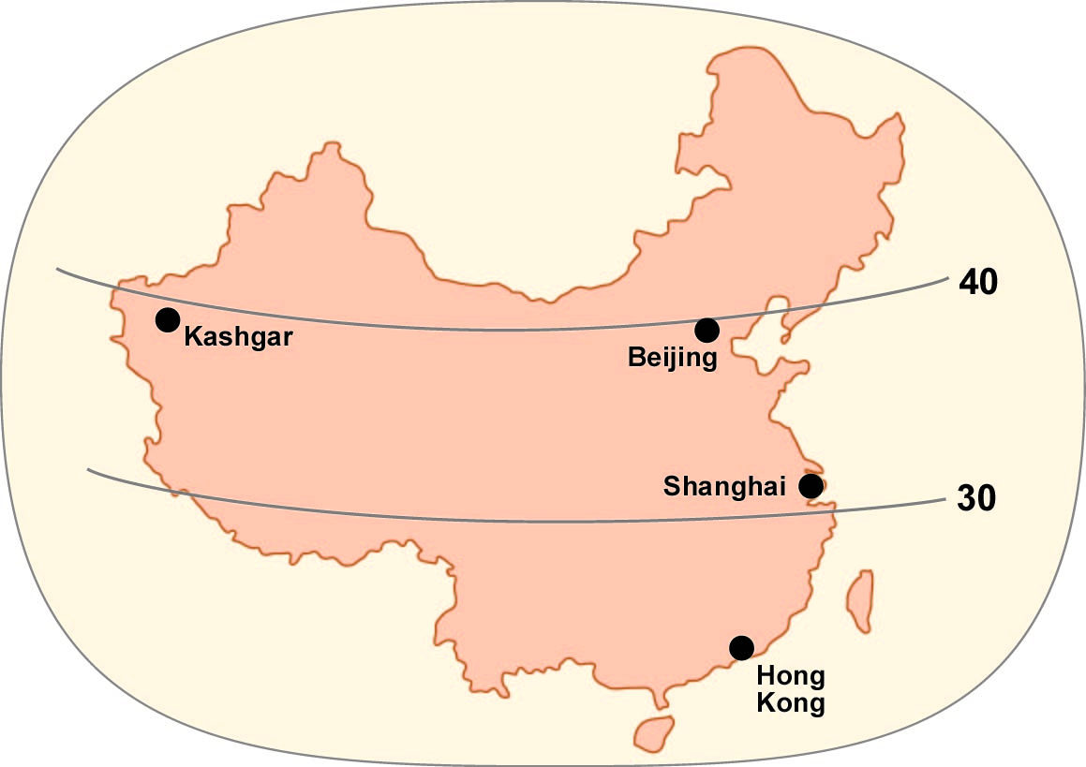
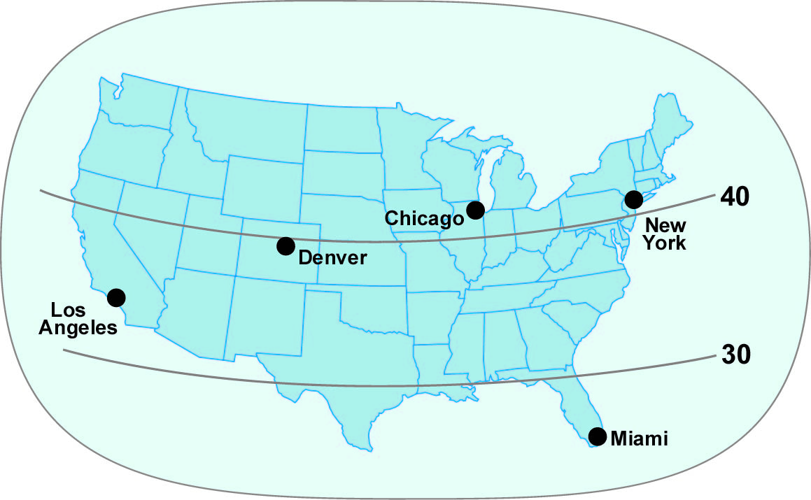
Now we have added some important cities
to the maps of the United States and China.
We have some questions to ask you
about these cities.

Slide 26
New York City is located near the east coast
about 40 degrees of latitude north of the Equator.
What city in China is located in a similar position
(close to the east coast and about the same latitude)?

Slide 27
Because they are located at a similar latitude,
both New York and Beijing have
hot summers and cold winters.

Slide 28
Because they are located at a similar latitude,
both New York and Beijing have
hot summers and cold winters.
AND, because they are both close to an ocean,
they both get plenty of rain and snow.

Slide 29
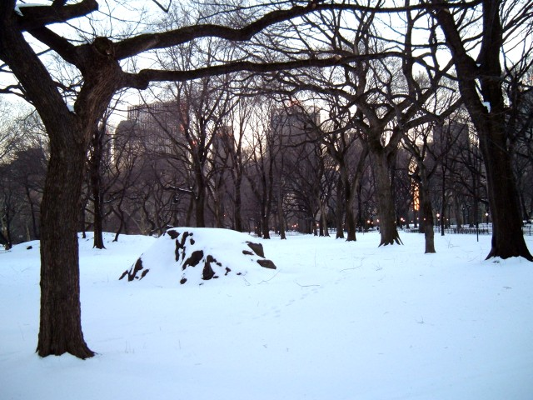
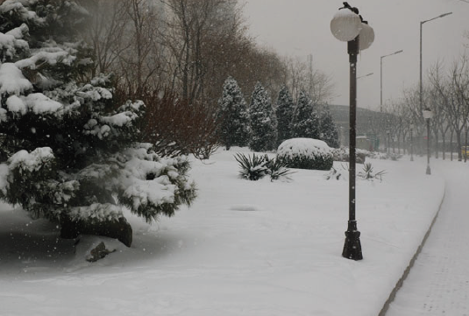
Snow in New York
(photo by P Gersmehl)
Snow in Beijing
(photo by Scott Meltzer)

Slide 30
Miami is also located on the east coast.
It is less than 30 degrees of latitude from the Equator.
Therefore it has high temperatures
in both summer and winter.

Slide 31
Miami is also located on the east coast.
It is less than 30 degrees of latitude from the Equator.
What city in China has a similar location
relative to the east coast and the Equator?

Slide 32
Both Miami and Hong Kong are hot and rainy.
They also have one more similarity.

Slide 33
Both Miami and Hong Kong are hot and rainy.
Both cities can have hurricanes in the autumn.
What do you know about hurricanes?

Slide 34
Hurricanes are storms with really strong winds
and big waves on the ocean.
They can do a lot of damage to places
that are not well protected.

Slide 35
Do you remember the big new word
that we used in the title of this lesson?

Slide 36
Do you remember the big new word
that we used in the title of this lesson?
Miami and Hong Kong have analogous locations -
they are at the same latitude and near a coast.

Slide 37
Do you remember the big new word
that we used in the title of this lesson?
Miami and Hong Kong have analogous locations -
they are at the same latitude and near a coast.
It is like you and your friend both put your books
in the lower right corner of your desk.
Those books are in analogous locations.

Slide 38
On a map, you could say that
Miami and Hong Kong are both located
in the lower right corner of their country.

Slide 39
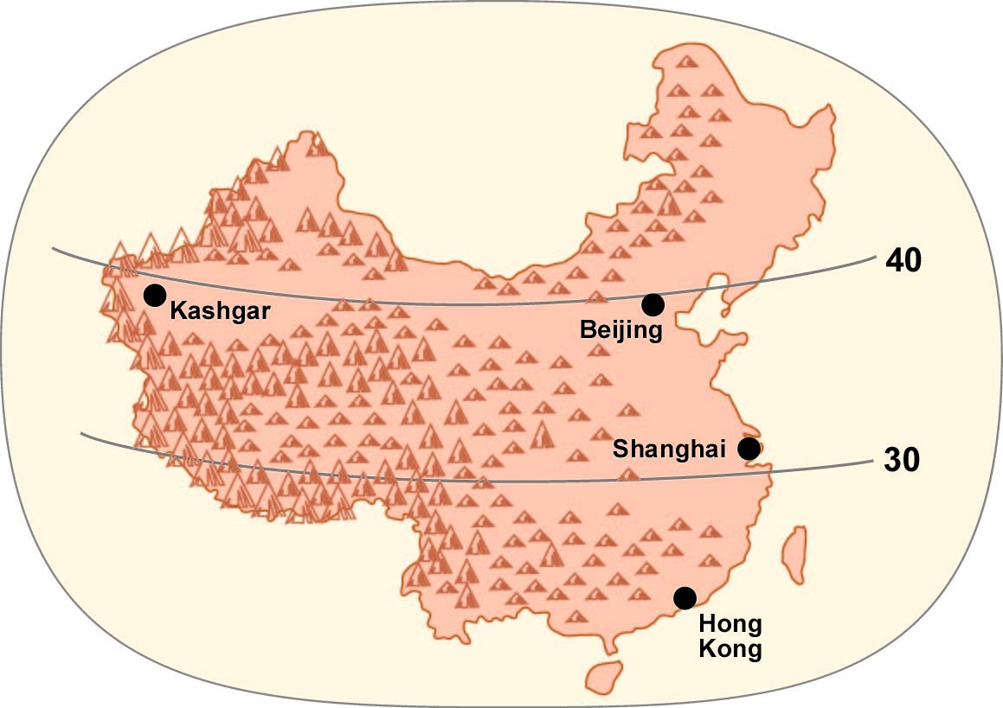
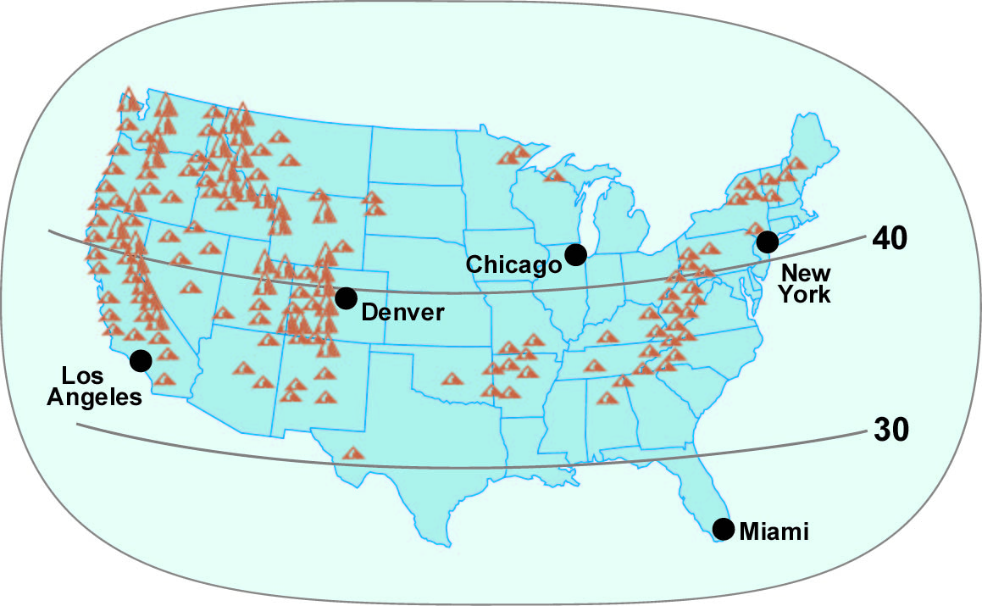
The maps now have some mountain symbols on them.
These will help us show another example
of two cities with analogous locations.

Slide 40
Kashgar is an important city in Chinese history.
How would you describe its location?

Slide 41
Kashgar is an important city in Chinese history.
It is located near the 40-degree latitude line,
far from the East Coast, close to high mountains.

Slide 42
Kashgar was
an important city
on the ancient
Silk Road from
China to Rome.
Kashgar is an important city in Chinese history.
It is located near the 40-degree latitude line,
far from the East Coast, close to high mountains.

Slide 43
Kashgar was
an important city
on the ancient
Silk Road from
China to Rome.
You will learn more
about the Silk Road
in 7th grade.
But even now, you can
tell people something
about Kashgar.
Kashgar is an important city in Chinese history.
It is located near the 40-degree latitude line,
far from the East Coast, close to high mountains.

Slide 44
Kashgar is an important city in Chinese history.
First, ask yourself - what city in the United States
has an analogous location?
Hint: look for similar latitude, distance, mountains.

Slide 45
Kashgar is an important city in Chinese history.
Denver is a big city with an analogous location
in the United States.

Slide 46
Kashgar is an important city in Chinese history.
Without ever visiting Kashgar,
you can still say something true about it.

Slide 47
You can say that Kashgar and Denver
have analogous locations,
and therefore they probably also have
similar weather and scenery.

Slide 48
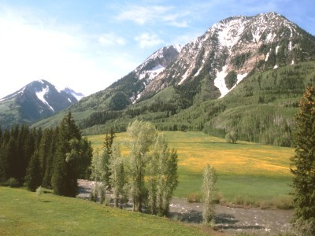
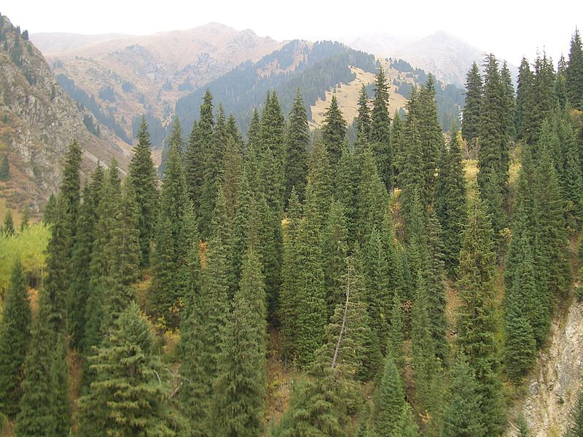
Mountain near Denver
(photo by P Gersmehl)
Mountain near Kashgar
(photo by User:Vmenkov)

Slide 49
One final question, to make sure
you understand the idea of analogous location.
Does China have a city that is
analogous to Los Angeles?

Slide 50
No - because China has only one ocean near it.
Unlike the United States,
China does not have a “West Coast.”
Therefore, it cannot have a “West Coast city”
like Los Angeles.

Slide 51
Remember, when it comes to location,
latitude, mountains, weather, and scenery,
many cities in China are like cities in the U.S...
Beijing is like New York . . . cold in winter
Hong Kong is like Miami . . . hot all year, with hurricanes!
Kashgar is like Denver . . . high mountains nearby
but no city in China is like Los Angeles
(because China doesn’t have an ocean on its west side)

Slide 52
Copyright 2014, Phil Gersmehl
Teachers who saw this presentation at a workshop
or downloaded it from our internet site have permission
to make a copy on their own computers for these purposes:
1. to help them review the workshop,
2. to show to colleagues or administrators,
3. to show the presentation in their own classrooms or at sessions they lead at teacher conferences,
4. to use individual frames (with attribution) in their own class or conference presentations.
For permission for any other use,
including posting frames on a personal blog or uploading to any network or website,
contact pgersmehl@gmail.com

