Slide 1
European Colonies
How did a group of small countries
(less than 5 percent of the world)
claim the legal right to rule over
more than 80 percent of the world?

Slide 2
Powerful countries have claimed colonies
far from their homeland for a long time –
at least since the ancient Phoenicians,
Greeks, Romans, South Asians, and Chinese.
In the 1400s, however, advances in shipbuilding, navigation, storage, and weapons technology
allowed some countries with good ports
to venture far across the sea and claim land.

Slide 3
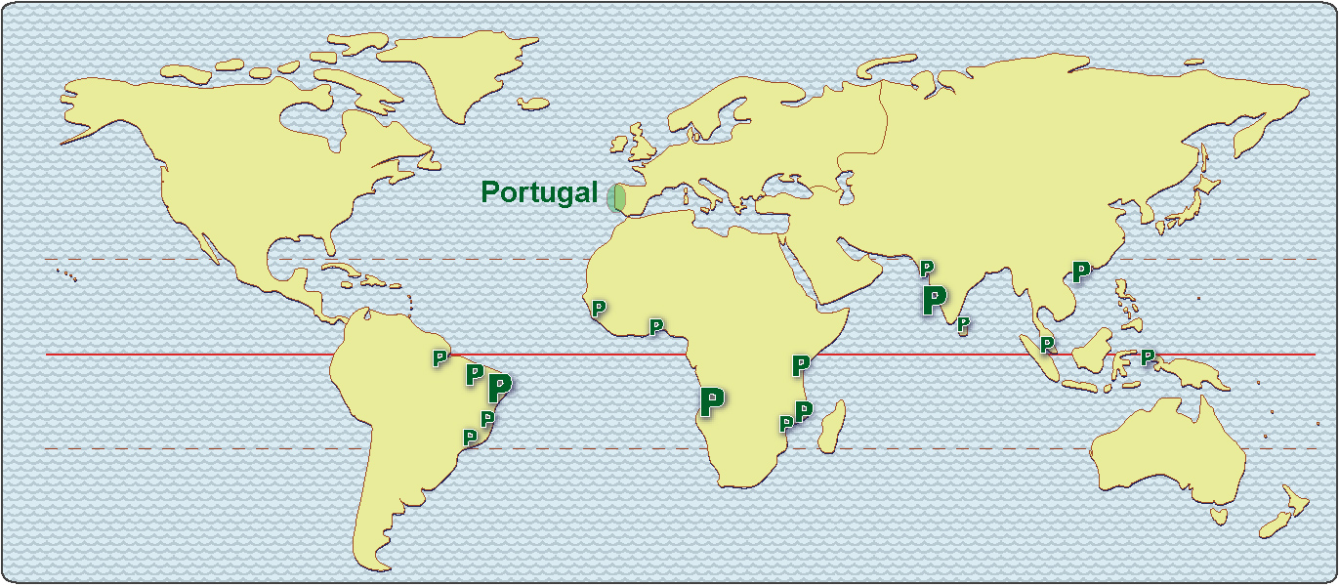
The tiny country of Portugal, for example,
claimed land in South America, Africa,
South Asia, and “the East Indies” (Indonesia).

Slide 4
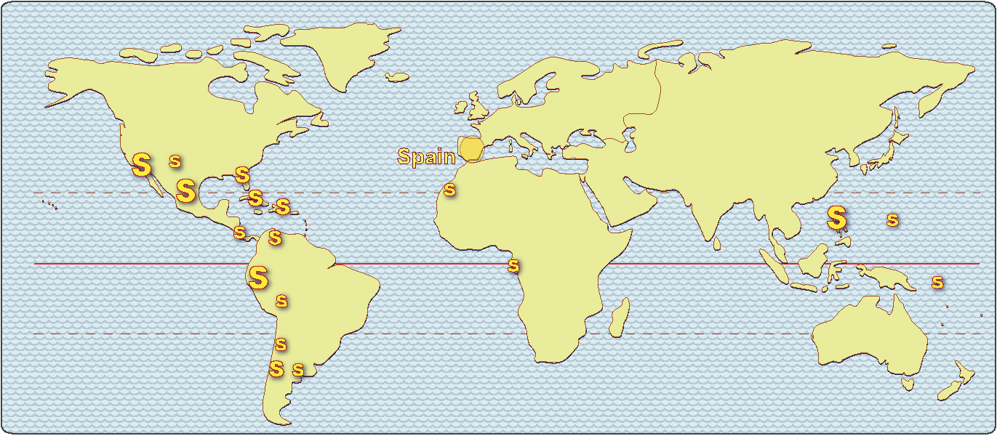
Portugal’s larger neighbor, Spain,
claimed a lot of land in the Americas
and a little in Africa and the Philippines.

Slide 5
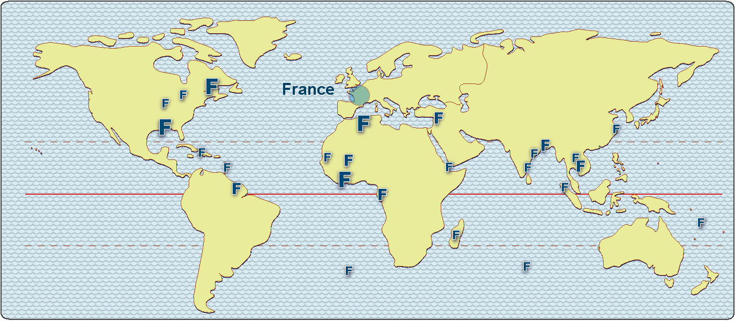
Their northern neighbor, France,
claimed land in North America, Africa,
and many islands around the world.

Slide 6
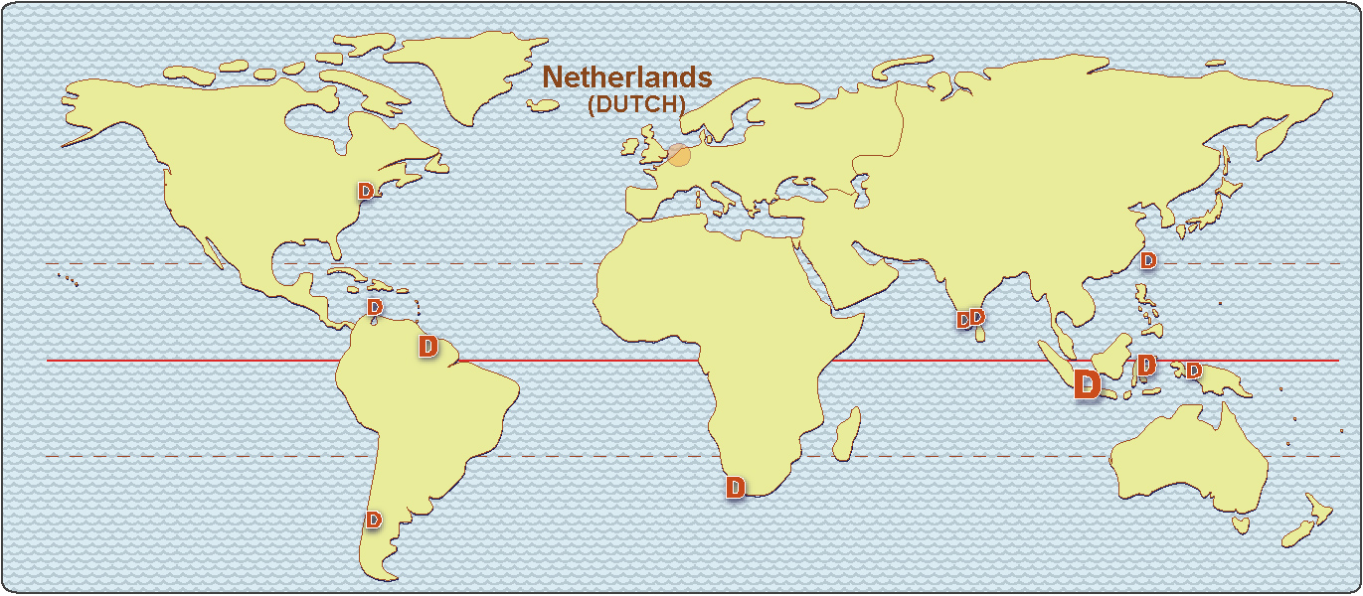
Dutch sailors, (from the Netherlands),
claimed land on every continent, plus
Indonesia (the Dutch East India Company)

Slide 7
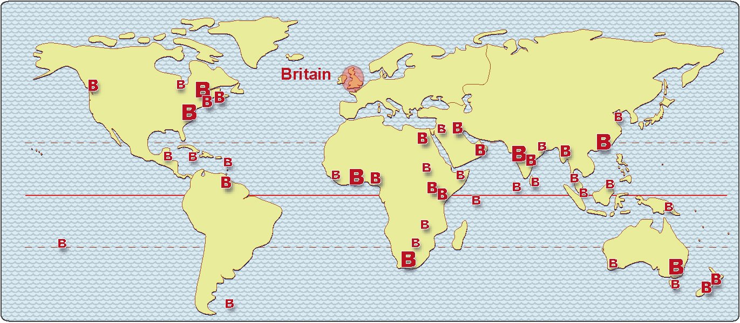
The island country of Great Britain
claimed the most land – as they bragged,
“the sun never sets on the British Empire.”

Slide 8
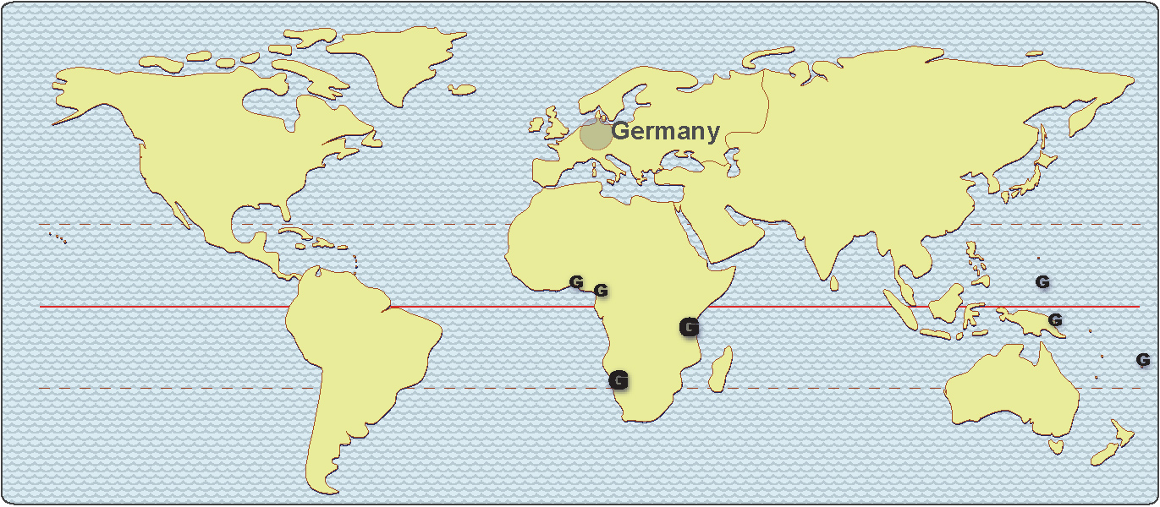
Germany “got into the game” too late,
and had to settle for a few colonies in Africa
and some islands in the Pacific Ocean.

Slide 9
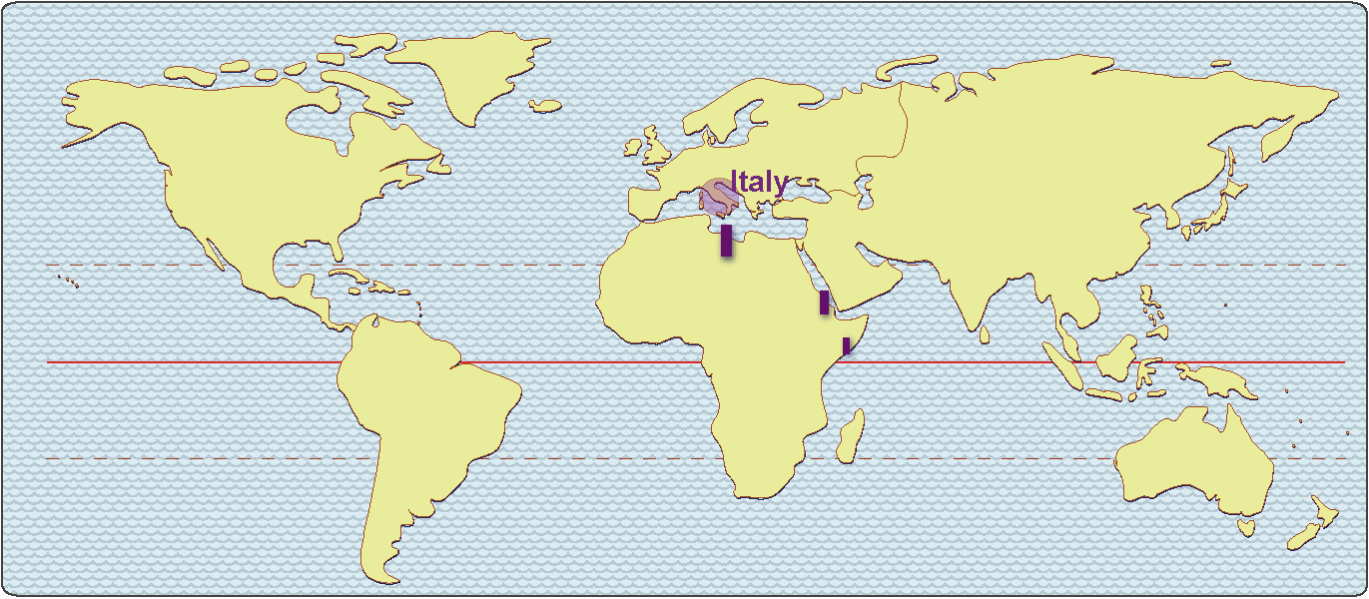
Italy was even later, and got even less.
This presentation is based on a clickable map,
which means that we can “turn layers on and off”
to show several countries at the same time.
This can show us where European countries
could have conflicts over their colonial claims.

Slide 10
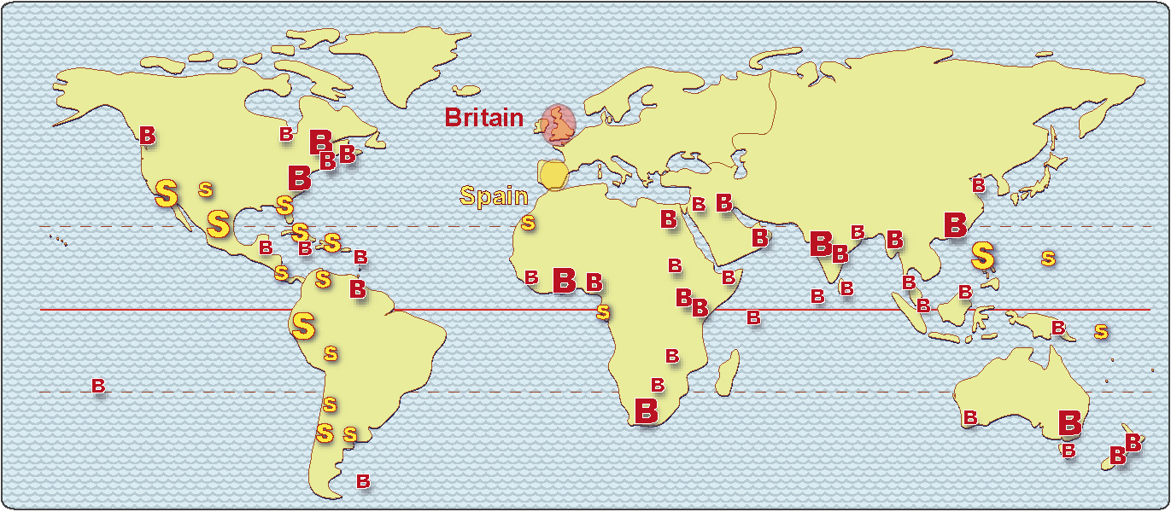
We can see, for example, that Britain and Spain
generally avoided each other, except
in the islands of the Caribbean Sea.

Slide 11
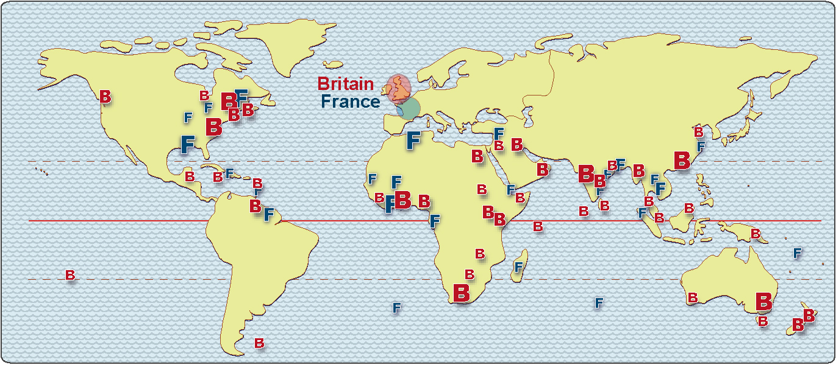
Britain and France, by contrast, often claimed
colonies in the same general areas, and
they fought many battles to settle their claims.
The battles here
were especially important
in the early history
of the United States.

Slide 12
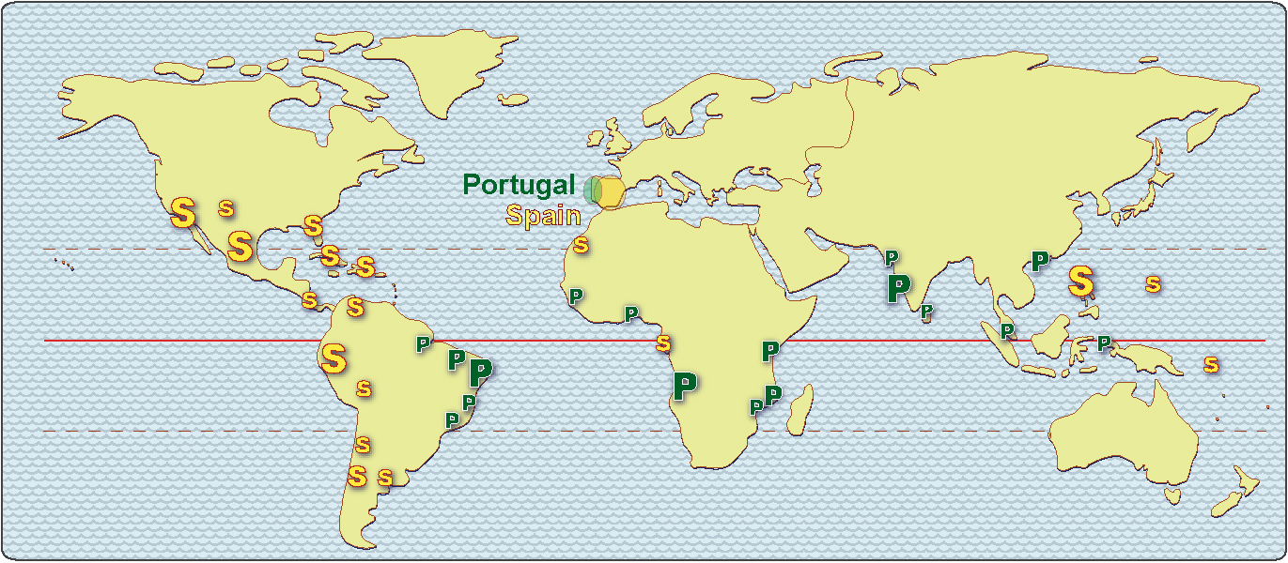
To prevent conflict between Spain and Portugal,
the Catholic Pope drew a line on the map
and told each country to stay on its side of the line.
That’s why people in Brazil speak Portuguese,
while people in most of the other countries
in South and Central America speak Spanish.

Slide 13
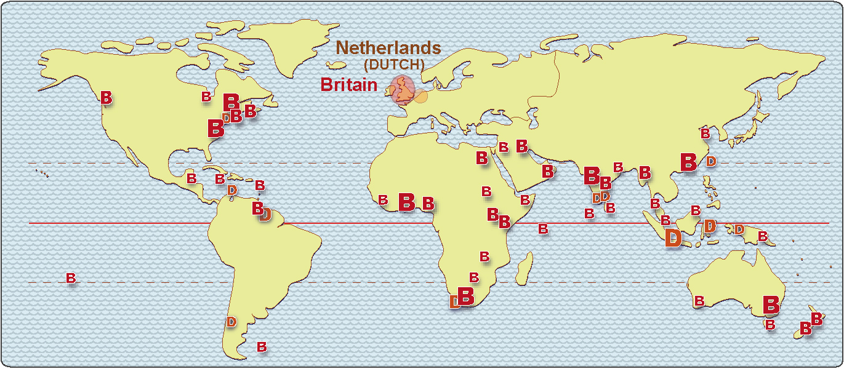
British and Dutch colonists came into conflict
in several places around the world –
notably the East Indies and South Africa.

Slide 14
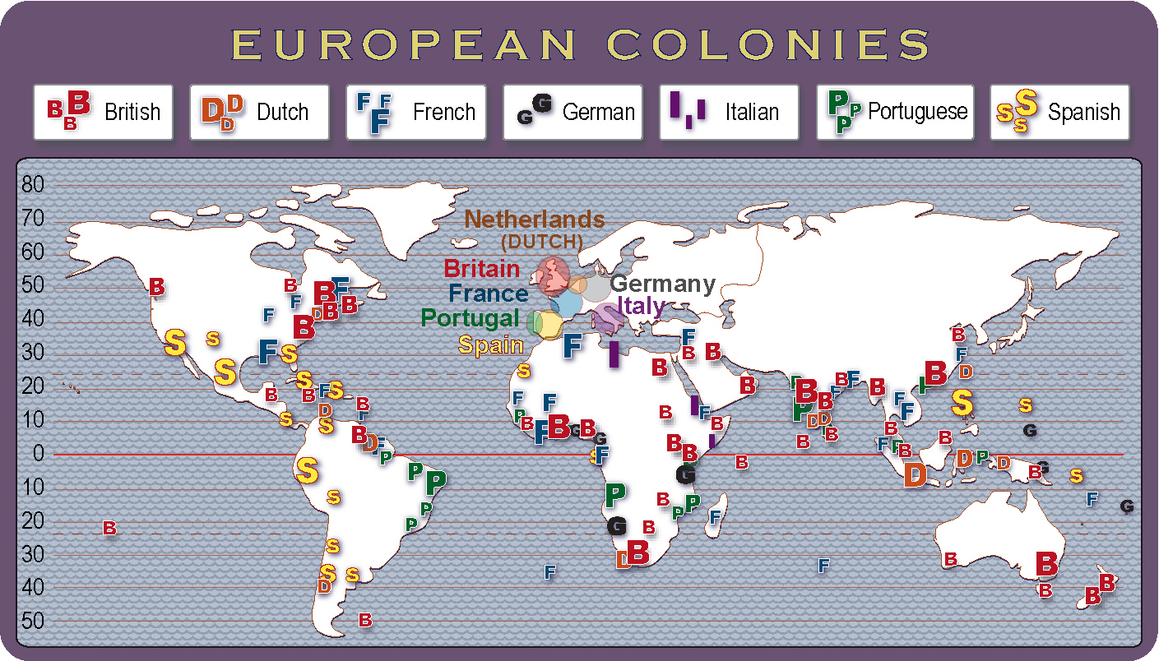
You do not need to memorize all these details now.
Just remember this clickable map when you read
about a colonial war in your history classes.

Slide 15
This map can also help you understand
some modern geographic patterns –
language, religion, trade, and culture.

Slide 16
Copyright 2016, Phil Gersmehl
Teachers who saw this presentation at a workshop
or downloaded it from our internet site have permission
to make a copy on their own computers for these purposes:
1. to help them review the workshop,
2. to show to colleagues or administrators,
3. to show the presentation in their own classrooms or at sessions they lead at teacher conferences,
4. to use individual frames (with attribution) in their own class or conference presentations.
For permission for any other use,
including posting frames on a personal blog or uploading to any network or website,
contact pgersmehl@gmail.com

