Slide 1
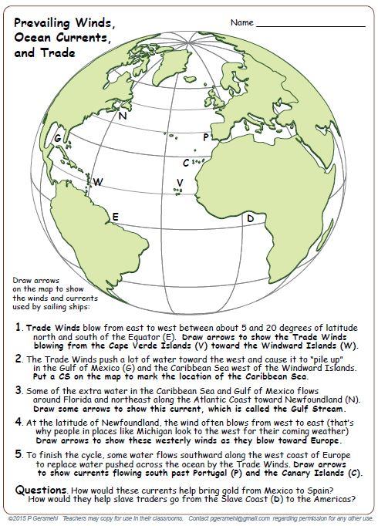

Slide 2
Background for the
Atlantic Trade Triangle
Global Winds

Slide 3
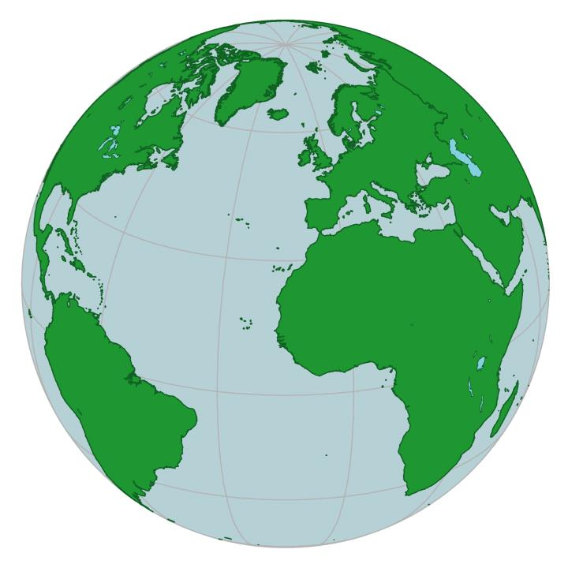
Here is a globe,
viewed from an angle
that helps you focus
on the Atlantic Ocean
and the continents
around it.

Slide 4
Here is a globe,
viewed from an angle
that helps you focus
on the Atlantic Ocean
and the continents
around it.
North
America
Europe
Africa
South
America

Slide 5
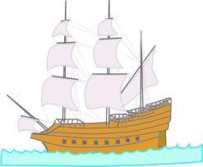
The orange square
marks the location
of the Cape Verde
Islands, which were
an important stop
for sailing ships.

Slide 6
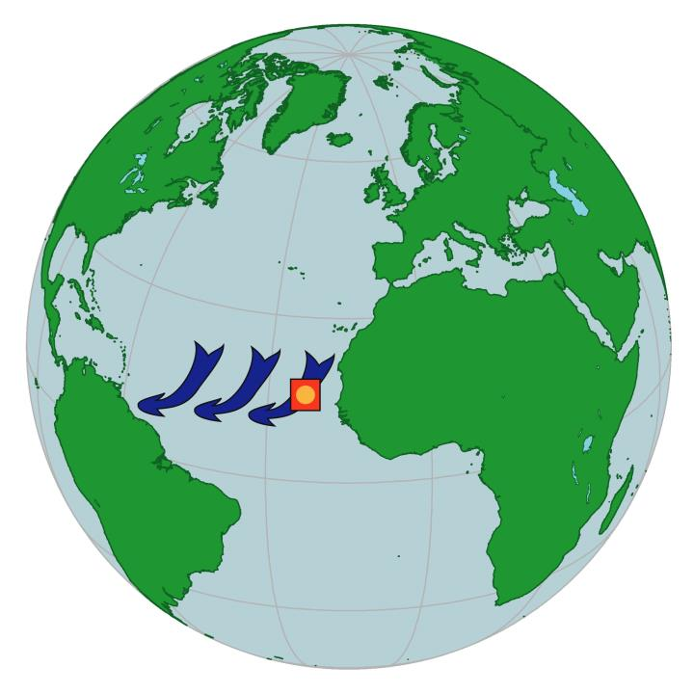
Near these islands,
the wind blows
from the northeast
most of the time.

Slide 7
Near these islands,
the wind blows
from the northeast
most of the time.
This was good news
if you wanted
to go west
in a sailing ship.

Slide 8
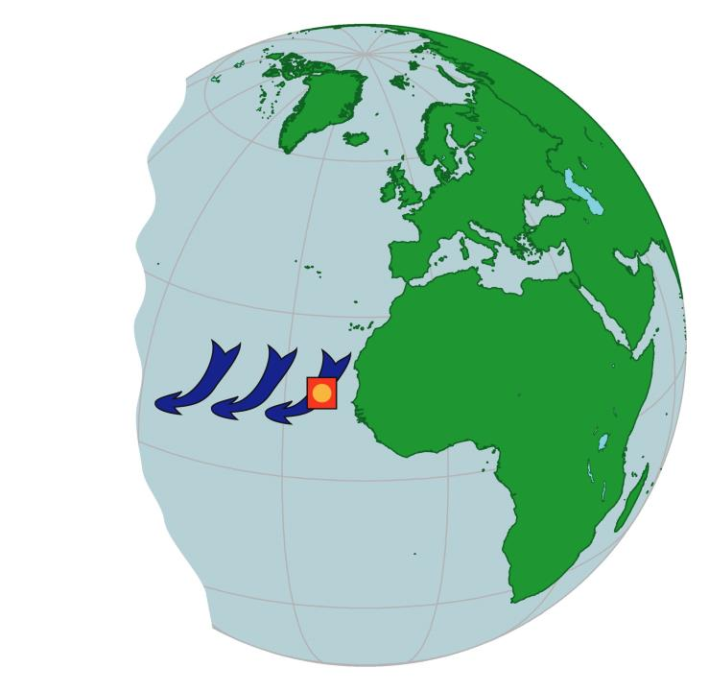
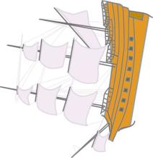
This was bad news
if you thought
that a flat world
had an edge
to the west!

Slide 9
What would you
do about this?

Slide 10
One possibility
is to observe
the prevailing winds
in different places.

Slide 11
For example,
you might see
what direction
the winds blew
at the latitude
of Great Britain.

Slide 12
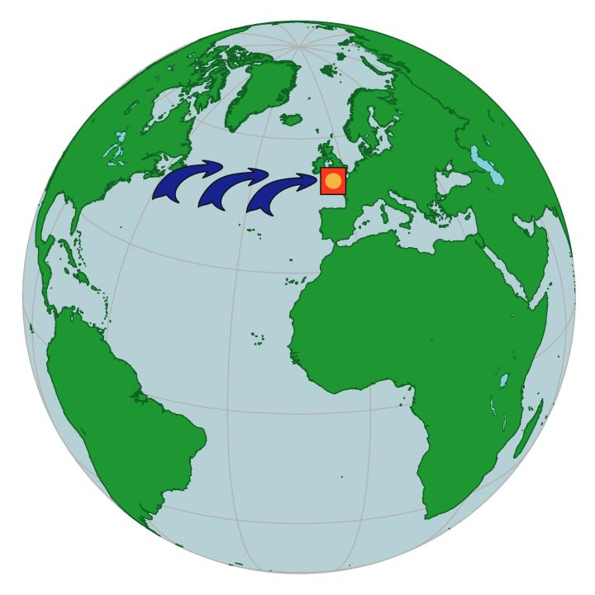
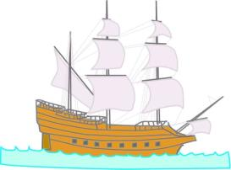
Observations there
led to the conclusion
that the winds tended
to blow more often
from the west
or southwest.

Slide 13
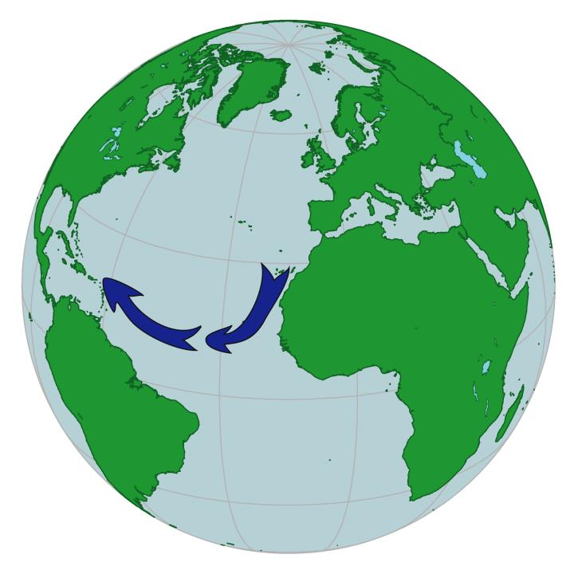
When people put these
observations together,
they realized that a ship
could “ride the trade winds”
across the Atlantic Ocean
. . . .

Slide 14
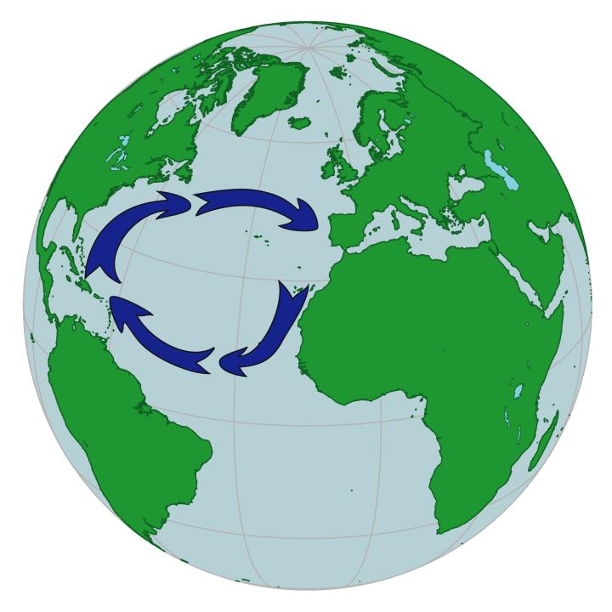
. . and then turn northward and go along the coast
(or the edge of the world!)
until the westerly winds could push their ships
back to Europe.

Slide 15
That is why explorers
often landed on islands
in the Caribbean Sea
rather than the coasts
of North America
or South America.

Slide 16
Now let’s look at
how this worked
during the era
of colonial trade.

Slide 17
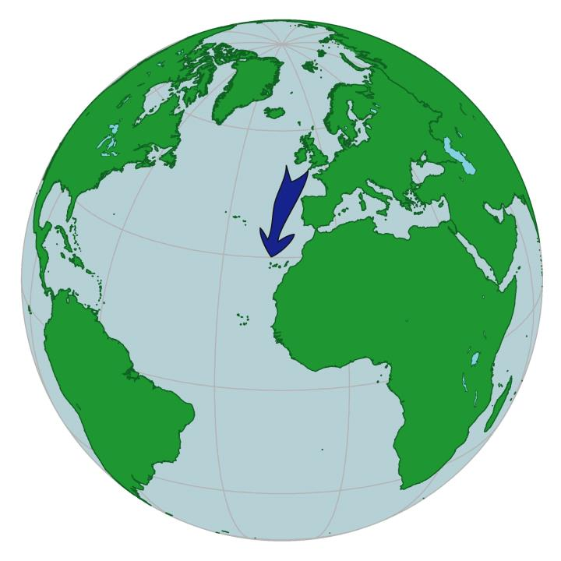
Ships from Europe
would first go south
along the coast
of Africa.

Slide 18
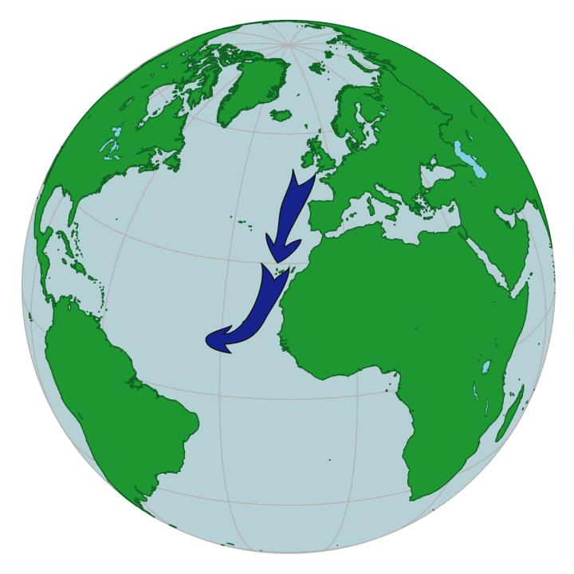
Then they turned
and headed west,
pushed by the wind
from the east.

Slide 19
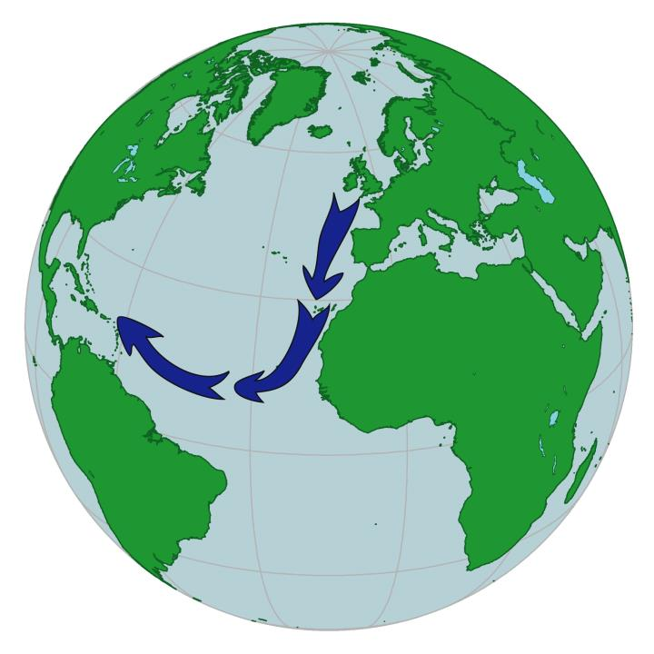
The trade winds
could take them
quickly across
the Atlantic Ocean.

Slide 20
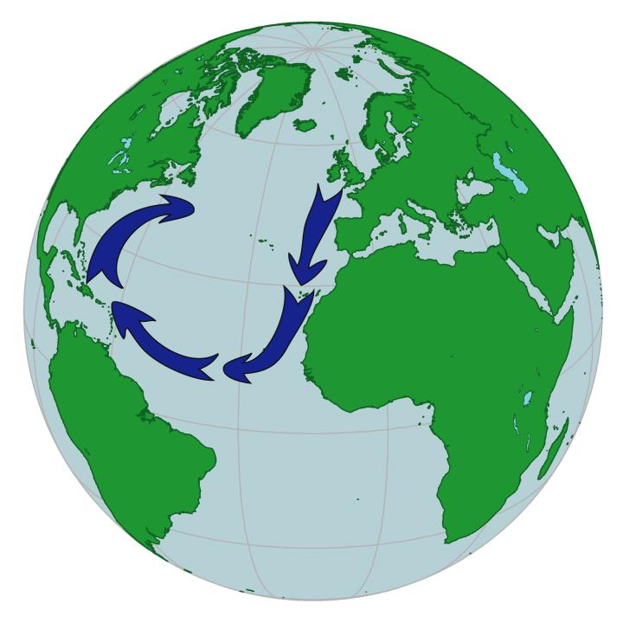
Then they
would go north
along the coast
of North America.

Slide 21
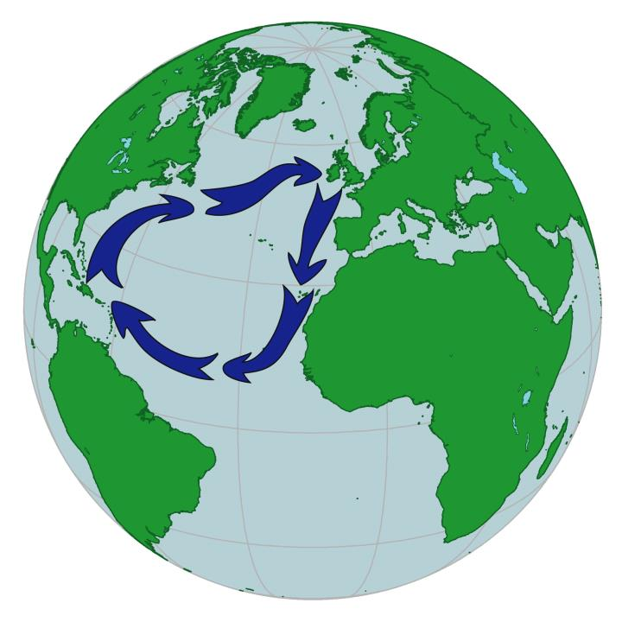
Finally, they used
the westerly wind
to push them
back to Europe.

Slide 22
Summary
From the British point of view,
the North Atlantic winds were like
an automatic gold-delivery system.
Spanish ships went to the Americas,
loaded up with treasure, and then
had to sail close to England
on their way back home.

Slide 23
And that is
the geographic setting
for the Spanish Armada
and, later,
the Triangle Trade.

Slide 24
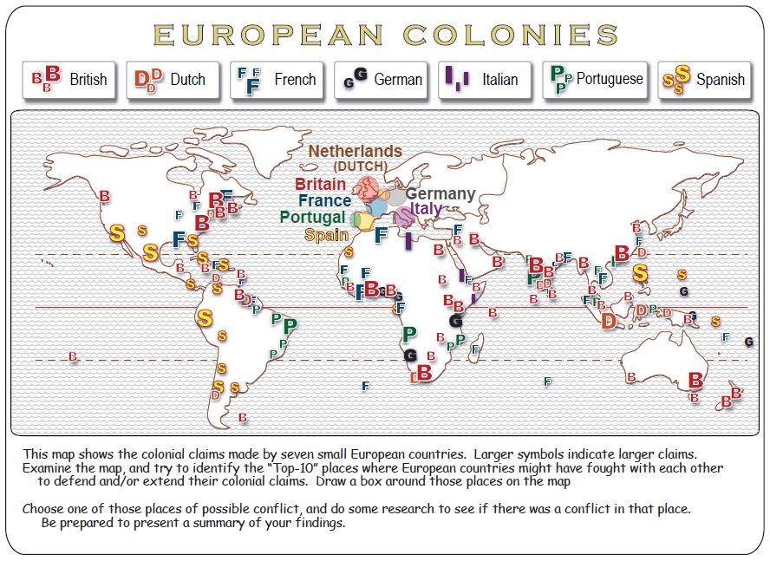

Slide 28
PS. Benjamin Franklin
drew the first maps
of this circulation.

Slide 29
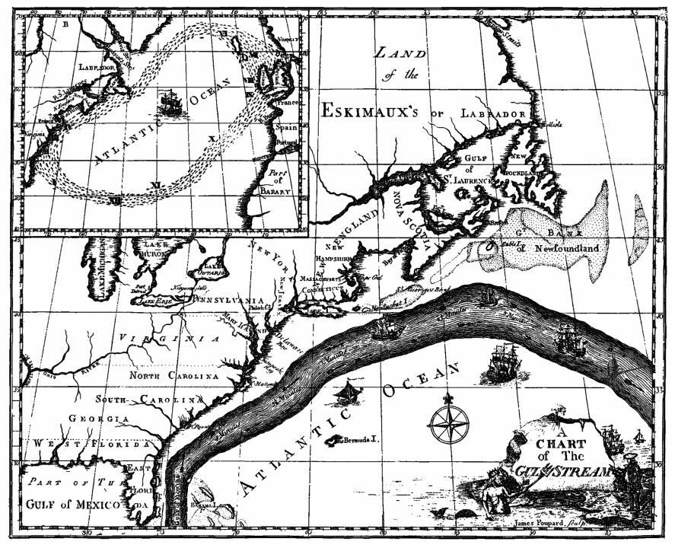
Here is one
of his maps
He was especially
interested in the Gulf Stream.

Slide 30
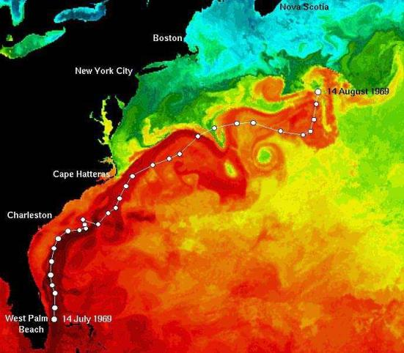
This is a modern map
showing the temperature
of the surface water
in the Gulf Stream
(red is warm, blue is cold).
(National Oceanic and
Atmospheric Administration

Slide 31
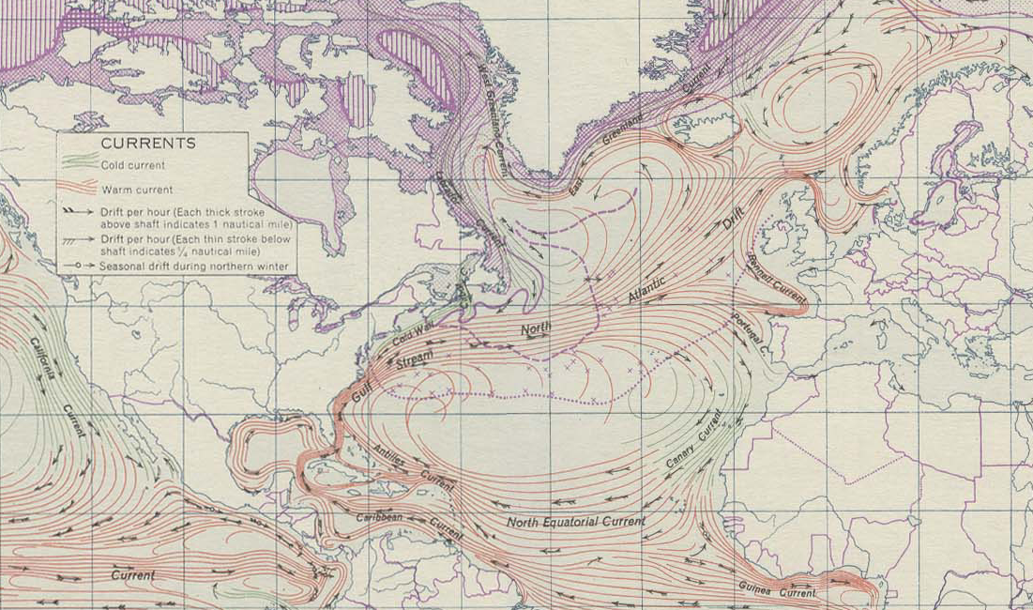

Slide 32
Copyright 2015, Phil Gersmehl
Teachers who saw this presentation at a workshop
or downloaded it from our internet site have permission
to make a copy on their own computers for these purposes:
1. to help them review the workshop,
2. to show to colleagues or administrators,
3. to show the presentation in their own classrooms
or at sessions they lead at teacher conferences,
4. to use individual frames (with attribution)
in their own class or conference presentations.
For permission for any other use,
including posting frames on a personal blog
or uploading to any network or website,
contact pgersmehl@gmail.com

