Slide 1
Geographic
Conditions and Connections
© 2015 P Gersmehl, Michigan Geographic Alliance
Today, we will focus on the difference
between a geographic condition
and a geographic connection
(and why the difference is important).

Slide 2
You will investigate
a real place,
at a real time in history.

Slide 3
You will investigate
a real place,
at a real time in history.
You can try to figure out
where in the world this is.
We are keeping its identity secret, for now,
in order to focus on a more important question.

Slide 4
Here is the big question:
How do people decide
where to locate a town?

Slide 5
You should think about
how you are making a decision,
not just
what decision you are making.

Slide 6
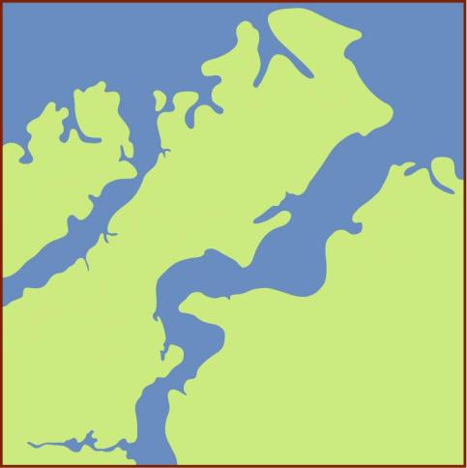
You are on a ship, going across the ocean,
about a century after Columbus.
Here is a map of the area where you are going.
You do not
have a cell phone !
The mapmaker followed
the general rule in choosing colors:
“make the water blue and the land green”
(Many maps use that rule, even though we all know
that all land is not green, and all water is not blue!)

Slide 7
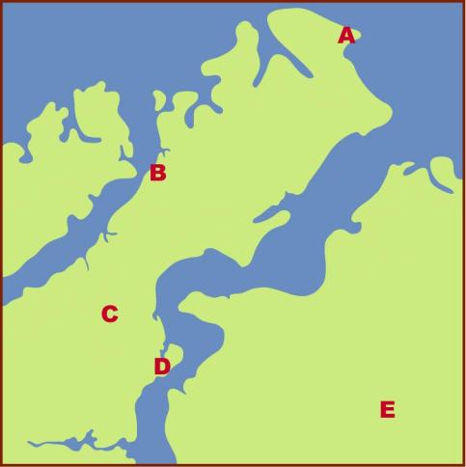
Your scouts suggest these five places
as possible locations for your new town.
Which one would you vote for? Why?

Slide 8
Asking you to vote after looking at a simple map
highlights a basic issue about democracy:
Advantage ?
Disadvantage ?

Slide 9
Asking you to vote after looking at a simple map
highlights a basic issue about democracy:
Advantage: people cannot blame anyone else
when they get what they voted for.
Disadvantage ?:

Slide 10
Asking you to vote after looking at a simple map
highlights a basic issue about democracy:
Advantage: people cannot blame anyone else
when they get what they voted for.
Disadvantage: it takes time and effort
to gain the knowledge needed
to cast an informed vote.

Slide 11
Here is that map again,
with your five choices on it.
What else would you like to know?

Slide 12
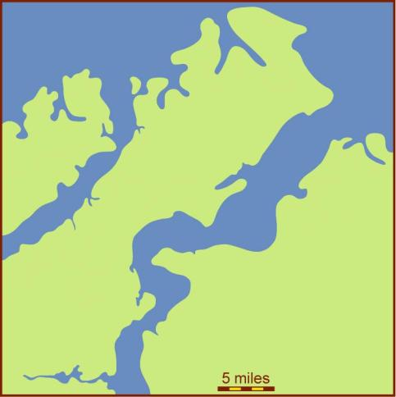
Here is that map again,
with your five choices on it.
What else would you like to know?
For one thing, it might help to know
how big this area is.
The map is about 33 miles wide.
How long would it take
to walk that far?

Slide 13
Here is that map again,
with your five choices on it.
What else would you like to know?
For one thing, it might help to know
how big this area is.
The map is about 33 miles wide.
How long would it take
to walk that far?
About two days, through the kind
of hilly forest
your scouts say
is growing
in this area.

Slide 14
Before we go any farther,
maybe we should make sure
that we all know what is meant
by the concept of “location.”

Slide 15
To a geographer,
the idea of location
has two parts:
The Conditions
in a specific place,
right there

Slide 16
Cold
Bears
Iron ore
To a geographer,
the idea of location
has two parts:
Low
Hills
The Conditions
in a specific place,
Sandy
Trees
Rainy

Slide 17
To a geographer,
the idea of location
has two parts:
The Conditions
in a specific place,
Can you name a kind of place condition
that did not flash on the screen?

Slide 18
Canal
Road
To a geographer,
the idea of location
has two parts:
Far from
camp
The Conditions
in a specific place,
Treaty
Trade
The Connections
with other places
Upstream

Slide 19
Can you name
any kind of connection
that did not flash
on the screen?
To a geographer,
the idea of location
has two parts:
The Conditions
in a specific place,
The Connections
with other places

Slide 20
To make sure you understand the distinction,
here is a quick review. When you click, a phrase
will flash on the screen. Decide whether the phrase
is a geographic condition or connection. Then click.
Upstream from swamp
Good well water
Part of NATO
Level land for house
Close to town
Fertile soil
Geographic
Condition
Geographic
Connection

Slide 21
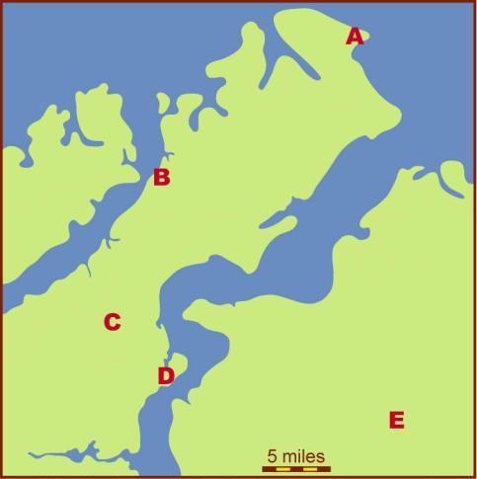
Here is that simple map again,
with the five suggested locations for your town.
Is it easier to see
geographic conditions
or
geographic connections
on a simple map
like this one?

Slide 22
400 years ago, a key geographic connection was
the possibility of unfriendly neighbors.
With that in mind, which location would you choose ?

Slide 23
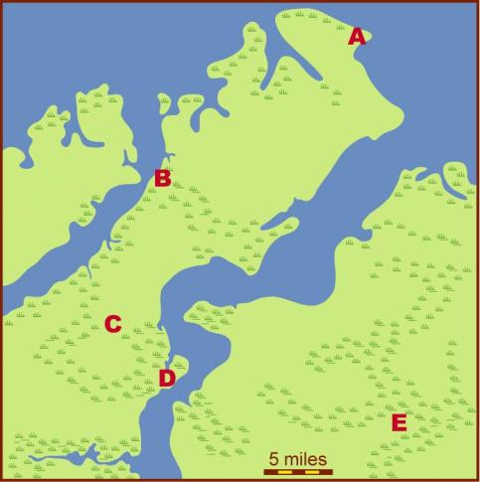
The map now includes symbols that show swampy areas.
Swamps can make it hard to travel, farm, or build houses.
Is a swampy area
a geographic condition
or
a geographic connection?
Definition:
Swamps
(also called marshes or bogs)
are areas of shallow water.
They are often filled
with cattails, reeds,
and other water weeds

Slide 24
Now that you know what areas have swampy conditions,
which lettered place would you choose for your town?

Slide 25

The map now has blue lines that show creeks and rivers.
Notice that rivers flow in low areas,
which are often swampy in rainy climates.
Is a river
a geographic condition
or
a geographic connection?
Is a river
a geographic condition
or
a geographic connection?
(Or can it be both?)

Slide 26
Now that you know where the rivers are,
which place would you vote for as a town location?

Slide 27
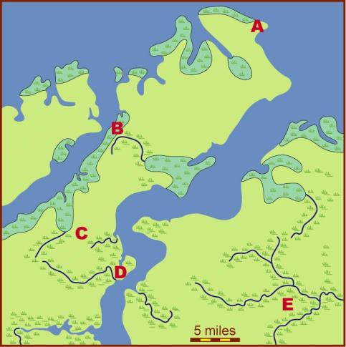
The map now has a color to identify saltwater marshes.
Unlike freshwater swamps near rivers, marshes near oceans often have salty water. You can’t drink salty water!
Is salty well water
a geographic condition
or
a geographic connection?

Slide 28
Now that you know about the quality of the water,
which place would you choose for your town?

Slide 29
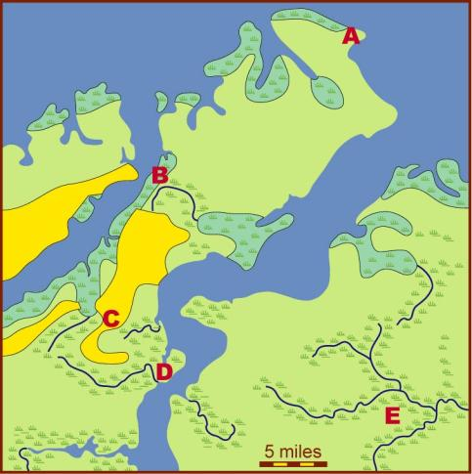
The map now uses a yellow color to show good cropland.
Good cropland has fertile soil that is easy to work.
It also tends to be good for roads and buildings.
Is good cropland
a geographic condition
or
a geographic connection?

Slide 30
Now that you know about the quality of the land,
which place would you choose for your town?

Slide 31
Which lettered place has the best conditions?
Which place has the best connections?
How do you find a balance
between conditions
and connections
in choosing a location
for a settlement ?
Now we will look at some photos
taken at each location.
Do these photos persuade you
to change your mind
about which place to choose?
Photos taken by Melinda Dickinson,
Michigan Geographic Alliance

Slide 32
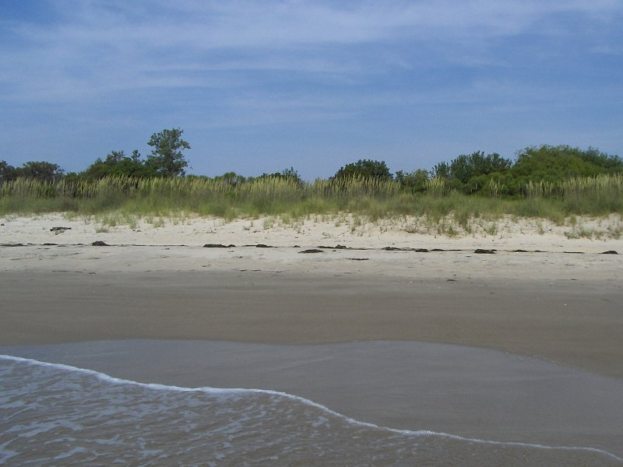
Location A

Slide 33
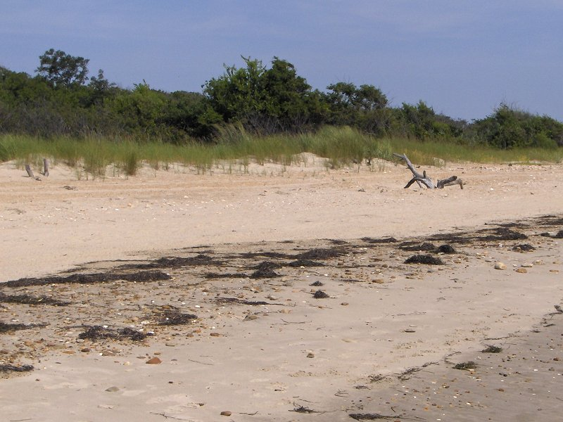
Location A

Slide 34
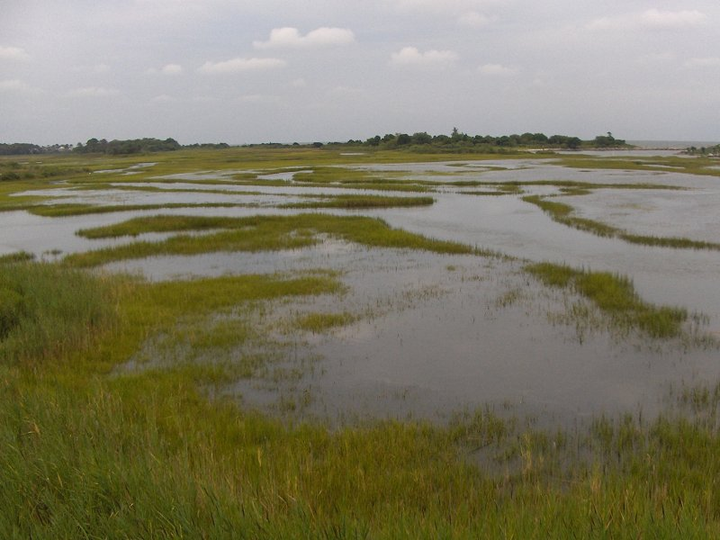
Location B

Slide 35
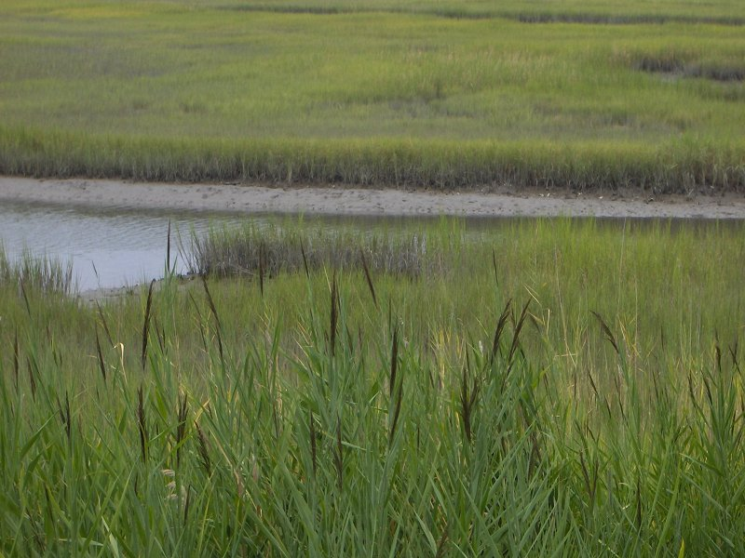
Location B

Slide 36
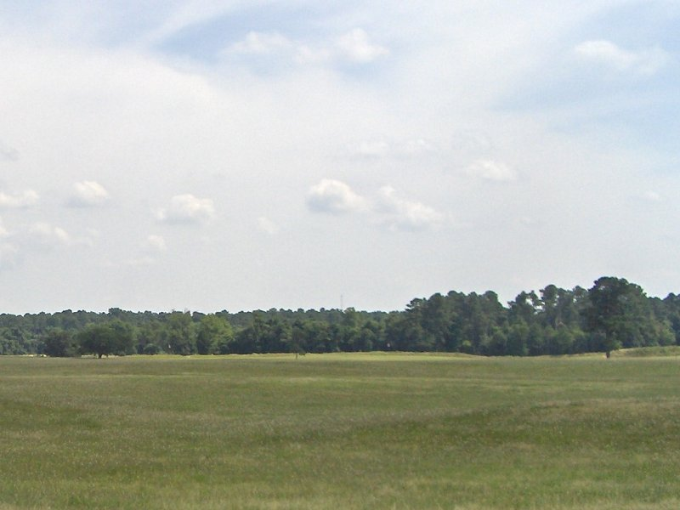
Location C

Slide 37
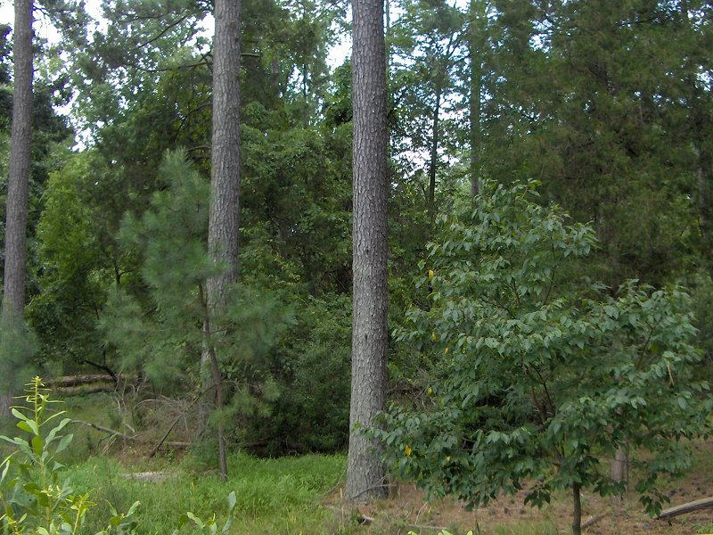
Location C

Slide 38
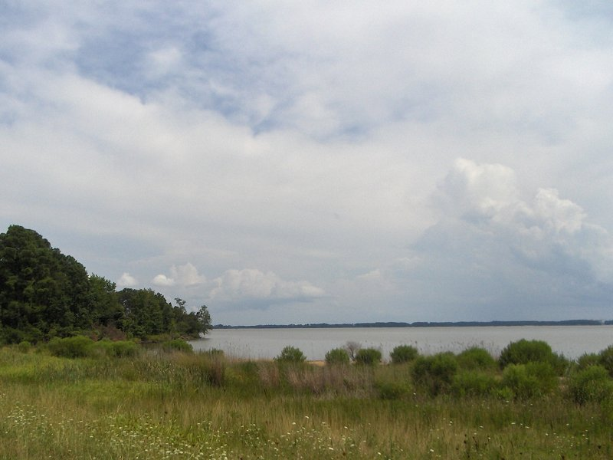
Location D

Slide 39
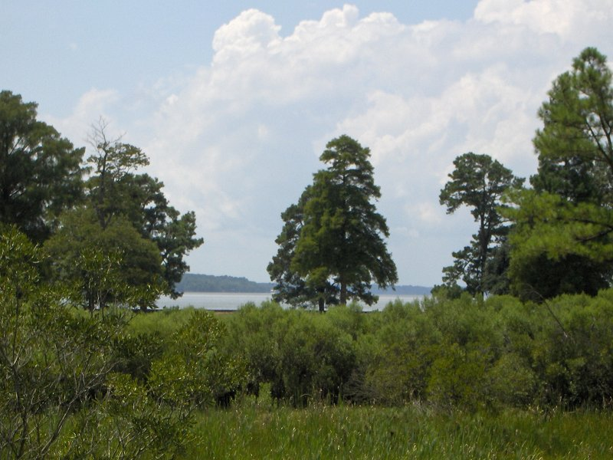
Location D

Slide 40
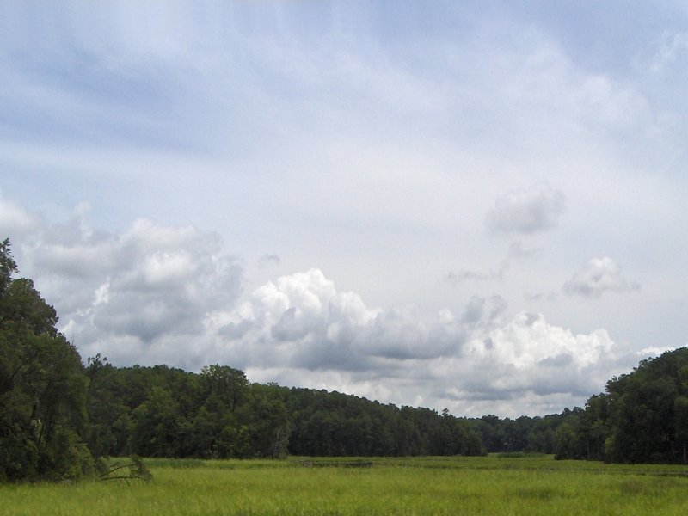
Location E

Slide 41
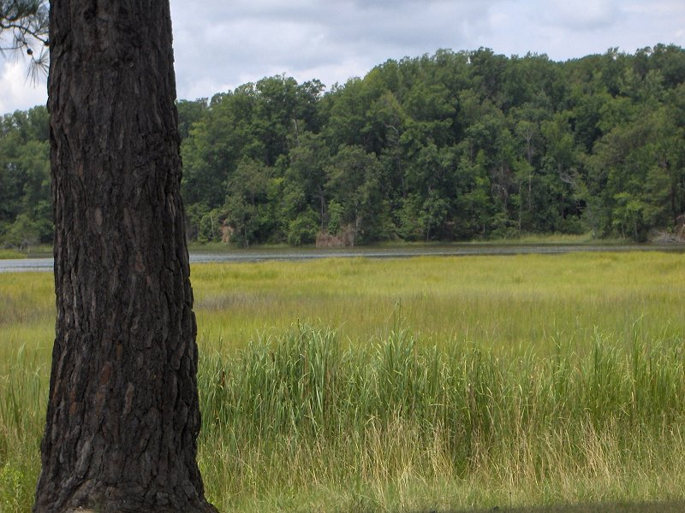
Location E

Slide 42
Now that you have seen photos of the places,
which one would you choose for your town?

Slide 43
Copyright 2015, Phil Gersmehl
Teachers who saw this presentation at a workshop
or downloaded it from our internet site have permission
to make a copy on their own computers for these purposes:
1. to help them review the workshop,
2. to show the presentation in their own classrooms,
at sessions they present at teacher conferences,
or to administrators in their own school or district,
3. to use individual frames (with attribution)
in their own class or conference presentations.
For permission for any other use,
including posting frames on a personal blog
or uploading to any network or website
that can be accessed from outside your school,
contact pgersmehl@gmail.com

