Slide 1
WHERE IS the equator
???

Slide 2
The Equator
is a really important line
in geography . . .
BUT
it’s an imaginary line!
It’s not really drawn
on the earth itself.

Slide 3
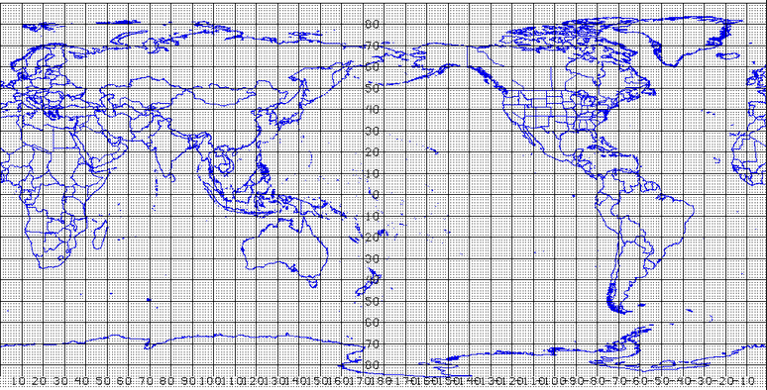
The Equator
is a “zero line”
in the grid (graph)
that people draw
on the earth
to help us
find places.

Slide 4
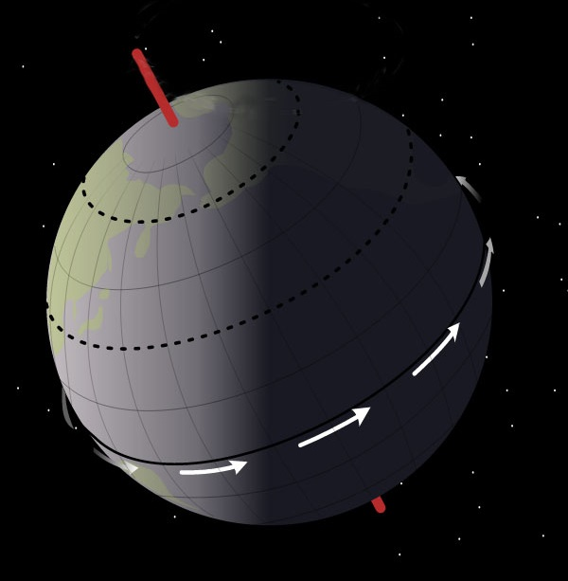
North Pole
It’s the line
that goes exactly
halfway between
the North Pole
and
the South Pole.
Equator
It’s like a belt
around the middle
of the earth.
South Pole

Slide 5
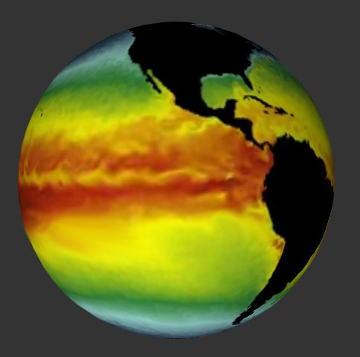
The Equator
is important
because
many things
are arranged in
“stripes” that run
roughly parallel
to the Equator.
COLD
MEDIUM
H O T
H O T
MEDIUM
These are
ocean-water
temperatures.
COLD

Slide 6
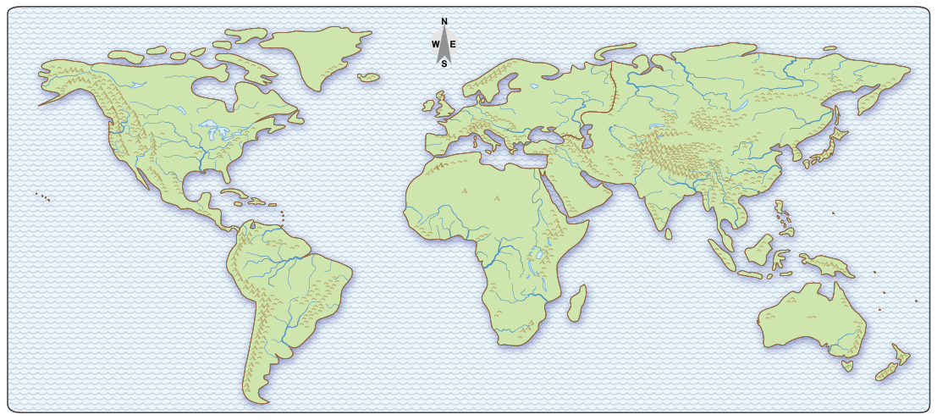
As we said, the Equator is really important,
but mapmakers do not always draw it on their maps.
When that happens, you have to be able
to add it “in your mind.”
Can you picture
where it is?

Slide 7
Here are some clues.
It goes through the “notch”
where the Amazon River
flows into the Atlantic Ocean.
South
America
PACIFIC
OCEAN
ATLANTIC
OCEAN
Science fact: It rains nearly every day near the Equator.
As a result, the Amazon River is the biggest one on the planet.

Slide 8
Here are some clues.
It goes under West Africa.
(This was called the “Gold Coast.”)
Africa
INDIAN
OCEAN
ATLANTIC
OCEAN
History fact: Europeans captured the most slaves
in this area near the south coast of West Africa.

Slide 9
Here are some clues.
It goes through the large round island
in Indonesia (the one called Borneo) and
just north of the biggest one (New Guinea)
PACIFIC
OCEAN
Indonesia
Australia
Science fact: New Guinea was actually connected to Australia
when sea level was lower during the Ice Age.

Slide 10
Here are some clues.
It goes through Singapore,
an island country at the south tip
of a long, skinny peninsula of Asia.
Asia
PACIFIC
OCEAN
INDIAN
OCEAN
History fact: Singapore is called a city-state.
It is a tiny country, but the people make a lot of money.

Slide 11
It doesn’t hurt to remember the place-names,
but you don’t need them to find the equator.
And you don’t even
need to remember
all five clues
(Two good ones are enough!).
Mouth of
the big river
Through the
round island
Tip of the
peninsula
Under
the bulge
North of the
largest island

Slide 12
Can you picture where the Equator is “in your mind”?

Slide 13
Copyright 2015, Phil Gersmehl
Teachers who saw this presentation at a workshop
or downloaded it from our internet site have permission
to make a copy on their own computers for these purposes:
1. to help them review the workshop,
2. to show to colleagues or administrators,
3. to show the presentation in their own classrooms
or at sessions they lead at teacher conferences,
4. to use individual frames (with attribution)
in their own class or conference presentations.
For permission for any other use,
including posting frames on a personal blog
or uploading to any network or website,
contact pgersmehl@gmail.com
Sea surface temperature animation:
http://sos.noaa.gov/Datasets/dataset.php?id=133#

