Slide 1
Map
Pattern
Comparison
A basic tool
of geographic analysis

Slide 2
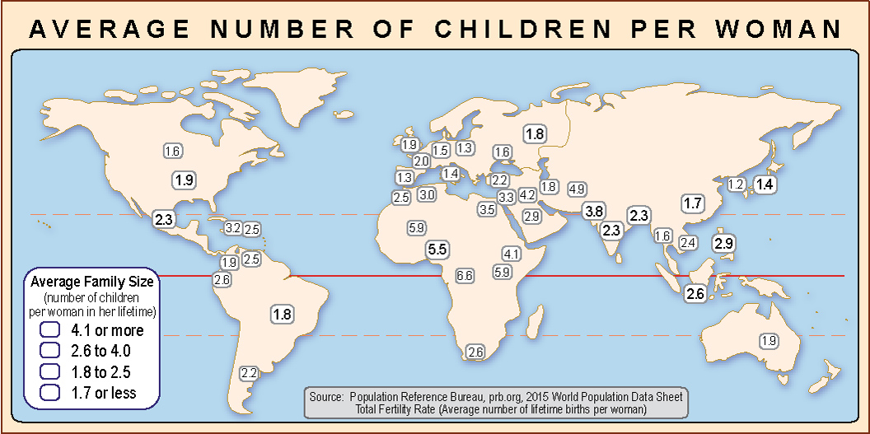

Slide 3
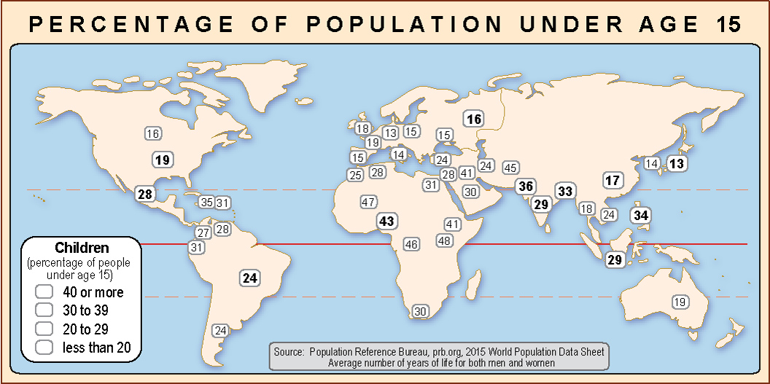

Slide 4
How do these two maps compare?

Slide 5
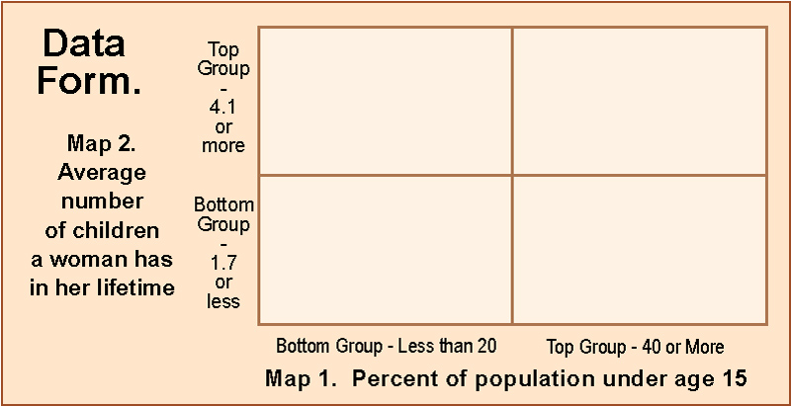
The key to making a scientific comparison of map patterns
is to make a data form where you can write
the names of the countries (or states, etc.)

Slide 6
Step 1.
Identify
all the countries
in the top group
on one map.

Slide 7
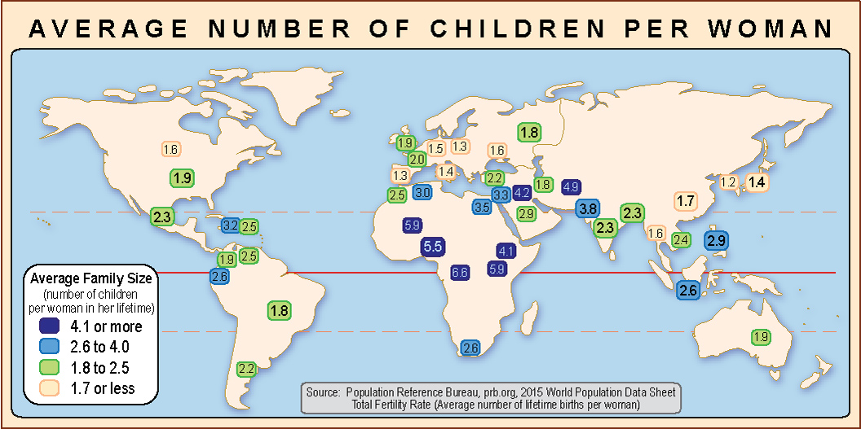
Step 1.
Identify
all the countries
in the top group
on one map.
One way to do this
is to choose
a color sequence
and color the boxes.
Your colors should follow
the cartographic rule:
“darker means more.”

Slide 8
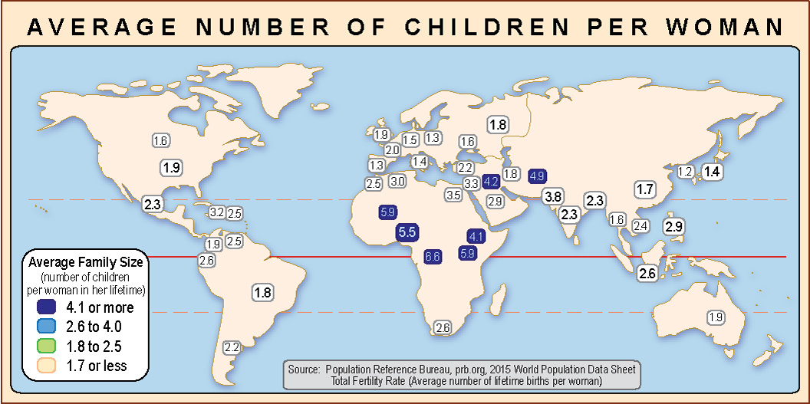
Step 1.
Identify
all the countries
in the top group
on one map.
An easier way
is to color
only the top group.
Eventually,
you can train yourself
to “see” the group
without coloring it.

Slide 9
Step 2.
Pick any country
in the top group
on one map
and find it
on the other map.

Slide 10
Step 2.
Pick any country
in the top group
on one map
and find it
on the other map.

Slide 11
Step 3.
See what group
this country is in
on the second map.

Slide 12
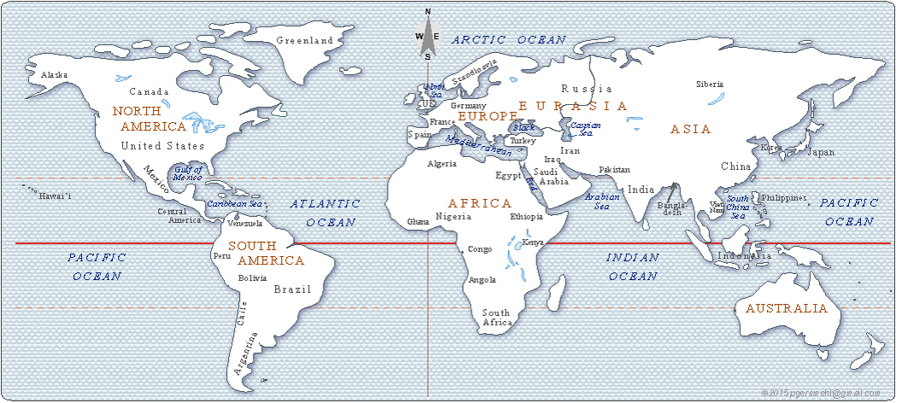
Step 3.
If you need to,
find the name
of that country
on a reference map.

Slide 13
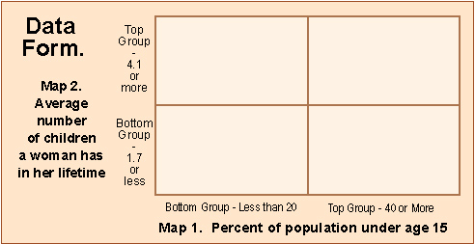
Congo
Step 4.
Write the name
of the country
in the proper box
on the data form.

Slide 14
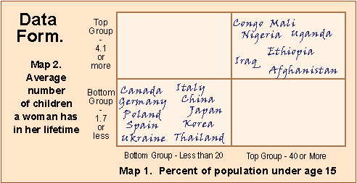
Step 5.
Continue until
you have done
all the countries
in both the top
and bottom group
on one map.

Slide 15
Step 6. Examine your data form.
If all the country names
are in the lower left and upper right boxes,
the map patterns are positively related (high on one is high on the other,
low on one is low on the other).
But if all the country names
are in the upper left and lower right boxes,
the map patterns are negatively related (high on one is low on the other, and vice versa).

Slide 16
Step 7.
Try to interpret
your results.
In this example,
it makes sense
that a country
where women have
a lot of children
would also have
many people
under age 15.
We chose
a simple example
so that we could
focus on the skill.

Slide 17
Conclusion
Map pattern comparison can be
a powerful tool for geographic analysis.
It can help us identify relationships that are worth investigating,
even for topics that might be quite controversial.
For example, . . . you could compare maps that show:
You get the point . . .
you can use this tool
to investigate a lot of topics
where people can have very strong opinions.
When you do this, you must remember on thing:
correlation does not always mean causation.
Gasoline taxes and road condition in different states
Average income and Democratic or Republican vote
Marijuana use and suicide in different towns
Surveillance cameras and crime on street corners
Even when it does,
you still have to investigate
to figure out what is the cause
and what is the effect!
Indoor rock concerts and hearing loss
Gun registration laws and murder rates
Income taxes and job creation in different states

Slide 18
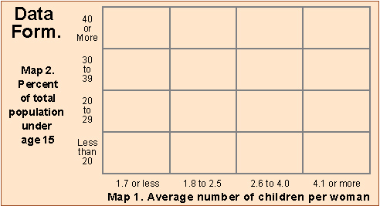
P.S.
If you have the time,
you can make your investigation more accurate
by writing the names of every country on the map
in the proper box on a more detailed data form

Slide 19
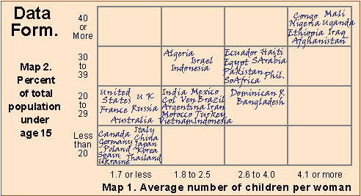
If you do that for the two maps in this presentation,
you get a pattern that is still positively correlated,
but there are some countries that are higher on one map
than you would expect based on their score on the other map.
This can be a lot of work if you do it by hand.
Fortunately, there are computer programs
that do the analysis quickly and accurately.
You still have to know how to interpret the results!
Bonus: A good map reader
can learn how to do it “by eye”
and get fairly accurate results.
That’s a worthwhile skill to have!

