Slide 1
Region A geographic “BIG IDEA” that can help us organize our knowledge about North America

Slide 2
Note to Teachers
1. This presentation has a specific purpose. It is designed as an illustrated teacher guide to provide content background
about the “layers of information” on the clickable map of North America.
It is not designed for use in class “as is” – to tailor it for a specific class, you might shorten it, edit frames, add pictures or discussion questions, etc.
(see below)
2. This presentation has two parts – explanation and question. You can cut-and-paste to put question frames where you want them in order to promote class discussion or identify misconceptions.
The question frames can also serve as reviews, assessments,
or prompts for inquiry activities (individual or group).
3. This presentation is much too long. There is a good reason for this – your computer has a DELETE key,
but it does not have a CREATE key.
This is important, because many teachers have reviewed this presentation. If anyone suggested an addition (like a definition, explanation, or example), we usually put it in – because other teachers might also find it useful,
and it takes much less time to delete a frame than to make one!
(PS. You can delete this frame now!)
?
DELETE

Slide 3
Definition: a region is a group of places
that are like each other
and close to each other

Slide 4
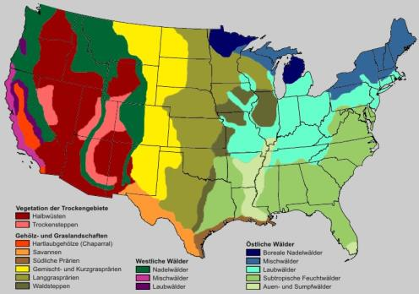
Definition: a region is a group of places
that are like each other
and close to each other
If you draw a line around the places,
the result is a regional map.

Slide 5
Why do we make regional maps?

Slide 6
Why do we make regional maps?
Because it is easier to remember
the general shape of a region,
rather than the locations
of many individual places.

Slide 7
Why do we make regional maps?
Because it is easier to remember
the general shape of a region,
rather than the locations
of many individual places.
Let’s look at how to make
a simple regional map
to help us remember
the environments
in North America.

Slide 8
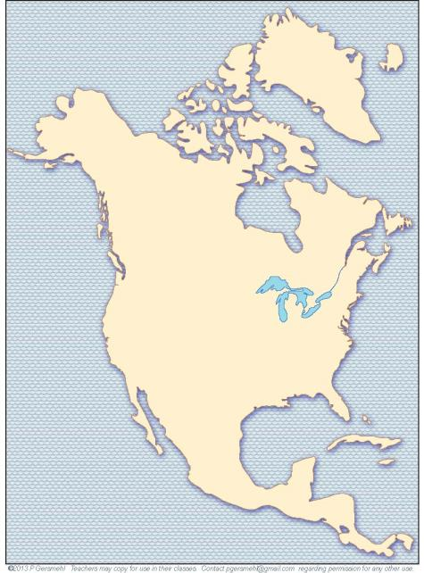
The continent
of North America
extends almost
from the Equator
to the North Pole.

Slide 9
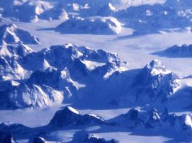
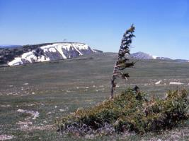
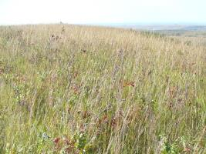
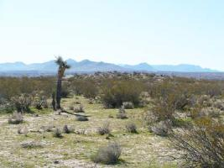
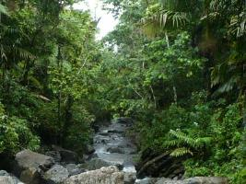
As a result, North America
has a wide range of
natural environments,
including:
- frozen ice caps
- wind-swept tundras
- waving grasslands,
- hardwood forests,
- tropical deserts,
- hot rainforests,
- and many more.

Slide 10
This presentation
is about how
we can draw
a few simple lines
to help organize
our knowledge
of these regions.
As a result, North America
has a wide range of
natural environments,
including:
- frozen ice caps
- wind-swept tundras
- waving grasslands,
- hardwood forests,
- tropical deserts,
- hot rainforests,
- and many more.

Slide 11
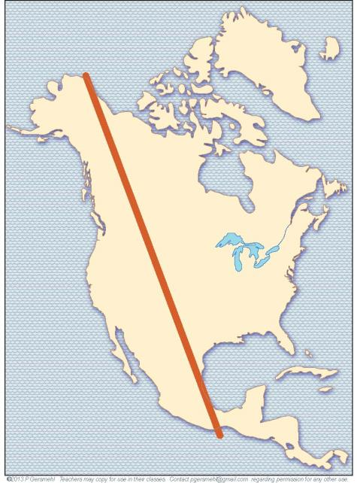
The first line starts
at the northern tip
of Alaska

Slide 12
The first line starts
at the northern tip
of Alaska
It goes
on a long diagonal
down to the east coast
of central Mexico.

Slide 13
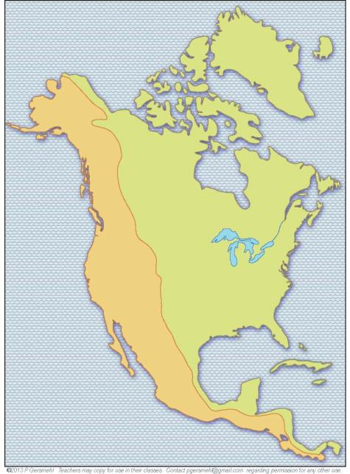
This line is a
generalization.
It traces
the general position
of a basic division.

Slide 14
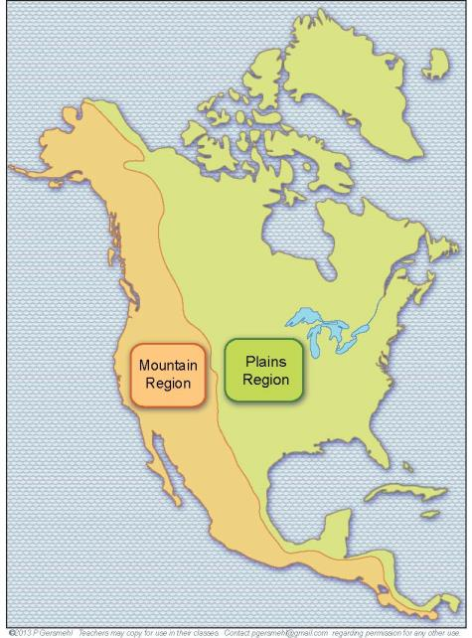
This line separates the continent
into:
1. Western Mountain Region
with young rocks, high land,
and many steep slopes,
and
2. Eastern Lowland Region
with older rocks, low hills,
and large, nearly flat plains.

Slide 15
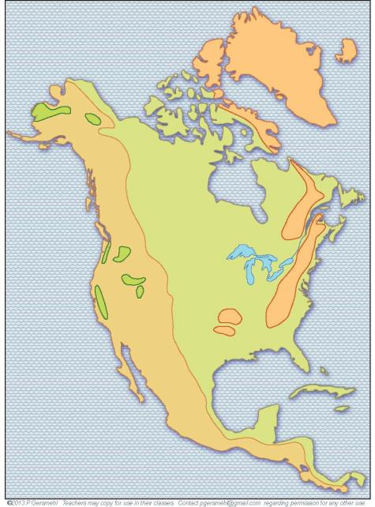
In the real world,
regional generalizations
usually have exceptions.

Slide 16
Here are three
important exceptions
in the West.
Willamette Valley
(end of the Oregon Trail)
Snake River Plain
(potatoes for French fries)
Central Valley of California (the most productive
food-growing area
in the country)

Slide 17
Important exceptions
in the East:
The cold highlands of Greenland
Appalachian “Mountains”
Ozark highlands

Slide 18
Important exceptions
in the East:
The cold highlands of Greenland
Appalachian “Mountains”
and many low hills
(left by the glaciers that
covered half the continent).
and many low hills
(left by the glaciers that
covered half the continent).
and many low hills
(left by the glaciers that
covered half the continent).
and many low hills
(left by the glaciers that
covered half the continent).
and many low hills
(left by the glaciers that
covered half the continent).
and many low hills
(left by the glaciers that
covered half the continent).
Ozark highlands

Slide 19
You do not (NOT)
need to remember
all these exceptions.
You can always
find that information
on a detailed map.

Slide 20
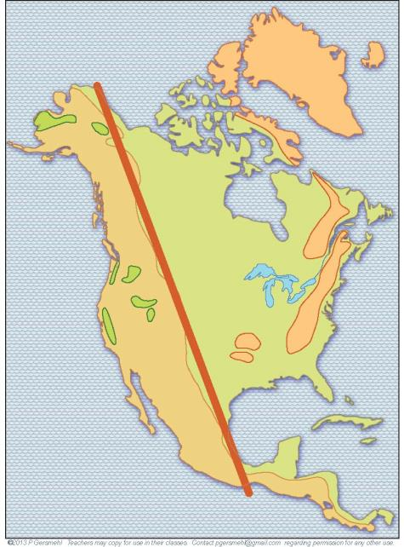
You should remember
the long line that
divides the continent
into these two regions:
1 - mountain West
and
2 - lowland East

Slide 21
And you should
be able to draw this line in your mind
whenever you see
a blank outline map
on the Internet,
in a newspaper,
or on TV.

Slide 22
And you should
be able to draw this line in your mind
whenever you see
a blank outline map
on the Internet,
in a newspaper,
or on TV.

Slide 23
The second line
is a big curve going
roughly east-west
through the Great Lakes.
(Some people say it looks
like a “sagging hammock”
with its “bottom” in
the middle of Michigan.)

Slide 24
North of this line,
it can freeze even in June.
As a result,
the summer growing season is
too short for most food crops.

Slide 25
North of this line,
it can freeze even in June.
As a result,
the summer growing season is
too short for most food crops.
This line stops
when it reaches
the mountains,
where high peaks
are usually cold
while low valleys
can be warm.

Slide 26
This line separates the East
into two regions:
- a northern region
that is too cold for farming,
- a warmer region, where
people can grow food.
Very few farms
Many
farms

Slide 27
The third line
runs due north
from the southern
tip of Texas.

Slide 28
This line divides
the rainy East
from the semi-arid
Great Plains.

Slide 29
This line divides
the rainy East
from the semi-arid
Great Plains.
Definition: a semi-arid place is
not very rainy, not completely dry;
“semi-arid” means “half-dry”

Slide 30
This line separates
places that have
more precipitation
than trees need
from places
that have less.

Slide 31
Here again, the western region
is complicated.
Most valleys
are very dry
while peaks
are covered
with forests
(even snow).

Slide 32
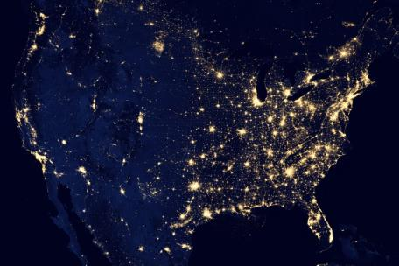
Note how the last
two lines that we drew
seem to outline the area where many people live
in North America
(and have lights in
their houses and cities).
Night-time image
from NASA satellite

Slide 33
The rest of the continent is dark, except for
a few urban areas.
Night-time image
from NASA satellite

Slide 34
The rest of the continent is dark, except for
a few urban areas.
Vancouver,
Canada
Seattle
Denver
San Francisco
Los Angeles
Phoenix
and Tucson
Night-time image
from NASA satellite

Slide 35
The rest of the continent is dark, except for
a few urban areas.
Vancouver,
Canada
Seattle
Denver
These two
places are
oil fields.
These two
light areas
are oil fields.
San Francisco
Los Angeles
Phoenix
and Tucson
Night-time image
from NASA satellite

Slide 36
Our last
important line
runs east-west
through the middle
of the farm region.

Slide 37
This line marks where
the frost-free season
is 7 months long.

Slide 38
This line marks where
the frost-free season
is 7 months long.
North of this line,
people pay more
for heating than
for air-conditioning.
South of the line,
air-conditioning
is more expensive
than heating.

Slide 39
This line is also
very important
in U.S. history.

Slide 40
This line is also
very important
in U.S. history.
South of this line
the growing season
is long enough
for cotton.
This crop is valuable,
but growing cotton
takes a lot of labor
(much more than corn or wheat).

Slide 41
This line is also
very important
in U.S. history.
South of this line
the growing season
is long enough
for cotton.
This crop is valuable,
but growing cotton
takes a lot of labor
(much more than corn or wheat).
Many landowners
bought slaves.

Slide 42
Cotton, slavery,
the Civil War,
and Reconstruction
had long-lasting effects.
As a result,
this line still marks
important differences
on maps of many topics,
including immigration,
military investment,
economic growth,
political voting,
and even religion.

Slide 43
That’s it – four lines
to divide North America
into six regions:

Slide 44
That’s it – four lines
to divide North America
into six regions:
1. western mountain region
1

Slide 45
That’s it – four lines
to divide North America
into six regions:
1. western mountain region
2
2. northern cold region
1

Slide 46
That’s it – four lines
to divide North America
into six regions:
1. western mountain region
2
2. northern cold region
3. Great Plains grass region
3
1

Slide 47
That’s it – four lines
to divide North America
into six regions:
1. western mountain region
2
2. northern cold region
3. Great Plains grass region
3
1
4. southern cotton/pine region
4

Slide 48
That’s it – four lines
to divide North America
into six regions:
1. western mountain region
2
2. northern cold region
3. Great Plains grass region
3
5
1
4. southern cotton/pine region
4
5. farm and factory region
It could also be called Great Lakes farm region

Slide 49
That’s it – four lines
to divide North America
into six regions:
1. western mountain region
2
2. northern cold region
3. Great Plains grass region
3
5
1
4. southern cotton/pine region
4
5. farm and factory region
It could also be called Great Lakes farm region
6. Central American hot and hilly region
6

Slide 50
Can you remember
what each region
is like?

Slide 51
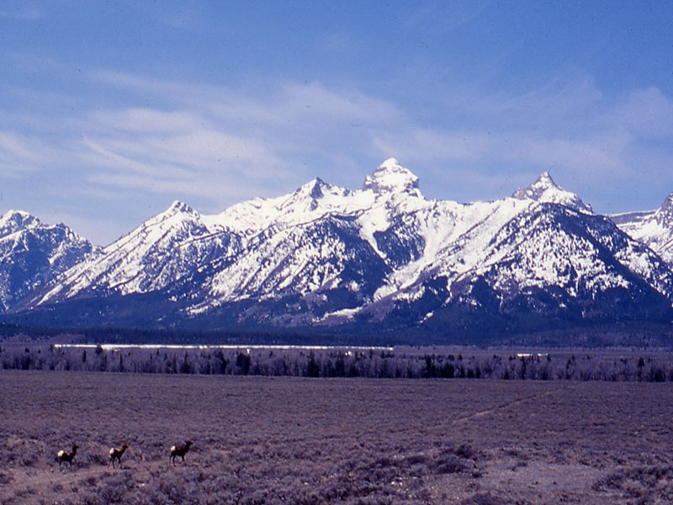
Western Mountain Region
younger rocks, earthquakes, dry lowlands, rainy slopes with forests,
snow on the high peaks, ski resorts,
metal mines, a few cities, national parks

Slide 52
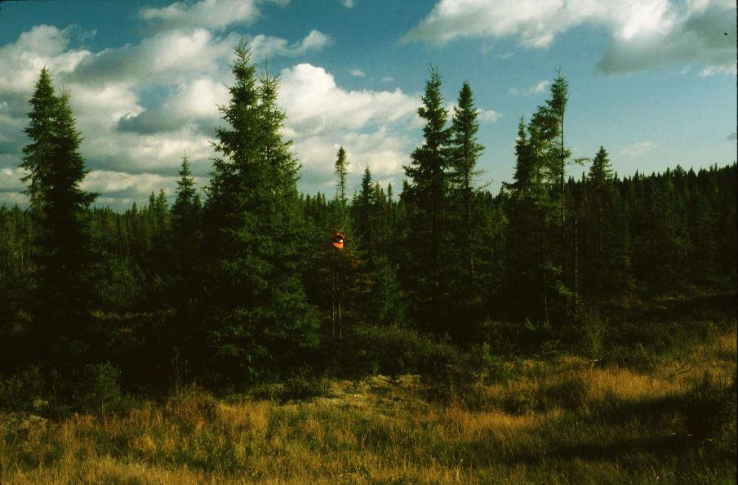
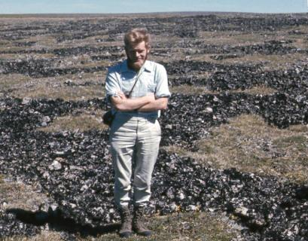
Northern Cold Region
old rocks, low hills or plains, many lakes,
dense forests of slow-growing needleleaf trees
OR treeless tundra near the Arctic Ocean,
very few people, few roads, some mines

Slide 53
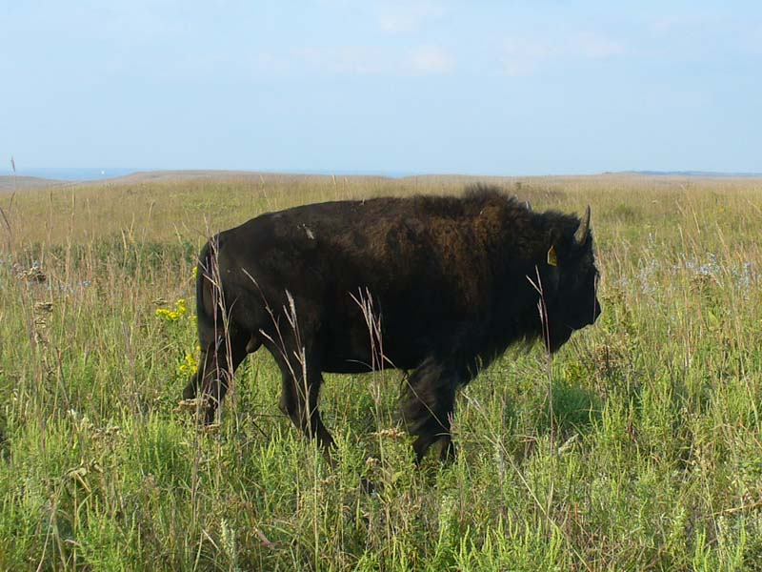
Great Plains Grassland Region
young rocks, flat plains or low hills, dry creeks,
occasional tornadoes, grassland, bison (buffalo), cattle ranches, wheat fields, a few irrigated fields,
scattered towns, some oil wells

Slide 54
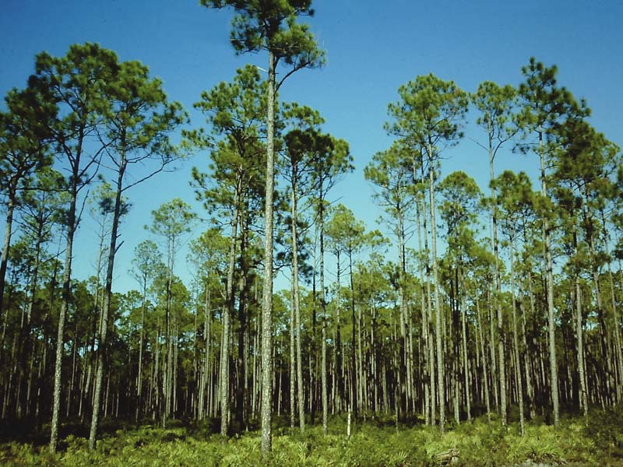
Southern Cotton / Pine Region
long summers, red soil, fast-growing forest,
old cotton plantations, slavery, Civil War,
sharecroppers, boll weevil, planted pines,
paper mills, some new factories (e.g., cars)

Slide 55
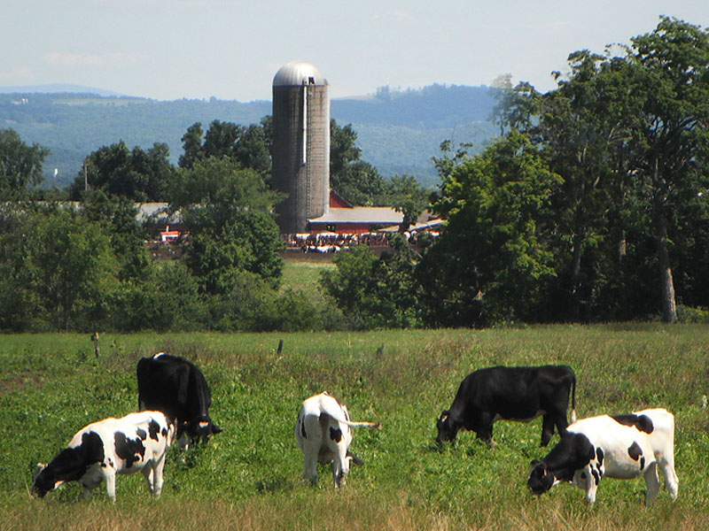
Great Lakes Forest/Farm Region
warm summers, cold winters, plains or low hills,
hardwood forest, corn fields, dairy cows,
cities on rivers or next to Great Lakes,
many small towns with factories

Slide 56
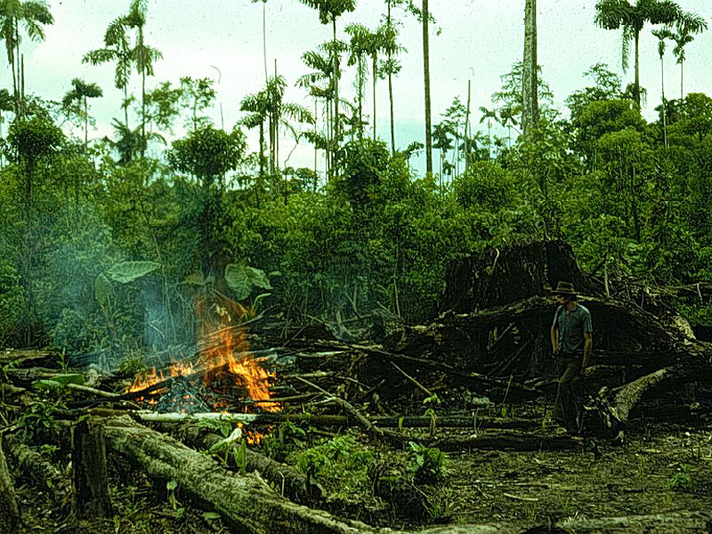
Central American Region
no freezing season, forested hills, beach resorts,
coffee plantations, many small countries
(it’s much harder to think of just one picture for this region,
this one shows slash-and-burn farming in the forest)

Slide 57
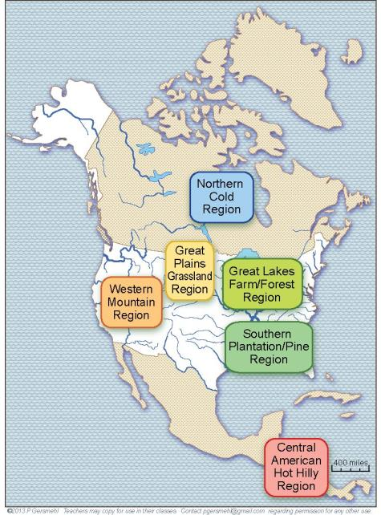
Here is another way
to show the regions.

Slide 58
Here is another way
to show the regions.
Can you remember
where to draw
the lines?

Slide 59
And that is how
you can use
a few lines
to help organize
a lot of information.

Slide 60
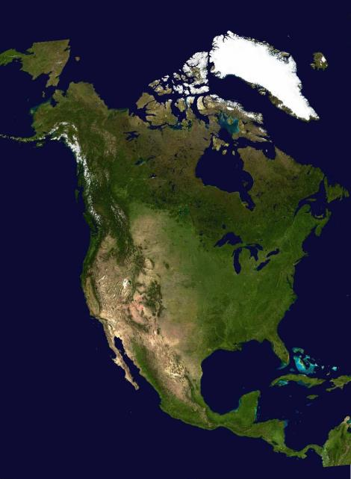
Here, we will draw
the same four lines
on a satellite image.

Slide 61
Here, we will draw
the same four lines
on a satellite image.
The mountain line
(young/old rocks)

Slide 62
Here, we will draw
the same four lines
on a satellite image.
The farm line
(4-month frostfree season)
The mountain line
(young/old rocks)

Slide 63
Here, we will draw
the same four lines
on a satellite image.
The farm line
(4-month frostfree season)
The mountain line
(young/old rocks)
The tree line
(enough rain)

Slide 64
Here, we will draw
the same four lines
on a satellite image.
The farm line
(4-month frostfree season)
The cotton line
(7-month frostfree season)
The mountain line
(young/old rocks)
The tree line
(enough rain)

Slide 65
Remember
a geographic region
is not a “real thing” out there
It is what we get when we draw lines
to put similar places together into groups
(in order to make them easier to remember).
If we use different ways of deciding
what places are similar to each other,
then we get different regions.

Slide 66
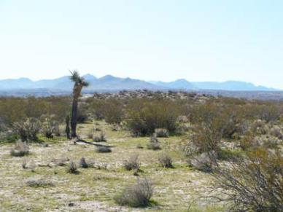
Here is an example.
Some people want
the map to include
a hot, dry region called
the “Desert Southwest.”

Slide 67
If you think
that makes things
easier to remember,
fine, . . . but

Slide 68
If you think
that makes things
easier to remember,
fine, . . . but
we suggest that it is
easier and more accurate
to remember two facts:
1. High mountains have
enough rain for trees
even in dry Arizona.
2. Low areas between
mountains are deserts
from Mexico to Canada.

Slide 69
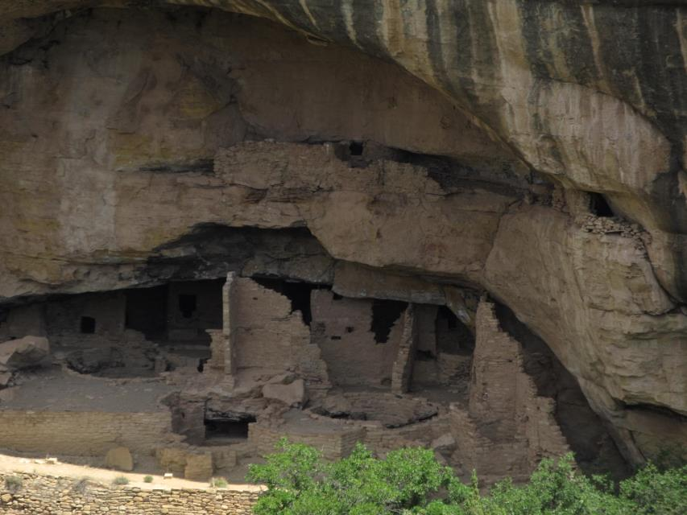
The pueblo people
of Mesa Verde,
for example,
did not really live in
“ the desert southwest.”

Slide 70
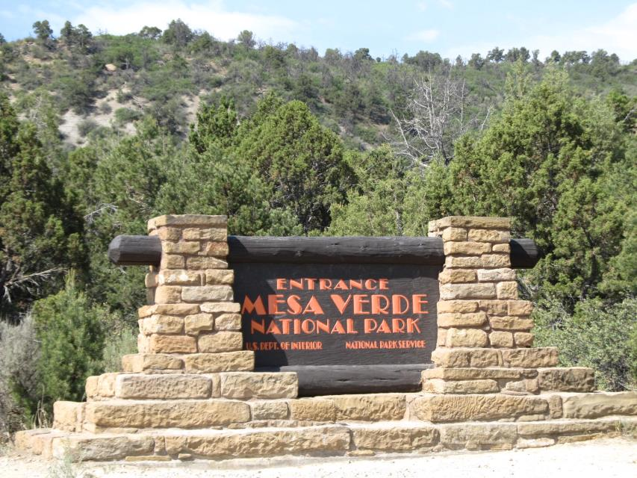
They lived
in the pine forests
on an isolated high hill
(a little cooler and rainier)
in southwestern Colorado.

Slide 71
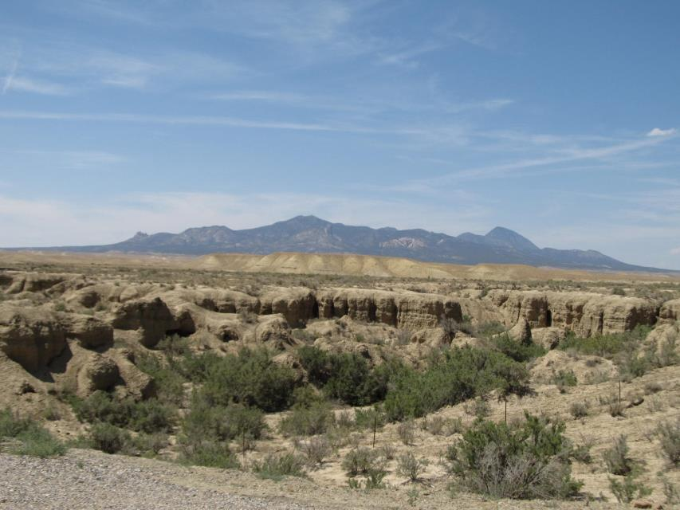
They were protected from enemies
by the fact that the surrounding land
is, indeed, a dry desert.

Slide 72
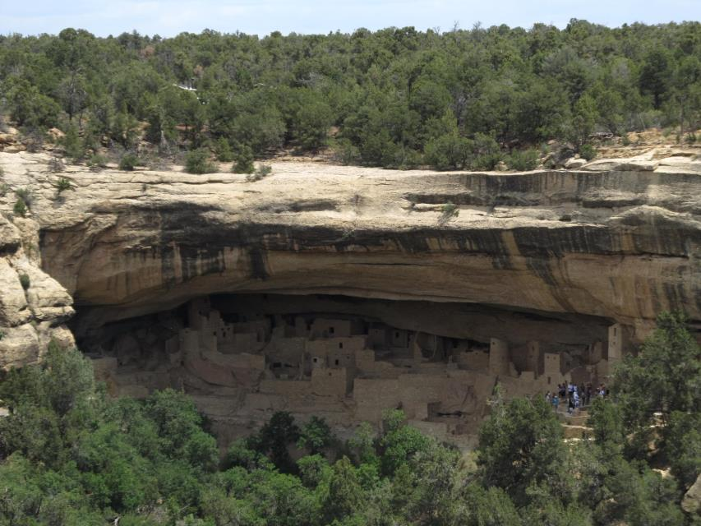
To say that they lived
in the “Desert Southwest”
is a simplification that hides
an important part of the truth.

Slide 73
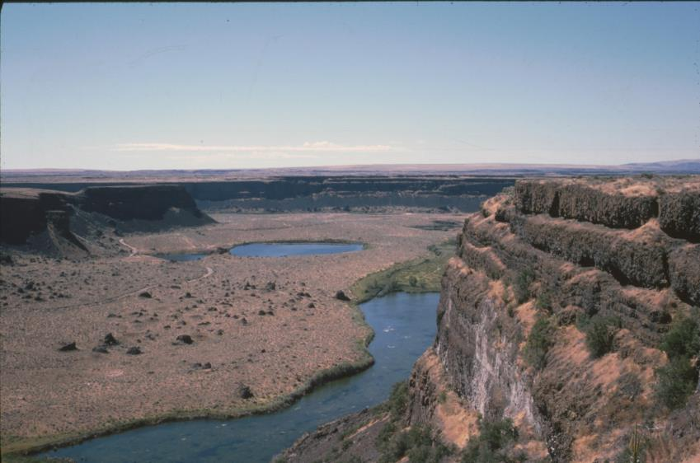
The situation is the same farther north.
This picture shows Dry Falls,
90 miles east of Seattle, Washington.
Coastal Washington is a very rainy area,
but central Washington is a desert – even though
it is not in an area called “the desert Southwest”!

Slide 74
One of the main reasons
to learn about regions
is this simple fact:
All regional maps
are generalizations.

Slide 75
An equally important goal,
however, is to realize
that a few simple lines
can help us organize
a lot of information
about North America!

Slide 76
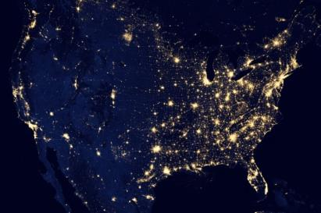
Here are the daytime and
night-time satellite images again.
Can you “see” the regions
in your mind?
Click and we’ll draw them again.

Slide 77
Here are the daytime and
night-time satellite images again.
Can you “see” the regions
in your mind?
Click and we’ll draw them again.

Slide 78
Here are the daytime and
night-time satellite images again.
Can you “see” the regions
in your mind?
Click and we’ll draw them again.

Slide 79
Here are the daytime and
night-time satellite images again.
Can you “see” the regions
in your mind?
Click and we’ll draw them again.

Slide 80
Here are the daytime and
night-time satellite images again.
Can you “see” the regions
in your mind?
Click and we’ll draw them again.

Slide 81
Here are the daytime and
night-time satellite images again.
Can you “see” the regions
in your mind?
Click and we’ll draw them again.

Slide 82
Here are the daytime and
night-time satellite images again.
Can you “see” the regions
in your mind?
Click and we’ll draw them again.

Slide 83
Here are the daytime and
night-time satellite images again.
Can you “see” the regions
in your mind?
Click and we’ll draw them again.

Slide 84
Here are the daytime and
night-time satellite images again.
Can you “see” the regions
in your mind?
Click and we’ll draw them again.

Slide 85
Here are the daytime and
night-time satellite images again.
Can you “see” the regions
in your mind?
Click and we’ll draw them again.
Remember,
this is a big
oil field!

Slide 86
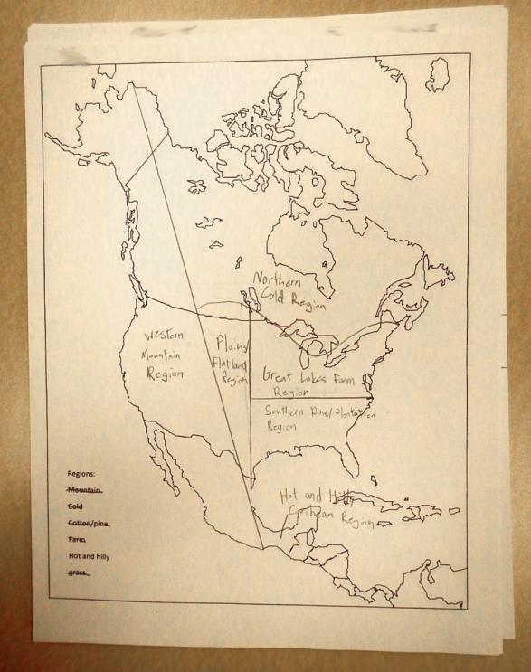
This map was drawn
by a 6th grade student
two weeks after doing
the region activity.

Slide 87
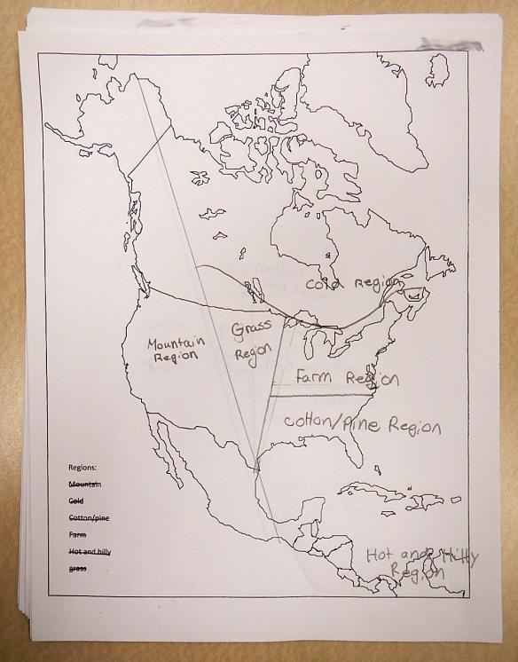
Here is another example.
A few lines are slightly off,
but this student remembers
the continent quite well.

Slide 88
Here is another example.
A few lines are slightly off,
but this student remembers
the continent quite well.
and that is
the whole point!

Slide 89
A good mental map
of regions like this
can help you organize
a lot of information
about North America!

Slide 90
We’ll give you
just two simple examples.

Slide 91
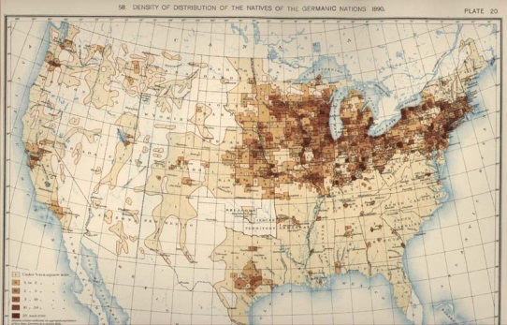
Here is a map that shows
German immigrants in 1898.
Mentally draw your regional lines, then click.

Slide 92
Here is a map that shows
German immigrants in 1898.
Mentally draw your regional lines, then click.

Slide 93
Here is a map that shows
German immigrants in 1898.
Mentally draw your regional lines, then click.

Slide 94
Here is a map that shows
German immigrants in 1898.
Mentally draw your regional lines, then click.

Slide 95
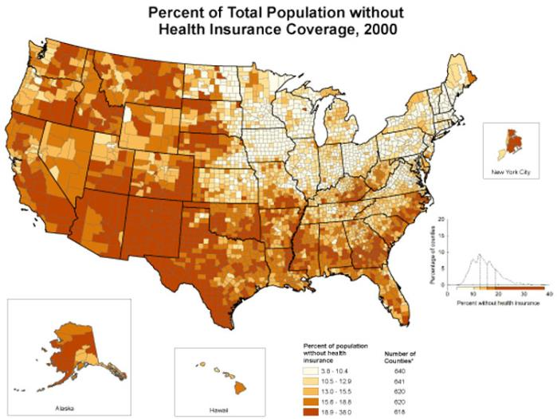
Here is a map of people
who did not have health insurance in 2000.
Mentally draw your regional lines, then click.

Slide 96
Here is a map of people
who did not have health insurance in 2000.
Mentally draw your regional lines, then click.

Slide 97
Here is a map of people
who did not have health insurance in 2000.
Mentally draw your regional lines, then click.

Slide 98
Here is a map of people
who did not have health insurance in 2000.
Mentally draw your regional lines, then click.

Slide 99
Do an image search to see what people call a fizzy soft drink:
(We can’t show a map like this, because of copyright rules.)
While you are on the internet, look at religion:
https://glenmary.org/missions/mapping-mission/
or high school graduation:
https://www.cdc.gov/dhdsp/maps/sd_high_school.htm
or life expectancy:
https://directorsblog.nih.gov/2017/05/16/widening-gap-in-u-s-life-expectancy/
or any of a thousand other regional maps . . . .

Slide 100
Remember:
People make regional maps
by putting similar places together.
(And people decide what places are similar!)
In this presentation, you learned that
four lines can help us organize a lot of information
if you know where to draw them on a map of North America.
This is why we recommend memorizing where these lines go.

Slide 101
Question
Section

Slide 102
What do you call
this kind of map?

Slide 103
What is the
general position
of North America
on a globe?

Slide 104
Why does North America
have such a wide range
of natural environments?

Slide 105
What regions
does this line
separate?

Slide 106
What are
some exceptions
to this basic division
of the continent?

Slide 107
What regions
does this line
separate?

Slide 108
What regions
does this line
separate?

Slide 109
What does
“semi-arid”
mean?

Slide 110
How is
the western region
more complicated
than the eastern part
of the continent?

Slide 111
How can our
first three lines
help us remember
the geographic pattern
of human population
in North America?
Night-time image
from NASA satellite

Slide 112
Vancouver,
Canada
Seattle
Denver
These two
places are
oil fields.
What are
these two
light areas?
San Francisco
Los Angeles
Phoenix
and Tucson
Night-time image
from NASA satellite

Slide 113
What regions
does this line
separate?

Slide 114
2
Can you describe
these five regions
in a few sentences?
3
5
1
4

Slide 115
What region is shown
in this photo?

Slide 116
What region is shown
in this photo?

Slide 117
What region is shown
in this photo?

Slide 118
What region is shown
in this photo?

Slide 119
What region is shown
in this photo?

Slide 120
Central American Region
no freezing season, forested hills, beach resorts,
coffee plantations, many small countries
(it’s much harder to think of just one picture for this region,
this one shows slash-and-burn farming in the forest)

Slide 121
Describe the land
in each major part
of this satellite image.

Slide 122
What environment
do some people
want to identify as
a separate region?

Slide 123
What is shown
in this photo?

Slide 124
How would you describe
the geographic position
of the Mesa Verde villages?

Slide 125
What state
has this river
flowing through
a dry desert?

Slide 127
Copyright 2018, Phil Gersmehl
Teachers who saw this presentation at a workshop
or downloaded it from our internet site have permission
to make a copy on their own computers for these purposes:
1. to help them review the workshop,
2. to show the presentation in their own classrooms, at sessions they present at teacher conferences, or to administrators in their own school or district,
3. to use individual frames (with attribution) in their own class or conference presentations.
For permission for any other use,
including posting frames on a personal blog or uploading to any network or website that can be accessed from outside your school,
contact pgersmehl@gmail.com

