Slide 1
Elevation A geographic “BIG IDEA” with many consequence in South America
Elevation is a big idea that can help us understand many geographic patterns in South America
including the patterns of rivers, rainforests,
ancient empires, food production,
mining, tourism, deforestation,
and the locations of capital cities.
Skip to
question
section.

Slide 2
Note to Teachers
1. This presentation has a specific purpose. It is designed as an illustrated teacher guide to provide content background
about the “layers of information” on the clickable map of South America.
It is not designed for use in class “as is” – to tailor it for a specific class, you might shorten it, edit frames, add pictures or discussion questions, etc.
(see below)
2. This presentation has two parts – explanation and question. You can cut-and-paste to put question frames where you want them in order to promote class discussion or identify misconceptions.
The question frames can also serve as reviews, assessments,
or prompts for inquiry activities (individual or group).
3. This presentation is much too long. There is a good reason for this – your computer has a DELETE key,
but it does not have a CREATE key.
This is important, because many teachers have reviewed this presentation. If anyone suggested an addition (like a definition, explanation, or example), we usually put it in – because other teachers might also find it useful,
and it takes much less time to delete a frame than to make one!
(PS. You can delete this frame now!)
?
DELETE

Slide 3
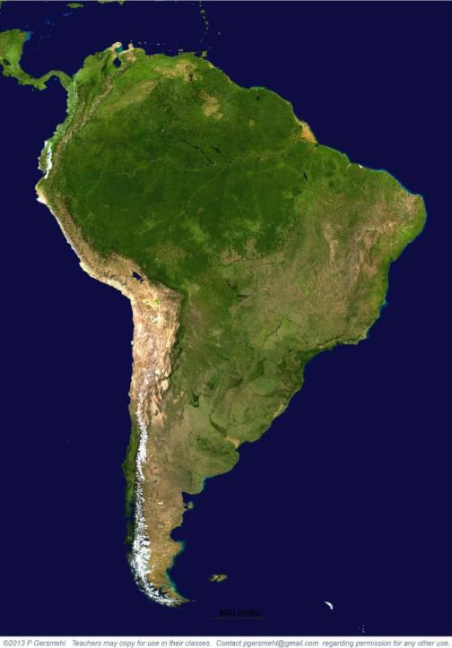
This satellite
image shows
the major
regions
of South America.

Slide 4
The green
Amazon
rainforest
This satellite
image shows
the major
regions
of South America.

Slide 5
The green
Amazon
rainforest
This satellite
image shows
the major
regions
of South America.
The high Andes
Mountains

Slide 6
The green
Amazon
rainforest
This satellite
image shows
the major
regions
of South America.
The high Andes
Mountains
The dry
grasslands
of Patagonia

Slide 7
The green
Amazon
rainforest
This satellite
image shows
the major
regions
of South America.
The highlands
of eastern
Brazil
The high Andes
Mountains
The dry
grasslands
of Patagonia

Slide 8
The green
Amazon
rainforest
This satellite
image shows
the major
regions
of South America.
Curriculum note.
There is a separate presentation about
making a mental map
of major regions
in South America.
The highlands
of eastern
Brazil
The high Andes
Mountains
The dry
grasslands
of Patagonia

Slide 9
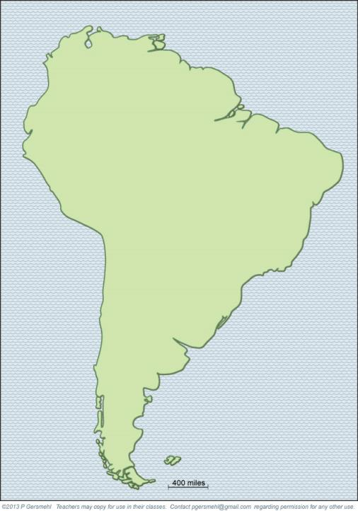
Here is
a simple
basemap.

Slide 10
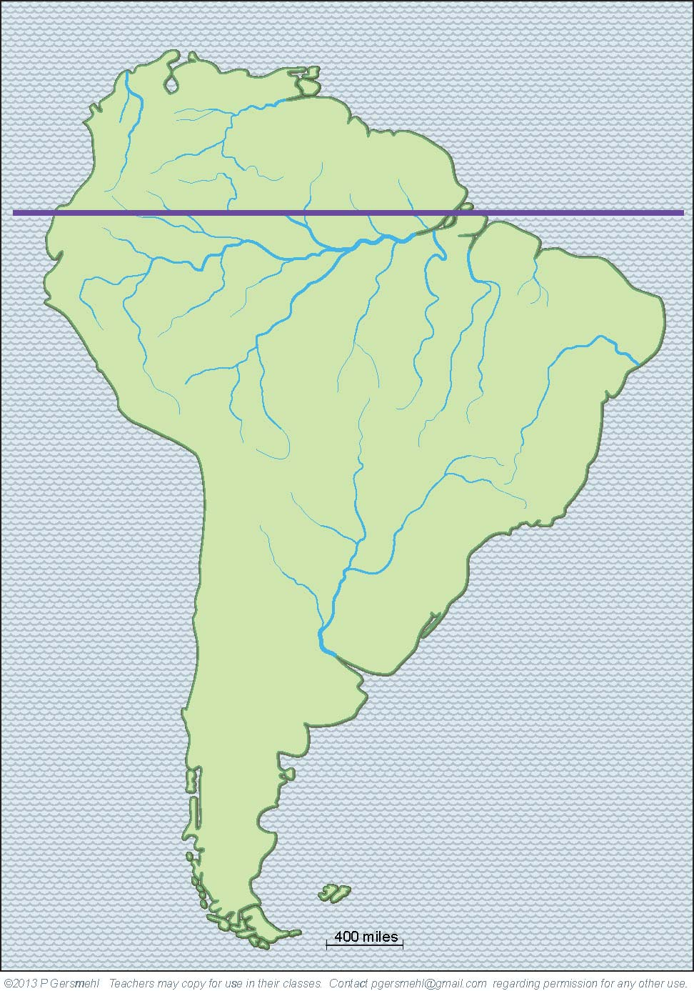
Here is
a simple
basemap.
The
equator
crosses
the mouth
of the
Amazon
River

Slide 11
Here is
a simple
basemap.
The
equator
crosses
the mouth
of the
Amazon
River
That fact is pure luck.
It makes it very easy
to remember the location
of the biggest river on the planet
(and also to find the equator
if a mapmaker forgets
to put it on a map).

Slide 12
Here is
a simple
basemap.
The
equator
crosses
the mouth
of the
Amazon
River
That fact is pure luck.
It makes it very easy
to remember the location
of the biggest river on the planet
(and also to find the equator
if a mapmaker forgets
to put it on a map).
Curriculum note.
There is a separate presentation called
“Where is the Equator”

Slide 13
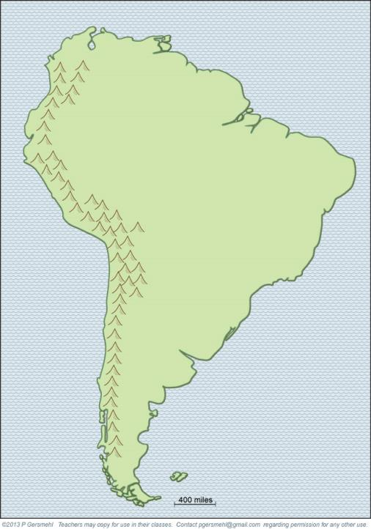
The high
Andes
Mountains
form a “wall”
near the
west coast.

Slide 14
The high
Andes
Mountains
form a “wall”
near the
west coast.
Curriculum note.
There is a world-map activity called “Where are the Mountains.”

Slide 15
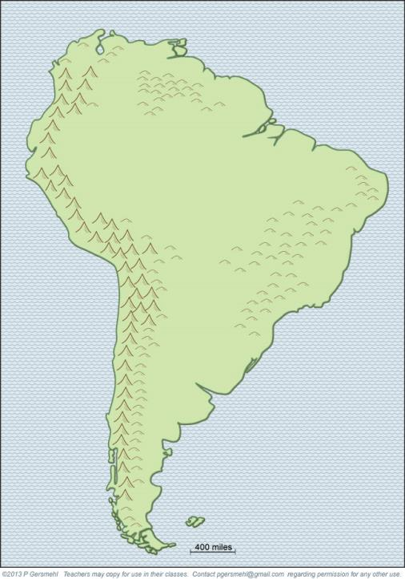
In the east
are low hills,
worn-down
“stumps”
of older
crustal
collisions.

Slide 16
Big Idea:
The elevation
of the land
in different places
has great influence
on many other
features of
South America.

Slide 17
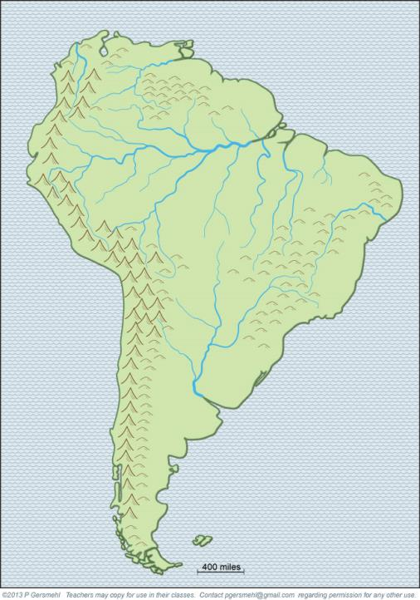
For example,
the Amazon River
starts in the high Andes Mountains and then flows
all the way
across the
continent.

Slide 18
The Paraguay River drains a large area
farther to the south.

Slide 19
The Paraguay River drains a large area
farther to the south.
This important river
has different names
in different countries.
It’s also called the Parana and Rio de la Plata.

Slide 20
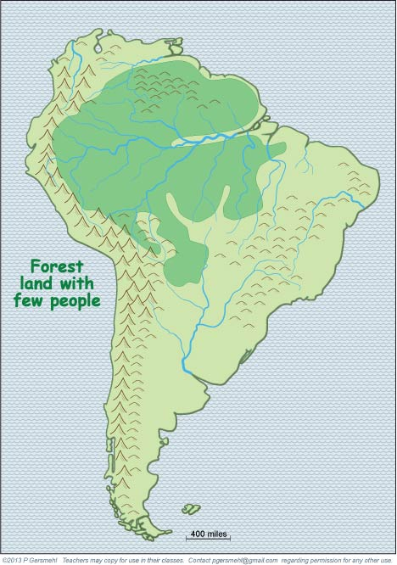
A dense rainforest
covers most
of the low land
near the equator.

Slide 21
A dense rainforest
covers most
of the low land
near the equator.
Curriculum note.
There is a clickable map
about the “ecoregions”
of the world.

Slide 22
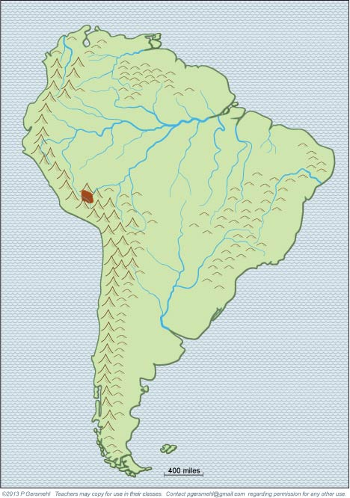
The
Inca Empire
started
in the high
mountains
of modern
Peru.

Slide 23
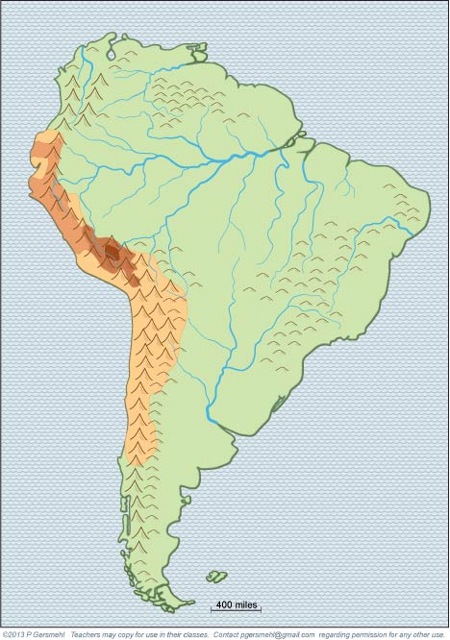
By 1525
it had spread
to cover
most of the
mountains.

Slide 24
By 1525
it had spread
to cover
most of the
mountains.
Curriculum note.
There is a clickable map
and printed activities
about major empires
in world history.

Slide 25
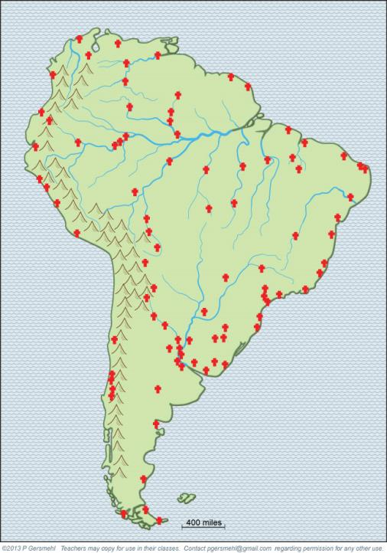
Then the Spanish
and Portuguese
explorers and
missionaries came.
You can tell
where they lived
by finding towns
named after saints
(San, Sao, Santa).

Slide 26
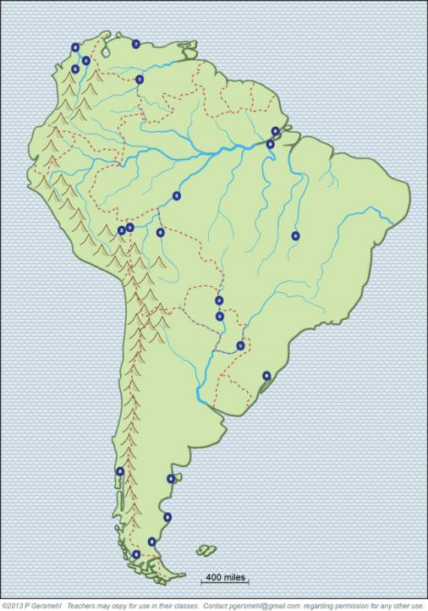
They also
named
many towns
Porto or Puerto
(which means port).

Slide 27
Remember,
the high
mountains
are along
the west coast.

Slide 28
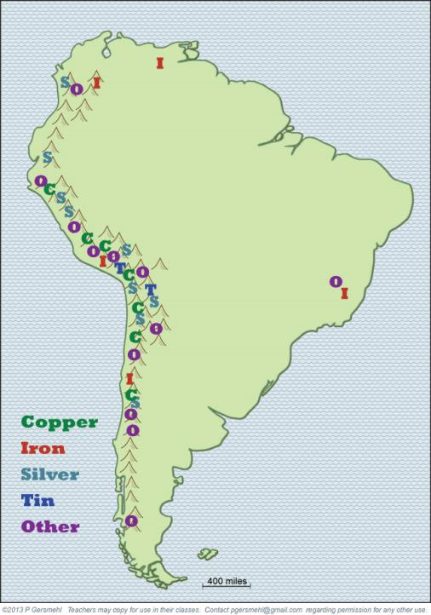
That is where
nearly all
of the metal
ores are found, . . .

Slide 29
That is where
nearly all
of the metal
ores are found, . . .
because
metal ores
are formed by
the geologic processes
that make
mountains.

Slide 30
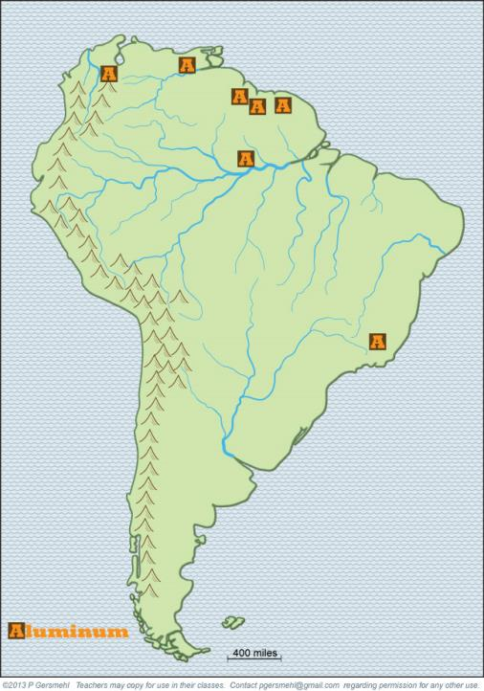
Aluminum is
and exception
to that rule.
It is formed
in the soil
in hot, rainy
environments.

Slide 31
Aluminum is
and exception
to that rule.
It is formed
in the soil
in hot, rainy
environments.
In other words,
in the low lands
near the equator!

Slide 32
Aluminum is
and exception
to that rule.
It is formed
in the soil
in hot, rainy
environments.
In other words,
in the low lands
near the equator!
Curriculum note.
There is a clickable map
and a presentation
about economic geology.

Slide 33
The Amazon River drains a lot of land
near the equator.
As a result, it is
a huge river –
by far the largest
in the world.

Slide 34
Much of the land
in the Amazon
watershed
is rainforest.

Slide 35
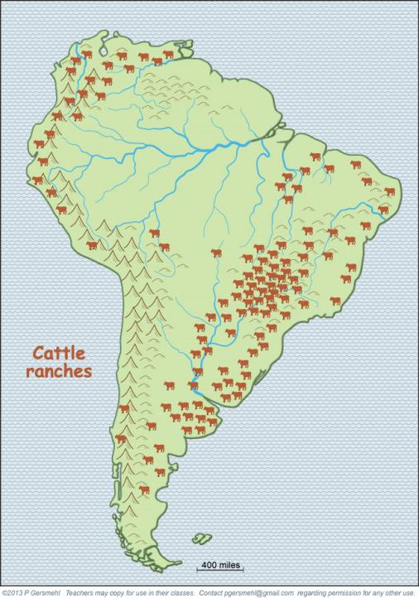
The old,
worn-down hills
now have many
cattle ranches
(think McDonalds!)

Slide 36
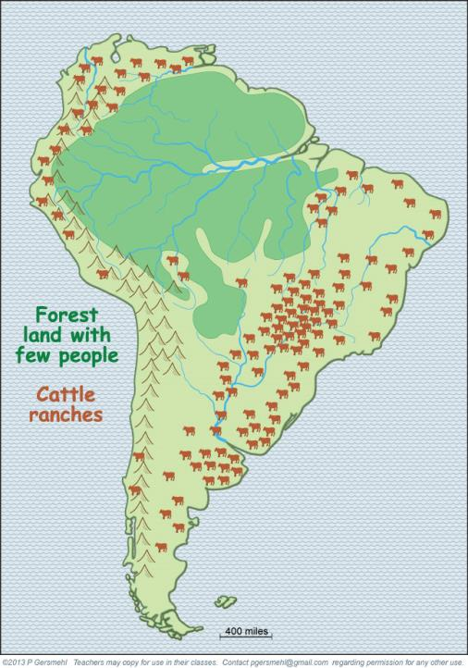
It’s hard
to raise cattle
on high mountains
or in hot lowlands,
even if you
clear the forest.
It’s hard
to raise cattle
on high mountains
or in hot lowlands,
even if you
clear the forest.

Slide 37
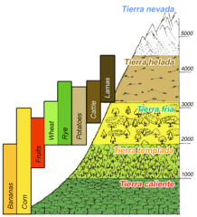
It’s hard
to raise cattle
on high mountains
or in hot lowlands,
even if you
clear the forest.
It’s hard
to raise cattle
on high mountains
or in hot lowlands,
even if you
clear the forest.
Curriculum note.
There are student activities about
“Elevation Zones and Land Uses”
and “Making a Fast-food Meal.”

Slide 38
Finally,
note how
elevation
influenced
the choice
of locations
for capital cities.

Slide 39
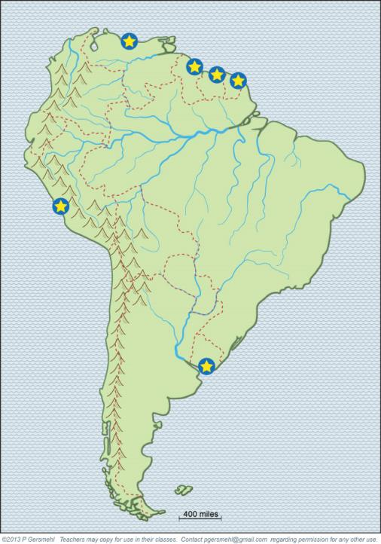
Half of the
countries put
their capitals
right next to
the cooling
ocean water.

Slide 40
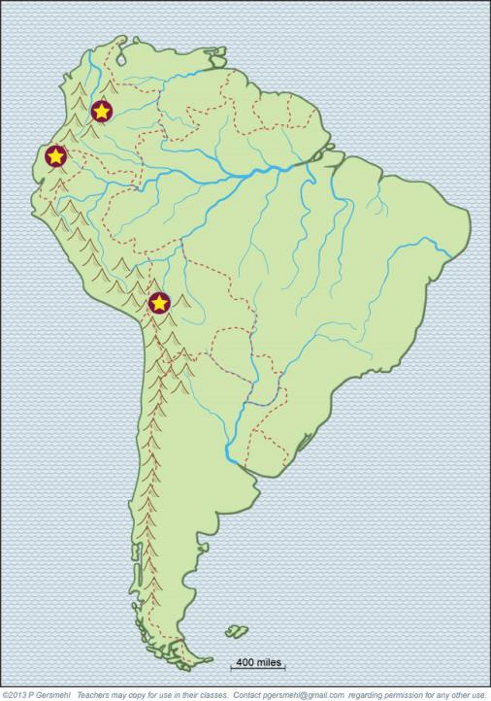
Three countries
near the equator
put their capitals
high in the mountains

Slide 41
Three countries
near the equator
put their capitals
high in the mountains
These cities are
as much as
two miles
above sea level.

Slide 42
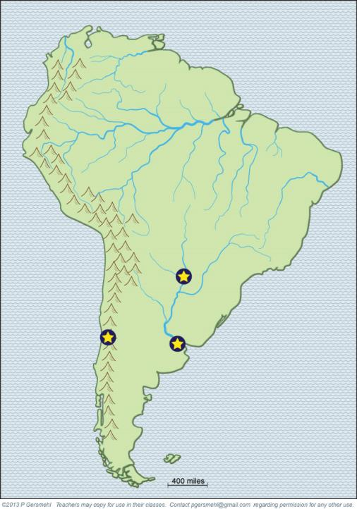
The three countries
that are farthest
from the equator
put their capitals
on low land
near rivers.

Slide 43
The three countries
that are farthest
from the equator
put their capitals
on low land
near rivers.
Remember,
the equator
goes through
the mouth of the
Amazon River.

Slide 44
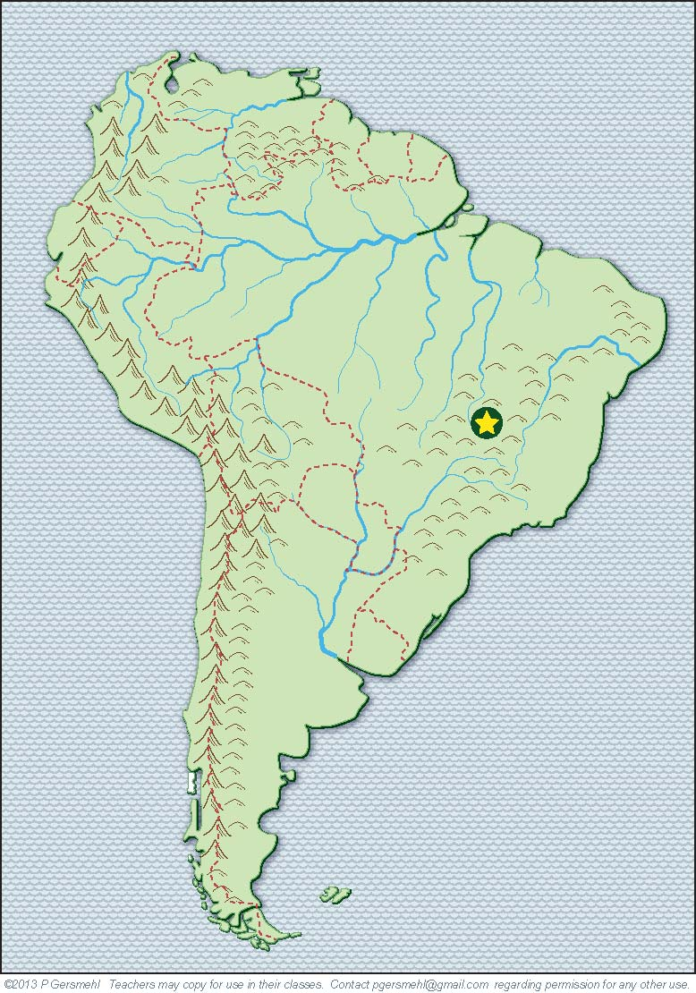
Brazil built
a new capital
high in the hills –
above 99%
of the country!

Slide 45
Brazil built
a new capital
high in the hills –
above 99%
of the country!
Curriculum note.
There is an activity called
“Elevation and Capital Cities.”

Slide 46
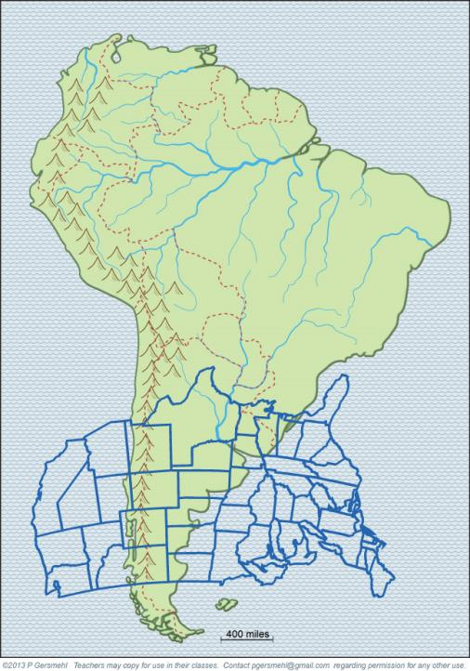
For comparison,
here is the
United States
at the same size
and proper
latitude.

Slide 47
For comparison,
here is the
United States
at the same size
and proper
latitude.
It’s “upside-down”
because this part
of South America
is south of
the Equator.

Slide 48
Many places
in Chile
and Argentina
are similar
to places
in the U.S.

Slide 49
But
no place
in the U.S.
is like the
Amazon rainforest
or the high Andes
near the
equator.
But
no place
in the U.S.
is like the
Amazon rainforest
or the high Andes
mountains.
Many places
in Chile
and Argentina
are similar
to places
in the U.S.

Slide 50
But
no place
in the U.S.
is like the
Amazon rainforest
or the high Andes
near the
equator.
But
no place
in the U.S.
is like the
Amazon rainforest
or the high Andes
mountains.
Many places
in Chile
and Argentina
are similar
to places
in the U.S.
Curriculum note.
There is another presentation
about analogous areas
in the United States
and South America.

Slide 51
This presentation showed one way to use
the clickable map of South America - to help us investigate
some consequences of the big idea of elevation.
Elevation can affect:
This presentation showed one way to use
the clickable mini-Atlas - to help us investigate
some consequences of the big idea of resources,
with examples from Southwest Asia and north Africa.
Resources can affect:

Slide 52
This presentation showed one way to use
the clickable map of South America - to help us investigate
some consequences of the big idea of elevation.
Elevation can affect:
This presentation showed one way to use
the clickable mini-Atlas - to help us investigate
some consequences of the big idea of resources,
with examples from Southwest Asia and north Africa.
Resources can affect:
Temperature – the air gets between 3 and 5 degrees colder for every thousand feet you go up.
(The actual change depends on starting temperature and humidity.)

Slide 53
This presentation showed one way to use
the clickable map of South America - to help us investigate
some consequences of the big idea of elevation.
Elevation can affect:
This presentation showed one way to use
the clickable mini-Atlas - to help us investigate
some consequences of the big idea of resources,
with examples from Southwest Asia and north Africa.
Resources can affect:
Temperature – the air gets between 3 and 5 degrees colder for every thousand feet you go up.
Precipitation – colder air cannot hold as much moisture, and therefore is likely to rain or snow.

Slide 54
This presentation showed one way to use
the clickable map of South America - to help us investigate
some consequences of the big idea of elevation.
Elevation can affect:
This presentation showed one way to use
the clickable mini-Atlas - to help us investigate
some consequences of the big idea of resources,
with examples from Southwest Asia and north Africa.
Resources can affect:
Temperature – the air gets between 3 and 5 degrees colder for every thousand feet you go up.
Precipitation – colder air cannot hold as much moisture, and therefore is likely to rain or snow.
Plants and animals – each kind of plant or animal has a “preferred” kind of weather, where it grows best

Slide 55
This presentation showed one way to use
the clickable map of South America - to help us investigate
some consequences of the big idea of elevation.
Elevation can affect:
This presentation showed one way to use
the clickable mini-Atlas - to help us investigate
some consequences of the big idea of resources,
with examples from Southwest Asia and north Africa.
Resources can affect:
Temperature – the air gets between 3 and 5 degrees colder for every thousand feet you go up.
Precipitation – colder air cannot hold as much moisture, and therefore is likely to rain or snow.
Plants and animals – each kind of plant or animal has a “preferred” kind of weather, where it grows best
Mineral resources – the same geologic processes that make high mountains also tend to concentrate
metal elements into ores that are profitable to mine

Slide 56
This presentation showed one way to use
the clickable map of South America - to help us investigate
some consequences of the big idea of elevation.
Elevation can affect:
This presentation showed one way to use
the clickable mini-Atlas - to help us investigate
some consequences of the big idea of resources,
with examples from Southwest Asia and north Africa.
Resources can affect:
Temperature – the air gets between 3 and 5 degrees colder for every thousand feet you go up.
Precipitation – colder air cannot hold as much moisture, and therefore is likely to rain or snow.
Plants and animals – each kind of plant or animal has a “preferred” kind of weather, where it grows best
Mineral resources – the same geologic processes that make high mountains also tend to concentrate
metal elements into ores that are profitable to mine
Human settlement and land use – economic activities like farming, fishing, forestry, or even city building do best under the conditions at specific elevations.

Slide 57
This presentation was a brief look
at the influence of elevation,
and some of its effects
in South America.

Slide 59
QUESTIONS section
Notes:
Discussion section

Slide 60
What does
dark green
represent?
A satellite
image shows
the major
regions.
What does
white
mean?
What does
this tan color
represent?

Slide 61
Where is
the equator?

Slide 62
What
big river
enters
the ocean
near the
equator?

Slide 63
What range
of high
mountains
runs near
the west
coast?

Slide 64
Why are
the hills
in the east
much lower
than the
Andes
Mountains?

Slide 65
Big Idea:
Why is elevation
an important
geographic
“big idea” ?

Slide 66
How does the
arrangement
of high mountains
help us understand
why the Amazon
is the largest
river on earth?

Slide 67
Why does the
Amazon rainforest
have very few
people?

Slide 68
What ancient
empire started
in the high
mountains
of modern
Peru?

Slide 69
By 1525, the
Inca Empire
covered
most of the
mountains.
What happened
then?

Slide 70
These towns
are all named
for Catholic saints
(San, Sao, Santa).
What does that
tell us about
their history?

Slide 71
What about
towns named
Porto or Puerto?

Slide 72
What are
some other
consequences
of mountains
along the
west coast?

Slide 73
Why are
metal ores
often found
in mountains?

Slide 74
Aluminum is
an important
exception –
do you
know why?

Slide 75
Review –
what kind of
vegetation
grows in
the low lands
close to the
equator?

Slide 76
Why do
these forests
have relatively
few people
in them?

Slide 77
Why are
cattle ranches
found mainly
on the low hills
in eastern Brazil?

Slide 78
It’s hard
to raise cattle
on high mountains
or in hot lowlands,
even if you
clear the forest.
Why is it hard
to raise cattle
on high mountains
or in hot lowlands?

Slide 79
Finally,
note how
elevation
influenced
the choice
of locations
for capital cities.

Slide 80
Why do
many countries put their capitals
right next to the
ocean shore?

Slide 81
Why do three
of the countries
near the equator put their capitals
high in the mountains?

Slide 82
What is
important about
the locations
of these three
capitals?

Slide 83
What is
the story
about this
capital city?

Slide 84
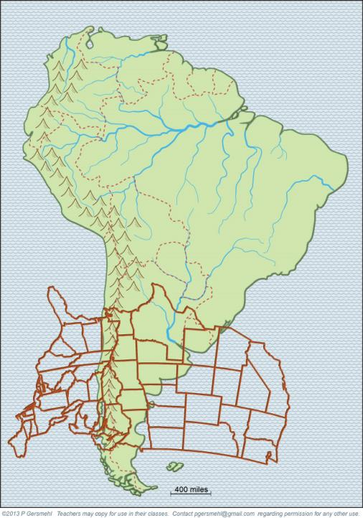
Why is
this image
of the U.S.
useful for
comparison?

Slide 85
Why is the
United States
“upside down”
for this comparison?

Slide 86
Why did
we “flip” it
backwards
to make the
comparison
better?

Slide 87
What country
is like
coastal
Texas –
and why?

Slide 88
What area
is like
Florida
-
and why?

Slide 89
What small country
is like
Mississippi
and Arkansas?

Slide 90
What country
is like Kansas?
(with corn farms
in the rainier east
and wheat farms
in the drier west)

Slide 91
What area
is like eastern
Montana –
cool and dry?

Slide 92
Patagonia
is like
eastern
Montana –
cool and dry.
How is
the central
coastal area
of Chile
like
California?

Slide 93
Patagonia
is like
eastern
Montana –
cool and dry.
How is
the central
coastal area
of Chile
like
California?
Why is that
important?

Slide 94
What state
is most like
Cape Horn?
Why?

Slide 95
Why does
the U.S.
have no
place that
is like the
equatorial
rainforest?

Slide 96
Here are a few questions for individual inquiry:
1. Why do rainforests grow on low land near the equator?
2. Why did people grow potatoes in the Inca highlands?
3. Why did several European countries claim colonies on the northern coast of South America?
4. What foods do Americans buy from farmers in Chile?
5. What foods do Americans buy from farmers in Brazil?
6. What metals do people in South America sell to factory owners in other countries?
7. Why is sugarcane a source of motor fuel in lowland Brazil?
8. Why are fish an important product in western South America?

Slide 98
Copyright 2019, Phil and Carol Gersmehl
Teachers who saw this presentation at a workshop
or downloaded it from our internet site have permission
to make a copy on their own computers for these purposes:
1. to help them review the workshop,
2. to show the presentation in their own classrooms, at sessions they present at teacher conferences, or to administrators in their own school or district,
3. to use individual frames (with attribution) in their own class or conference presentations.
For permission for any other use,
including posting frames on a personal blog or uploading to any network or website that can be accessed from outside your school,
contact pgersmehl@gmail.com

