Slide 1
distance: a geographic “big idea” with many consequences in AUSTRALIA
Distance is a big idea that helps us understand many other geographic features about Australia,
including the patterns of natural vegetation,
sheep, cattle, wine grapes, cities, and roads
(as well as the first use of this remote British colony,
the products Australians are able to sell today and the countries that are buying from them).

Slide 2
Note to Teachers
1. This presentation has a specific purpose. It is designed as an illustrated teacher guide to provide content background
about the “layers of information” on the clickable map of Australia.
It is not designed for use in class “as is” – to tailor it for a specific class, you might shorten it, edit frames, add pictures or discussion questions, etc.
(see below)
2. This presentation has two parts – explanation and question. You can cut-and-paste to put question frames where you want them in order to promote class discussion or identify misconceptions.
The question frames can also serve as reviews, assessments,
or prompts for inquiry activities (individual or group).
3. This presentation is much too long. There is a good reason for this – your computer has a DELETE key,
but it does not have a CREATE key.
This is important, because many teachers have reviewed this presentation. If anyone suggested an addition (like a definition, explanation, or example), we usually put it in – because other teachers might also find it useful,
and it takes much less time to delete a frame than to make one!
(PS. You can delete this frame now!)
?
DELETE

Slide 3
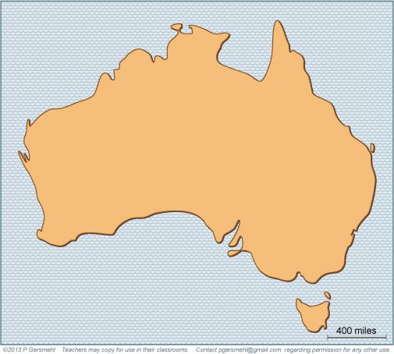
Australia is
the only country that
fills a whole continent.

Slide 4
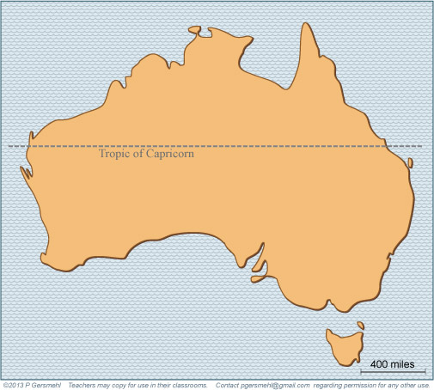
It is just the right distance
away from the Equator,
so the Tropic of Capricorn runs
through the middle of the country.

Slide 5
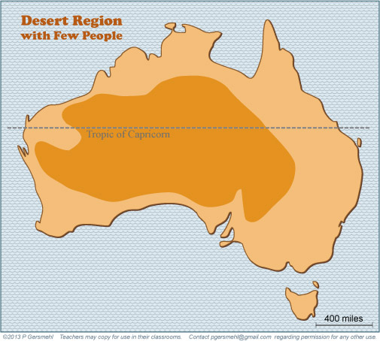
Air sinking downward
tends to make deserts
around the Tropic lines . . .

Slide 6
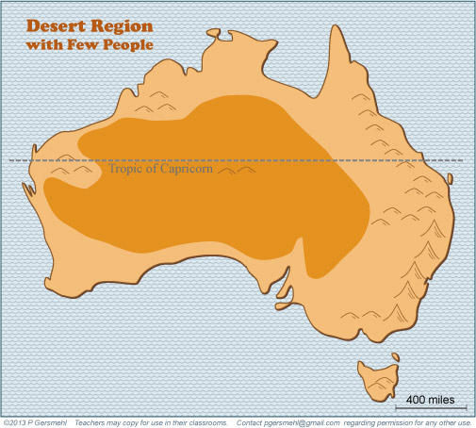
except near the east coast
and where mountains
can capture some rain.
Air sinking downward
tends to make deserts
around the Tropic lines.
Air sinking downward
tends to make deserts
around the Tropic lines . . .

Slide 7
except near the east coast
and where mountains
can capture some rain.
Air sinking downward
tends to make deserts
around the Tropic lines.
Curriculum note.
There is a presentation and a map activity called “What Makes Deserts.”
Air sinking downward
tends to make deserts
around the Tropic lines . . .

Slide 8
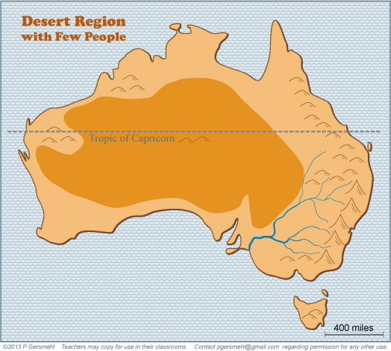
Here is one consequence of its dry climate:
Australia has only one major river system.
It carries water away from the rainy mountains along the east coast.

Slide 9
Definition: the outback is the dry
and sparsely populated area
in the interior of Australia.
Here is one consequence of its dry climate:
Australia has only one major river system.
It carries water away from the rainy mountains along the east coast.

Slide 10
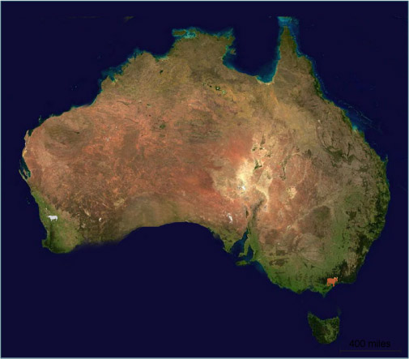
A satellite image
shows green vegetation
only around the edges.
A satellite image
shows green vegetation
only around the edges.
A satellite image
shows green vegetation
only around the edges.
A satellite image
shows green vegetation
only around the edges.

Slide 11
A satellite image
shows green vegetation
only around the edges.
Only the
mountains
near the coast
get enough rain
for forests.
A satellite image
shows green vegetation
only around the edges.
A satellite image
shows green vegetation
only around the edges.
A satellite image
shows green vegetation
only around the edges.

Slide 12
A satellite image
shows green vegetation
only around the edges.
Only the
mountains
near the coast
get enough rain
for forests.
A satellite image
shows green vegetation
only around the edges.
A satellite image
shows green vegetation
only around the edges.
A satellite image
shows green vegetation
only around the edges.
Caution: details can change
on a satellite image
from season to season
and from year to year.

Slide 13
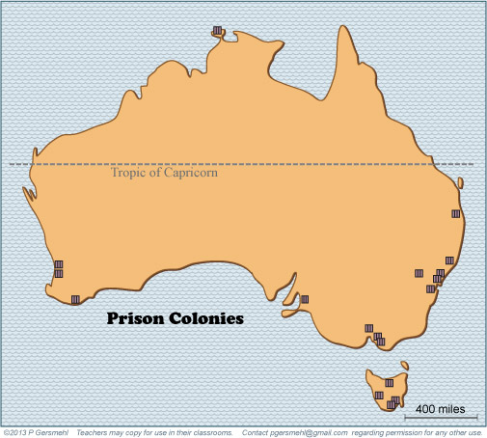
Because of its great distance from England,
one of the first “uses” of the British colony
in Australia was as a prison!

Slide 14
Because of its great distance from England,
one of the first “uses” of the British colony
in Australia was as a prison!
Why would it
be desirable
to put a prison
far away
from your
homeland?

Slide 15
Later, when more settlers came,
they had another big problem:
they had to find some products
that they could ship
all the way to England,
in order to earn money
to buy the things they needed.

Slide 16
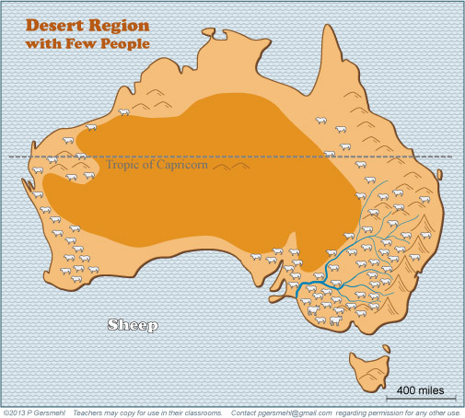
Textile mills in England needed a lot of wool and cotton.
Australia does not have enough rain for cotton, but sheep
can survive on the short grass around the central desert.

Slide 17
And wool
does not spoil
when shipped
long distances
on a boat.
Textile mills in England needed a lot of wool and cotton.
Australia does not have enough rain for cotton, but sheep
can survive on the short grass around the central desert.

Slide 18
Curriculum note.
There is a presentation and a graph activity
about distance and trade.
It’s called “Counting Down
[to decide what to grow].”
And wool
does not spoil
when shipped
long distances
on a boat.
Textile mills in England needed a lot of wool and cotton.
Australia does not have enough rain for cotton, but sheep
can survive on the short grass around the central desert.

Slide 19
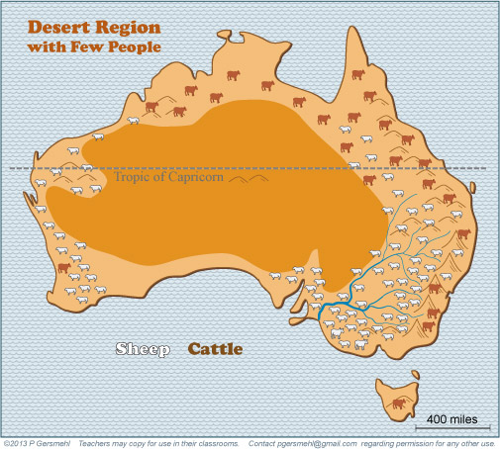
Raising cattle is another option for Australian ranchers,
especially in hot places, closer to the equator.

Slide 20
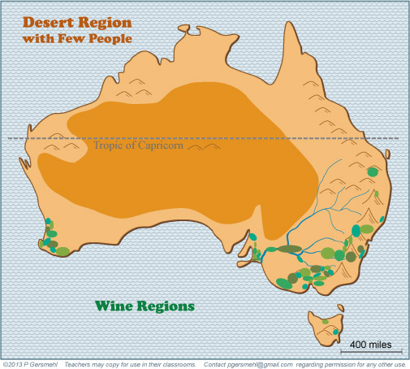
Still later, Australians learned
that they could sell high-quality wine
from grapes grown near the south coast.

Slide 21
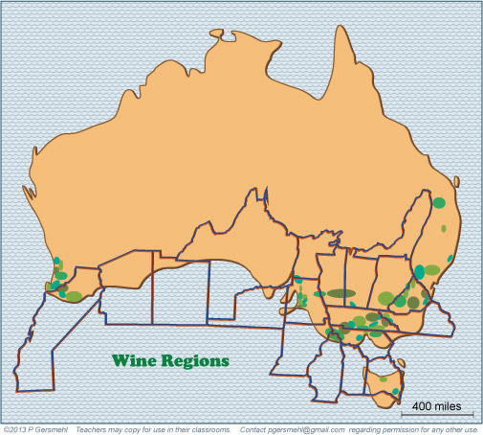
This area near the west coast
is about the same distance
from the Equator as California,
Spain, Italy, or central Chile.
As a result, it has basically
the same kind of climate –
good for growing wine grapes.

Slide 22
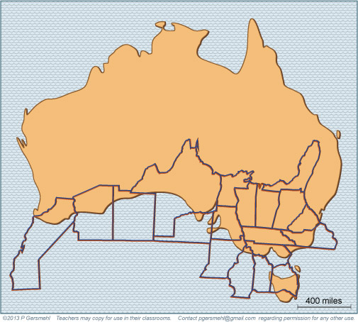
We have to turn the U.S. upside-down
to make this demonstration, because
Australia is in the southern hemisphere.

Slide 23
The map makes it clear that
most of Australia is like Mexico,
closer to the equator than Texas.
Deserts tend to form at this latitude.
(Mexico is lucky to have higher mountains).

Slide 24
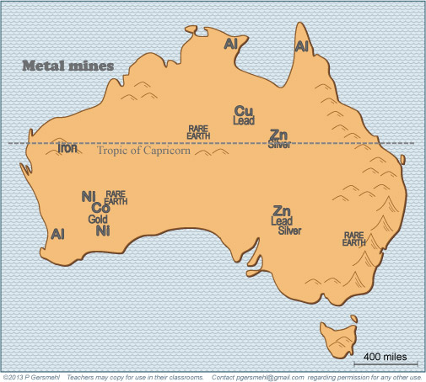
Australia is lucky to have rich deposits
of several important minerals –
including rare earths like neodymium
(which is used in hybrid cars and wind generators).

Slide 25
Metal ores are a good trade
commodity for Australia,
because they are:
1) not perishable,
2) valuable per ton,
and therefore
3) easy to transport
long distances.

Slide 26
Metal ores are a good trade
commodity for Australia,
because they are:
1) not perishable,
2) valuable per ton,
and therefore
3) easy to transport
long distances.
Curriculum note.
There is a clickable map about the Economic Geology of the World.

Slide 27
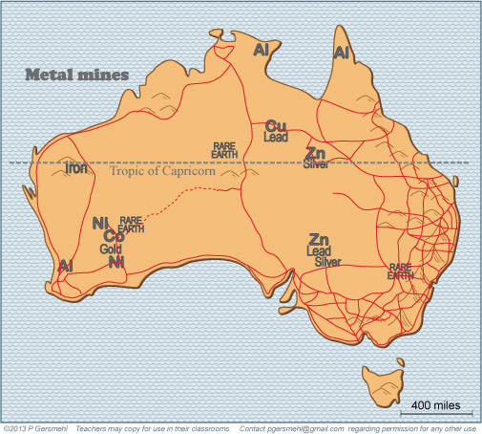
Most of the roads in the desert areas
were built to link mines with the coast.

Slide 28
Otherwise, it is
just too expensive
to build a long road
just to connect
a few people.
Otherwise, it is
just too expensive
to build a long road
just to connect
a few people.

Slide 29
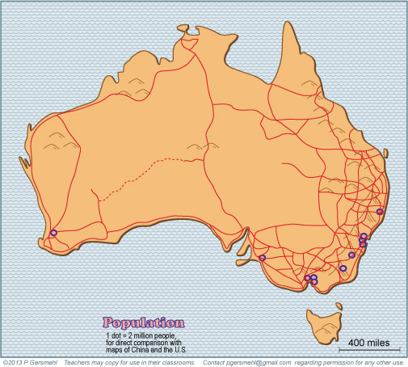
Most Australian people
live in cities in the rainy areas
near the southern coast.

Slide 30
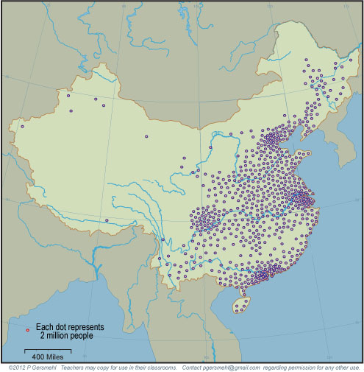
Both maps use
one dot for every
2 million people,
so you can compare
Australia with China
China has almost
60 times as many people
in about the same area.

Slide 31
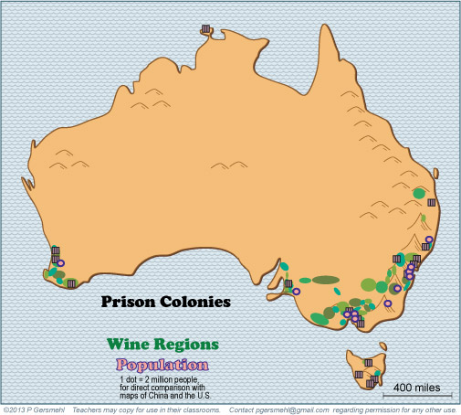
Overlaying three maps shows that
modern cities and grape growers
are in the same general areas
as the original prison colonies!

Slide 32
Because, as you remember,
most of Australia is the right distance
from the Equator to be a desert.

Slide 33
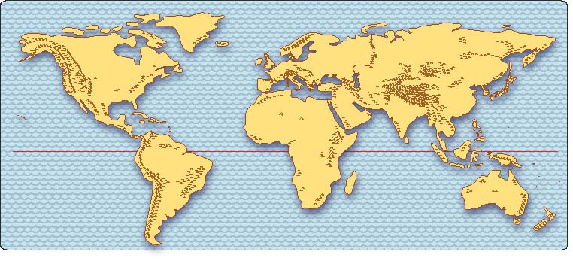
UNITED STATES
EUROPE
INDIA
CHINA
AUSTRALIA
A big issue in Australia today: change.
Australia’s population, language, culture, and trade
have long reflected its history as a British colony.
Australia is much closer, however, to India and China,
with their large populations, growing economies,
and rising demand for resources.
As a result, Australia is selling more products
to China, India, and other Asian countries,
and many people are moving from Asia to Australia.
This is changing the population and economy of Australia.

Slide 34
This presentation showed one way to use
the clickable map of Australia - to help us investigate
some consequences of the big idea of distance.
Distance can have an influence on:
This presentation showed one way to use
the clickable mini-Atlas - to help us investigate
some consequences of the big idea of resources,
with examples from Southwest Asia and north Africa.
Resources can affect:

Slide 35
This presentation showed one way to use
the clickable map of Australia - to help us investigate
some consequences of the big idea of distance.
Distance can have an influence on :
This presentation showed one way to use
the clickable mini-Atlas - to help us investigate
some consequences of the big idea of resources,
with examples from Southwest Asia and north Africa.
Resources can affect:
Climate – because Australia is the “right” distance from the equator to have a large desert

Slide 36
This presentation showed one way to use
the clickable map of Australia - to help us investigate
some consequences of the big idea of distance.
Distance can have an influence on :
This presentation showed one way to use
the clickable mini-Atlas - to help us investigate
some consequences of the big idea of resources,
with examples from Southwest Asia and north Africa.
Resources can affect:
Climate – because Australia is the “right” distance from the equator to have a large desert
Security – because a distant place is hard to defend, but also less likely to be attacked

Slide 37
This presentation showed one way to use
the clickable map of Australia - to help us investigate
some consequences of the big idea of distance.
Distance can have an influence on :
This presentation showed one way to use
the clickable mini-Atlas - to help us investigate
some consequences of the big idea of resources,
with examples from Southwest Asia and north Africa.
Resources can affect:
Climate – because Australia is the “right” distance from the equator to have a large desert
Security – because a distant place is hard to defend, but also less likely to be attacked
Economy – because what you produce in a distant place has to be able to pay the cost of transportation

Slide 38
This presentation showed one way to use
the clickable map of Australia - to help us investigate
some consequences of the big idea of distance.
Distance can have an influence on :
This presentation showed one way to use
the clickable mini-Atlas - to help us investigate
some consequences of the big idea of resources,
with examples from Southwest Asia and north Africa.
Resources can affect:
Climate – because Australia is the “right” distance from the equator to have a large desert
Security – because a distant place is hard to defend, but also less likely to be attacked
Economy – because what you produce in a distant place has to be able to pay the cost of transportation
Infrastructure – because roads, electricity, mail, ambulances, and many other services cost a lot more per person if there are fewer people per square mile to pay for them

Slide 39
This presentation showed one way to use
the clickable map of Australia - to help us investigate
some consequences of the big idea of distance.
Distance can have an influence on :
This presentation showed one way to use
the clickable mini-Atlas - to help us investigate
some consequences of the big idea of resources,
with examples from Southwest Asia and north Africa.
Resources can affect:
Climate – because Australia is the “right” distance from the equator to have a large desert
Security – because a distant place is hard to defend, but also less likely to be attacked
Economy – because what you produce in a distant place has to be able to pay the cost of transportation
Infrastructure – because roads, electricity, mail, ambulances, and many other services cost a lot more per person if there are fewer people per square mile to pay for them
Land use – because people tend to want to be close to things they like (parks, stores), and to push things they don’t like (prisons, smelly factories) farther away

Slide 41
Questions VERSION

Slide 42
How is Australia
different from all
other continents?

Slide 43
Why is it important that the
Tropic of Capricorn runs through the middle of the country?

Slide 44
What causes deserts
to form near
the Tropic lines?

Slide 45
Why do the mountains
and coastal areas
get more rain?
Air sinking downward
tends to make deserts
around the Tropic lines.

Slide 46
Why is it important
that Australia has only
one major river system?

Slide 47
A satellite image
shows green vegetation
only around the edges.
A satellite image
shows green vegetation
only around the edges.
A satellite image
shows green vegetation
only around the edges.
A satellite image
shows green vegetation
only around the edges.
A satellite image
shows green vegetation
only around the edges.
What is the green color
near the coasts
on this satellite image?
A satellite image
shows green vegetation
only around the edges.
A satellite image
shows green vegetation
only around the edges.

Slide 48
Why would it
be desirable
to put a prison
far away
from your
homeland?

Slide 49
What was a big challenge
for colonists trying to find
a product to grow or make
in a place like Australia?

Slide 50
How does an economy based on raising sheep
help solve the problem you just described?

Slide 51
Still later, Australians learned
that they could sell high-quality wine
from grapes grown near the south coast.
What conditions make the south coast
a good place to grow grapes
for wine production?

Slide 52
Why is it significant that
this area on the west coast
is about the same distance
from the Equator as California,
Spain, Italy, or central Chile?

Slide 53
Why did we turn the U.S. upside-down
to make this demonstration?

Slide 54
Is it more accurate
to describe Australia
as being like Mexico
or like Canada?
Why?

Slide 55
Why is Australia lucky to have deposits
of several important minerals –
including rare earths like neodymium?

Slide 56
Why is Australia lucky to have deposits
of several important minerals –
including rare earths like neodymium?
What is neodymium
used to make?

Slide 57
Why are the roads in Australia
built in the places they are?

Slide 58
How would you describe
the geographic pattern
of population in Australia?

Slide 59
And how would
you compare
the pattern
of population
in Australia
to the pattern
in China?

Slide 60
Why are the geographic patterns of modern grape growers and major urban areas
so similar to the patterns
the original prison colonies?

Slide 61
UNITED STATES
EUROPE
INDIA
CHINA
AUSTRALIA
How have the population, language, culture,
and trading partners of Australia
reflected its history as a British colony?
What is the significance of the fact that
Australia is much closer to India and China,
with their large populations, growing economies,
and rising demand for resources?
How are things changing
as a result of that shorter distance?

Slide 62
Here are a few questions for individual inquiry:
1. Why do deserts tend to form near the Tropic lines?
2. Why does Australia have “unusual” plants and animals?
3. Why did rabbits become a serious problem in Australia?
4. What foods do Americans buy from farmers in Australia?
5. What products do Americans sell to people in Australia?
6. What metals do people in Australia sell to factory managers in China? What are they used for?
7. What is the Australian policy about immigration?
8. How is global warming affecting the economy of Australia?

Slide 64
Copyright 2019, Phil and Carol Gersmehl
Teachers who saw this presentation at a workshop
or downloaded it from our internet site have permission
to make a copy on their own computers for these purposes:
1. to help them review the workshop,
2. to show the presentation in their own classrooms, at sessions they present at teacher conferences, or to administrators in their own school or district,
3. to use individual frames (with attribution) in their own class or conference presentations.
For permission for any other use,
including posting frames on a personal blog or uploading to any network or website that can be accessed from outside your school,
contact pgersmehl@gmail.com

