Slide 1
LATITUDE
A geographic “big idea” with many consequences in
AfricA
Latitude is a big idea in geography.
It can help us understand
many other geographic features in Africa,
including patterns of rainfall, plants, animals,
fires, floods, crops, early civilizations, trade,
languages, slavery, and diseases like malaria.

Slide 2
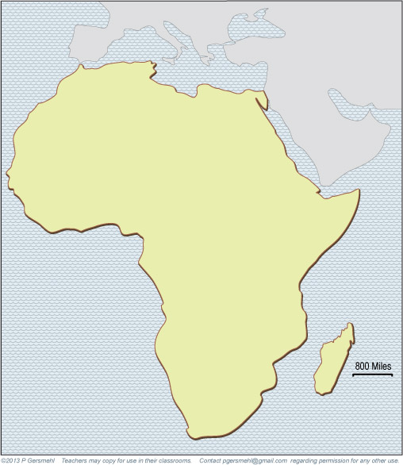
Note to Teachers
1. This presentation has a specific purpose.
It is designed as an illustrated teacher guide to provide content background
about the “layers of information” on the clickable map of Africa.
It is not designed for use in class “as is” – to tailor it for a specific class,
you might shorten it, edit frames, add pictures or discussion questions, etc.
(see below)
2. This presentation has two parts – explanation and question.
You can cut-and-paste to put question frames where you want them
in order to promote class discussion or identify misconceptions.
The question frames can also serve as reviews, assessments,
or prompts for inquiry activities (individual or group).
3. This presentation is much too long.
There is a good reason for this – your computer has a DELETE key,
but it does not have a CREATE key.
This is important, because many teachers have reviewed this presentation.
If anyone suggested an addition (like a definition, explanation, or example),
we usually put it in – because other teachers might also find it useful,
and it takes much less time to delete a frame than to make one!
(PS. You can delete this frame now!)
?
DELETE

Slide 3
Africa is the
second largest continent.
It’s three times as big
as the United States.

Slide 4
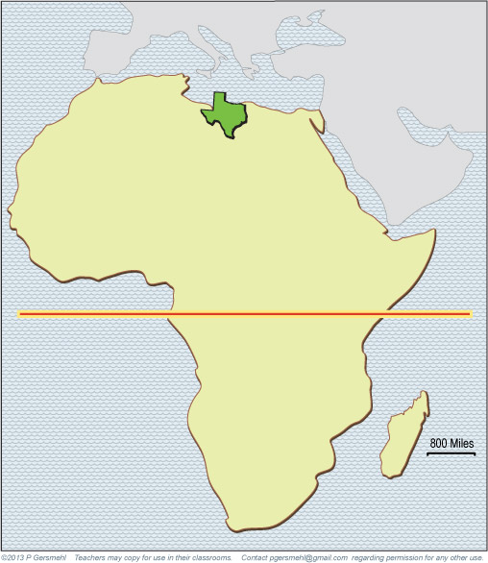
Here is Texas,
at the correct size
and latitude.
Most of Africa is
closer to the equator
than any part of
the United States.
Equator

Slide 5
Here is Texas,
at the correct size
and latitude.
Most of Africa is
closer to the equator
than any part of
the United States.
As a result, most of Africa
has higher average temperature
than Texas.
Equator

Slide 6
Want proof? Here’s the average temperature
for each month in Austin, the capital of Texas
(annual average 67 degrees):
51 55 61 69 77 82 88 85 80 71 61 52
Equator

Slide 7
Want proof? Here’s the average temperature
for each month in Austin, the capital of Texas
(annual average 67 degrees):
51 55 61 69 77 82 88 85 80 71 61 52
Equator
58 63 72 80 89 96 101 99 94 86 69 61
And here are the temperatures for InSalah, Algeria (annual average 80 degrees)

Slide 8
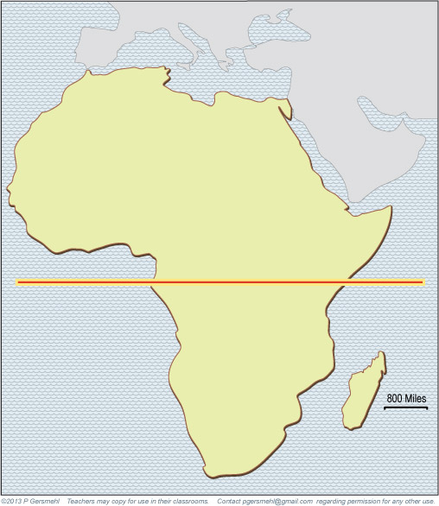
Equator
The equator runs through
the middle of Africa.

Slide 9
Curriculum note.
If students need a review,
there is another
presentation called
“Where is the Equator?”
Equator

Slide 10
North
Equator
The continent extends
about the same distance
north and south
of the equator.
South

Slide 11
As a result, Africa
is a good place to study
the effects of latitude.
Any process
that depends on latitude
will occur twice in Africa,
once north and once south
of the equator.
North
Equator
The continent extends
about the same distance
north and south
of the equator.
South

Slide 12
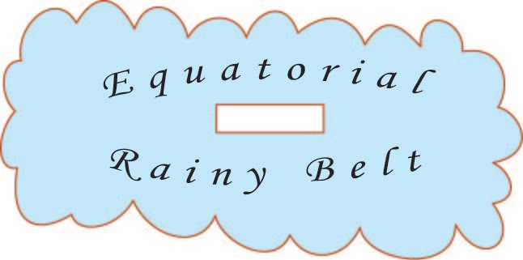
There is a belt of rainy weather
that is always close to
the equator.

Slide 13
There is a belt of rainy weather
that is always close to
the equator.
It’s caused by the simple fact
that the sun provides more energy
to places near the equator
than at any other latitude.

Slide 14
There is a belt of rainy weather
that is always close to
the equator.
It’s caused by the simple fact
that the sun provides more energy
to places near the equator
than at any other latitude
The sun heats the ground,
evaporates a lot of water,
and causes the air to rise.
Rising humid air makes clouds,
which make thunderstorms
later in the afternoon.
They cool the ground
(a little!)
So remember,
energy is more than heat –
it’s also clouds and rain!

Slide 15
There is a belt of rainy weather
that is always close to
the equator.
It’s caused by the simple fact
that the sun provides more energy
to places near the equator
than at any other latitude
The sun heats the ground,
evaporates a lot of water,
and causes the air to rise.
Rising humid air makes clouds,
which make thunderstorms
later in the afternoon.
They cool the ground
(a little!)
So remember,
energy is more than heat –
it’s also clouds and rain!
But it’s still hot. Here are the midday
temperatures for each month in this area.
88 89 89 88 88 86 86 85 86 86 87 87

Slide 16
So, the sun makes hot days
and afternoon thunderstorms
at places close to the equator.

Slide 17
In summer,
the Equatorial Rainy Belt
moves a few hundred miles
north of the equator.

Slide 18
Science note:
Because the Rainy Belt
is caused by the heat of the sun,
it “follows the sun” and moves
toward the Tropic of Cancer
in May, June, July, and August.
In summer,
the Equatorial Rainy Belt
moves a few hundred miles
north of the equator.

Slide 19
In September and October,
the Rainy Belt is back
over the equator.

Slide 20
In November, December,
January, and February,
the Rainy Belt
is south of the equator.

Slide 21
In March and April,
the Rainy Belt is back
over the equator.

Slide 22

If your computer can run
a Microsoft Powerpoint,
you can click to see
an animation that shows
the seasonal movement
of the Rainy Belt.

Slide 23
Curriculum note.
There is also
a student activity called
“Equatorial Rainy Belt.”

Slide 24
The next four maps
show the actual pattern
of rain in Africa.

Slide 25
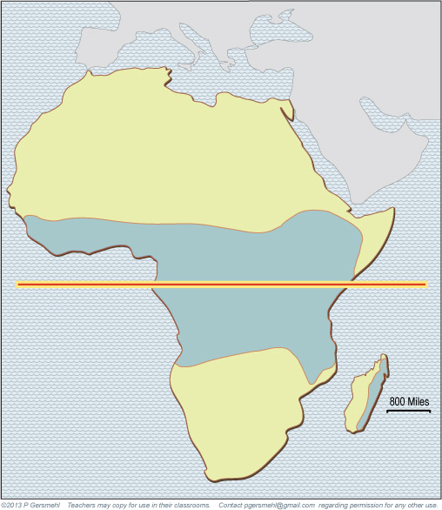
In March,
the Rainy Belt is
near the equator.
Map Key
The blue area gets
more than 4 inches
of rain per month.

Slide 26
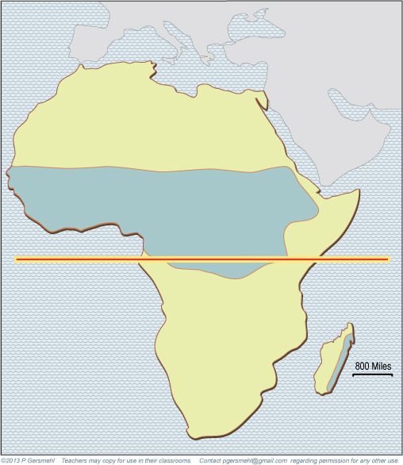
In June,
the Rainy Belt is
north of the equator.
Map Key
The blue area gets
more than 4 inches
of rain per month.

Slide 27
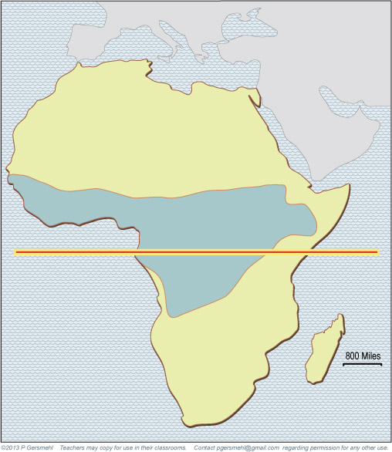
In September,
the rain is mostly
near the equator.
Map Key
The blue area gets
more than 4 inches
of rain per month.

Slide 28
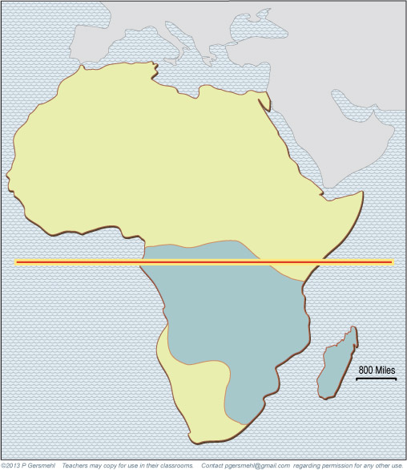
In December,
the rain has moved
south of the equator.
Map Key
The blue area gets
more than 4 inches
of rain per month.

Slide 29
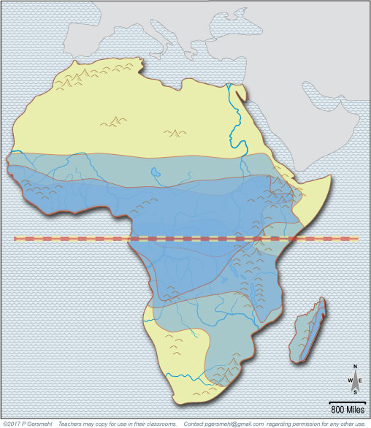
If we click
to show the rainfall
for all of the months
at the same time,
you can see that it rains
every month of the year
near the equator.

Slide 30
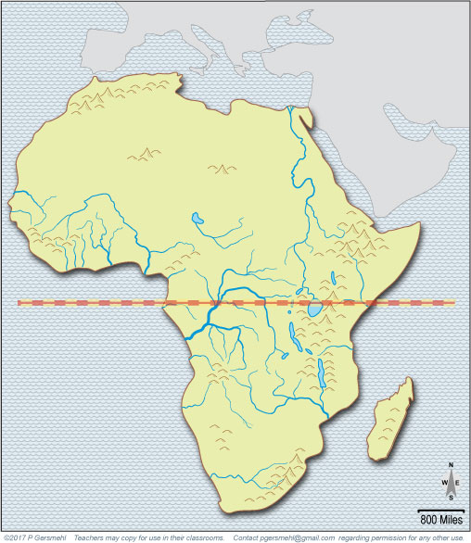
As a result,
the Congo River
has a lot of water
all year long.

Slide 31
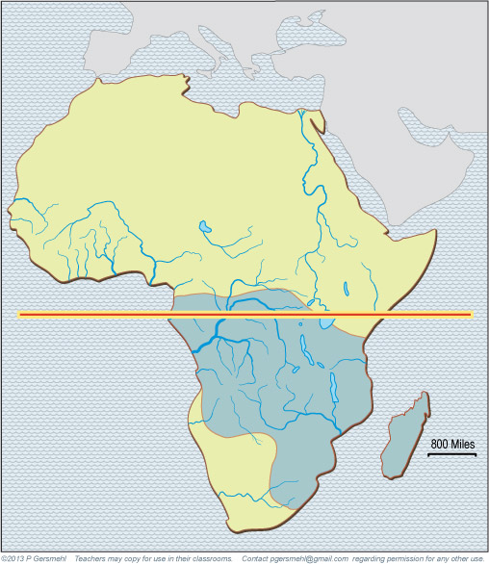
The Zambezi River
tends to make floods
when the Rainy Belt
is south of the equator.

Slide 32
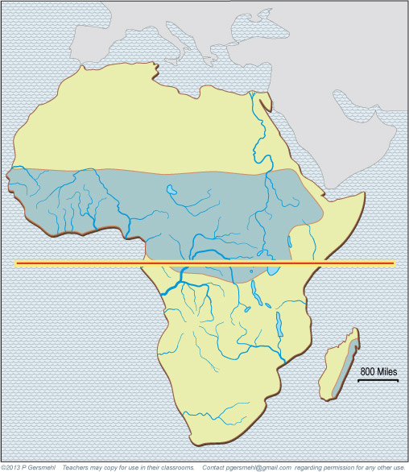
When the Rainy Belt moves north,
the famous Nile River of Egypt
and the rivers of West Africa
(like the Niger) are likely to flood.

Slide 33
When the Rainy Belt moves north,
the famous Nile River of Egypt
and the rivers of West Africa
(like the Niger) are likely to flood.
Historic Fact
These floods
were important
for the development
of ancient civilizations
in Egypt and Mali.

Slide 34
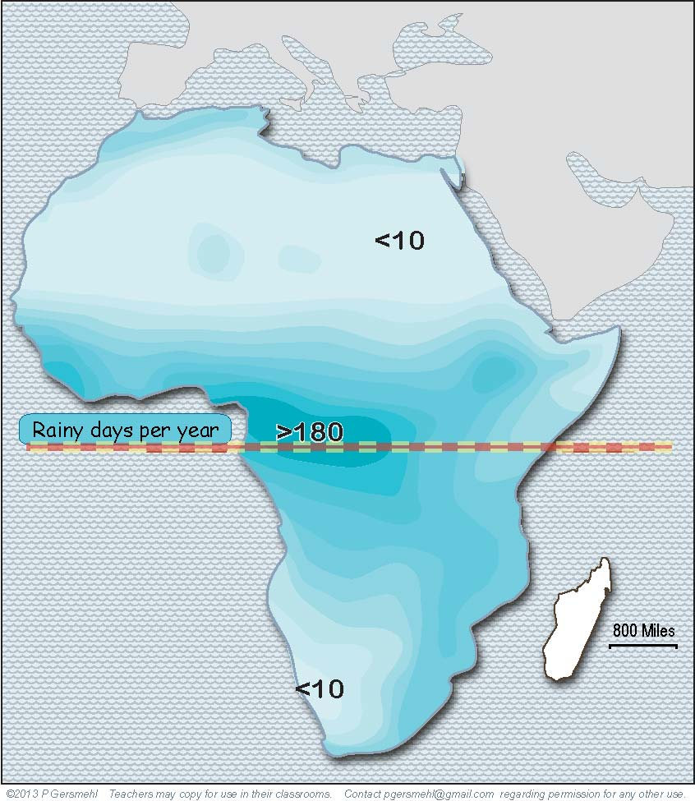
Important fact
The number of
rainy days per year
depends on latitude.

Slide 35
Near the
equator,
it is hot
and rainy
in every
month.

Slide 36
Near the
Tropic of
Cancer
and the
Tropic of
Capricorn,
it hardly
ever rains.
Near the
Tropic of
Cancer
and the
Tropic of
Capricorn,
it hardly
ever rains.

Slide 37
Near the
Tropic of
Cancer
and the
Tropic of
Capricorn,
it hardly
ever rains.
And in
between,
the number
of rainy days
depends
mainly
on latitude.

Slide 38
Near the
Tropic of
Cancer
and the
Tropic of
Capricorn,
it hardly
ever rains.
And in
between,
the number
of rainy days
depends
mainly
on latitude.
As you go
farther from
the equator,
places have
fewer days
of rain.

Slide 39
Curriculum note.
For additional practice,
there is an activity called
“Africa Climagraphs.”

Slide 40
NOTE
This map is
really important.
Take a good
“mental snapshot”
of it for future use.
Curriculum note.
For additional practice,
there is an activity called
“Africa Climagraphs.”

Slide 41
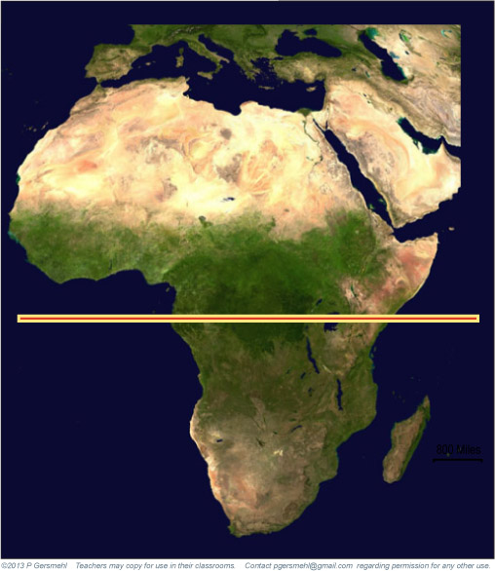
A satellite image
clearly shows the effect
of the different numbers
of rainy days
at different latitudes.

Slide 42
Rainforest
A satellite image
clearly shows the effect
of the different numbers
of rainy days
at different latitudes.

Slide 43
Desert
Rainforest
A satellite image
clearly shows the effect
of the different numbers
of rainy days
at different latitudes.

Slide 44
Desert
Grassland
Rainforest
A satellite image
clearly shows the effect
of the different numbers
of rainy days
at different latitudes.

Slide 45
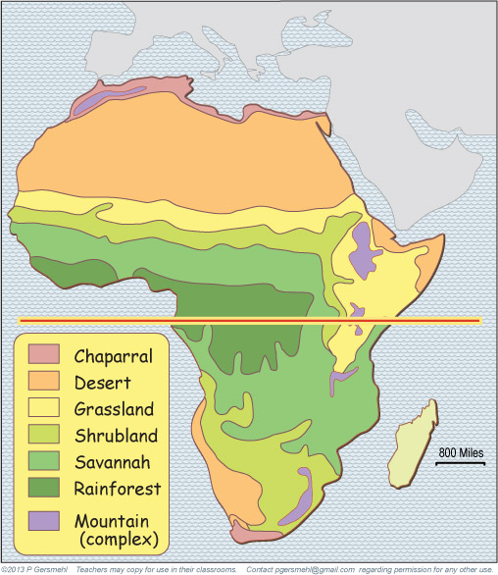
The latitude bands
are also very obvious
on a map of ecoregions.

Slide 46
The latitude bands
are also very obvious
on a map of ecoregions.
Desert

Slide 47
The latitude bands
are also very obvious
on a map of ecoregions.
Desert
Grassland

Slide 48
The latitude bands
are also very obvious
on a map of ecoregions.
Desert
Grassland
Rainforest

Slide 49
The latitude bands
are also very obvious
on a map of ecoregions.
The main thing
that “messes up”
the latitude bands
of natural regions
is the cooler
highland areas
of east Africa.

Slide 50
The latitude bands
are also very obvious
on a map of ecoregions.
Curriculum note.
There are student activities
about African environments
and a clickable map called
“Ecoregions of the World.”

Slide 51
The influence of latitude
is especially obvious
when we look at maps
of places where fires
are likely to occur
in each season.

Slide 52
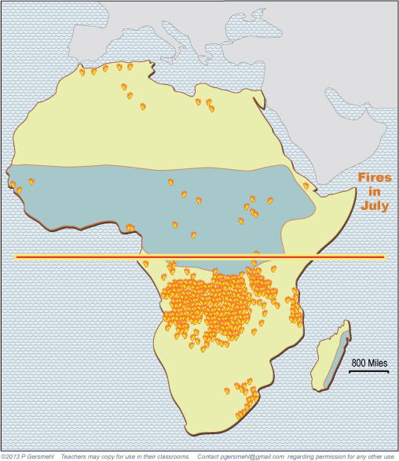
In July, when the
Equatorial Rainy Belt
is north of the equator,
there are a lot of fires
in the savannas
south of the equator.

Slide 53
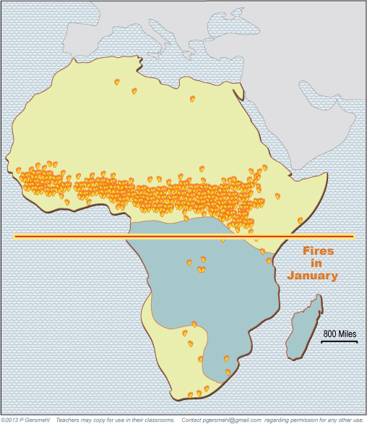
In January, when the
Equatorial Rainy Belt
is south of the equator,
fires are more common
north of the equator.

Slide 54
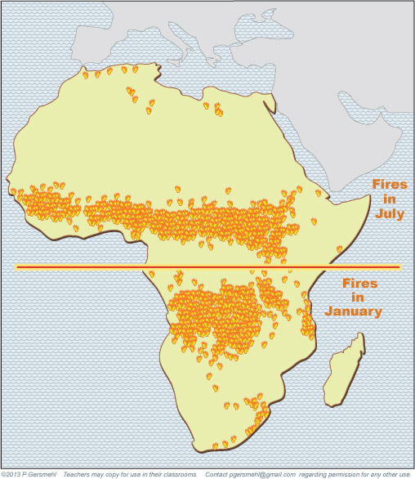
If we show
just the two fire maps
at the same time, we see
three basic principles

Slide 55
1. The desert areas
near the Tropic of Cancer
do not have enough plants
to provide fuel for a wildfire.

Slide 56
1. The desert areas
near the Tropic of Cancer
do not have enough plants
to provide fuel for a wildfire.
2. The rainforest areas
near the Equator
have so much rain,
the trees growing there are too wet to burn.

Slide 57
1. The desert areas
near the Tropic of Cancer
do not have enough plants
to provide fuel for a wildfire.
3. The desert areas
near the Tropic of Cancer
do not have enough plants
to provide fuel for a wildfire.
3. The fires occur
mainly in the places
where it rains in just
part of the year.
2. The rainforest areas
near the Equator
have so much rain,
the trees growing there are too wet to burn.

Slide 58
The influence of latitude
is also obvious
when we look at where
different kinds of animals
are likely to be found.

Slide 59
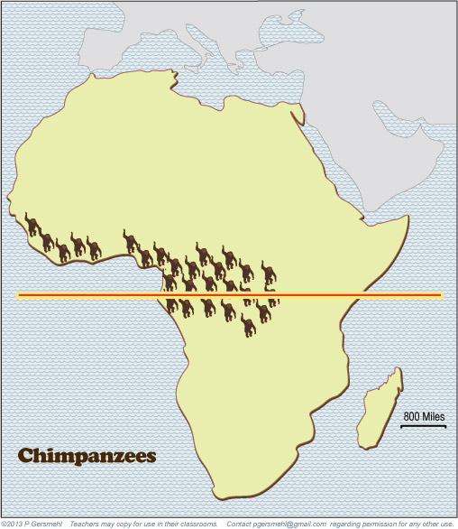
Chimpanzees, monkeys,
and many kinds of birds
live in the tall trees
near the equator.

Slide 60
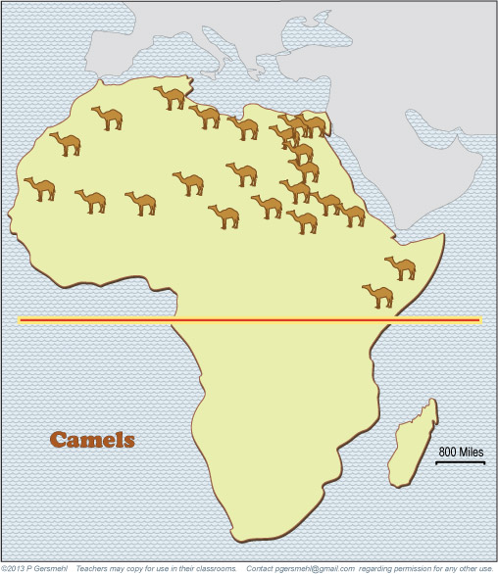
Camels are by far
the largest animals you
might see in the desert
near the Tropic of Cancer.

Slide 61
Camels are by far
the largest animals you
might see in the desert
near the Tropic of Cancer.
Curriculum note.
In earlier grades,
students might have seen
some maps like these
in a readalong activity.
If not, show them how
to draw a line around
“the camel region.”

Slide 62
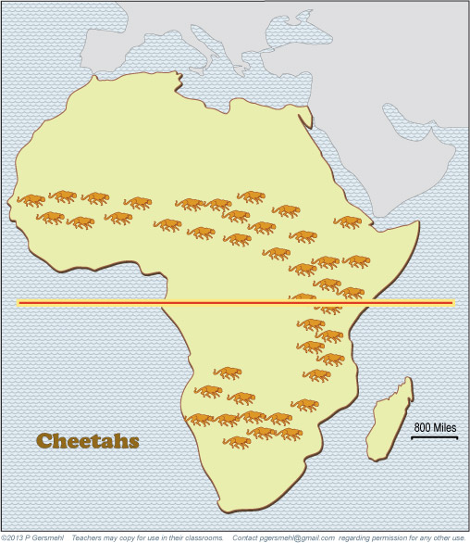
Many large animals
live in the savannas
and grasslands,
including giraffes, zebras,
antelope, elephants,
lions, and cheetahs.

Slide 63
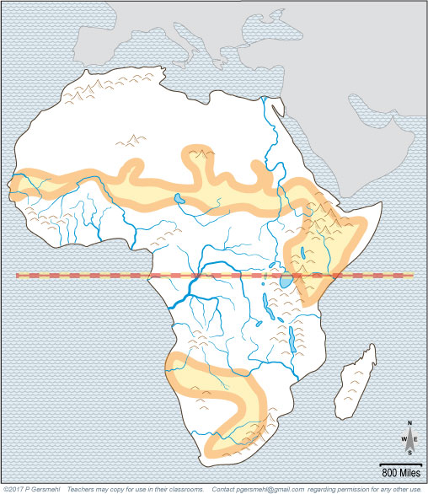
The tropical savannas
and grasslands are
the natural environments
where pastoral nomads
could make a living
by herding livestock.
Pastoral nomads
are people who move
from place to place
with their cattle.
Pastoral nomads
are people who move
from place to place
with their cattle.

Slide 64
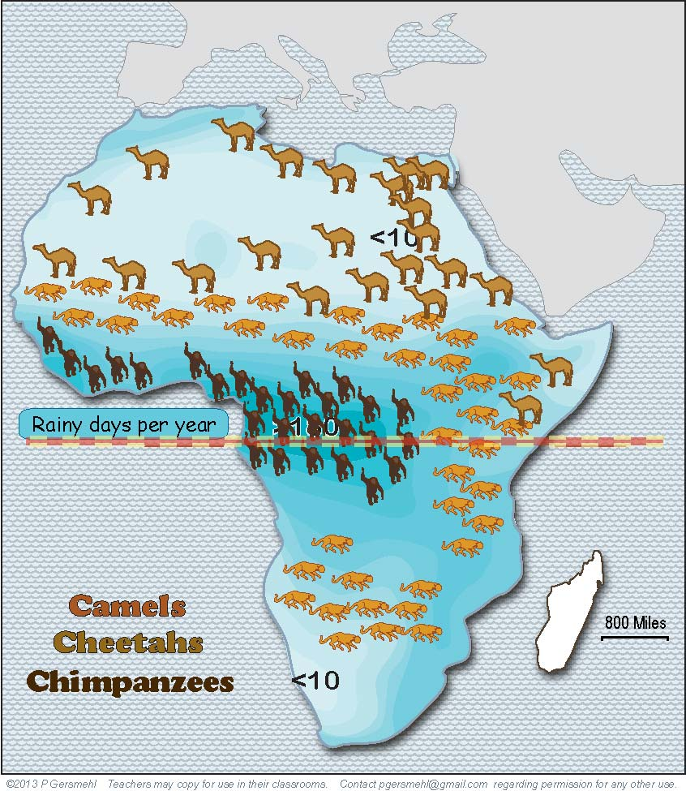
Show all the animals
on the map of rainy days,
and you can see how
different animals live
in different environments

Slide 65
Show all the animals
on the map of rainy days,
and you can see how
different animals live
in different environments
Remember,
the highlands
of east Africa
are cooler
and drier than
the lowland
rainforest.

Slide 66
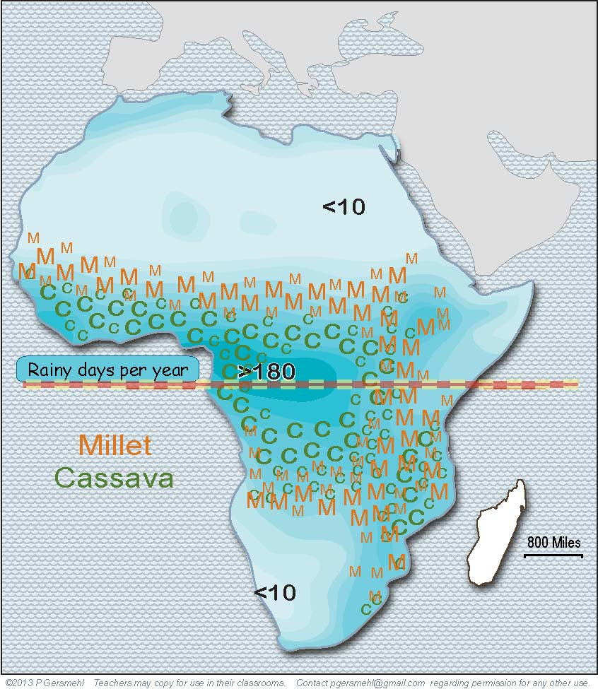
The main food crops
also tend to grow
at specific latitudes
(where each crop can get
the amount of rain it needs).

Slide 67
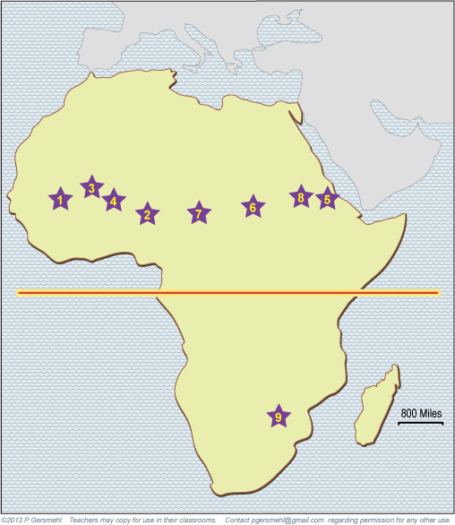
In ancient times, people
lived in the latitudes
where they could hunt,
grow food, or raise cattle.
The stars show
the major cities
of ancient empires.

Slide 68
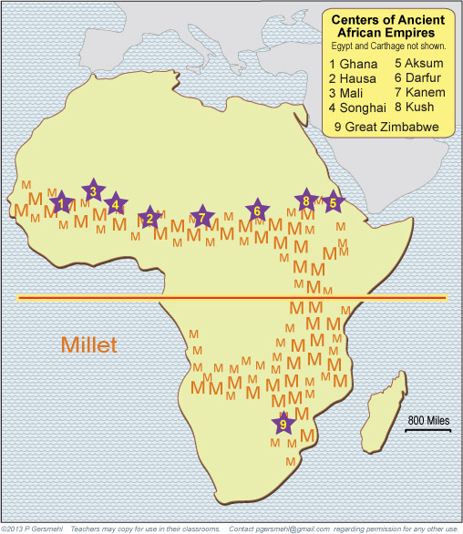
The ancient empires
all had their centers
in the grasslands
near fields of millet.

Slide 69
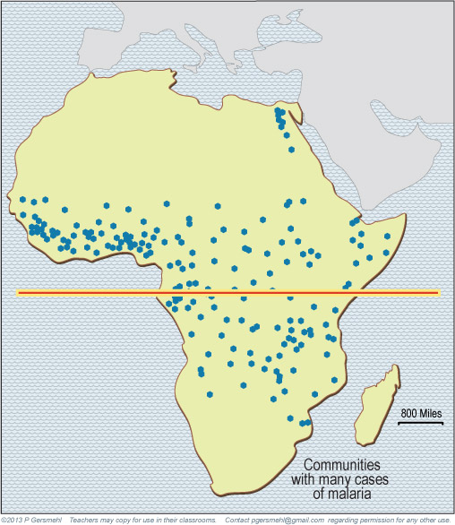
Those places are dry enough
to prevent the diseases
(like malaria)
that are common
in rainier places.

Slide 70
Those places are dry enough
to prevent the diseases
(like malaria)
that are common
in rainier places.
Curriculum note.
For additional practice,
there is an activity called
“Malaria Association.”

Slide 71
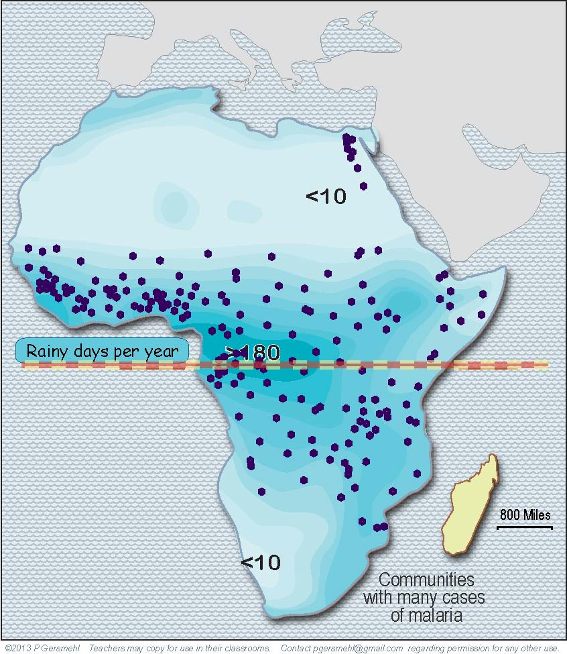
Malaria is transmitted
by mosquitoes that live
in the latitudes that have
long rainy seasons.
(It makes sense, no?)

Slide 72
The Nile River floods made the soil better
in ancient Egypt,
but they also allowed
malaria mosquitoes
to live in a desert.
Malaria is transmitted
by mosquitoes that live
in the latitudes that have
long rainy seasons.
(It makes sense, no?)

Slide 73
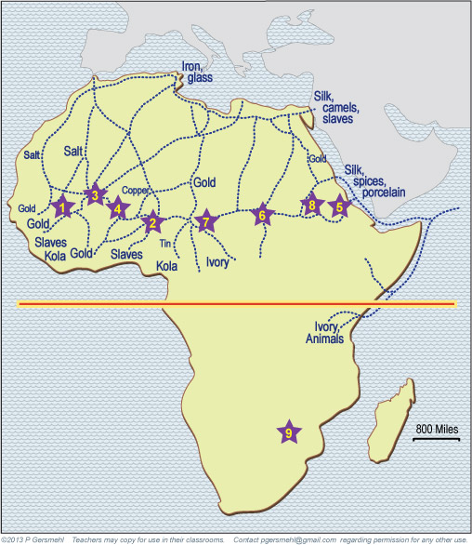
to India
1000 miles
The ancient cities
were the centers
of trading networks
that reached all the way
to India and China.

Slide 74
Not surprisingly,
they traders used
camel caravans
to carry the goods.

Slide 75
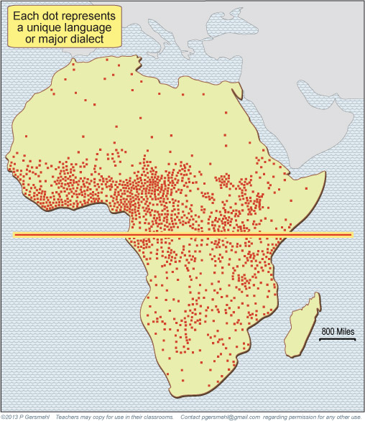
One very interesting
influence of latitude
is on human languages.

Slide 76
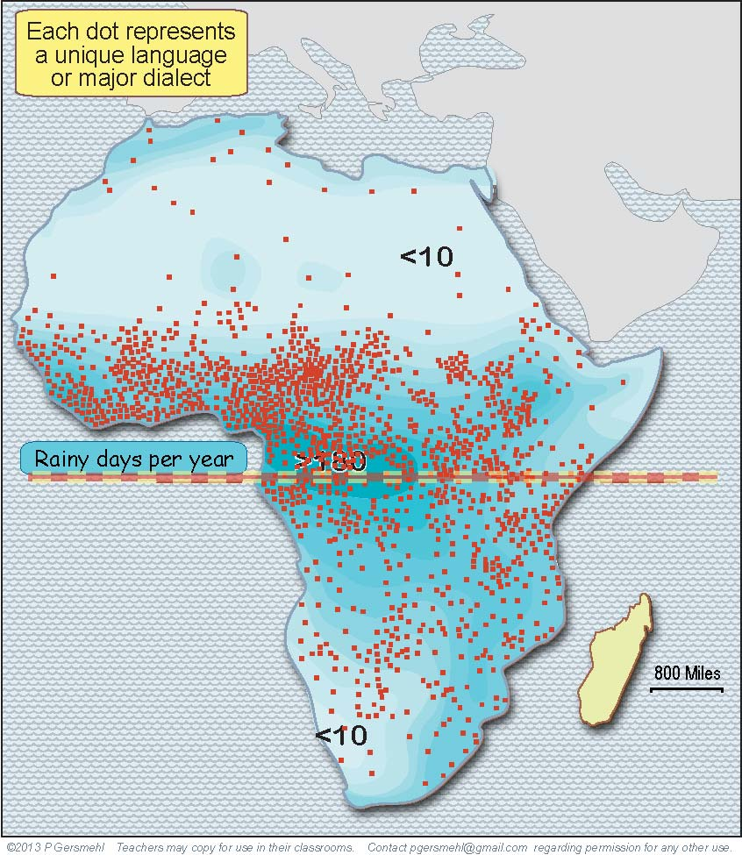
In rainy environments,
people could find almost
everything they needed
close to home.
When people don’t travel,
the languages of different
communities are likely
to become different.

Slide 77
Dryland people were lucky
to have horses and camels,
because they had to travel,
often very long distances,
in order to find food
and to trade for things
they couldn’t get at home.

Slide 78
Dryland people were lucky
to have horses and camels,
because they had to travel,
often very long distances,
in order to find food
and to trade for things
they couldn’t get at home.
To do their trading,
they needed to know
at least one language
that they could use
over a large area.

Slide 79
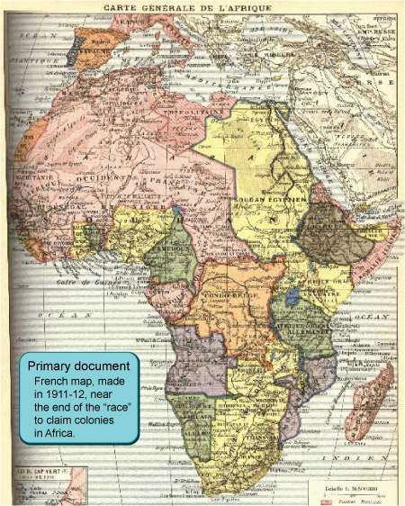
The language map
is especially important
when we “fast forward”
to the colonial claims
and the slave trade.

Slide 80
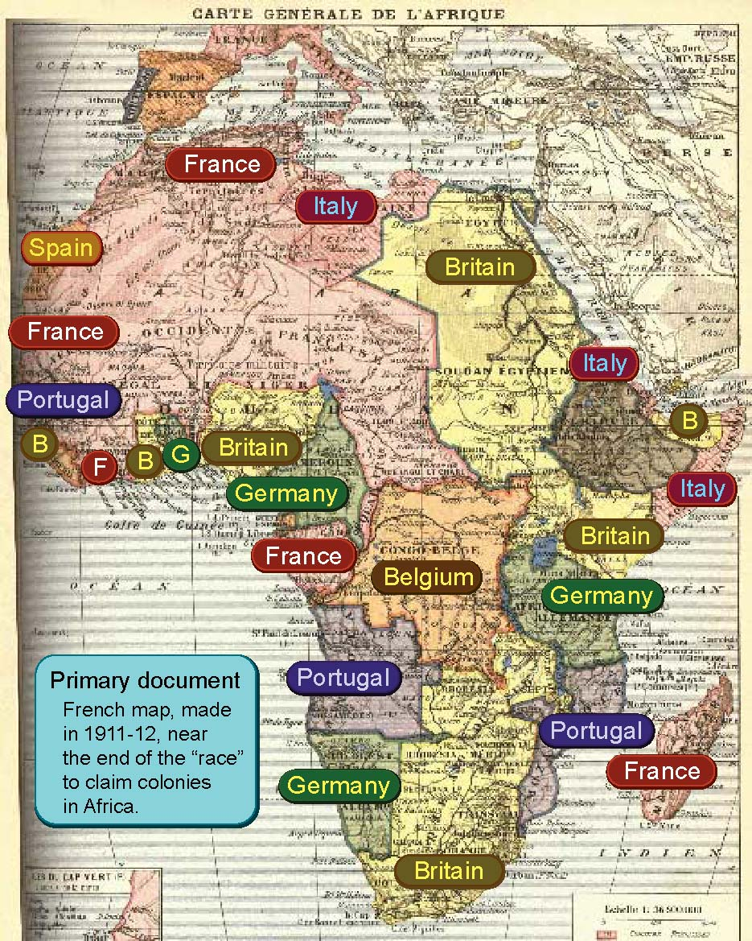
Seven different
European countries
claimed colonies
in different parts
of Africa.

Slide 81
It is plausible
that it was easier
to capture slaves
in areas where
people lived
in small groups and spoke
many different
languages.

Slide 82
It is plausible
that it was easier
to capture slaves
in areas where
people lived
in small groups and spoke
many different
languages.
Curriculum note.
There is a clickable map
and related activities
about European Colonies.

Slide 83
When European countries
divided Africa into colonies,
they did not pay much attention
to the natural dividing lines
between environments
or language regions.
Why might that
be a problem?

Slide 84
The natural borders
between environments
and language regions
run mainly east-west
(following lines of latitude),
but the colonial borders
often go north-south,
especially in West Africa.

Slide 85
The natural borders
between environments
and language regions
run mainly east-west
(following lines of latitude),
but the colonial borders
often go north-south,
especially in West Africa.
Think about what that means
for governments and businesses
in these countries.

Slide 86
This presentation showed one way to use
the clickable map of Africa - to help us investigate
some consequences of the big idea of latitude.
Latitude has an effect on:

Slide 87
This presentation showed one way to use
the clickable map of Africa - to help us investigate
some consequences of the big idea of latitude.
Latitude has an effect on:
Climate – because the rainy season gets shorter and shorter
as you go from the equator to the Tropic lines

Slide 88
This presentation showed one way to use
the clickable map of Africa - to help us investigate
some consequences of the big idea of latitude.
Latitude has an effect on:
Climate – because the rainy season gets shorter and shorter
as you go from the equator to the Tropic lines
Plants and animals – because different plants need different
amounts of rain, and are eaten by different animals

Slide 89
This presentation showed one way to use
the clickable map of Africa - to help us investigate
some consequences of the big idea of latitude.
Latitude has an effect on:
Climate – because the rainy season gets shorter and shorter
as you go from the equator to the Tropic lines
Plants and animals – because different plants need different
amounts of rain, and are eaten by different animals
Floods and fires – because these “natural hazards” occur
at specific latitudes and specific times of the year

Slide 90
This presentation showed one way to use
the clickable map of Africa - to help us investigate
some consequences of the big idea of latitude.
Latitude has an effect on:
Climate – because the rainy season gets shorter and shorter
as you go from the equator to the Tropic lines
Plants and animals – because different plants need different
amounts of rain, and are eaten by different animals
Floods and fires – because these “natural hazards” occur
at specific latitudes and specific times of the year
Human economies – because people grow different crops
and hunt/herd different animals at different latitudes

Slide 91
This presentation showed one way to use
the clickable map of Africa - to help us investigate
some consequences of the big idea of latitude.
Latitude has an effect on:
Climate – because the rainy season gets shorter and shorter
as you go from the equator to the Tropic lines
Plants and animals – because different plants need different
amounts of rain, and are eaten by different animals
Floods and fires – because these “natural hazards” occur
at specific latitudes and specific times of the year
Human economies – because people grow different crops
and hunt/herd different animals at different latitudes
Health – because the insects that carry diseases like malaria
live in hot, rainy places close to the equator

Slide 92
This presentation showed one way to use
the clickable map of Africa - to help us investigate
some consequences of the big idea of latitude.
Latitude has an effect on:
Climate – because the rainy season gets shorter and shorter
as you go from the equator to the Tropic lines
Plants and animals – because different plants need different
amounts of rain, and are eaten by different animals
Floods and fires – because these “natural hazards” occur
at specific latitudes and specific times of the year
Human economies – because people grow different crops
and hunt/herd different animals at different latitudes
Health – because the insects that carry diseases like malaria
live in hot, rainy places close to the equator
Languages, empires, colonization, slave trading, and many other aspects
of African history that are affected by rain, floods, fires, insects, etc.

Slide 94
Question version

Slide 95
What is one
consequence
of the fact that most
of the continent of Africa
is closer to the equator
than the state of Texas?
Equator

Slide 96
North
Equator
The equator runs through
the middle of Africa.
South
The continent extends
about the same distance
north and south
of the equator.

Slide 97
Why does this fact
make Africa
a good “laboratory”
to study the effects
of latitude?
North
Equator
The equator runs through
the middle of Africa.
South
The continent extends
about the same distance
north and south
of the equator.

Slide 98
Explain the seasonal movement
of the Equatorial Rainy Belt
and why it is important.

Slide 99
Why would
the Congo River
be big all year?

Slide 100
What happens near
the Zambezi River
in this season?

Slide 101
What happens
near the Nile
and Niger Rivers
in this season?

Slide 102
What happens
near the Nile
and Niger Rivers
in this season?
Why were
these river events
important in history?

Slide 103
Describe
the climate
near the
equator.

Slide 104
Near the
Tropic of
Cancer
and the
Tropic of
Capricorn,
it hardly
ever rains.
Describe
the climate
near the
Tropic of
Cancer
and the
Tropic of
Capricorn.

Slide 105
Near the
Tropic of
Cancer
and the
Tropic of
Capricorn,
it hardly
ever rains.
Describe the climate
between
the equator
and the
Tropic lines.

Slide 106
Interpret the colors
on this satellite image.
Focus especially on
the influence of latitude.

Slide 107
Why do
grasslands
grow near
the equator
in east Africa?

Slide 108
Why do fires
occur in these latitudes
at this time of year?

Slide 109
Why do fires
occur in these latitudes
at this time of year?

Slide 110
3. The desert areas
near the Tropic of Cancer
do not have enough plants
to provide fuel for a wildfire.
Why do fires occur
mainly in these areas?

Slide 111
1. Why are fires rare
in this area?

Slide 112
1. Why are fires rare
in this area?
2. Why are fires rare
in this area?
(It’s a different reason!)

Slide 113
Why do chimpanzees,
gorillas, and many birds
live here?

Slide 114
Why is it important
that these animals
could live in these areas?

Slide 115
Why are large cats
like lions and cheetahs
common in this area?

Slide 116
Pastoral nomads
are people who move
from place to place
with their cattle.
What do we call
people who move
from place to place
with their cattle?

Slide 117
Describe the
relationships
between rainfall
and animal life.

Slide 118
Describe the
relationships
between rainfall
and food crops.

Slide 119
What do these
numbered stars
represent?
Why do they occur
in this line pattern?

Slide 120
Make a generalization
about ancient empires
and millet farming.

Slide 121
What is the link
between the climate
and the disease
called malaria?

Slide 122
How can malaria
occur in this
desert area?

Slide 123
to India
1000 miles
Make a generalization
about the pattern
of trade in Africa.

Slide 124
What is the link
between these animals
and ancient empires?

Slide 125
Make a generalization
about the relationship
between languages
and the length of
the rainy season?

Slide 126
Finally,
how can languages
be an important part
of the colonial era?

Slide 127
Why did so many
European countries
claim colonies
in Africa?

Slide 128
What is the relationship
between colonial borders
and the natural borders
between ecoregions?
Why is this important
for foreign policy
in Africa today?

Slide 129
Here are a few questions for individual inquiry:
1. Why does the Equatorial Rainy Belt “follow the sun”
and move north and south in different seasons?
2. Why was salt an important trade good in the desert?
3. Why were floods important in early civilizations?
4. Why was Timbuktu an important trading center?
5. Do chimpanzees and monkeys get malaria?
6. Do lions and cheetahs get burned by wildfires?
7. What ecoregion has the best potential for solar electricity?
8. Is the malaria area expanding due to global warming?

Slide 131
Copyright 2018, Phil and Carol Gersmehl
Teachers who saw this presentation at a workshop
or downloaded it from our internet site have permission
to make a copy on their own computers for these purposes:
1. to help them review the workshop,
2. to show the presentation in their own classrooms,
at sessions they present at teacher conferences,
or to administrators in their own school or district,
3. to use individual frames (with attribution)
in their own class or conference presentations.
For permission for any other use,
including posting frames on a personal blog
or uploading to any network or website
that can be accessed from outside your school,
contact pgersmehl@gmail.com

