Slide 1
Rainforests, Deserts, and the Transitions Between Them How to make a good mental map of the regions of Africa

Slide 2
Definition: a region is a group of places
that are like each other
and close to each other

Slide 3
Definition: a region is a group of places
that are like each other
and close to each other
Draw a line around the places.
You’re making a regional map!

Slide 4
Definition: a region is a group of places
that are like each other
and close to each other
Draw a line around the places.
You’re making a regional map!
Q. Why do we make regional maps?

Slide 5
Definition: a region is a group of places
that are like each other
and close to each other
Draw a line around the places.
You’re making a regional map!
Q. Why do we make regional maps?
A. It makes things easier.
It is usually easier to remember
the general shape and position of a region,
rather than the features and positions
of a lot of separate things.

Slide 6
Definition: a region is a group of places
that are like each other
and close to each other
Draw a line around the places.
You’re making a regional map!
Q. Why do we make regional maps?
A. It makes things easier.
It is usually easier to remember
the general shape and position of a region,
rather than the features and positions
of a lot of separate things.
Let’s see how to make
a simple regional map
to help us remember
the environments in Africa.

Slide 7
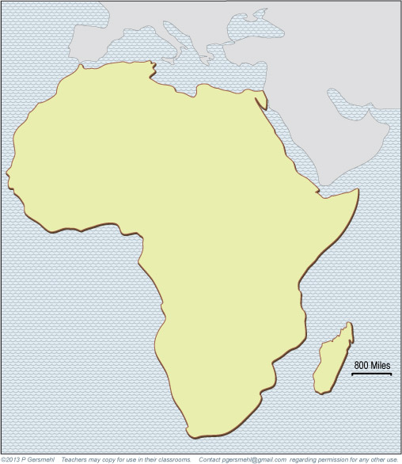
The continent
of Africa is unique
in one important way.

Slide 8
Equator
The Equator runs
roughly through
the middle of it.

Slide 9
North
Equator
Africa extends
almost the same distance
north and south
of the equator.
The Equator runs
roughly through
the middle of it.
South

Slide 10
North
Equator
As a result, Africa
is a good place to study
the effects of latitude.
WHY?
South

Slide 11
North
Equator
As a result, Africa
is a good place to study
the effects of latitude.
WHY?
South
because anything
that depends on latitude
will happen twice in Africa –
both north and south
of the equator.

Slide 12
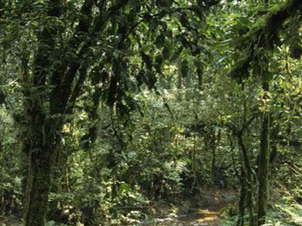
For example, Africa
has a dense rainforest
just north of the equator.
Forest
Equator
Forest

Slide 13
For example, Africa
has a dense rainforest
just north of the equator.
Forest
Equator
The rainforest continues
just south of the equator.
Forest

Slide 14
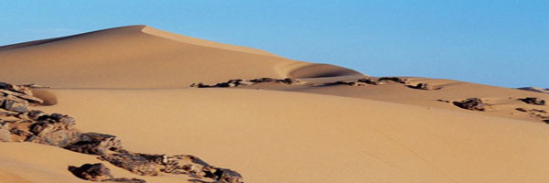
Desert
A large area
in North Africa
is a barren desert.
Forest
Equator
Forest
Desert

Slide 15
Desert
A large area
in North Africa
is a barren desert.
Forest
Equator
Forest
Southern Africa
has another desert
at the same distance
from the equator.
Desert

Slide 16
Desert
Desert
A large area
in North Africa
is a barren desert.
Forest
Forest
Equator
Equator
Forest
Forest
Southern Africa
has another desert
at the same distance
from the equator.
Desert
Desert
It’s smaller, because Africa
is not as “wide” there!

Slide 17
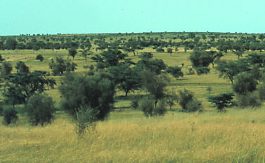
Between the deserts
and the rainforest
are savannas
(also called thorn forests).
Desert
These are mixtures
of tall grasses, shrubs,
and short trees.
Savanna
Forest
Forest
Thorn
Forests
Desert

Slide 18
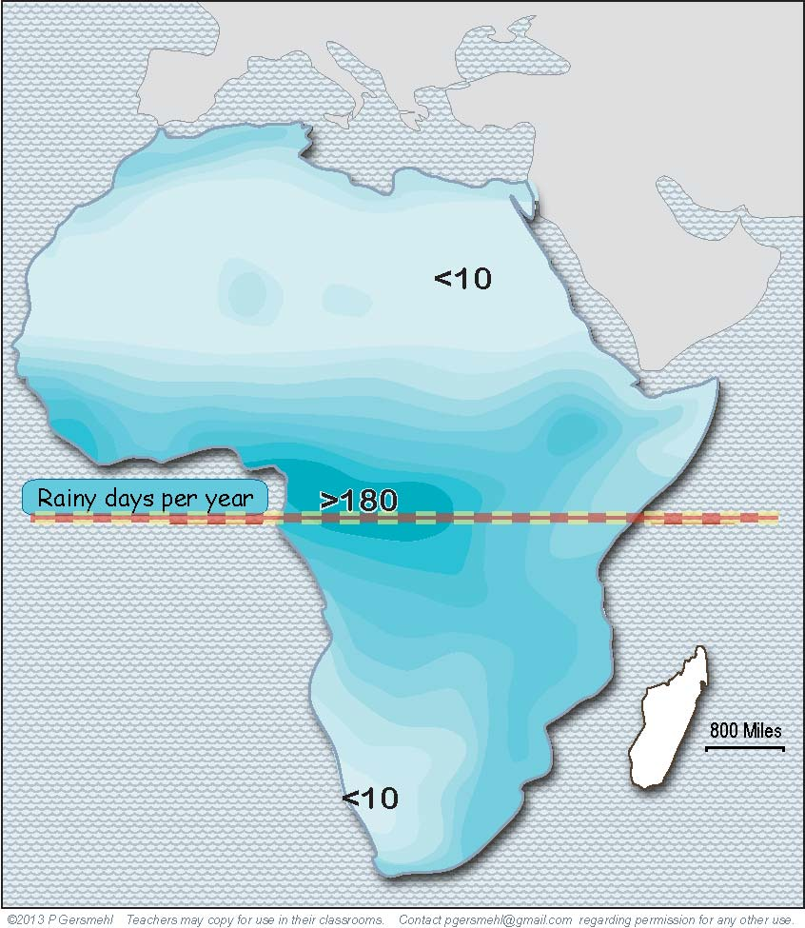
If you want
to memorize
just one line
in North Africa,
start at the western
tip of the continent
and go directly east.
Desert
Forest
Forest
Desert

Slide 19
This line comes
out of Africa
just north of the eastern tip
of the continent.
If you want
to memorize
just one line
in North Africa,
start at the western
tip of the continent
and go directly east.
Desert
Forest
Forest
Desert

Slide 20
This line comes
out of Africa
just north of the eastern tip
of the continent.
If you want
to memorize
just one line
in North Africa,
start at the western
tip of the continent
and go directly east.
Desert
Forest
Forest
This line separates
the dry desert
from the places
that get enough rain
for people to grow food.
Desert

Slide 21
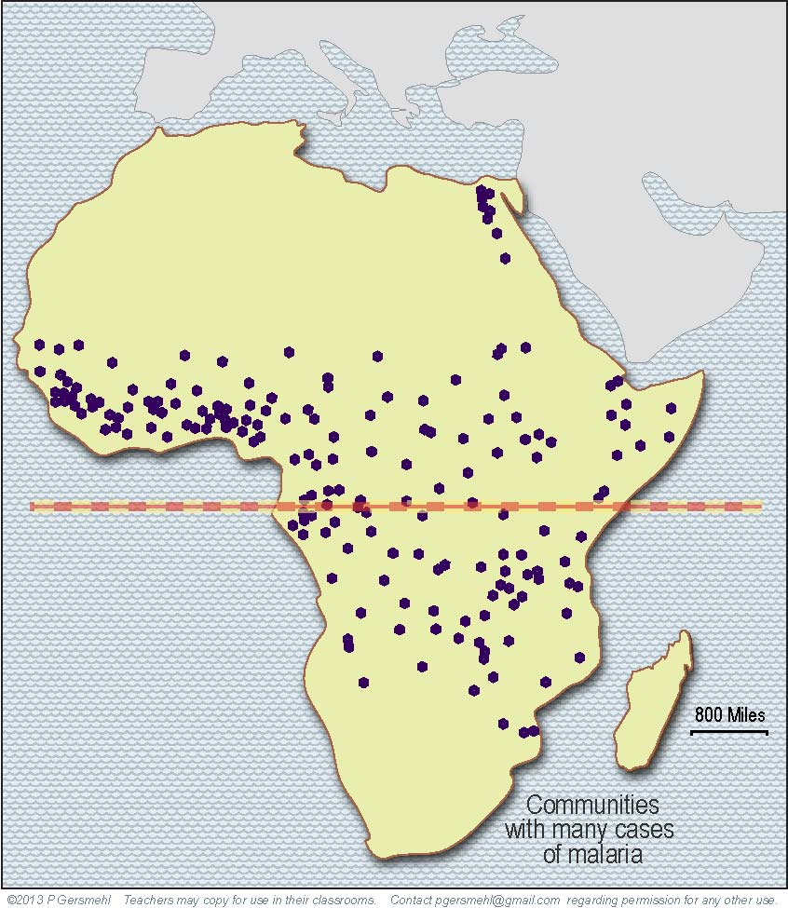
It also runs
along the edge
of the area that
gets enough rain
for the mosquitoes
that cause malaria
(a really bad disease).
Desert
Forest
Forest
Desert

Slide 22
Not surprisingly,
the capital cities
of many ancient
African empires
were just barely
on the rainy side
of this line –
enough rain for crops,
but also dry enough
to limit malaria.
Desert
Forest
Forest
Desert

Slide 23
Memphis (Giza) –
near the Nile River
Timbuktu –
near the Niger River
Not surprisingly,
the capital cities
of many ancient
African empires
were just barely
on the rainy side
of this line –
enough rain for crops,
but also dry enough
to limit malaria.
Desert
Forest
The big exceptions
are desert cities
next to big rivers.
The big exceptions
are desert cities
next to big rivers.
Forest
Desert

Slide 24
Next, we will
draw the outlines
of three areas
of high, hilly land.
Desert
Forest
Forest
Desert

Slide 25
Next, we will
draw the outlines
of three areas
of high, hilly land.
Desert
1. Atlas Mountains, parallel to the coast
in the northwest.
Forest
Forest
Desert

Slide 26
Next, we will
draw the outlines
of three areas
of high, hilly land.
Desert
1. Atlas Mountains, parallel to the coast
in the northwest.
Forest
Forest
2. The Drakensberg, parallel to the coast
in the southeast.
Desert

Slide 27
Next, we will
draw the outlines
of three areas
of high, hilly land.
Desert
1. Atlas Mountains, parallel to the coast
in the northwest.
Forest
3. A large area
parallel to the coast
in East Africa.
Forest
2. The Drakensberg, parallel to the coast
in the southeast.
Desert

Slide 28
Next, we will
draw the outlines
of three areas
of high, hilly land.
Desert
1. Atlas Mountains, parallel to the coast
in the northwest.
Forest
3. A large area
parallel to the coast
in East Africa.
Forest
These are called,
not surprisingly, the
East African Highlands.
2. The Drakensberg, parallel to the coast
in the southeast.
Desert

Slide 29
If you want to add
a few more lines,
put a blurry line
about halfway
between the equator
and the desert line.
Desert
Forest
Forest
Desert

Slide 30
If you want to add
a few more lines,
put a blurry line
about halfway
between the equator
and the desert line.
Desert
Forest
Forest
Another one goes
about the same distance
south of the equator.
Desert

Slide 31
Desert
Savanna
Forest
These fuzzy lines go between
rainforests and savannas
(also called thorn forests).
Forest
Thorn
Forests
Desert

Slide 32
Desert
Savanna
Forest
Add one more
blurry diagonal line
to separate
the thorn forest
from the desert.
Forest
Thorn
Forests
Desert

Slide 33
That’s it !
a good mental map of Africa –
five vegetation regions
and three highland areas.

Slide 34
That’s it !
a good mental map of Africa –
five vegetation regions
and three highland areas.
This map can help
you understand
the geographic patterns
of many things, including plant cover, fires, floods,
wild animals and hunting,
farming and animal herding,
human migration,
languages and religions,
empires and trade routes,
slave-capture areas,
European colonies,
many diseases,
and some effects of
global climate change.

Slide 35
That’s it !
a good mental map of Africa –
five vegetation regions
and three highland areas.
This map can help
you understand
the geographic patterns
of many things, including plant cover, fires, floods
wild animals and hunting,
farming and animal herding,
human migration,
languages and religions,
empires and trade routes,
slave-capture areas,
European colonies,
many diseases,
and some effects of
global climate change.
Can you
remember
the name
of each area,
or something
else about it?

Slide 36
That’s it !
a good mental map of Africa –
five vegetation regions
and three highland areas.
Atlas Mountains
Sahara (the name means desert!)
This map can help
you understand
the geographic patterns
of many things, including plant cover, fires, floods,
wild animals and hunting,
farming and animal herding,
human migration,
languages and religions,
empires and trade routes,
slave-capture areas,
European colonies,
many diseases,
and some effects of
global climate change.
Savanna
East
Africa
Highlands
Rainforest
Thorn
Forest
Kalahari
Desert
Drakensberg

Slide 37
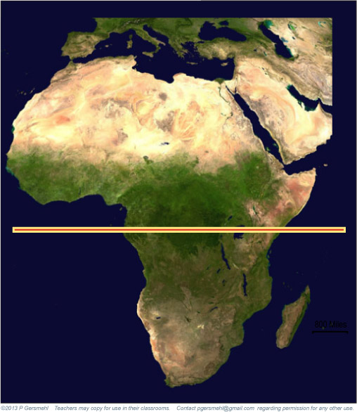
This is what
the four lines
look like
on a photo
from a satellite.

Slide 38
One more thing:
this little area
east of the highlands
is also very dry.
This is what
the four lines
look like
on a photo
from a satellite.

Slide 39
To see a variety of pictures about these regions,
start an image search using these keywords:
Rainforest in Congo
Sahara in Libya or Sahara in Mali
(“desert in Mali” just gets you pictures of boots for sale!)
Savanna in Nigeria
Grassland in Niger
Atlas Mountains
Drakensberg
East African Highlands or Rift Valley

Slide 40
Looking at several pictures
is better than studying
just one example . . .
you see how things vary
within a region!
To see a variety of pictures about these regions,
start an image search using these keywords:
Rainforest in Congo
Sahara in Libya or Sahara in Mali
(“desert in Mali” just gets you pictures of boots for sale!)
Savanna in Nigeria
Grassland in Niger
Atlas Mountains
Drakensberg
East African Highlands or Rift Valley

Slide 41
And to see maps
of many other things
that might be related to latitude,
check out the clickable map of Africa:
http://textbooks.wmisd.org/BI05.html

Slide 43
Copyright 2018, Phil and Carol Gersmehl
Teachers who saw this presentation at a workshop
or downloaded it from our internet site have permission
to make a copy on their own computers for these purposes:
1. to help them review the workshop,
2. to show the presentation in their own classrooms, at sessions they present at teacher conferences, or to administrators in their own school or district,
3. to use individual frames (with attribution) in their own class or conference presentations.
For permission for any other use,
including posting frames on a personal blog or uploading to any network or website that can be accessed from outside your school,
contact pgersmehl@gmail.com

