Slide 1
RESOURCES A BIG geographical IDEA with many consequences IN SouthWEST ASIA
This big idea can help us understand many geographic patterns in Southwest Asia,
including patterns of food production, population, ancient empires, religions,
trade, borders, oil production, and terrorism.

Slide 2
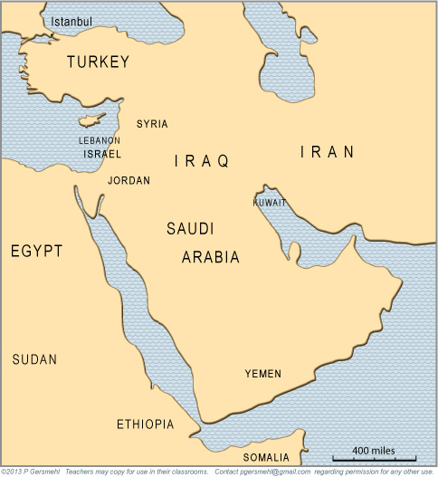
Note to Teachers
1. This presentation has a specific purpose. It is designed as an illustrated teacher guide to provide content background
about the “layers of information” on the clickable map of Southwest Asia.
It is not designed for use in class “as is” – to tailor it for a specific class, you might shorten it, edit frames, add pictures or discussion questions, etc.
(see below)
2. This presentation has two parts – explanation and question. You can cut-and-paste to put question frames where you want them in order to promote class discussion or identify misconceptions.
The question frames can also serve as reviews, assessments,
or prompts for inquiry activities (individual or group).
3. This presentation is much too long. There is a good reason for this – your computer has a DELETE key,
but it does not have a CREATE key.
This is important, because many teachers have reviewed this presentation. If anyone suggested an addition (like a definition, explanation, or example), we usually put it in – because other teachers might also find it useful,
and it takes much less time to delete a frame than to make one!
(PS. You can delete this frame now!)
?
DELETE

Slide 3
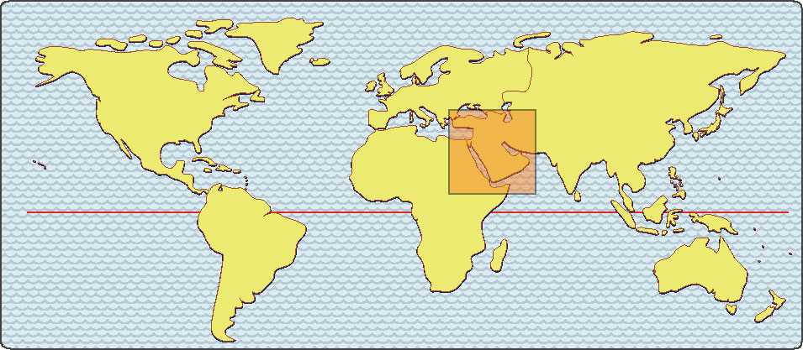
Southwest Asia
has been called
“the crossroads of history.”
(It is located where Asia, Africa, and Europe meet.)

Slide 4
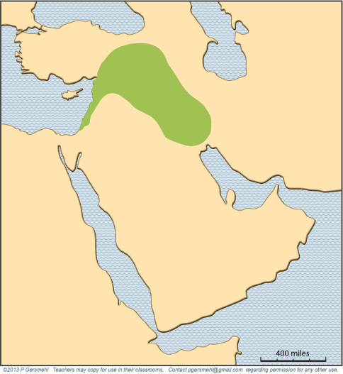
A very important area
is an arc-shaped blob
that some people call
the Fertile Crescent.

Slide 5
A very important area
is an arc-shaped blob
that some people call
the Fertile Crescent.
Note
That is an odd name,
because the area
doesn’t really look
like a crescent.
Moreover, much of it
is not very fertile
(compared to, say,
the American Corn Belt
or the North China Plain).

Slide 6
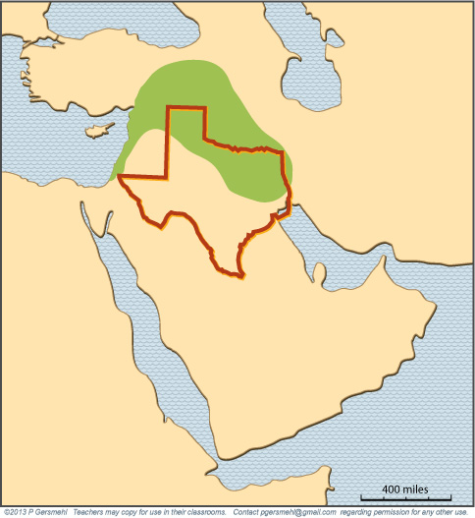
The Fertile Crescent
is roughly the same size
and latitude of Texas.

Slide 7
This small region
had some of the first
urban civilizations
of the world –
starting more than
6000 years ago.

Slide 8
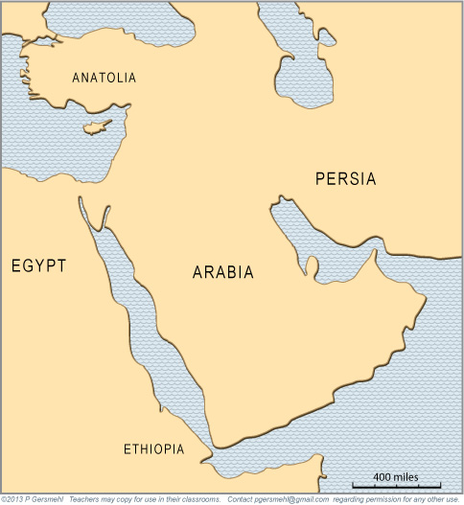
BYZANTIUM
CAPPADOCIA
LYDIA
TAURUS
SCYTHIA
MEDIA
LEVANT
ASSYRIA
PHOENICIA
BABYLON
ELAM
CANAAN
AKKAD
Not surprisingly,
many parts of this area
have had different names
in the past.
NUBIA
KUSH
AKSUM

Slide 9
Including one
of the most famous names:
Mesopotamia
BYZANTIUM
CAPPADOCIA
LYDIA
TAURUS
SCYTHIA
MEDIA
LEVANT
ASSYRIA
PHOENICIA
BABYLON
ELAM
CANAAN
AKKAD
Not surprisingly,
many parts of this area
have had different names
in the past.
NUBIA
KUSH
AKSUM

Slide 10
These ancient civilizations developed
in an area that is now the home of:
- large numbers of very poor people,
- a few multimillionaire families,
- some of the least democratic governments
in the world,
and
- some well-known terrorist organizations.

Slide 11
These ancient civilizations developed
in an area that is now the home of:
- large numbers of very poor people,
- a few multimillionaire families,
- some of the least democratic governments
in the world,
and
- some well-known terrorist organizations.
Why are they here?

Slide 12
One clue to understanding SW Asia
is the idea of resources.

Slide 13
One clue to understanding SW Asia
is the idea of resources.
Definition: a resource is something that nature provides in a place
and people have learned how to use

Slide 14
One clue to understanding SW Asia
is the idea of resources.
Definition: a resource is something that nature provides in a place
and people have learned how to use
People use resources to produce everything
that they eat, wear, buy, or use –
from wood chips to potato chips, computer chips, and poker chips.

Slide 15
One clue to understanding SW Asia
is the idea of resources.
Definition: a resource is something that nature provides in a place
and people have learned how to use
Resources are geographically important,
because different places have different resources.
.

Slide 16
One clue to understanding SW Asia
is the idea of resources.
Definition: a resource is something that nature provides in a place
and people have learned how to use
Resources are geographically important,
because different places have different resources.
Resources are also historically important,
because technology changes, and therefore
people used different resources at different times.

Slide 17
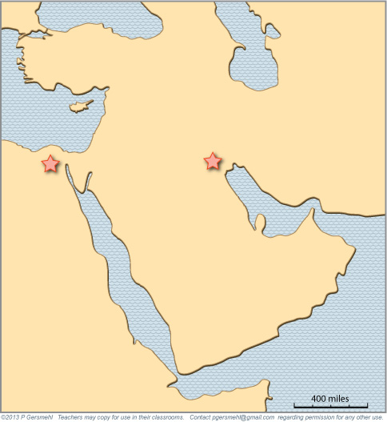
To see how resources work,
let’s look at where
the first two large cities
of the world were built.
To see how resources work,
let’s look at where
the first two large cities
of the world were built.

Slide 18
To see how resources work,
let’s look at where
the first two large cities
of the world were built.
To see how resources work,
let’s look at where
the first two large cities
of the world were built.
Curriculum note.
To put this in perspective,
there is a student activity
and presentation called “Ancient Cities
and Temperatures.”

Slide 19
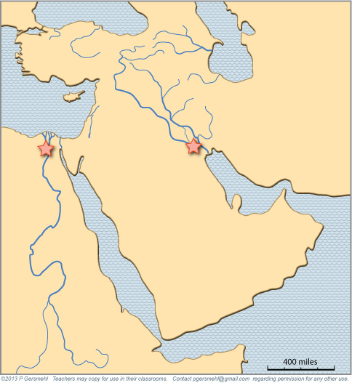
Each city was located
near the end of a river
flowing through a desert.

Slide 20
Each city was located
near the end of a river
flowing through a desert.
River water is a resource.

Slide 21
The rivers help make
the soil soft and fertile, good for growing food
(especially before
tractors were invented).

Slide 22
The rivers help make
the soil soft and fertile, good for growing food
(especially before
tractors were invented).
Soft soil is a resource.

Slide 23
The rivers help make
the soil soft and fertile, good for growing food
(especially before
tractors were invented).
Even the surrounding desert
was also a useful resource,
because it was a kind of barrier
against enemy attack.

Slide 24
Later, people learned how
to take water out of the rivers
and spread it out on their fields
to help their crops grow better.

Slide 25
That’s called irrigation.
It’s one of the key inventions
of the ancient world.
Later, people learned how
to take water out of the rivers
and spread it out on their fields
to help their crops grow better.

Slide 26
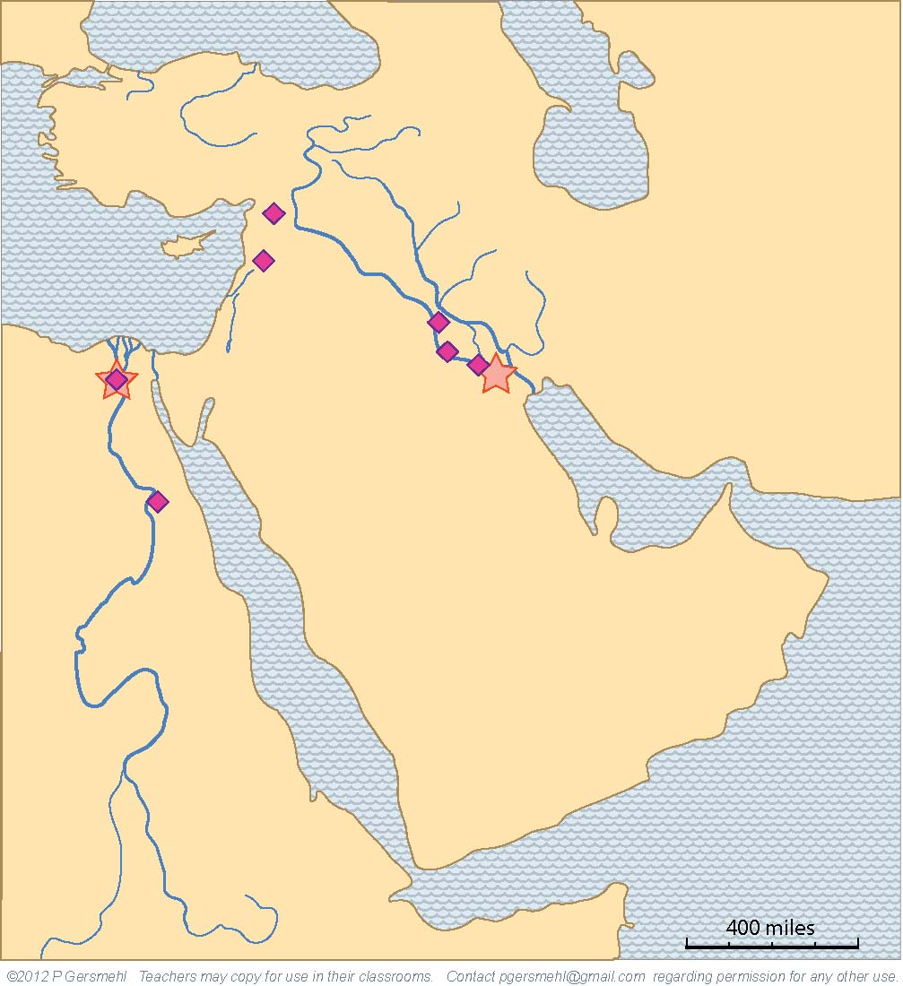
Using the technology of irrigation,
people settled all along the rivers,
and they built many new cities
in strategically important places
(often near river crossings).

Slide 27
Using the technology of irrigation,
people settled all along the rivers,
and they built many new cities
in strategically important places
(often near river crossings).
River-crossing places
are a resource.

Slide 28
Curriculum note.
To put this in perspective,
there is a student activity
about “Early Civilizations.”
Using the technology of irrigation,
people settled all along the rivers,
and they built many new cities
in strategically important places
(often near river crossings).
River-crossing places
are a resource.

Slide 29
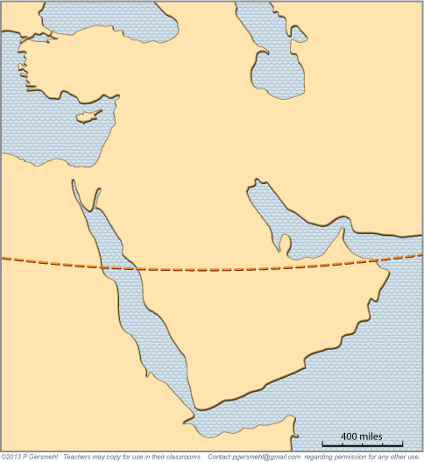
To put this all in context,
let’s look more closely
at where this area is.
The Tropic of Cancer
goes right through
Southwest Asia.

Slide 30
To put this all in context,
let’s look more closely
at where this area is.
The Tropic of Cancer
goes right through
Southwest Asia.
For good reasons,
deserts tend to form
near the Tropic lines.

Slide 31
To put this all in context,
let’s look more closely
at where this area is.
The Tropic of Cancer
goes right through
Southwest Asia.
For good reasons,
deserts tend to form
near the Tropic lines.
Curriculum note.
There is a presentation
and student activity called
“What Makes Deserts”
and a clickable map
“Ecoregions of the World.”

Slide 32
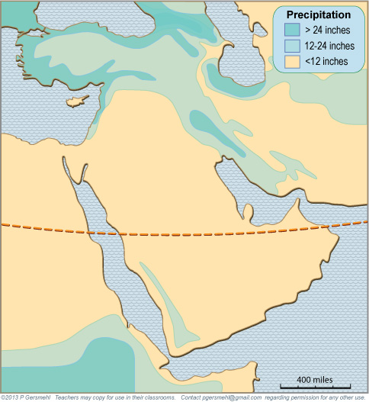
The weather is rainier
both north and south
of the desert area.
It rains
both north and south
of the desert area.

Slide 33
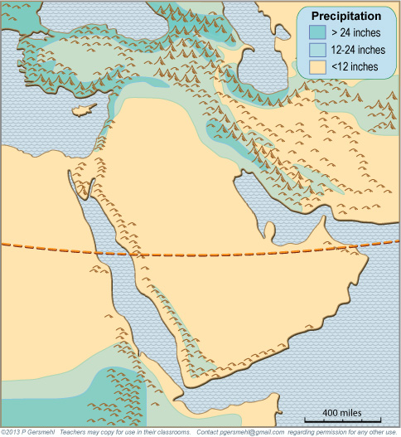
The actual pattern
of precipitation
is also influenced
by the locations
of high mountains.
The actual pattern
of precipitation
is also influenced
by the locations
of high mountains.
The actual pattern
of precipitation
is also influenced
by the locations
of high mountains.

Slide 34
Curriculum note.
The South America unit
has more information
about the climate
effects of elevation.
The actual pattern
of precipitation
is also influenced
by the locations
of high mountains.
The actual pattern
of precipitation
is also influenced
by the locations
of high mountains.
The actual pattern
of precipitation
is also influenced
by the locations
of high mountains.

Slide 35
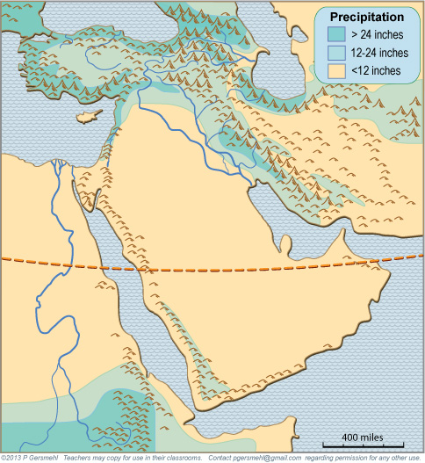
The actual pattern
of precipitation
is also influenced
by the locations
of high mountains.
The rivers start
in rainy mountains
and then flow
across the desert.

Slide 36
These two river systems
are different, however.
The main difference
occurs because of
when the rain falls
around them.

Slide 37
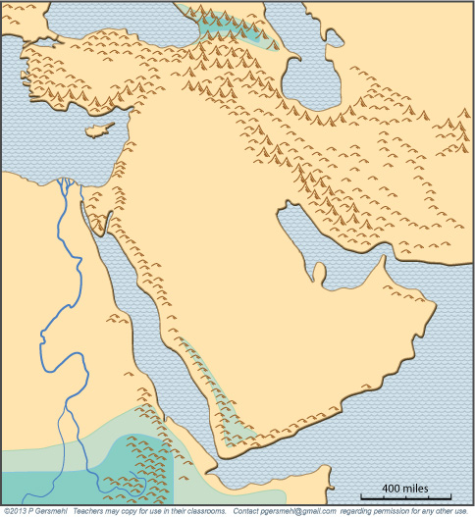
In summer, the
Equatorial Rainy Belt
moves northward.
This brings rain
to the highlands in
Ethiopia and Yemen.
In summer, the
Equatorial Rainy Belt
moves northward,
and brings rain
to the highlands in
Ethiopia and Yemen.

Slide 38
Not surprisingly,
the Nile River floods
after the summer rains.
In summer, the
Equatorial Rainy Belt
moves northward.
This brings rain
to the highlands in
Ethiopia and Yemen.
In summer, the
Equatorial Rainy Belt
moves northward,
and brings rain
to the highlands in
Ethiopia and Yemen.

Slide 39
Not surprisingly,
the Nile River floods
after the summer rains.
Curriculum note.
The Africa unit
has more information
and some activities about
the Equatorial Rainy Belt
and its seasonal movement.
In summer, the
Equatorial Rainy Belt
moves northward.
This brings rain
to the highlands in
Ethiopia and Yemen.
In summer, the
Equatorial Rainy Belt
moves northward,
and brings rain
to the highlands in
Ethiopia and Yemen.

Slide 40
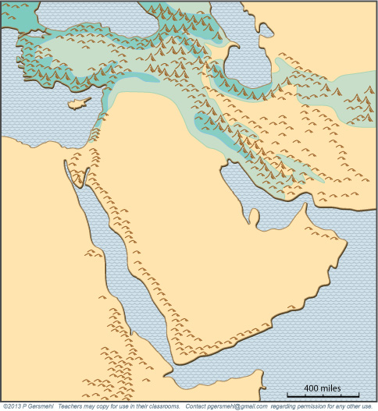
In winter,
the Rainy Belt
and the Tropical desert
are a little farther south.
When that happens,
mid-latitude storms
can bring rain and snow
to the highlands
of Anatolia and Persia
(now called Turkey and Iran).
T
I

Slide 41
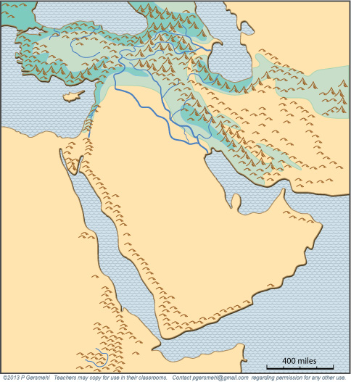
The two rivers
of Mesopotamia
(the Tigris and Euphrates)
usually make floods
when snow melts
in early spring.
That’s a good time
to start growing food.

Slide 42
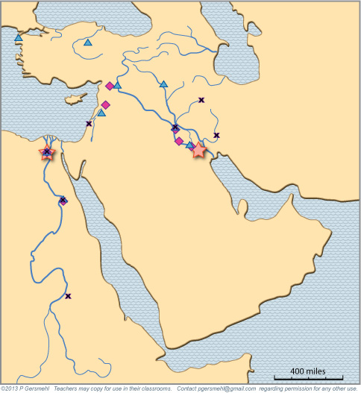
As a result,
populations
grew larger
in this area.
The stars, squares,
triangles, and x’s
show the main cities
at different times.
You can check this
in the clickable map
of Southwest Asia.

Slide 43
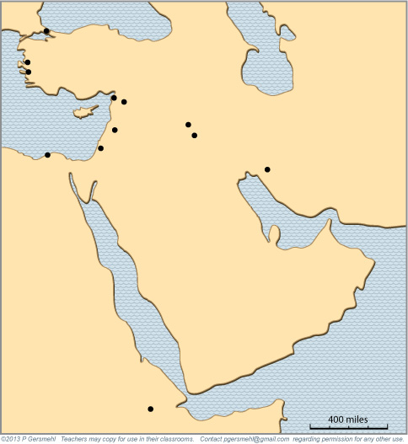
By Roman times (100 BCE)
people had learned to build
all-weather sea-going ships.
People built new cities
in good places for ports.
By Roman times (100 BCE)
people had learned how
to build sea-going ships.
The sea became a resource,
and new cities were built
along the shore.
By Roman times (100 BCE)
people had learned how
to build sea-going ships.
The sea became a resource,
and new cities were built
along the shore.
By Roman times (100 BCE)
people had learned how
to build sea-going ships.
The sea became a resource,
and new cities were built
along the shore.

Slide 44
By Roman times (100 BCE)
people had learned to build
all-weather sea-going ships.
People built new cities
in good places for ports.
By Roman times (100 BCE)
people had learned how
to build sea-going ships.
The sea became a resource,
and new cities were built
along the shore.
By Roman times (100 BCE)
people had learned how
to build sea-going ships.
The sea became a resource,
and new cities were built
along the shore.
By Roman times (100 BCE)
people had learned how
to build sea-going ships.
The sea became a resource,
and new cities were built
along the shore.
A safe harbor
is a resource.

Slide 45
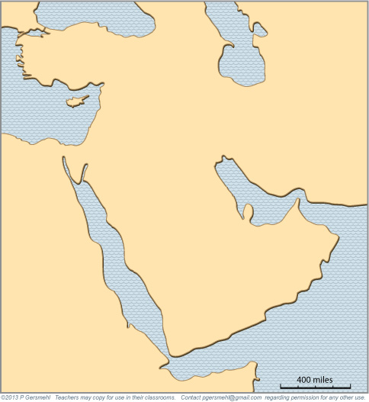
The combination of flooding rivers, easy-to-work soil,
irrigation technology, and the surrounding desert
helped farmers grow a lot of food in these two areas.
One farm worker could feed many people.
This gave other people time to do other jobs –
in trade, government, science, education, religion.
It is no accident that astronomy, mathematics, writing,
legal systems, and several major religions
all developed in these two fairly small areas.

Slide 46
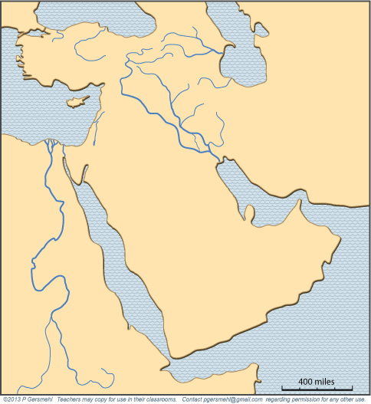
For example, about 4000 years ago,
a Babylonian king named Hammurabi made one of the first sets of written laws.

Slide 47
Another example
from the same time:
a religion called Zoroastrianism
started in the hills
of western Iran.

Slide 48
About 1200 BCE,
according to the Bible,
a man named Moses led
the “Children of Israel,”
out of slavery in Egypt.

Slide 49
These people
(also called the Jews)
settled in the land
west of the Jordan River (this area had many names throughout its long history – including Retenu, Canaan, Philistia,
Samaria, Judea, Palestine, Israel).

Slide 50
Christianity started
in that same small area
during the Roman Empire
(at the beginning of the
Common Era - CE).

Slide 51
So . . . . Zoroastrianism, Judaism, and Christianity
all started in Southwest Asia, thousands of years ago.
Christianity spread to most of Europe, Russia,
the Americas, Australia, and much of Africa.
Jews migrated to many places around the world,
and now live mainly in urban areas.
Zoroastrianism also still exists,
although it has not grown as fast
or spread as far as Christianity.

Slide 52
So . . . . Zoroastrianism, Judaism, and Christianity
all started in Southwest Asia, thousands of years ago.
Christianity spread to most of Europe, Russia,
the Americas, Australia, and much of Africa.
Jews migrated to many places around the world,
and now live mainly in urban areas.
Zoroastrianism also still exists,
although it has not grown as fast
or spread as far as Christianity.
Curriculum note.
There is a presentation
a clickable map,
and some activities
about the spread
of major religions.

Slide 53
In the early 600s,
the Prophet Muhammad
started another religion
in Southwest Asia,
called Islam.

Slide 54
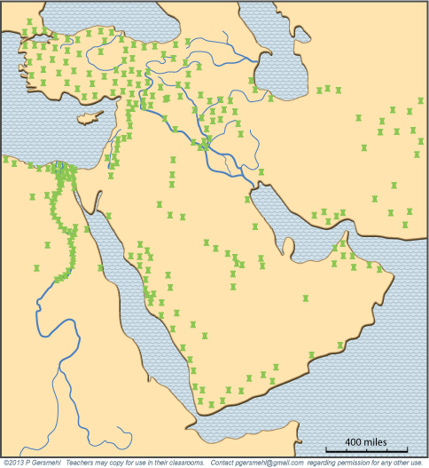
Islam soon split
into two main groups.
About three quarters
are Sunni Muslims
(shown on this map).

Slide 55
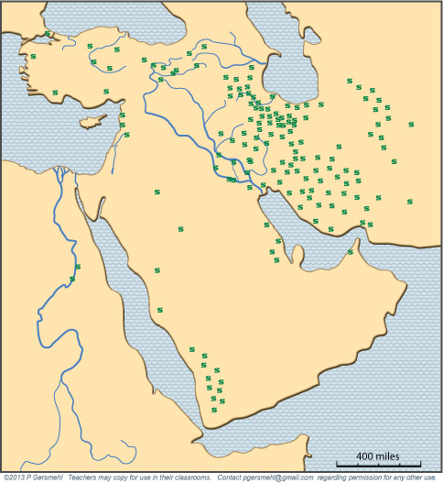
About one-fifth
are Shi’a Muslims.
Shi’ites are the majority
in the modern country
of Iran (ancient Persia).

Slide 56
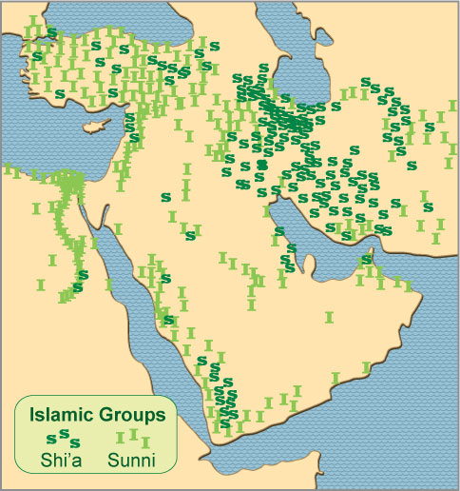
If your map shows both groups,
you can see that they do not
always live in separate areas.

Slide 57
If your map shows both groups,
you can see that they do not
always live in separate areas.
For example, countries like
Yemen have
large numbers
of both groups.

Slide 58
Over the next few centuries,
Islamic traders spread their religion
throughout much of the known world -
west across North Africa to Spain,
and east to India and Indonesia.

Slide 59
Over the next few centuries,
Islamic traders spread their religion
throughout much of the known world -
west across North Africa to Spain,
and east to India and Indonesia.
Curriculum note.
There is a presentation,
several student activities,
and supplementary maps
about the spread of Islam.

Slide 60
For six centuries
after Muhammad,
Islamic caliphs (rulers)
had complete control
over the Persian Gulf
and the Red Sea.
These waterways were
the main trade routes
between Europe
and China.
P
For five centuries
after Muhammad,
Islamic traders
controlled the
main resource,
R

Slide 61
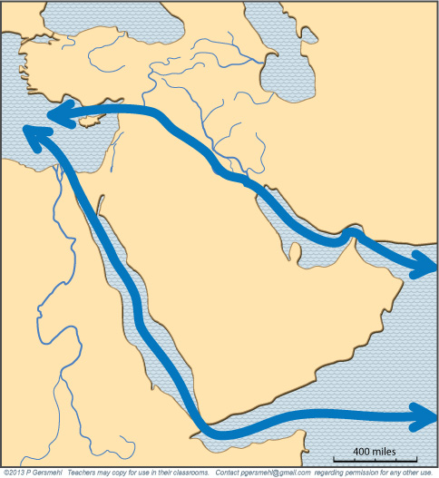
Control of a major trade route
helped the city of Baghdad.
It grew to become
what was probably the largest
and richest city in the world.

Slide 62
Control of a major trade route
helped the city of Baghdad.
It grew to become
what was probably the largest
and richest city in the world.
Curriculum note.
There are presentations
and student activities called
“Sailing the Arabian Sea”
and “The Belitung Shipwreck.”

Slide 63
Then four important things happened:
1. The Islamic empire split into regional dynasties.
2. People invented better ships that could sail farther.
3. Europeans got the magnetic compass from China.
and
4. The Islamic Moors were driven out of Spain in 1492
and no longer controlled the Strait of Gibraltar.
How do these ideas fit together?

Slide 64
Then four important things happened:
1. The Islamic empire split into regional dynasties.
2. People invented better ships that could sail farther.
3. Europeans got the magnetic compass from China.
and
4. The Islamic Moors were driven out of Spain in 1492
and no longer controlled the Strait of Gibraltar.
How do these ideas fit together?
Together, events 1 and 4 “set the stage”
and inventions 2 and 3 made it possible
for explorers like Vasco de Gama and Columbus
to sail all the way around Africa to India and China
and across the Atlantic Ocean to America.

Slide 65
Consequence: The Red Sea and Persian Gulf were
no longer the most valuable trade routes in the world.
In short, they were no longer uniquely valuable resources.
Southwest Asia started to lose wealth and power.

Slide 66
To make matters worse for Southwest Asia,
the Industrial Revolution came next.
The new factories relied on water power, coal, and iron ore.
Southwest Asia does not have these resources.

Slide 67
To make matters worse for Southwest Asia,
the Industrial Revolution came next.
The new factories relied on water power, coal, and iron ore.
Southwest Asia does not have these resources.
Curriculum note.
The unit about Europe has
a presentation and activity about
Changing Technology of Iron.

Slide 68
To make matters worse for Southwest Asia,
the Industrial Revolution came next.
The new factories relied on water power, coal, and iron ore.
Southwest Asia does not have these resources.
What did Southwest Asia have?
- a lot of people who used to work as traders,
- some old cities that were falling into ruin,
- a relatively small amount of good cropland.
That’s a recipe for poverty!

Slide 69
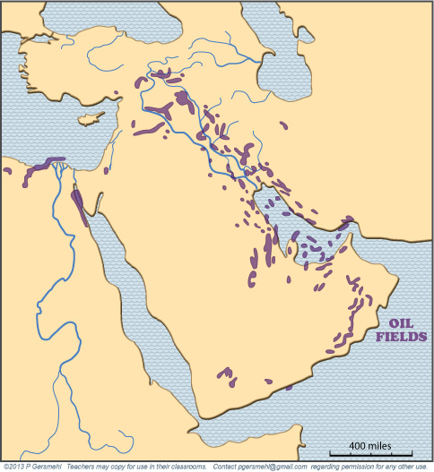
Then people discovered
another key resource
- - - petroleum - - -

Slide 70
Then people discovered
another key resource
- - - petroleum - - -
Southwest Asia
has more than half
of the world’s oil.

Slide 71
Then people discovered
another key resource
- - - petroleum - - -
Southwest Asia
has more than half
of the world’s oil.
Curriculum note.
There is a presentation
and map activity about
“Oil in the World.”

Slide 72
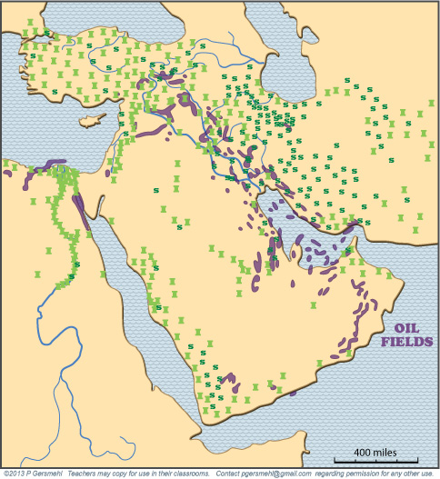
Oil is found where
both Sunni and Shi’a
Muslims live.

Slide 73
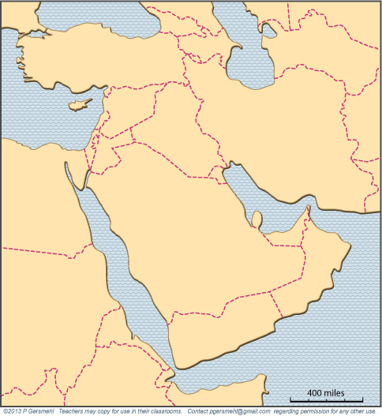
To make things
even more
complicated,
the borders
between
countries
were drawn
by European
colonial powers.

Slide 74
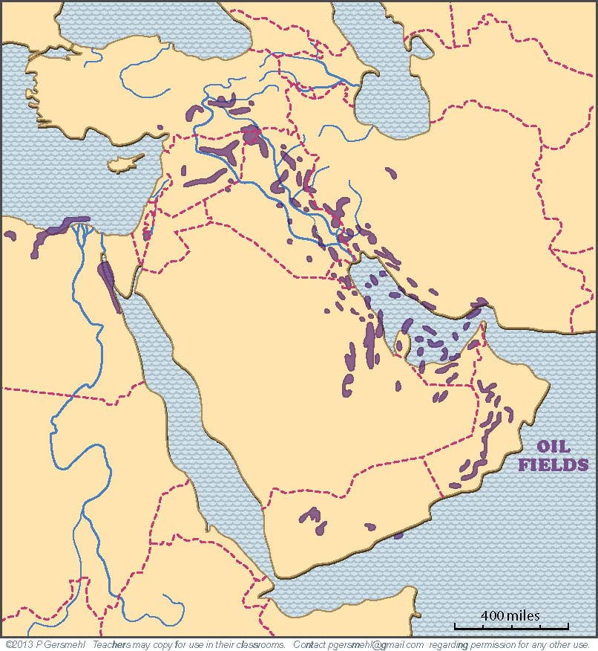
These borders
were made with
little concern
for the location
of resources –
rivers, cropland, OR petroleum.

Slide 75
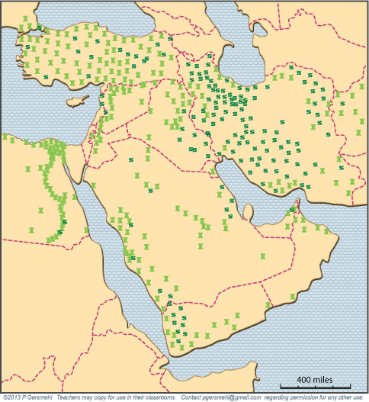
The new borders
also did not pay
much attention
to the pattern
of Sunni
and Shi’a
populations.

Slide 76
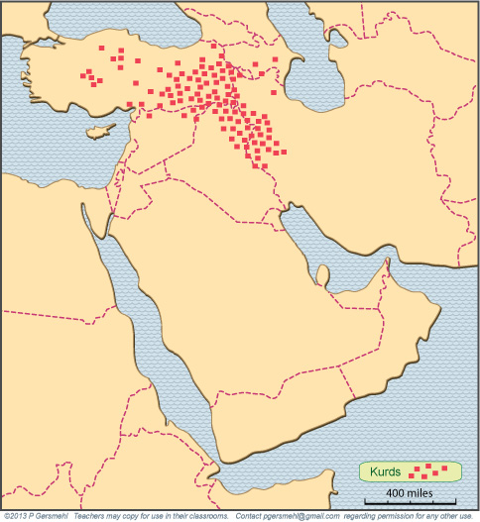
Even more
important,
the borders
ignored
large groups
of people
who want
their own country –
such as the Kurds.

Slide 77
Even more
important,
the borders
ignored
large groups
of people
who want
their own country –
such as the Kurds.
Today,
Kurds are scattered
in six
different
countries.

Slide 78
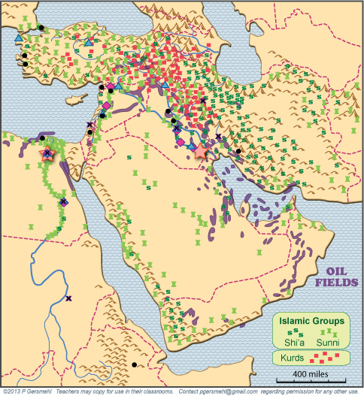
When we put
all this onto one map -
formerly wealthy cities,
several branches of Islam,
mismatched country borders,
Kurds, petroleum deposits, etc. -
it helps us understand
why this region now has
so much political unrest.

Slide 79
As these maps show, this part of the world
has a very long and complicated history.
Here is one result of that history:
this region has many groups of people
who were treated badly at various times in the past
and think they deserve more than they have now
(e.g. Jews Samaritans Shi’ites Sunnis Palestinians Kurds etc. etc. etc.)
A big complication in this region
is the simple fact that a high world price for oil
can support undemocratic governments.

Slide 80
Governments can use oil money to:
- buy weapons, police, and security forces,
- support a lavish lifestyle for the elite,
and
- provide cheap food and gasoline to the people
(in effect, “bribing” people to accept the status quo).

Slide 81
Governments can use oil money to:
- buy weapons, police, and security forces,
- support a lavish lifestyle for the elite,
and
- provide cheap food and gasoline to the people
(in effect, “bribing” people to accept the status quo).
BUT . . .
what happens when the oil runs out?

Slide 82
This presentation showed one way to use
the clickable map of Southwest Asia - to help us investigate
some consequences of the big idea of resources.
Resources can affect:
This presentation showed one way to use
the clickable mini-Atlas - to help us investigate
some consequences of the big idea of resources,
with examples from Southwest Asia and north Africa.
Resources can affect:

Slide 83
This presentation showed one way to use
the clickable map of Southwest Asia - to help us investigate
some consequences of the big idea of resources.
Resources can affect:
This presentation showed one way to use
the clickable mini-Atlas - to help us investigate
some consequences of the big idea of resources,
with examples from Southwest Asia and north Africa.
Resources can affect:
Population growth – because productive use of resources
can help people live longer and have more children.

Slide 84
This presentation showed one way to use
the clickable map of Southwest Asia - to help us investigate
some consequences of the big idea of resources.
Resources can affect:
This presentation showed one way to use
the clickable mini-Atlas - to help us investigate
some consequences of the big idea of resources,
with examples from Southwest Asia and north Africa.
Resources can affect:
Population growth – because productive use of resources
can help people live longer and have more children.
Military power – because countries that have resources
can afford professional armies and security forces

Slide 85
This presentation showed one way to use
the clickable map of Southwest Asia - to help us investigate
some consequences of the big idea of resources.
Resources can affect:
This presentation showed one way to use
the clickable mini-Atlas - to help us investigate
some consequences of the big idea of resources,
with examples from Southwest Asia and north Africa.
Resources can affect:
Population growth – because productive use of resources
can help people live longer and have more children.
Military power – because countries that have resources
can afford professional armies and security forces
Trade – because people with unique resources
have something they can sell to other people

Slide 86
This presentation showed one way to use
the clickable map of Southwest Asia - to help us investigate
some consequences of the big idea of resources.
Resources can affect:
This presentation showed one way to use
the clickable mini-Atlas - to help us investigate
some consequences of the big idea of resources,
with examples from Southwest Asia and north Africa.
Resources can affect:
Population growth – because productive use of resources
can help people live longer and have more children.
Military power – because countries that have resources
can afford professional armies and security forces
Trade – because people with unique resources
have something they can sell to other people
Science and religion– because resources help workers
become more productive and able to support people
who can do other things (art, science, religion, trade)

Slide 87
This presentation showed one way to use
the clickable map of Southwest Asia - to help us investigate
some consequences of the big idea of resources.
Resources can affect:
This presentation showed one way to use
the clickable mini-Atlas - to help us investigate
some consequences of the big idea of resources,
with examples from Southwest Asia and north Africa.
Resources can affect:
Population growth – because productive use of resources
can help people live longer and have more children.
Military power – because countries that have resources
can afford professional armies and security forces
Trade – because people with unique resources
have something they can sell to other people
Science and religion– because resources help workers
become more productive and able to support people
who can do other things (art, science, religion, trade)
Balance of Power – because changes in technology
may help other places (with other resources)
become richer and more powerful

Slide 89
RESOURCES A BIG geographical IDEA with many consequences IN SouthWEST ASIA
QUESTIONS SECTION
This big idea can help us understand many geographic patterns in Southwest Asia,
including patterns of food production, population, ancient empires, religions,
trade, borders, oil production, and terrorism.

Slide 90
What is this general area
often called?

Slide 91
Why is this area
sometimes called
“the crossroads
of history”?

Slide 92
What is another
common name
for this area?

Slide 93
What are some
consequences
of its latitude
(compared with
Texas in the US)

Slide 94
What is the general name
for this area, which supported
several ancient civilizations?
BYZANTIUM
CAPPADOCIA
LYDIA
TAURUS
SCYTHIA
MEDIA
LEVANT
ASSYRIA
PHOENICIA
BABYLON
ELAM
CANAAN
AKKAD
NUBIA
KUSH
AKSUM

Slide 95
One way to try to understand this region
is to look at the idea of resources.

Slide 96
One way to try to understand this region
is to look at the idea of resources.
What is a resource?

Slide 97
One way to try to understand this region
is to look at the idea of resources.
What is a resource?
Definition: a resource
is something that nature provides
and people have learned how to use

Slide 98
One way to try to understand this region
is to look at the idea of resources.
What is a resource?
Definition: a resource
is something that nature provides
and people have learned how to use
Why are resources are geographically important?
Why are resources historically important?

Slide 99
To see how resources work,
let’s look at where
the first two large cities
of the world were built.
What do the first cities
that people ever built
in this world region
have in common?

Slide 100
Describe how the soil
near the end of a river
is made by the river,
and why that is important.

Slide 101
Describe why a surrounding desert
could be called a resource.

Slide 102
What technology helped people
grow more food near a river?
How did they choose locations
when they decided to build
many new cities?

Slide 103
What kind of environment
is usually found
near the Tropic lines?

Slide 104
The actual pattern
of precipitation
is also influenced
by the locations
of high mountains.
How is the pattern
of precipitation
influenced
by the locations
of high mountains?
The actual pattern
of precipitation
is also influenced
by the locations
of high mountains.

Slide 105
In summer, the
Equatorial Rainy Belt
moves northward,
and brings rain
to the highlands in
Ethiopia and Yemen.
What season is this?
What causes
the rain to fall
in these areas
at this time?

Slide 106
What river is this?
In what season
does it usually flood?

Slide 107
What season is this?
What causes
rain and snow
to fall in these areas
at this time of year?

Slide 108
In what season
do these two rivers
usually flood?
Why is that
a good time
for food production?

Slide 109
Name at least
three civilizations
that developed
in this general area.
The stars, squares,
triangles, and x’s
show the main cities
at different times.
You can check this
in the clickable map
of Southwest Asia.

Slide 110
What technology
became important at the time
of the Greek and Roman empires?
What were some consequences
of this new technology?
By Roman times (100 BCE)
people had learned how
to build sea-going ships.
The sea became a resource,
and new cities were built
along the shore.
By Roman times (100 BCE)
people had learned how
to build sea-going ships.
The sea became a resource,
and new cities were built
along the shore.
By Roman times (100 BCE)
people had learned how
to build sea-going ships.
The sea became a resource,
and new cities were built
along the shore.

Slide 111
The combination of flooding rivers, easy-to-work soil,
irrigation technology, and the surrounding desert
helped the farmers become very productive.
What is an important consequence
of that rise in productivity?

Slide 112
What Babylonian king made one of the first
sets of written laws?

Slide 113
A few centuries later, what religion
started in the hills
of western Iran?

Slide 114
What group of people
trace their history
to a time of slavery
and an Exodus
out of Egypt?

Slide 115
What are some names
of the area that these people
called their “Promised Land”?
What group of people
trace their history
to a time of slavery
and an Exodus
out of Egypt?

Slide 116
What other religion started
in that same small area
during the Roman Empire
(the beginning of the
Common Era - CE).

Slide 117
Zoroastrianism, Judaism, and Christianity
all started in Southwest Asia, thousands of years ago,
but today they are no longer the main religions
in this part of the world.
Briefly describe the history of Christianity.
Briefly describe the history of Judaism.
Briefly describe the history of Zoroastrianism.

Slide 118
What happened
in this desert area
in the early 600s?

Slide 119
What branch of Islam
is shown on this map?

Slide 120
What branch of Islam
is shown on this map?
In what country
are they the majority?

Slide 121
What is the balance
among different
Islamic groups
in Egypt?
in Turkey?
In Iran?
In Yemen?

Slide 122
What is the balance
among different
Islamic groups
in Egypt?
in Turkey?
In Iran?
In Yemen?
Why is it difficult
to make generalizations
about relationships
between different
Islamic groups?

Slide 123
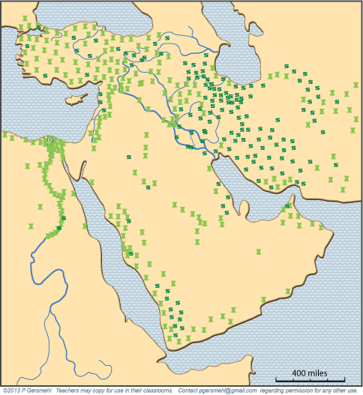
This map shows only Southwest Asia.
Within a century after Muhammad,
How far west had Islam spread?
How far east had Islam spread?

Slide 124
What are the names
of these two bodies
of water?
Why were they
strategically important
in the Middle Ages?
Who controlled
travel at that time?
For five centuries
after Muhammad,
Islamic traders
controlled the
main resource,

Slide 125
What city grew to become
what was probably the largest
and richest city in the world?
What is important
about its location?

Slide 126
Describe at least four things that happened
to change the balance of power
after 1500 CE.
What region gained by these changes?
What region lost?

Slide 127
What resource
is shown on this map?

Slide 128
What resource
is shown on this map?
Roughly what fraction
of world oil reserves
are in Southwest Asia?

Slide 129
Do Sunni
or Shi’a
Muslims
control
more
of the oil?

Slide 130
How were
the borders
between
countries
established?

Slide 131
Which
countries
control
most of
the large
oil fields?

Slide 132
Were borders
carefully drawn
to separate
different
branches
of Islam?
Why or why not?

Slide 133
What group
of people
are shown
by the red
squares
on this map?

Slide 134
How does comparing
all of these maps
help us understand
why this world region
has so much
political unrest?

Slide 135
How does comparing
all of these maps
help us understand
why this world region
has so much
political unrest?
What is the role
that oil resources
might be playing
to help support
undemocratic
governments?

Slide 136
Here are a few questions for individual inquiry:
1. Why do some people call Egypt “The Gift of the Nile?”
2. What were some of the laws in Hammurabi’s Code?
3. What products came from China and India in early trade?
4. How did camel trading help the spread of Islam?
5. What caused the split between Sunni and Shi’a Islam?
6. What led to the development of the Sykes-Picot map?
7. What is OPEC and why is it important?
8. What was the Arab Spring and why was it important?

Slide 138
Copyright 2019, Phil and Carol Gersmehl
Teachers who saw this presentation at a workshop
or downloaded it from our internet site have permission
to make a copy on their own computers for these purposes:
1. to help them review the workshop,
2. to show the presentation in their own classrooms, at sessions they present at teacher conferences, or to administrators in their own school or district,
3. to use individual frames (with attribution) in their own class or conference presentations.
For permission for any other use,
including posting frames on a personal blog or uploading to any network or website that can be accessed from outside your school,
contact pgersmehl@gmail.com

