Slide 1
complexity A geographic “BIG IDEA” with many consequences IN europe
Complexity (of shape, geology, terrain, etc,)
is a big idea that can help us understand many other geographic features in Europe,
including patterns of early civilizations,
empires, invasions, overseas colonization,
industrial development, two World Wars,
and issues facing the European Union today.
.
.

Slide 2
Note to Teachers
1. This presentation has a specific purpose. It is designed as an illustrated teacher guide to provide content background
about the “layers of information” on the clickable map of Europe.
It is not designed for use in class “as is” – to tailor it for a specific class, you might shorten it, edit frames, add pictures or discussion questions, etc.
(see below)
2. This presentation has two parts – explanation and question. You can cut-and-paste to put question frames where you want them in order to promote class discussion or identify misconceptions.
The question frames can also serve as reviews, assessments,
or prompts for inquiry activities (individual or group).
3. This presentation is much too long. There is a good reason for this – your computer has a DELETE key,
but it does not have a CREATE key.
This is important, because many teachers have reviewed this presentation. If anyone suggested an addition (like a definition, explanation, or example), we usually put it in – because other teachers might also find it useful,
and it takes much less time to delete a frame than to make one!
(PS. You can delete this frame now!)
?
DELETE

Slide 3
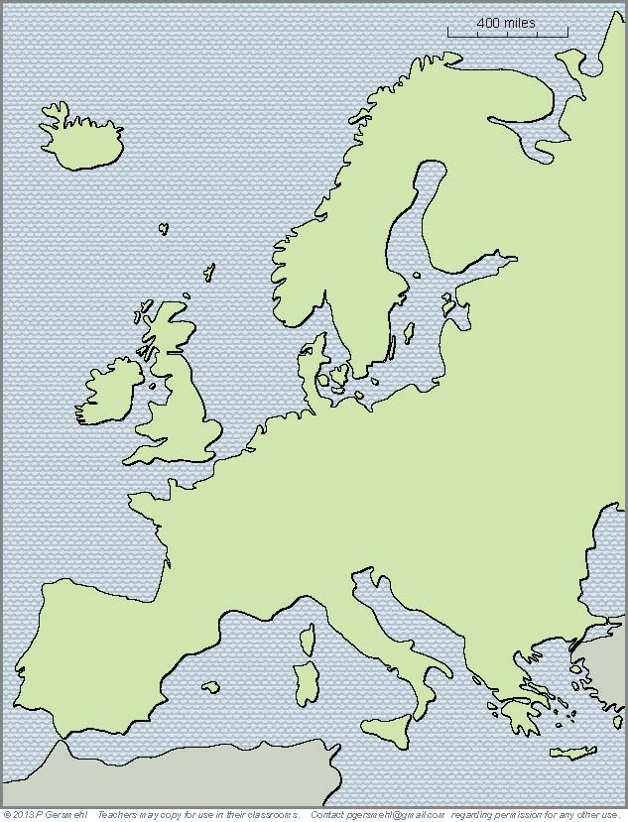
If
a continent is defined as
“a large mass of land
surrounded by water,”
Then
Europe is not a continent.
We should call it a subcontinent
(like South Asia).

Slide 4
Here is the reason why Europe
is generally considered to be
“one of the seven continents:”
The maps that say so
were mostly drafted by
European cartographers.
The fact that many explorers
were from Europe, however,
is actually part of our story about the effects of complexity!
The maps that say so
were mostly drafted by
European cartographers
(using reports from European explorers).

Slide 5
The story starts
when we notice how
Europe is different
from most of the
“real continents.”

Slide 6
For one thing,
its overall shape is different.
Europe is not
a compact mass of land.
It is a big peninsula
that is made out of many
smaller peninsulas.

Slide 7
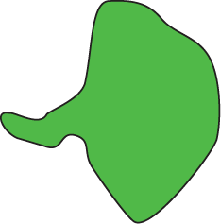
For one thing,
its overall shape is different.
Europe is not
a compact mass of land.
It is a big peninsula
that is made out of many
smaller peninsulas.
Definition: a peninsula
is like a “finger” of land
(or leg, arm, thumb, nose)
connected to a larger landmass
on one side, and surrounded
by water on the other three sides.

Slide 8
Let’s make a list
of important peninsulas
in European history.

Slide 9
Let’s make a list
of important peninsulas
in European history.
1. Greece
1

Slide 10
Let’s make a list
of important peninsulas
in European history.
1. Greece
2. Italy (Rome)
2
1

Slide 11
Let’s make a list
of important peninsulas
in European history.
1. Greece
2. Italy (Rome)
3. Iberia
(Spain and
Portugal)
3
2
1

Slide 12
Let’s make a list
of important peninsulas
in European history.
4
1. Greece
2. Italy (Rome)
3. Iberia
(Spain and
Portugal)
4. Scandinavia
3
2
1

Slide 13
Let’s make a list
of important peninsulas
in European history.
4
1. Greece
2. Italy (Rome)
5
3. Iberia
(Spain and
Portugal)
4. Scandinavia
5. Jutland (Denmark)
3
2
1

Slide 14
Let’s make a list
of important peninsulas
in European history.
4
1. Greece
2. Italy (Rome)
5
3. Iberia
(Spain and
Portugal)
4. Scandinavia
C
D
6
B
N
5. Jutland (Denmark)
6. Dover, Cornwall,
Brittany, Normandy
3
2
1

Slide 15
Let’s make a list
of important peninsulas
in European history.
7
4
1. Greece
2. Italy (Rome)
5
3. Iberia
(Spain and
Portugal)
4. Scandinavia
C
D
6
B
N
5. Jutland (Denmark)
6. Dover, Cornwall,
Brittany, Normandy
3
2
1
7. Kola
(Cold War
submarines)

Slide 16
A peninsula is like
a room with only one door.
Enemy armies can attack it
from only one direction.
(Attack from the sea is hard, because the people who live
on islands and peninsulas
often use ships to get around
and usually have a strong navy!)

Slide 17
All these peninsulas
and islands give Europe
a very long coastline.
Even though Europe is only one-third as large as Africa,
it has nearly twice as many
miles of coastline as Africa,
Australia, and South America,
put together.
Why is that important?

Slide 18
Because . . .
Europe has
a lot of quiet bays
and sheltered harbors
for sailing ships to use.
That is an important part
of Europe’s history.

Slide 19
The complex shape
is a consequence of
Europe’s complex
geologic history

Slide 20
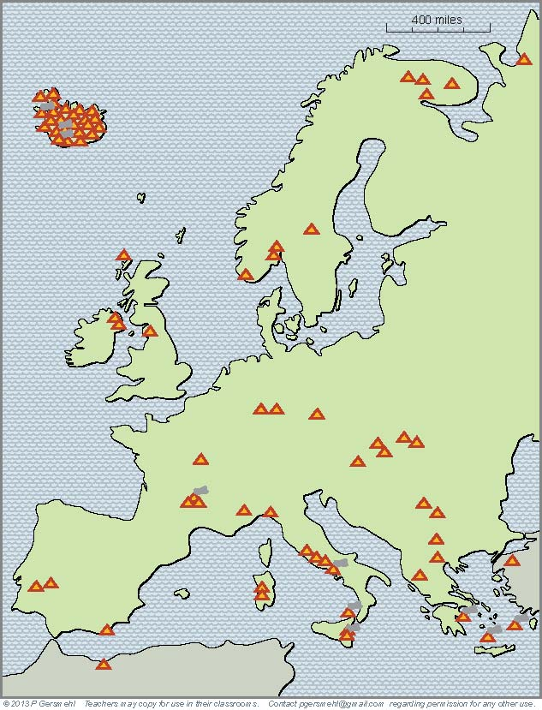
Even if
we don’t count Iceland
(which is all volcanic),
Europe has
many more volcanoes
than most other areas
of comparable size.

Slide 21
Even if
we don’t count Iceland
(which is all volcanic),
Europe has
many more volcanoes
than most other areas
of comparable size.
The list of volcanoes
includes Vesuvius
(the famous volcano that destroyed
the Roman city of Pompeii).

Slide 22
Even more important,
Europe’s volcanoes
are scattered around,
not grouped together
in one small area.

Slide 23
Most of the volcanoes
mark the locations
where crustal plates
“collided” in the past.
Europe has had a lot
of crustal collisions –
the subcontinent was
actually “put together”
from a large number
of smaller plates.

Slide 24
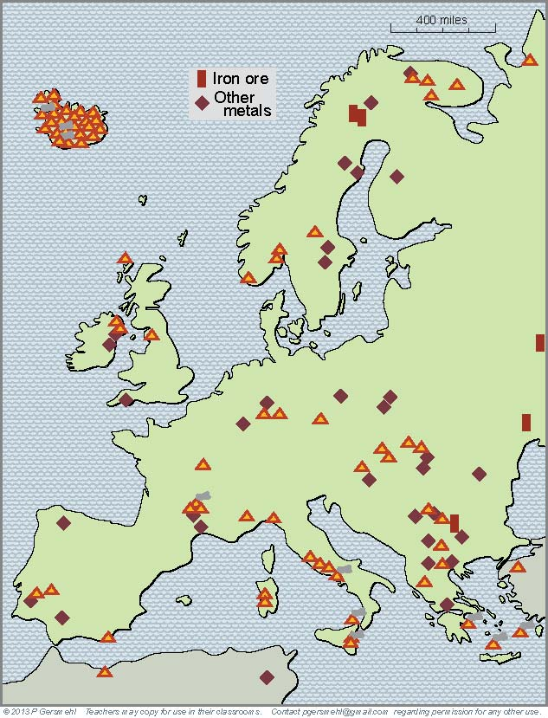
This is important,
because certain kinds
of crustal collisions
can put metal ores
into the ground
This map now shows how
Europe is lucky – it has
a lot of metal mines!

Slide 25
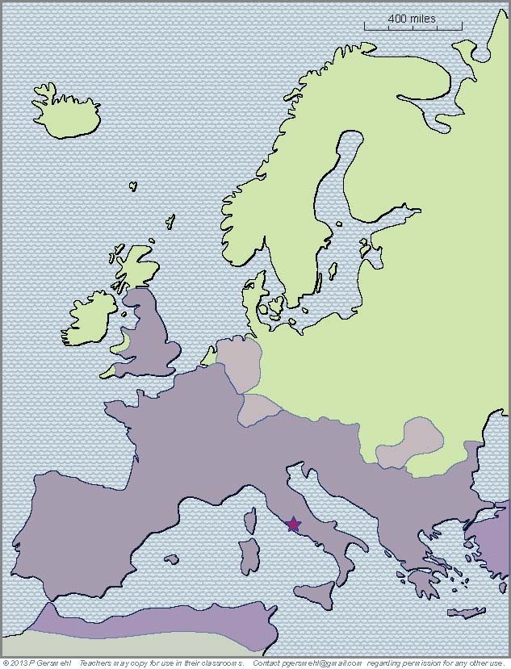
Ancient people
may not have understood
the geologic principles,
but they knew how
to find metal ores.
The Romans, for example,
got tin from Cornwall
silver from Dalmatia
and copper and lead
from Iberia (Spain).
Roman Empire
Rome

Slide 26
Ancient people
may not have understood
the geologic principles,
but they knew how
to find metal ores.
The Romans, for example,
got tin from Cornwall
silver from Dalmatia
and copper and lead
from Iberia (Spain).
Curriculum note.
To put this in perspective,
there is a clickable map,
activity, and presentation:
“World Economic Geology.”
Roman Empire
Rome

Slide 27
What do you think
you are likely to see
if you add mountains
to a complex shape,
with many bays
and peninsulas?

Slide 28
What do you think
you are likely to see
if you add mountains
to a complex shape,
with many bays
and peninsulas?
Curriculum note.
There is an activity called
“Where Are the Mountains.”

Slide 29
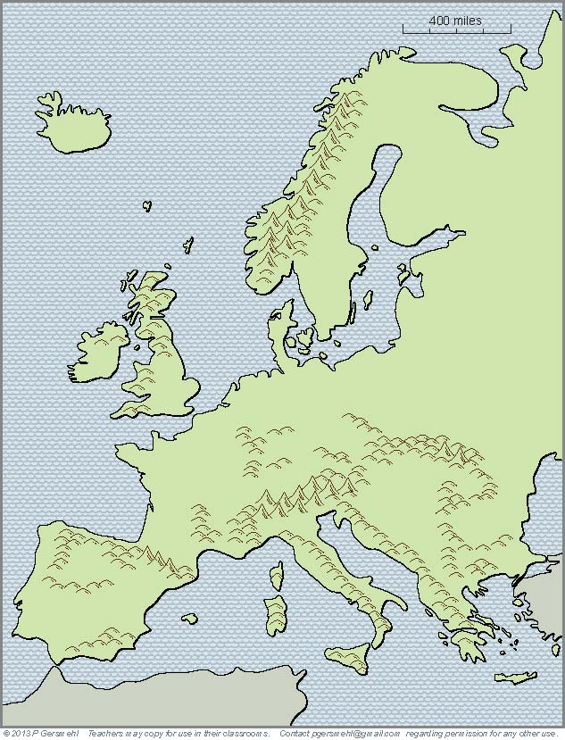
Some mountains
act like a “door”
in the “entrance”
to a peninsula.

Slide 30
Some mountains
act like a “door”
in the “entrance”
to a peninsula.
For example,
Thermopylae
was a narrow path
around the mountains
that blocked the entrance
into the Greek peninsula

Slide 31
Some mountains
act like a “door”
in the “entrance”
to a peninsula.
The Alps were a barrier
(until Hannibal crossed them
in order to attack Rome!)

Slide 32
Some mountains
act like a “door”
in the “entrance”
to a peninsula.
The Pyrenees
blocked the advance
of the Moor armies
invading from Africa.

Slide 33
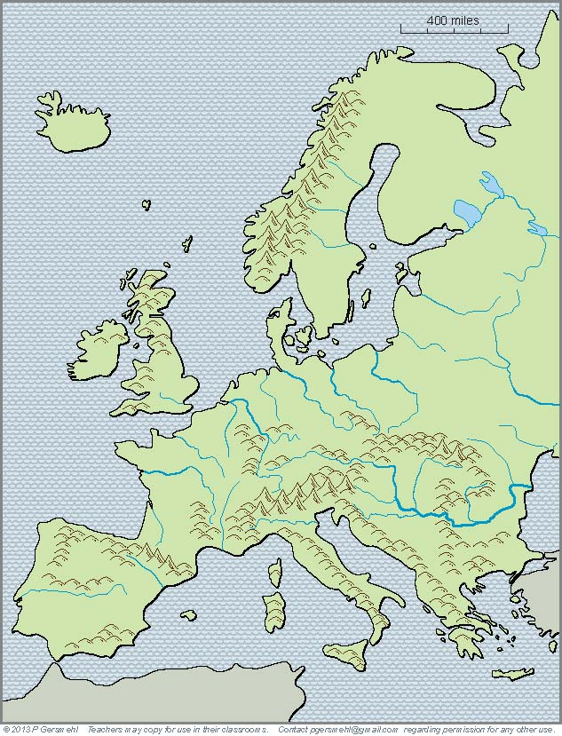
Europe also has
a lot of mountains
cutting across the land.

Slide 34
Europe also has
a lot of mountains
cutting across the land.
The Carpathian Mountains
were a barrier between Magyars (Hungarians)
and Slavs (Russians).
These mountains also helped
stop the advance of the Mongols
when they invaded from Asia.

Slide 35
The Ottoman sultans
tried several times
to capture Vienna,
which blocked the gap
where the Danube River
goes through the mountains.
The Romans had a fort there, too,
and Napoleon was defeated there.
Europe also has
a lot of mountains
cutting across the land.

Slide 36
In short, locations on peninsulas
(or in areas that were protected by mountains)
helped many different groups of people
to defend themselves against enemies.
Several times in the past, people spread
out from their peninsula and tried to capture
a larger area as part of their empire.

Slide 37
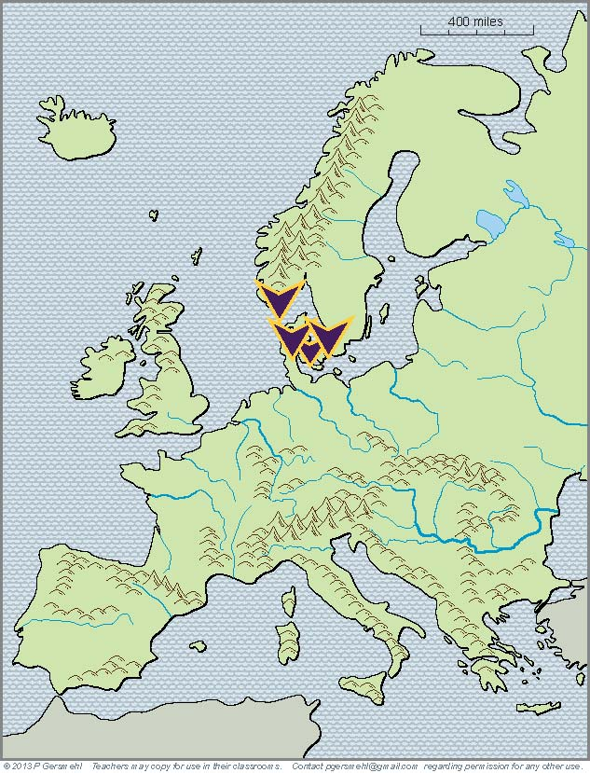
For example,
around the year 750,
the Norsemen were
a loosely organized group
on a peninsula called Jutland,
the south end of Scandinavia,
and some islands in between.

Slide 38
For example,
around the year 750,
the Norsemen were
a loosely organized group
on a peninsula called Jutland,
the south end of Scandinavia,
and some islands in between.
Curriculum note.
There is a presentation
called “The Norse
Become the Vikings.”

Slide 39
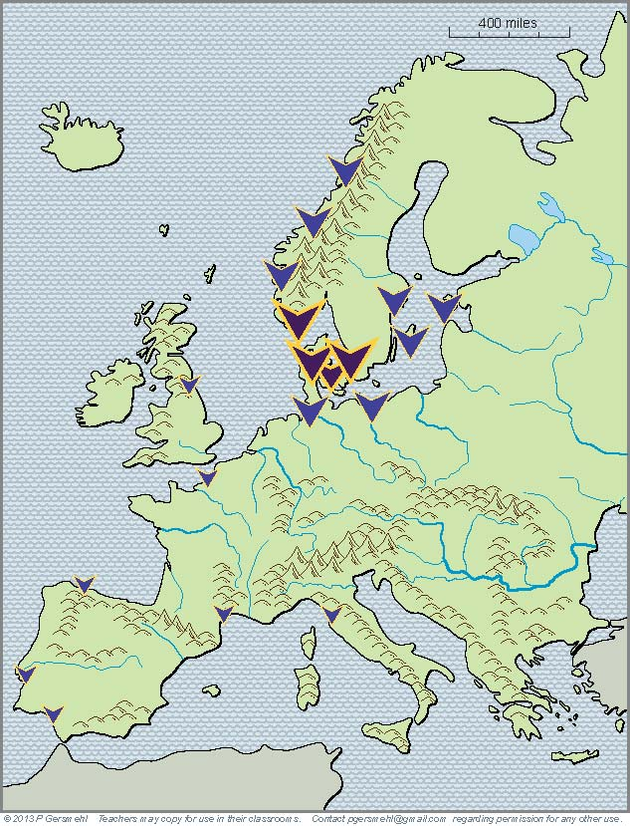
By the middle of the 8th century,
the Norsemen had
“gone Viking” (raiding)
along the coasts around them
and as far south as Italy.

Slide 40
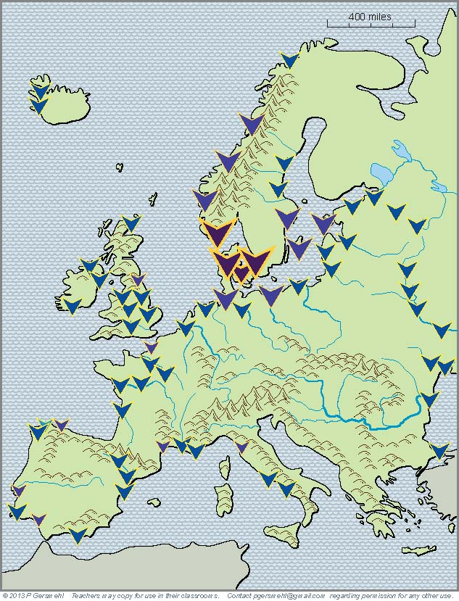
By the middle of the 9th century,
the Vikings had spread
across much of Britain
and gone on raiding trips
and/or built trading posts
as far south as Constantinople.

Slide 41
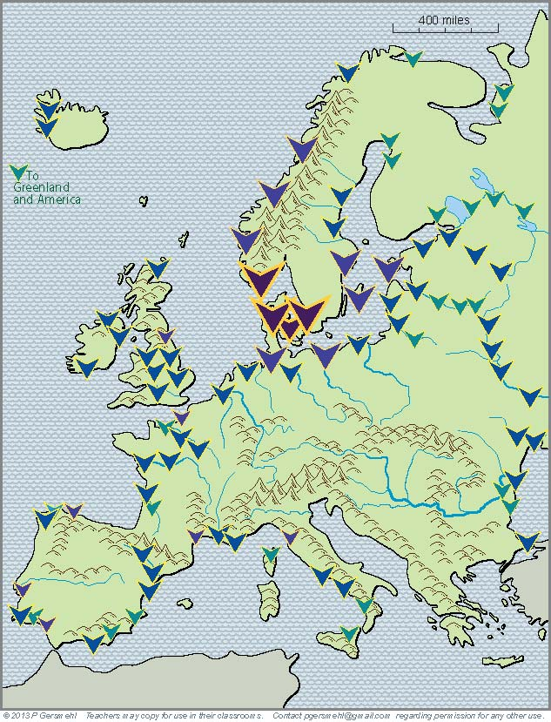
By the mid-10th century,
other European countries
had become stronger.
The Vikings were losing
in many parts of Europe,
but many Viking explorers
crossed the Atlantic Ocean
to Greenland and America.

Slide 42
What do we know so far?

Slide 43
What do we know so far?
1. A peninsular location may be good
for defensive purposes (and for survival),
BUT

Slide 44
What do we know so far?
1. A peninsular location may be good
for defensive purposes (and for survival),
BUT
2. A small peninsula is seldom likely
to have all the resources needed
for a rapidly growing economy.

Slide 45
What do we know so far?
1. A peninsular location may be good
for defensive purposes (and for survival),
BUT
2. A small peninsula is seldom likely
to have all the resources needed
for a rapidly growing economy.
As a result, peninsular countries
have often tried to expand across the land
and around the bays and sheltered seas
since the time of the Greeks and Romans.

Slide 46
In the 13th century,
Europe got gunpowder
and magnetic compasses
from Chinese inventors.
Soon, the deep bays
and sheltered harbors
between the peninsulas
and islands of Europe
became the home bases
for explorers who sailed
across the oceans
(like Vasco de Gama and Christopher Columbus).
Home Ports for
Overseas Explorers

Slide 47
Home Ports for
Overseas Explorers
Portugal, Spain,
England, France,
the Netherlands,
Italy, and Germany
all claimed colonies
on other continents

Slide 48
Home Ports for
Overseas Explorers
Portugal, Spain,
England, France,
the Netherlands,
Italy, and Germany
all claimed colonies
on other continents
Curriculum note.
There is a clickable map
about European Colonies.

Slide 49
Later in the colonial era . . . .
the geologic complexity of Europe
gave its people another big advantage
at the start of the Industrial Revolution.

Slide 50
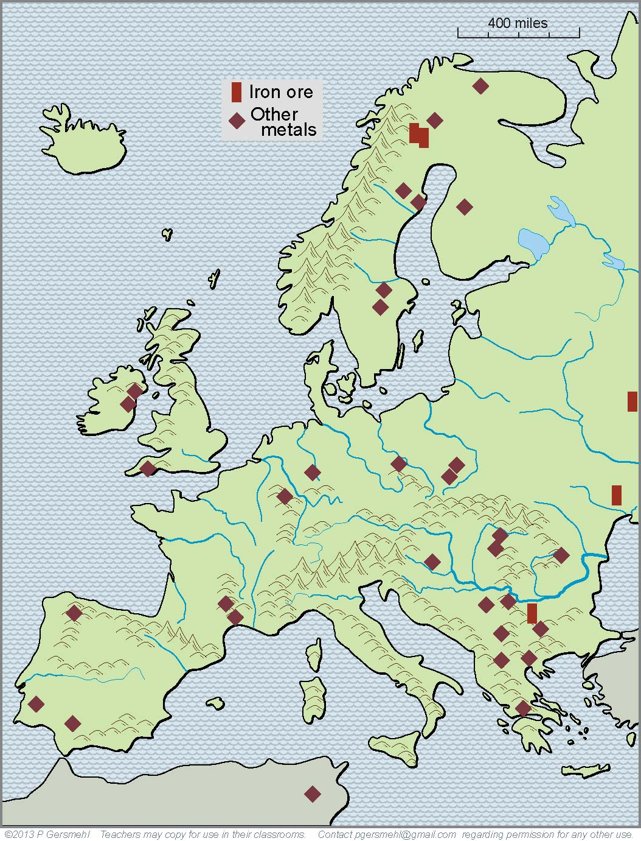
We have already seen
how geologic forces
made a complex pattern
of mountains of different ages
and were also responsible
for the formation of
valuable metal ores.

Slide 51
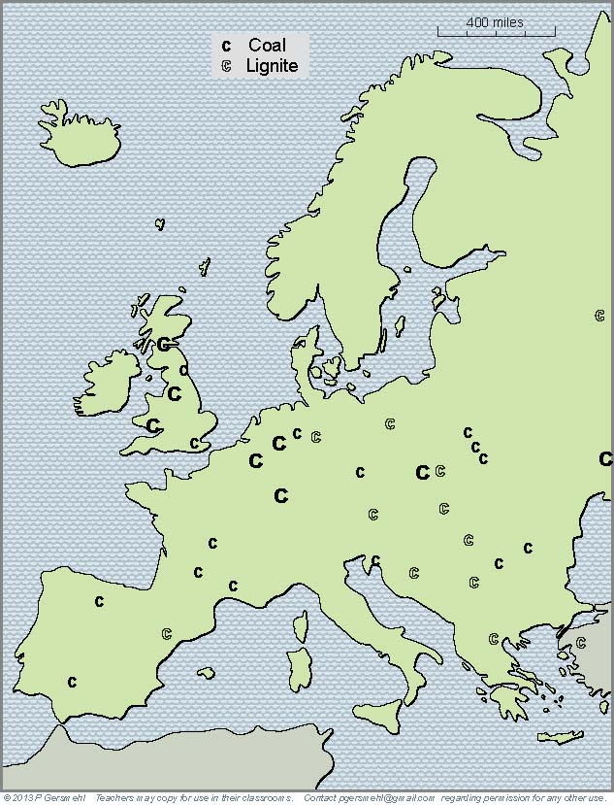
This geologic complexity
also helps us understand
why Europe is fortunate
to have deposits of coal
scattered in many places.

Slide 52
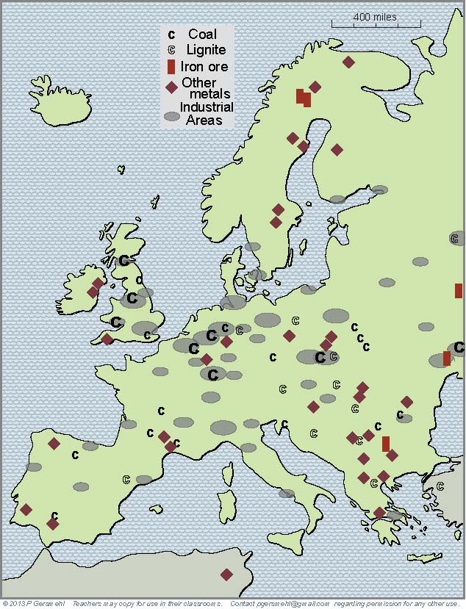
At the start
of the Industrial Revolution,
these widely scattered
metal and coal mines
could support many
separate clusters of factories
(the gray ovals on this map).

Slide 53
At the start
of the Industrial Revolution,
these widely scattered
metal and coal mines
could support many
separate clusters of factories
(the gray ovals on this map).
Curriculum note.
There is an activity about
Changing Technology
in Steel Production.

Slide 54
Especially important
industrial areas
included:

Slide 55
Especially important
industrial areas
included:
The Midlands

Slide 56
Especially important
industrial areas
included:
The Midlands
Ruhr Valley

Slide 57
Especially important
industrial areas
included:
The Midlands
Ruhr Valley
Silesia

Slide 58
Especially important
industrial areas
included:
The Midlands
Ruhr Valley
Silesia
Donbass

Slide 59
Especially important
industrial areas
included:
The Midlands
Ruhr Valley
Silesia
Donbass
Rhone
Valley

Slide 60
Especially important
industrial areas
included:
The Midlands
Ruhr Valley
Silesia
Donbass
Bilbao
Rhone
Valley

Slide 61
Especially important
industrial areas
included:
The Midlands
Ruhr Valley
These areas often became
important targets
during wars.
Silesia
Donbass
Bilbao
Rhone
Valley

Slide 62
The scattered development
allowed by complex geology
had a downside, however.

Slide 63
The scattered development
allowed by complex geology
had a downside, however.
Sweden
Russia
Overseas colonies
and scattered factories
helped many countries
stay independent.
As a result, they could
continue old rivalries
into the modern age.
Lithuania
England
Nether-
lands
Prussia
Austria
Hungary
France
Balkans
Italy
Ottoman
Empire
Spain

Slide 64
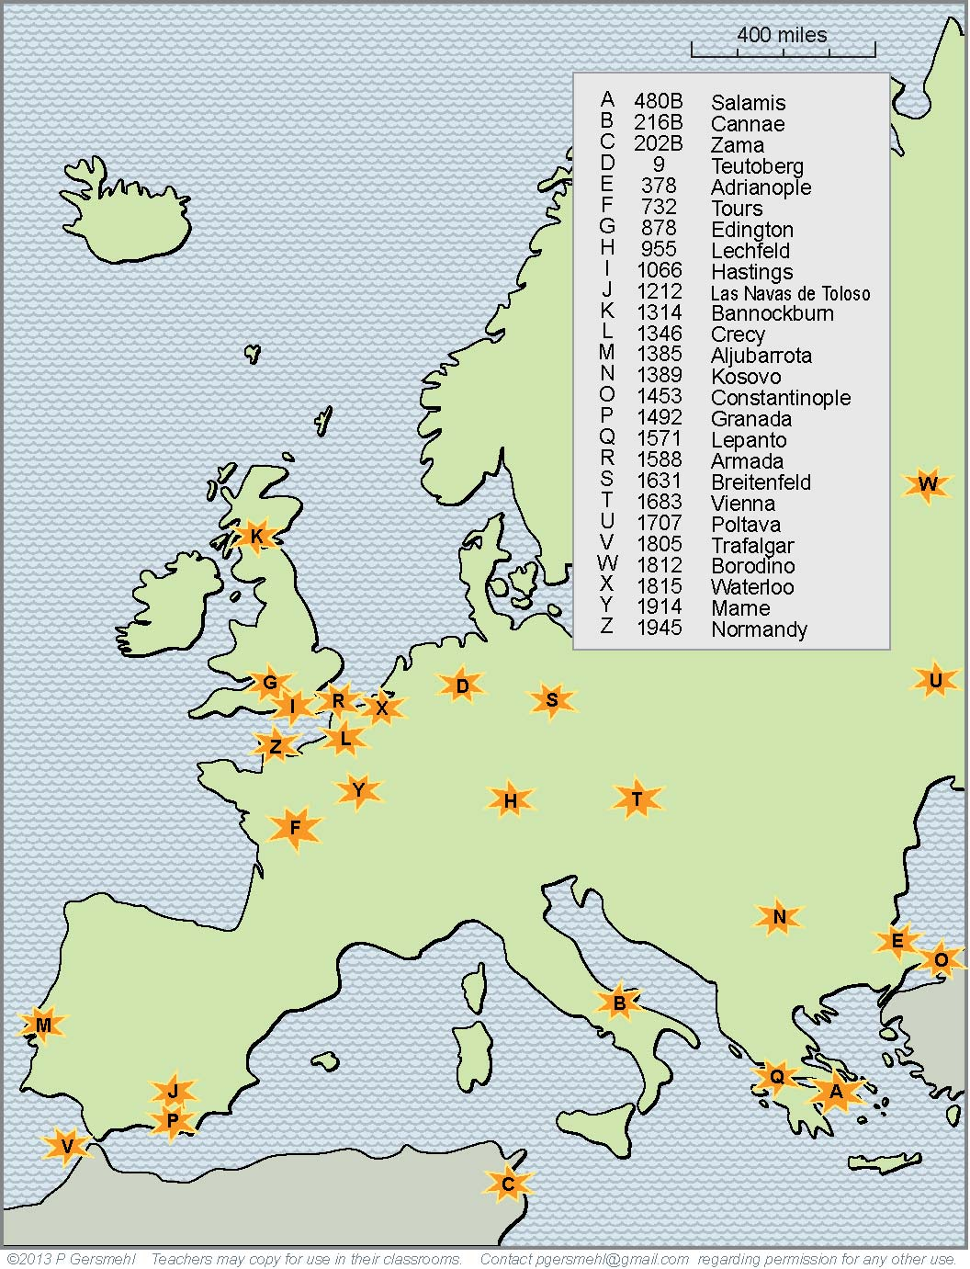
This map shows the locations
of just 25 of the major battles
that marked turning points
in European history.

Slide 65
This map shows the locations
of just 25 of the major battles
that marked turning points
in European history.
As time went on,
weapons became
more and more deadly.
In the twentieth century,
old European rivalries
led to two world wars.

Slide 66
Military history
offers a “backhand”
form of evidence
for the importance of
geographic complexity,
To see what this means,
we might look at an area
that is not very complex,
not on a peninsula,
and not protected
by mountains.

Slide 67
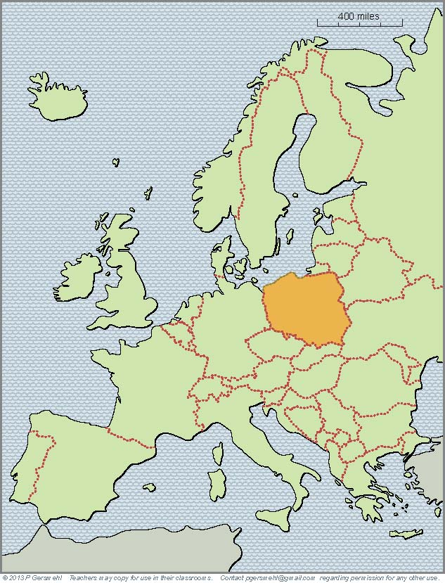
The country we now know
as Poland has a history
that stretches back
a thousand years.

Slide 68
The country we now know
as Poland has a history
that stretches back
a thousand years.
During that time,
it has been invaded
(and often conquered)
by a “Who’s Who”
of great invaders:
Huns, Vikings,
Mongols, Slavs,
Hapsburgs, Prussians,
Napoleon, the Nazis,
and the Soviet Union.
You can find websites that show the extent
of “Poland” at many different times in history –
here, we will show just a few time periods.

Slide 69
Around the year 700,
a group of people
called themselves
the Polans.

Slide 70
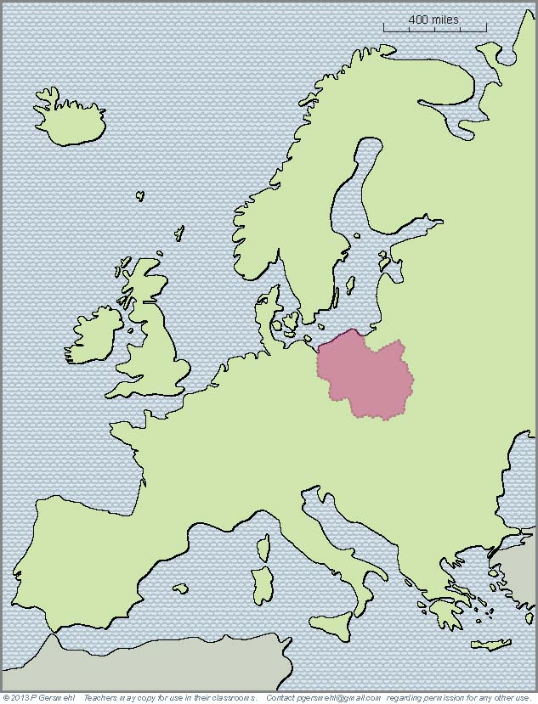
Around the year 700,
a group of people
called themselves
the Polans.
By about the year 1000,
the Polans had expanded
and formed a national
government.

Slide 71
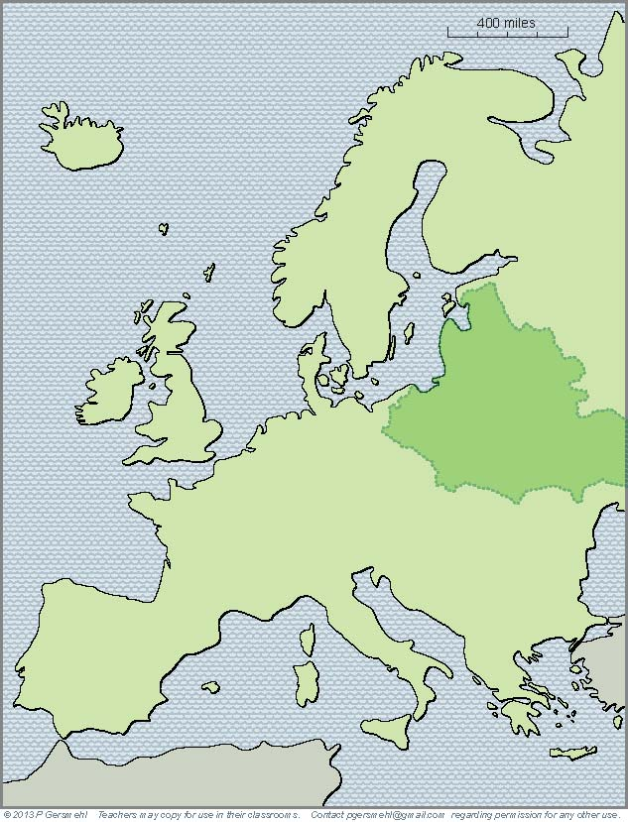
Around the year 700,
a group of people
called themselves
the Polans.
By about the year 1000,
the Polans had expanded
and formed a national
government.
By the 1500s,
Poland had linked
with Lithuania to form
a major European empire.
Under John Sobieski, they helped save
Vienna (and the Hapsburg Empire)
from the Ottoman invaders.

Slide 72
Around the year 700,
a group of people
called themselves
the Polans.
By about the year 1000,
the Polans had expanded
and formed a national
government.
By the 1500s,
Poland had linked
with Lithuania to form
a major European empire.
Then other countries became more powerful,
and “Poland” disappeared from the map

Slide 73
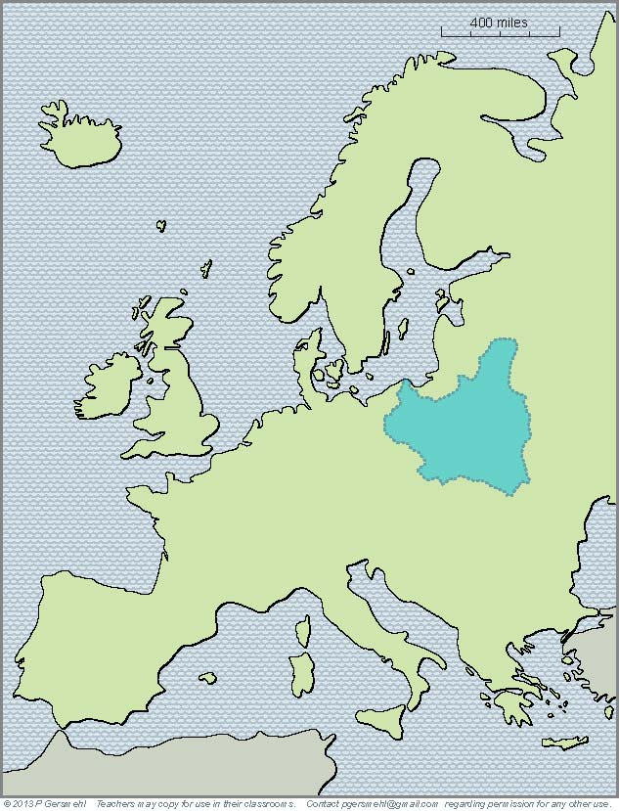
Around the year 700,
a group of people
called themselves
the Polans.
By about the year 1000,
the Polans had expanded
and formed a national
government.
By the 1500s,
Poland had linked
with Lithuania to form
a major European empire.
In the mid 20th century,
after several centuries
of rule by other countries,
Poland reappeared as
an independent country.

Slide 74
Around the year 700,
a group of people
called themselves
the Polans.
By about the year 1000,
the Polans had expanded
and formed a national
government.
By the 1500s,
Poland had linked
with Lithuania to form
a major European empire.
In the mid 20th century,
after several centuries
of rule by other countries,
Poland reappeared as
an independent country.
Then the German Nazis invaded,
and “Poland” disappeared again.

Slide 75
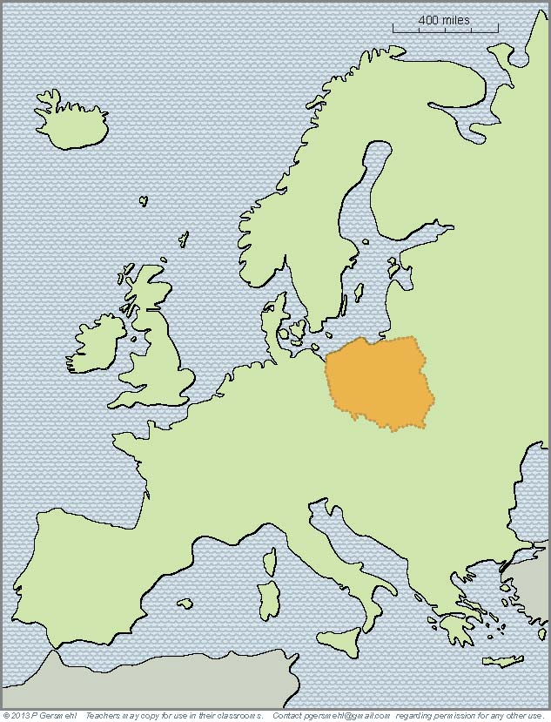
Around the year 700,
a group of people
called themselves
the Polans.
By about the year 1000,
the Polans had expanded
and formed a national
government.
By the 1500s,
Poland had linked
with Lithuania to form
a major European empire.
In the mid 20th century,
after several centuries
of rule by other countries,
Poland reappeared as
an independent country.
1n 1945, Poland
reappeared on the map,
but in a somewhat
different area.

Slide 76
Around the year 700,
a group of people
called themselves
the Polans.
By about the year 1000,
the Polans had expanded
and formed a national
government.
By the 1500s,
Poland had linked
with Lithuania to form
a major European empire.
In the mid 20th century,
after several centuries
of rule by other countries,
Poland reappeared as
an independent country.
1n 1945, Poland
reappeared on the map,
but in a somewhat
different area.
It was, however,
under the control
of the Soviet Union.

Slide 77
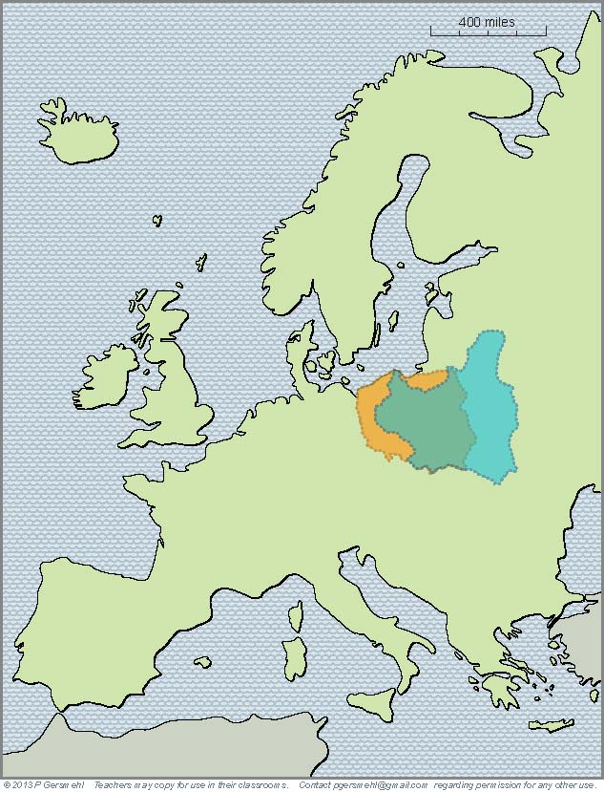
Around the year 700,
a group of people
called themselves
the Polans.
By about the year 1000,
the Polans had expanded
and formed a national
government.
By the 1500s,
Poland had linked
with Lithuania to form
a major European empire.
In the mid 20th century,
after several centuries
of rule by other countries,
Poland reappeared as
an independent country.
1n 1945, Poland
reappeared on the map
covering a somewhat
different area.
Compare the shape of Poland
before and after World War II.
You can see why many
Poles decided to move.

Slide 78
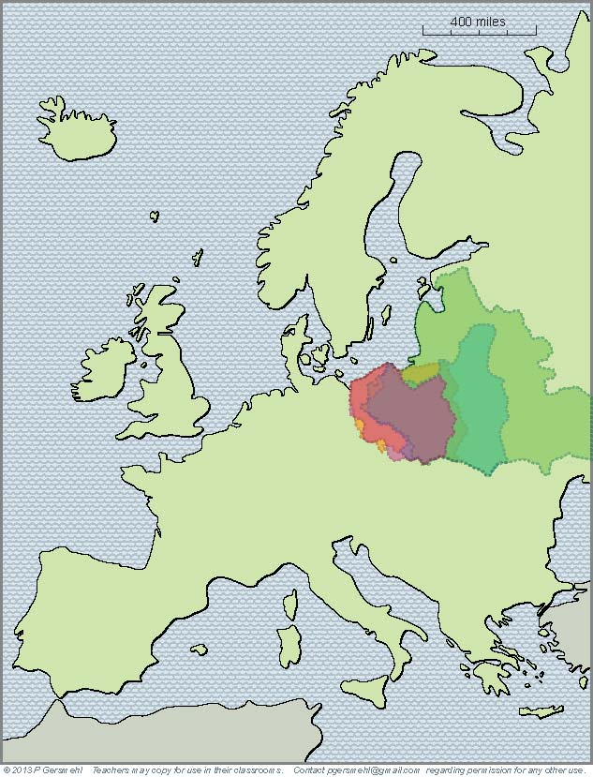
And if you put
even our limited sample
of historical “Polands”
together on one map,
you can see the effects
of living in an area
that is hard to defend.

Slide 79
One more consequence
of the historic complexity of Europe
is in the headlines today.
Dismayed by centuries of fighting,
European rulers tried a bold experiment.
They decided to give up
some of their national powers
and form a European Union.
But the age-old differences
have emerged in new ways
to threaten this Union.

Slide 80
Here’s a big issue
for European people today:
Can Europeans resolve
their old differences,
so that they can
work together to deal
with changing economies,
immigration, terrorism,
and aging populations?

Slide 81
This presentation showed one way to use
the clickable map of Europe - to help us investigate
some consequences of the big idea of complexity.
A complex geology has an influence on:

Slide 82
This presentation showed one way to use
the clickable map of Europe - to help us investigate
some consequences of the big idea of complexity.
A complex geology has an influence on:
Security – complex shapes can make land easier to defend,
because peninsulas have only one “entrance door

Slide 83
This presentation showed one way to use
the clickable map of Europe - to help us investigate
some consequences of the big idea of complexity.
A complex geology has an influence on:
Security – complex shapes can make land easier to defend,
because peninsulas have only one “entrance door
Terrain – many separate ranges of mountains can also help isolate places and make them harder to attack

Slide 84
This presentation showed one way to use
the clickable map of Europe - to help us investigate
some consequences of the big idea of complexity.
A complex geology has an influence on:
Security – complex shapes can make land easier to defend,
because peninsulas have only one “entrance door
Terrain – many separate ranges of mountains can also help isolate places and make them harder to attack
Ports – complex coastlines often provide safe harbors,
which are especially important for sailing ships

Slide 85
This presentation showed one way to use
the clickable map of Europe - to help us investigate
some consequences of the big idea of complexity.
A complex geology has an influence on:
Security – complex shapes can make land easier to defend,
because peninsulas have only one “entrance door
Terrain – many separate ranges of mountains can also help isolate places and make them harder to attack
Ports – complex coastlines often provide safe harbors,
which are especially important for sailing ships
Metal ores – complex geology is usually the result of
many crustal collisions, which also form metal ores

Slide 86
This presentation showed one way to use
the clickable map of Europe - to help us investigate
some consequences of the big idea of complexity.
A complex geology has an influence on:
Security – complex shapes can make land easier to defend,
because peninsulas have only one “entrance door
Terrain – many separate ranges of mountains can also help isolate places and make them harder to attack
Ports – complex coastlines often provide safe harbors,
which are especially important for sailing ships
Metal ores – complex geology is usually the result of
many crustal collisions, which also form metal ores
Energy resources – complex geology also gave Europe
a lot of coal, important for the Industrial Revolution

Slide 87
This presentation showed one way to use
the clickable map of Europe - to help us investigate
some consequences of the big idea of complexity.
A complex geology has an influence on:
Security – complex shapes can make land easier to defend,
because peninsulas have only one “entrance door
Terrain – many separate ranges of mountains can also help isolate places and make them harder to attack
Ports – complex coastlines often provide safe harbors,
which are especially important for sailing ships
Metal ores – complex geology is usually the result of
many crustal collisions, which also form metal ores
Energy resources – complex geology also gave Europe
a lot of coal, important for the Industrial Revolution
Conflicts – large numbers of independent countries can
have economic conflicts and frequent wars

Slide 89
questions section

Slide 90
Why
is it inaccurate to call
Europe a continent?
Why
is it more accurate
to call Europe a
subcontinent
(like South Asia).

Slide 91
What does it mean
to call Europe
a big peninsula
made out of many
smaller peninsulas?

Slide 92
What does it mean
to call Europe
a big peninsula
made out of many
smaller peninsulas?
Definition: a peninsula
is like a small nose of land
(or leg, arm, finger, thumb)
connected to a larger landmass
on one side, and surrounded
by water on the other three sides.

Slide 93
Do you remember
the names of these
European peninsulas?
7
4
5
C
D
6
B
N
3
2
1

Slide 94
Do you remember
the names of these
European peninsulas?
7
4
1. Greece
2. Italy (Rome)
5
3. Iberia
(Spain and
Portugal)
4. Scandinavia
C
D
6
B
N
5. Jutland (Denmark)
6. Dover, Cornwall,
Brittany, Normandy
3
2
1
7. Kola
(Cold War
submarines)

Slide 95
Why is a peninsula like
a room with only one door?

Slide 96
Why is a peninsula like
a room with only one door?
Why was this important
in European history?

Slide 97
How does the coastline
of Europe compare
with the coastlines
of Africa, Australia,
or South America?

Slide 98
How does the coastline
of Europe compare
with the coastlines
of Africa, Australia,
or South America?
Why was this important
in European history?

Slide 99
How does the pattern
of volcanic eruptions
have an effect
on the overall shape
and subsurface geology
of Europe?

Slide 100
What is the relationship
between volcanoes
and metal ores?

Slide 101
What is the relationship
between volcanoes
and metal ores?
Why was this important
in European history?

Slide 102
Ancient people
may not have understood
the geologic principles,
but they knew how
to find metal ores.
What did the Romans
get from Cornwall,
from Dalmatia,
and from
Iberia (Spain).
Roman Empire
Roman Empire
Rome
Rome

Slide 103
Why does Europe
have so many
separate ranges
of mountains?

Slide 104
Why does Europe
have so many
separate ranges
of mountains?
Why was this important
in European history?

Slide 105
What was the name
of a narrow path
around the mountains
that blocked the entrance
into the Greek peninsula?

Slide 106
What is the name
of these mountains?
What African general surprised many people
when he crossed them
in order to attack Rome?

Slide 107
What is the name
of this mountain range?
What was the role
of these mountains
in European history?

Slide 108
What is the name
of this mountain range?
What was the role
of these mountains
in European history?

Slide 109
What city
is located here?
Why is this location
strategically important?
Name at least three
different times
when this place
was important.

Slide 110
What group of people
started on these
northern peninsulas?
About when did they
begin to expand
and raid other territories?

Slide 111
Two centuries later,
these people had
gone on raiding trips
and/or built trading posts
as far south as
this famous city.
What is its name?
Why is it important?

Slide 112
Home Ports for
Overseas Explorers
What two inventions
did Europeans get
from Chinese inventors?
What major world era
started shortly after
these technical changes?

Slide 113
What major world era
was based on using coal
to run steam engines
and make steel?

Slide 114
Name these
industrial areas:
1
2
3
4
6
5

Slide 115
How can ideas
about shape complexity
and geologic complexity
help us understand
the military history
of Europe?

Slide 116
How would you describe
the location of Poland?

Slide 117
How would you describe
the location of Poland?
What are some
consequences
of its location
in an area
with few mountains
or sheltered harbors?

Slide 118
How does putting
several historic
maps of “Poland”
onto a single map
help us understand
some of the problems
of living in an area
that is hard to defend?

Slide 119
Finally, how does
the complex geography
(and the complex history)
of the subcontinent of Europe
help us understand the problems
facing the European Union today?

Slide 120
Here are a few questions for individual inquiry:
1. What happened at Thermopylae and why was it important?
2. What factors contributed to the Fall of the Roman Empire?
3. What happened to the Viking settlements in Greenland?
4. What was the Siege of Vienna and why was it important?
5. What inventions were part of the early Industrial Revolution?
6. What events helped Hitler rise to power after World War I?
7. What countries lost the most people in World War II?
8. What is Brexit and why was it important?

Slide 122
Copyright 2019, Phil and Carol Gersmehl
Teachers who saw this presentation at a workshop
or downloaded it from our internet site have permission
to make a copy on their own computers for these purposes:
1. to help them review the workshop,
2. to show the presentation in their own classrooms, at sessions they present at teacher conferences, or to administrators in their own school or district,
3. to use individual frames (with attribution) in their own class or conference presentations.
For permission for any other use,
including posting frames on a personal blog or uploading to any network or website that can be accessed from outside your school,
contact pgersmehl@gmail.com

