Slide 1
Big Ideas in
Geography
Materials to support
K-12 teachers of
world geography
and history

Slide 2
These educational materials start with a simple idea:
You can build a good framework for learning about places
by exploring a few powerful causes and their effects.

Slide 3
These educational materials start with a simple idea:
You can build a good framework for learning about places
by exploring a few powerful causes and their effects.
D E F I N I T I O N C A R D
Geographic Big Idea (noun phrase):
an important cause
that has predictable effects
in different parts of the world.

Slide 4
These educational materials start with a simple idea:
You can build a good framework for learning about places
by exploring a few powerful causes and their effects.
D E F I N I T I O N C A R D
Geographic Big Idea (noun phrase):
an important cause
that has predictable effects
in different parts of the world.
Geographic big ideas help us understand
many things we see in a place.
The ideas are about the forces
that help shape features.

Slide 5
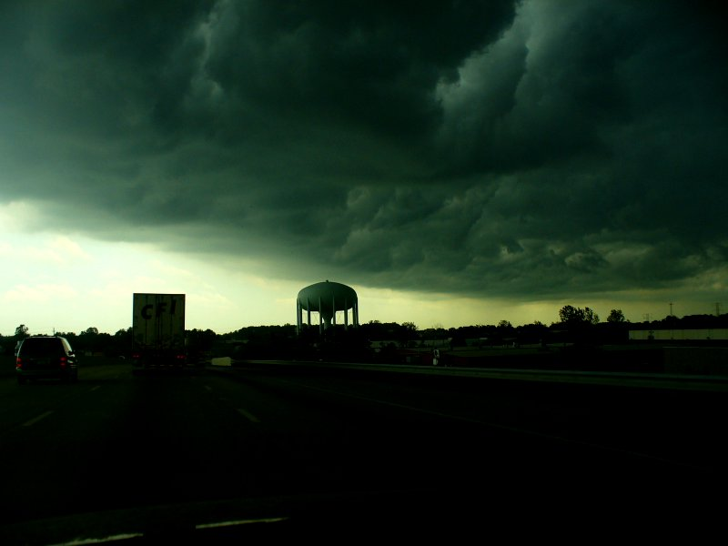
Here’s an example:
Climate is an important influence
on how people live in a place.

Slide 6
Here’s an example:
Climate is an important influence
on how people live in a place.
So climate is a big idea?

Slide 7
Here’s an example:
Climate is an important influence
on how people live in a place.
So climate is a big idea?
Not exactly . . .
at least not for our purposes.

Slide 8
Here’s an example:
Climate is an important influence
on how people live in a place.
So climate is a big idea?
Not exactly . . .
at least not for our purposes.
Why not?

Slide 9
Here’s an example:
Climate is an important influence
on how people live in a place.
So climate is a big idea?
Not exactly . . .
at least not for our purposes.
Why not?
Because a climate map is complicated.
It’s hard to remember accurately,
and
it is possible to describe climate
as the effect of several other causes
that are easier to remember.

Slide 10
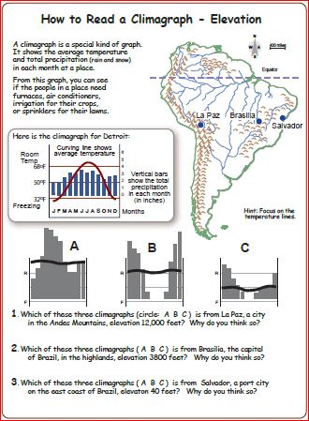
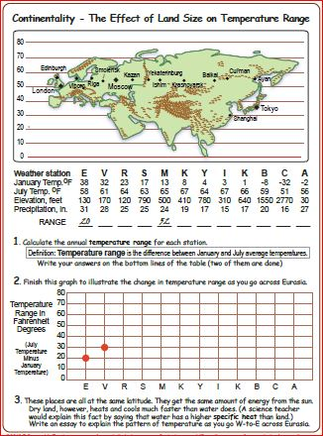
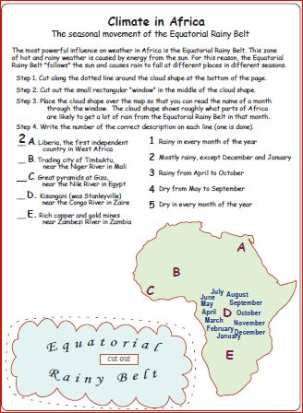
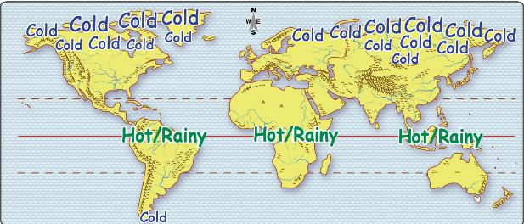
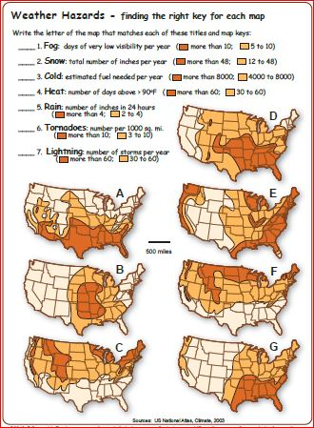
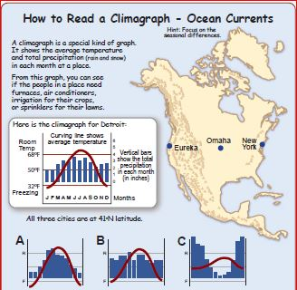
Our teaching materials include
a clickable map, a presentation,
and several student activities
that show how climate is influenced
by latitude, elevation, and distance
from an ocean or big lake.

Slide 11
Our teaching materials include
a clickable map, a presentation,
and several student activities
that show how climate is influenced
by latitude, elevation, and distance
from an ocean or big lake.
So if I know about
latitude – a simple idea,
elevation – a simple idea,
and
distance – a simple idea,
I can explain a lot about climate
at any place on earth?

Slide 12
Our teaching materials include
a clickable map, a presentation,
and several student activities
that show how climate is influenced
by latitude, elevation, and distance
from an ocean or big lake.
So if I know about
latitude – a simple idea,
elevation – a simple idea,
and
distance – a simple idea,
I can explain a lot about climate
at any place on earth?
Yes!

Slide 13
So . . .
a geographic big idea
is just a basic cause
with a lot of effects
in different places.

Slide 14
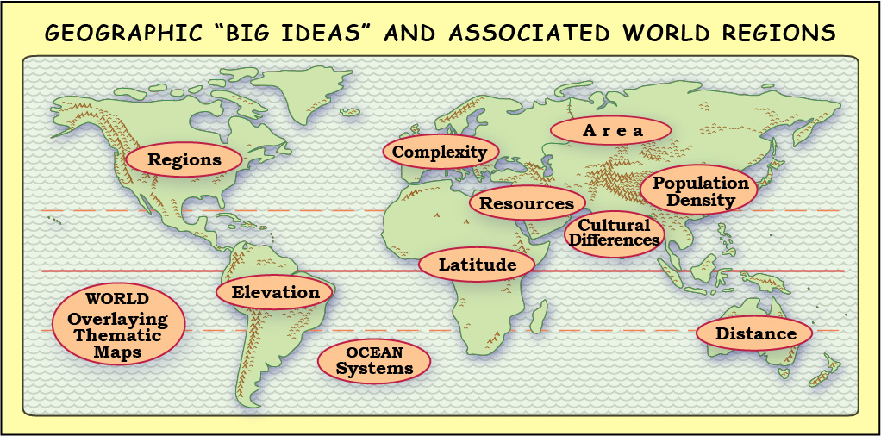
It will have
about
a dozen
folders.
How do we decide on a list
of big ideas in geography?

Slide 15
It will have
about
a dozen
folders.
To make this simple-looking map, more than 100 scholars and teachers
met in small groups in a dozen different places around the world.
Discussions, drafts, reviews, and revisions took more than two years.
How do we decide on a list
of big ideas in geography?

Slide 16
It will have
about
a dozen
folders.
Task 1: identify a handful of big ideas
that have a lot of effects.
How do we decide on a list
of big ideas in geography?

Slide 17
It will have
about
a dozen
folders.
Task 1: identify a handful of big ideas
that have a lot of effects.
How do we decide on a list
of big ideas in geography?
Task 2: identify a world region where it is especially easy
to describe the effects of a particular big idea.

Slide 18
Comparison Footnote.
It’s like a chemistry teacher, who says
“valence is a more important concept
than color or weight or smell,”
because an understanding of valence
makes it easier to explain chemical reactions.

Slide 19
Comparison Footnote.
It’s like a chemistry teacher, who says
“valence is a more important concept
than color or weight or smell,”
because an understanding of valence
makes it easier to explain chemical reactions.
Or a physics teacher, who says
“force and mass are important,
because they help us explain motion.”

Slide 20
Comparison Footnote.
It’s like a chemistry teacher, who says
“valence is a more important concept
than color or weight or smell,”
because an understanding of valence
makes it easier to explain chemical reactions.
Or a physics teacher, who says
“force and mass are important,
because they help us explain motion.”
In exactly the same way,
geographers think it is important
to learn about things like latitude,
resources, and population density,
because these understandings can help us
interpret observations of many other things,
like weather hazards, jobs, and migration.

Slide 21
One more clarifying footnote
Geographic Big Ideas
are important everywhere.
For example, elevation has a strong influence
in nearly every place on earth.
The effects are just easier to see (and explain)
in some places than in others.

Slide 22
One more clarifying footnote
Geographic Big Ideas
are important everywhere.
For example, elevation has a strong influence
in nearly every place on earth.
The effects are just easier to see (and explain)
in some places than in others.
So, we tried to match each big idea
with a world region where it has a lot of effects
that are easy to describe and understand.

Slide 23
One more clarifying footnote
Geographic Big Ideas
are important everywhere.
For example, elevation has a strong influence
in nearly every place on earth.
The effects are just easier to see (and explain)
in some places than in others.
After you learn the effects of elevation in South America,
you can apply the big idea on the other continents.

Slide 24
It will have
about
a dozen
folders.
To help people understand these big ideas,
we made five different kinds of files.

Slide 25
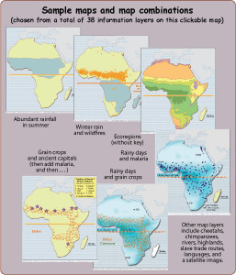
http://textbooks.wmisd.org/bigClickableMaps.html
The main product is
a set of clickable maps.
Each map has 30-40 “layers”
that show different features
influenced by big idea.
These interactive maps
make it easy for viewers
to show these layers
in any combination.
This allows you to explore
many difference effects
of the big idea.

Slide 26
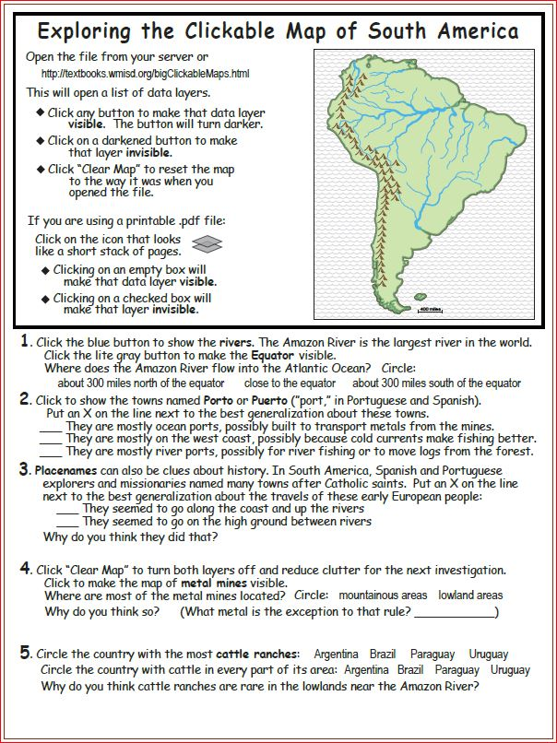
http://textbooks.wmisd.org/bigActivities.html
The activities section has
a 2-page “intro activity”
for each clickable map.
This activity starts
with simple fact questions
about some consequences
of the big idea.
On the back side
is an important question
about an effect of the big idea
in that world region

Slide 27
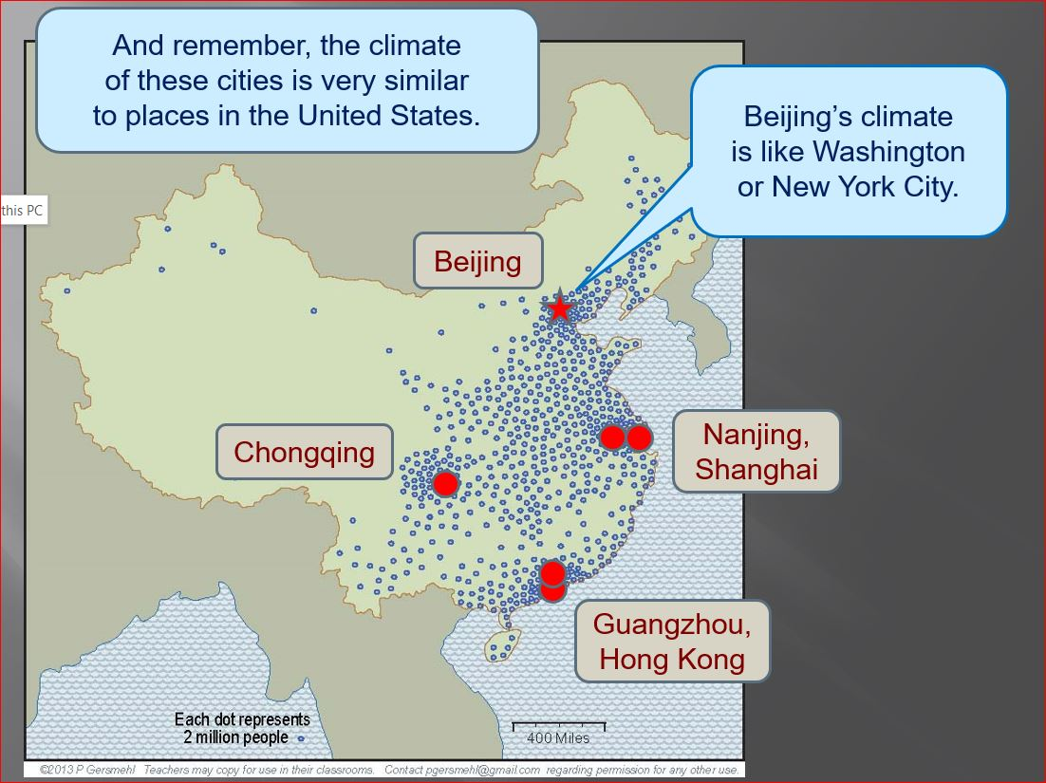
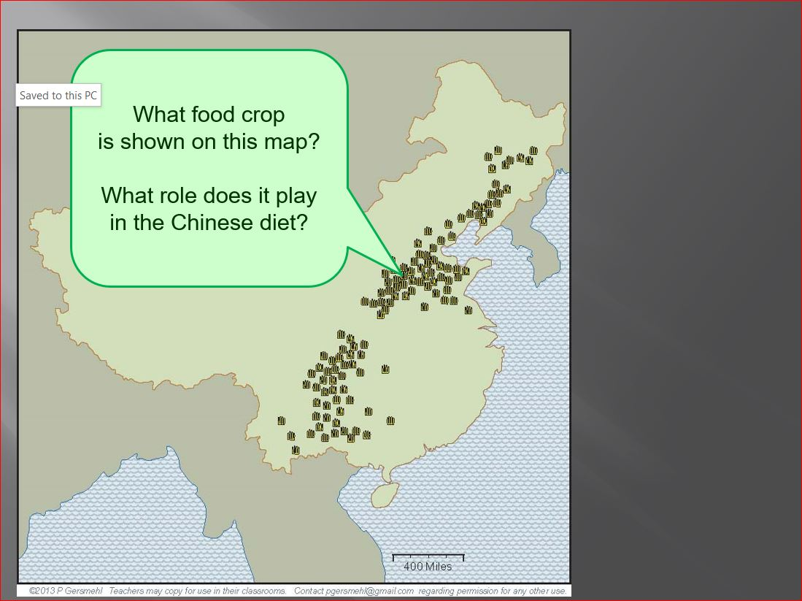
http://textbooks.wmisd.org/bigPresentations.html
The presentations are like
“electronic teacher guides.”
They use screen-shots
from the clickable maps
to explain some effects
of the big idea.
Most frames come
in two versions –
a brief explanation,
and some questions
for class discussion
or assessment.

Slide 28
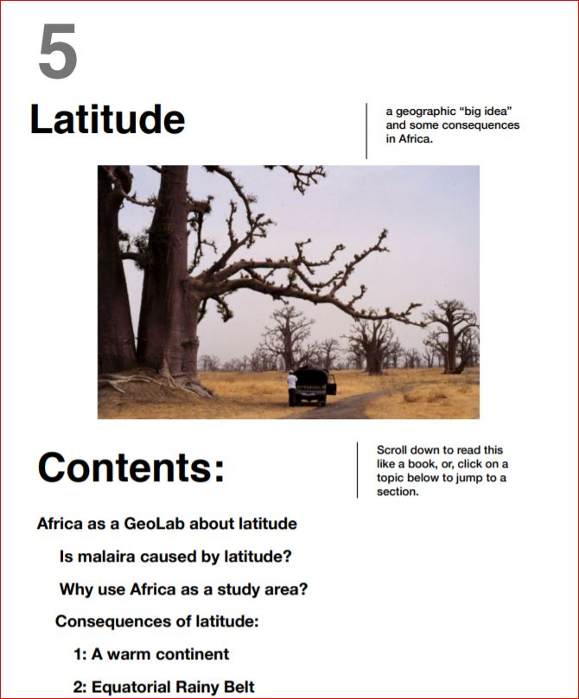
http://textbooks.wmisd.org/bigChapters.html
The chapters are
interactive readings
(there is also a printable version).
Each chapter
summarizes one big idea
and some consequences
in one world region.

Slide 29
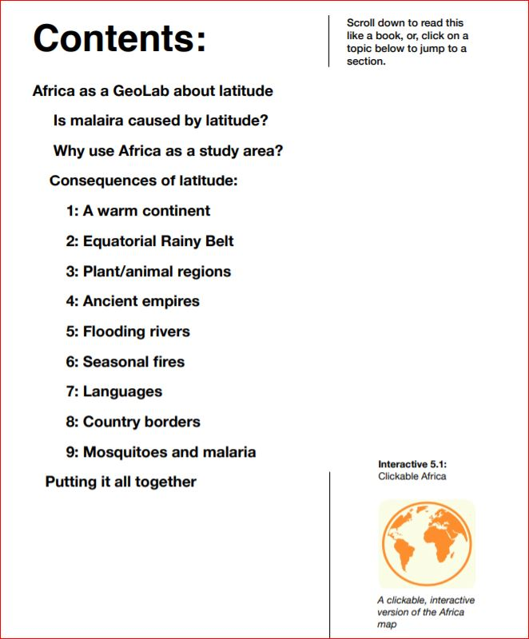
http://textbooks.wmisd.org/bigChapters.html
The first page of each chapter
has a “live” table of contents.
Just click on any heading
to jump directly to that part.

Slide 30
http://textbooks.wmisd.org/bigChapters.html
The first page of each chapter
has a “live” table of contents.
Just click on any heading
to jump directly to that part.
This button opens
the clickable map
in a separate window.

Slide 31
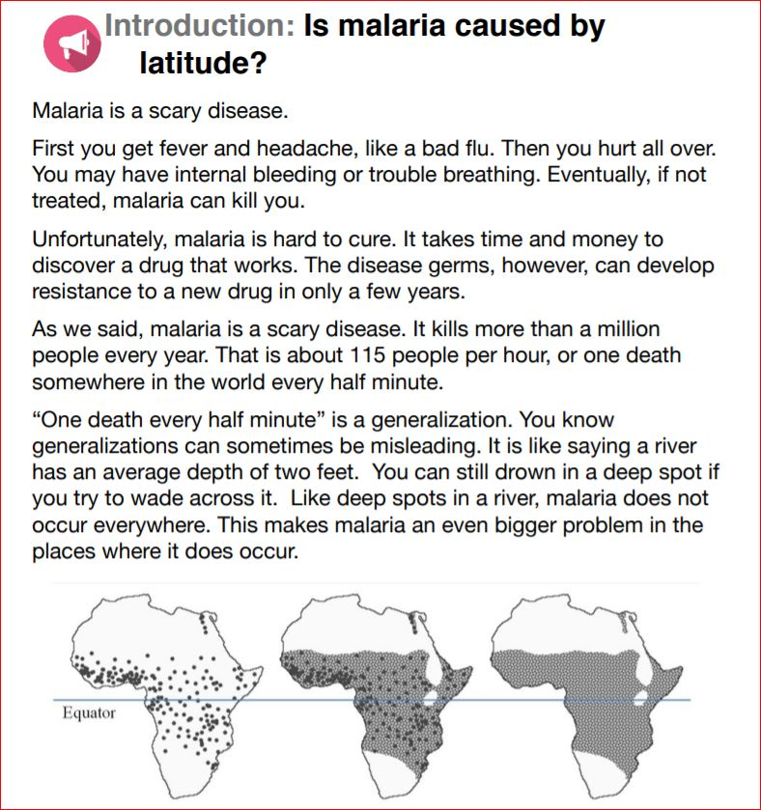
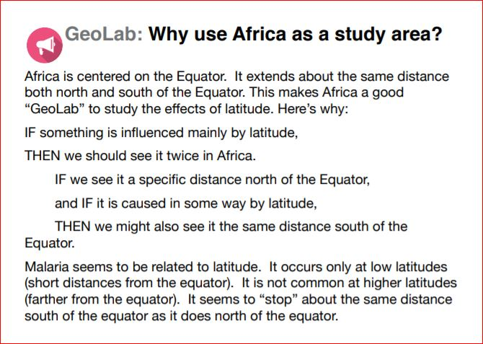
http://textbooks.wmisd.org/bigChapters.html
After a brief introduction
to one of the big ideas,
a “GeoLab” section explains
why this world region
is a good place to study
the effects of this idea.

Slide 32
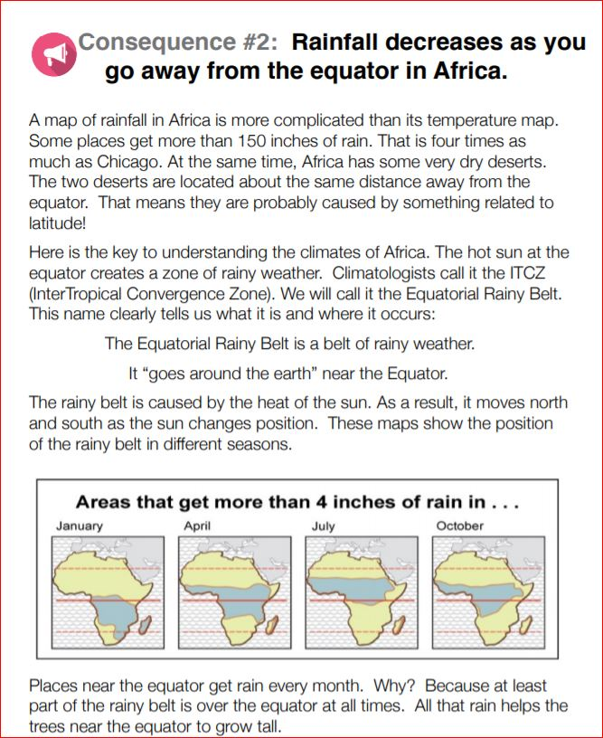
http://textbooks.wmisd.org/bigChapters.html
Each main consequence
of the big idea is explained
in a separate section.
Students can read them all,
or
you can assign each one
to a different individual
(or small group)
to read and make
a summary report
(oral or written).

Slide 33
http://textbooks.wmisd.org/bigChapters.html
Maps often come directly
from the clickable map.

Slide 34
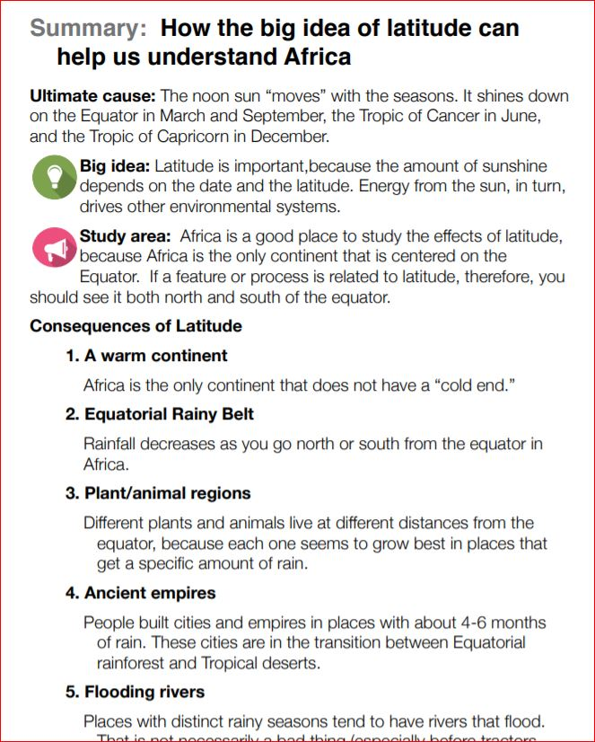
http://textbooks.wmisd.org/bigChapters.html
The chapter ends
with a summary
of the big idea
and its main
consequences.

Slide 35
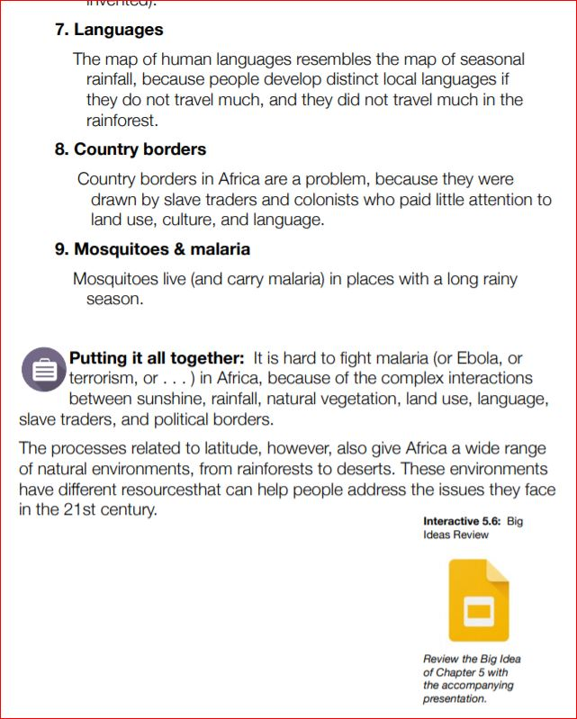
http://textbooks.wmisd.org/bigChapters.html
At the end
is a direct link
to the presentation.

Slide 36
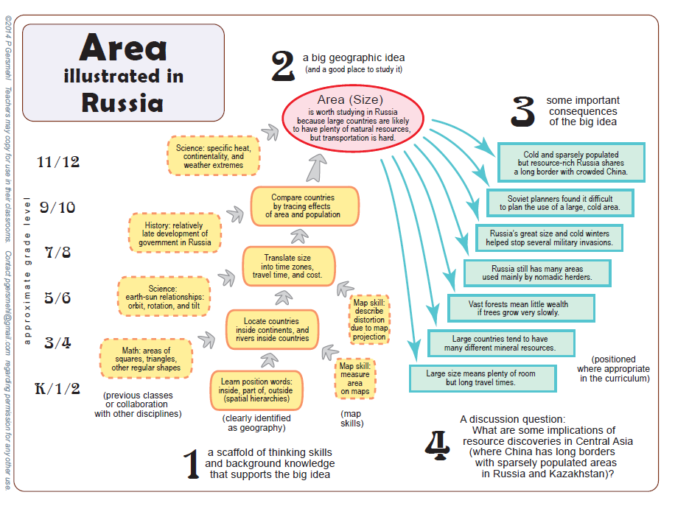
The
teacher package
has a scaffold
for each big idea.

Slide 37
The
teacher package
has a scaffold
for each big idea.
A
presentation
explains
how to read
these diagrams.

Slide 38
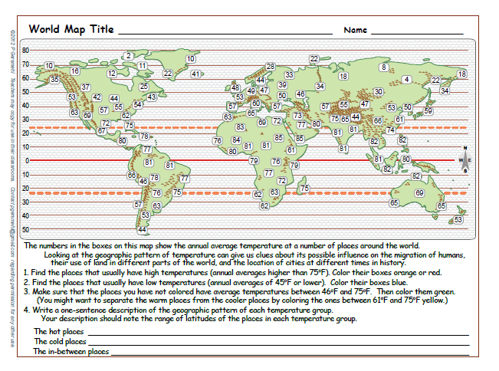
The websites already have
a number of draft student activities.

Slide 39
The websites already have
a number of draft student activities.
Most of these activities
have everything you need
in one or two easy-to-copy pages.

Slide 40
The websites already have
a number of draft student activities.
Most of these activities
have everything you need
in one or two easy-to-copy pages.
Many are in color,
but they print well
in black and white.

Slide 41
The activities have a variety
of “activity engines” –
things students do
in order to learn.

Slide 42
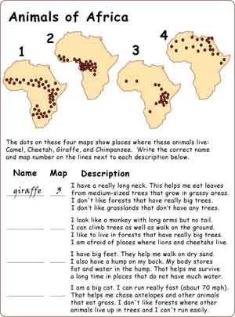
Match maps
with short text
(Reading)
The activities have a variety
of “activity engines” –
things students do
in order to learn.

Slide 43
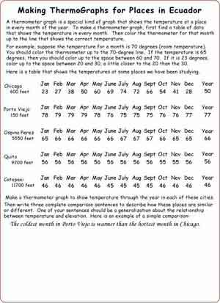
Analyze data
and graphs
(Math)
The activities have a variety
of “activity engines” –
things students do
in order to learn.

Slide 44
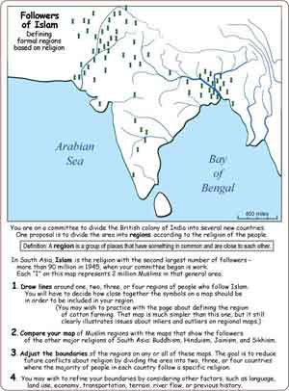
Make and
analyze a map
(Writing)
The activities have a variety
of “activity engines” –
things students do
in order to learn.

Slide 45
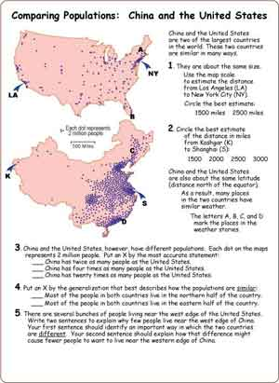
Compare
places by
using maps
The activities have a variety
of “activity engines” –
things students do
in order to learn.

Slide 46
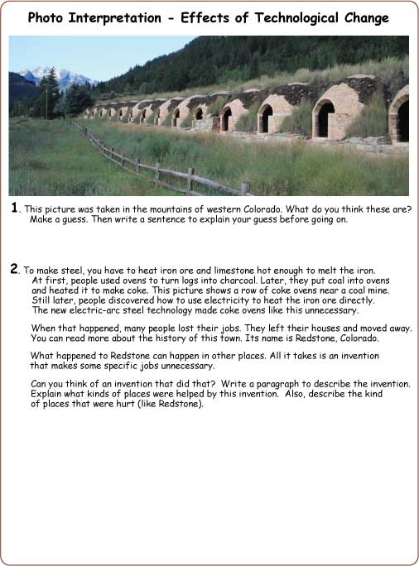
Interpret a
photograph
(writing)
The activities have a variety
of “activity engines” –
things students do
in order to learn.

Slide 47
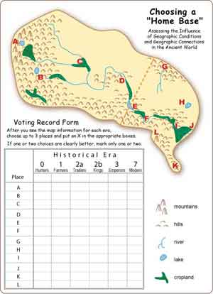
Do whole-class
or small-group
simulations
The activities have a variety
of “activity engines” –
things students do
in order to learn.

Slide 48
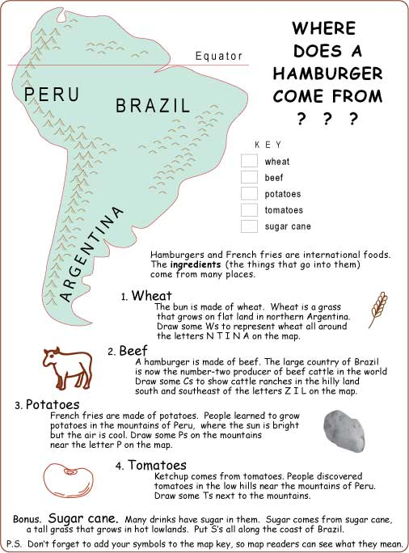
Trace origins
of products
in their lives
The activities have a variety
of “activity engines” –
things students do
in order to learn.

Slide 49
The scaffold shows
how the activities
support the big idea.
You can expand,
substitute, or adapt
the activities to fit
your curriculum.

Slide 50
Some activities have several versions
with different levels of difficulty.
Most activities have teacher guides
with answers and curriculum hints.

Slide 51
The scaffolds and draft activities
are accessible at
http://www.mi6thGradeClass.com

Slide 52
The scaffolds and draft activities
are accessible at
http://www.mi6thGradeClass.com
A model course outline,
with direct links to readings, activities,
handouts, and assessments, is at
http://ss.oaisd.org/6th-grade-giants.html

Slide 53
SUMMARY AND OFFER

Slide 54
SUMMARY AND OFFER
A “Geographic Big Idea” is an important cause
that has understandable effects in different places.

Slide 55
SUMMARY AND OFFER
A “Geographic Big Idea” is an important cause
that has understandable effects in different places.
Geographic Big Ideas can be an important part
of an effective class in world geography or history.

Slide 56
SUMMARY AND OFFER
A “Geographic Big Idea” is an important cause
that has understandable effects in different places.
Geographic Big Ideas can be an important part
of an effective class in world geography or history.
To help students learn the Geographic Big Ideas,
we made a linked set of clickable maps,
presentations, chapters, and activities.

Slide 57
SUMMARY AND OFFER
A “Geographic Big Idea” is an important cause
that has understandable effects in different places.
Geographic Big Ideas can be an important part
of an effective class in world geography or history.
To help students learn the Geographic Big Ideas,
we made a linked set of clickable maps,
presentations, chapters, and activities.
Most of the draft activities
and the course outlines on the websites
were written by West Michigan teachers
for West Michigan teachers.

Slide 58
SUMMARY AND OFFER
A “Geographic Big Idea” is an important cause
that has understandable effects in different places.
Geographic Big Ideas can be an important part
of an effective class in world geography or history.
To help students learn the Geographic Big Ideas,
we made a linked set of clickable maps,
presentations, chapters, and activities.
Most of the draft activities
and the course outlines on the websites
were written by West Michigan teachers
for West Michigan teachers.
Teachers in other places
might want different activities
(or different versions of these activities).

Slide 59
SUMMARY AND OFFER
A “Geographic Big Idea” is an important cause
that has understandable effects in different places.
That is the reason
for the offer
that is described
in the handout.
Geographic Big Ideas can be an important part
of an effective class in world geography or history.
To help students learn about Geographic Big Ideas,
we have prepared a linked set of clickable maps,
presentations, interactive chapters, and activities.
Most of the draft activities
and the course outlines on the websites
were written by West Michigan teachers
for West Michigan teachers.
Teachers in other places
might want different activities
(or different versions of these activities).

Slide 60
W E B S I T E S
http://textbooks.wmisd.org/bigClickableMaps.html
http://textbooks.wmisd.org/bigPresentations.html
http://textbooks.wmisd.org/bigActivities.html
http://textbooks.wmisd.org/bigChapters.html
Scaffolds and draft activities
http://www.mi6thGradeClass.com
Model course outline, with direct links
to readings, activities, handouts, etc.
http://ss.oaisd.org/6th-grade-giants.html

